Slide 1
F5 Tools & Troubleshooting
Chas Lesley
Field Systems Engineer
Tony Ganzer
Territory Account Manager

Slide 2

tOoLz… (General Overview)
TCPdumping (On F5)
Wireshark Overview
Wireshark SSL Decrypting
Wireshark Dissector
SSLdumping (On F5)
Wireshark Local
HTTPWatch
iControl
AGENDA

Slide 3
As we know, there are known knowns.
There are things we know we know.
We also know there are known unknowns.
That is to say we know there are some things we do not know.
But there are also unknown unknowns,
The ones we don't know, we don't know.
Secretary of Defense, Donald Rumsfeld, February 12, 2002, Department of Defense news briefing

Slide 4

Every environment is at different levels
We don’t know everything,
Everyone needs to contribute.

Slide 5











tOoLz …
tcpdump (On Platform)
WinSCP ( http://winscp.net/eng/download.php )
ssldump (On Platform)
cygWIN (http://cygwin.com/install.html )
Wireshark ( https://www.wireshark.org )
SOAPUI ( http://www.soapui.org/ )
F5 Wireshark Plugin
( https://devcentral.f5.com/wiki/AdvDesignConfig.F5WiresharkPlugin.ashx )
HTTPWatch ( http://www.httpwatch.com/download/ )
PuTTY
( http://www.chiark.greenend.org.uk/~sgtatham/putty/download.html )
Fiddler ( http://www.telerik.com/fiddler )
Several other preferential tools … these are the ones we will touch on today

Slide 6


TCPdump General Warnings
IMPORTANT:
The BIG-IP system is designed as an application delivery network platform and not as a packet capture device. If you intend to capture traffic under high load conditions, F5 recommends that you mirror traffic to a dedicated sniffing device.
IMPORTANT:
TCPdump is considered best effort, as it will place more load on the CPU. On heavily loaded BIG-IP systems, F5 recommends that you use TCPdump filter expressions to mitigate the potential for missed packets.
Liability Release Complete
As with any tool, understand it before you use it

Slide 7
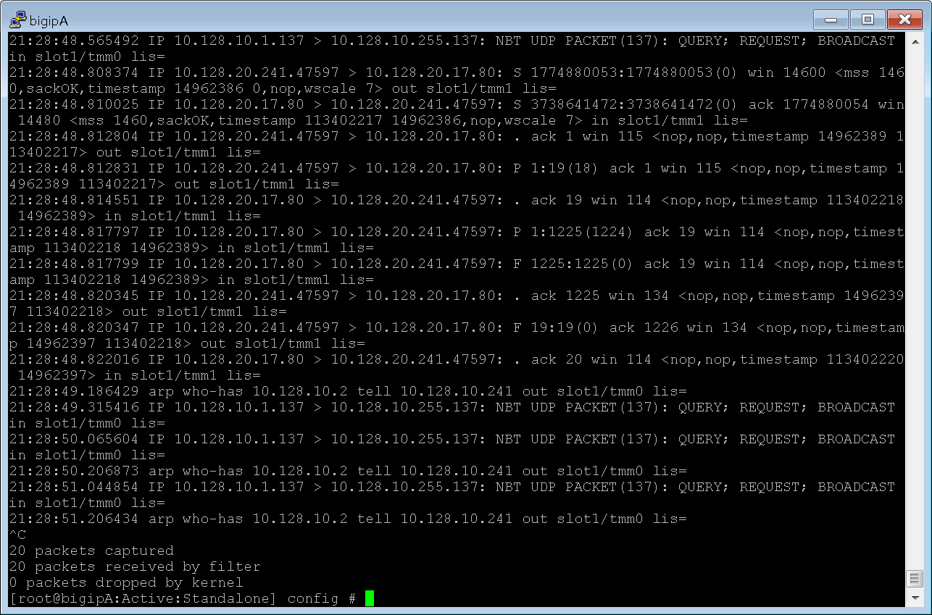
What is TCPdump?
tcpdump is a common packet analyzer that runs under the command line. It allows the user to display TCP/IP and other packets being transmitted or received over a network

Slide 8
What can TCPdump tell us …
21:28:48.565492 IP 10.128.10.1.137 > 10.128.10.255.137: NBT UDP PACKET(137): QUERY; REQUEST; BROADCAST in slot1/tmm0 lis=
21:28:48.808374 IP 10.128.20.241.47597 > 10.128.20.17.80: S 1774880053:1774880053(0) win 14600 <mss 1460,sackOK,timestamp 14962386 0,nop,wscale 7> out slot1/tmm1 lis=
21:28:48.810025 IP 10.128.20.17.80 > 10.128.20.241.47597: S 3738641472:3738641472(0) ack 1774880054 win 14480 <mss 1460,sackOK,timestamp 113402217 14962386,nop,wscale 7> in slot1/tmm1 lis=
21:28:48.812804 IP 10.128.20.241.47597 > 10.128.20.17.80: . ack 1 win 115 <nop,nop,timestamp 14962389 113402217> out slot1/tmm1 lis=
21:28:48.812831 IP 10.128.20.241.47597 > 10.128.20.17.80: P 1:19(18) ack 1 win 115 <nop,nop,timestamp 14962389 113402217> out slot1/tmm1 lis=
21:28:48.814551 IP 10.128.20.17.80 > 10.128.20.241.47597: . ack 19 win 114 <nop,nop,timestamp 113402218 14962389> in slot1/tmm1 lis=
21:28:48.817797 IP 10.128.20.17.80 > 10.128.20.241.47597: P 1:1225(1224) ack 19 win 114 <nop,nop,timestamp 113402218 14962389> in slot1/tmm1 lis=
21:28:48.817799 IP 10.128.20.17.80 > 10.128.20.241.47597: F 1225:1225(0) ack 19 win 114 <nop,nop,timestamp 113402218 14962389> in slot1/tmm1 lis=
21:28:48.820345 IP 10.128.20.241.47597 > 10.128.20.17.80: . ack 1225 win 134 <nop,nop,timestamp 14962397 113402218> out slot1/tmm1 lis=
21:28:48.820347 IP 10.128.20.241.47597 > 10.128.20.17.80: F 19:19(0) ack 1226 win 134 <nop,nop,timestamp 14962397 113402218> out slot1/tmm1 lis=
21:28:48.822016 IP 10.128.20.17.80 > 10.128.20.241.47597: . ack 20 win 114 <nop,nop,timestamp 113402220 14962397> in slot1/tmm1 lis=
21:28:49.186429 arp who-has 10.128.10.2 tell 10.128.10.241 out slot1/tmm0 lis=
21:28:49.315416 IP 10.128.10.1.137 > 10.128.10.255.137: NBT UDP PACKET(137): QUERY; REQUEST; BROADCAST in slot1/tmm0 lis=
21:28:50.065604 IP 10.128.10.1.137 > 10.128.10.255.137: NBT UDP PACKET(137): QUERY; REQUEST; BROADCAST in slot1/tmm0 lis=
21:28:50.206873 arp who-has 10.128.10.2 tell 10.128.10.241 out slot1/tmm0 lis=
21:28:51.044854 IP 10.128.10.1.137 > 10.128.10.255.137: NBT UDP PACKET(137): QUERY; REQUEST; BROADCAST in slot1/tmm0 lis=
21:28:51.206434 arp who-has 10.128.10.2 tell 10.128.10.241 out slot1/tmm0 lis=
Destination IP
Destination Port
Source IP
Source Port
Host to Host Communication
Data Payload and other information
Certainly, enough to get us in trouble

Slide 9

TCPdump on …
VLANs
Interfaces
Route Domains
Recommended for in-depth troubleshooting
Processed by TMM
Special considerations for non-default partitions
-i /<partition_name>/<vlan_name>
Special considerations for systems containing PVA ASICs (not processed by TMM)
tmsh show /sys hardware |grep -i pva
disable PVA Acceleration (temporary)
Recommended for only basic troubleshooting
Packet copied by SCCP/AOM
Rate-limited 200 pckts/sec
Interface of trunk captures entire trunk
On VIPRION, must be on blade of TCPdump interface
Run TCPdump from the default Route Domain (0)
tcpdump –nni 0.0
Limitation: TCPdump does not capture traffic when run from a non-default Route-Domain
Default Route Domain
rdsh:0
Notes:
Switch Card Control Processor (SCCP)
Always-On Management (AOM)
https://support.f5.com/kb/en-us/solutions/public/6000/500/sol6546.html

Slide 10

TCPdump – Primary Command Options
tcpdump –nni <interface>:nnnp –s 0 –w <filename>
n: No address translation
n: No port translation
i: Interface
:nnn (Noise Amplitude)
“TMM Details”
-w (output file)
<filename> (*.cap)
<interface>
VLAN
Interface
Route Domain
:p (Peer Flow)
“Copies matching peer flow”(Can be used together or separate :nnnp or :p
-s (snarf/Snap Length)
0 = Full Packet
>1 = Number of bytes
Supports most of the standard TCPdump options

Slide 11

TCPdump – Other Cool Options …
-X: ASCII format to screen
-r: Read a saved TCPdump file (You can apply filters)
> Pipe to a text file (human readable)
-W: Number of files in ring (used with –w)
-C: Number of millions of bytes per each file (used with –W –w)
  ie: 1MB = -C 1
-vvv: Verbosity
iCall TCPdump on Event: https://devcentral.f5.com/wiki/iCall.Run_tcpdump_on_event.ashx
Perl Script on Log Action: http://devcentral.f5.com/wiki/default.aspx/AdvDesignConfig/ActionOnLog.html

Slide 12
TCPdump Filters
Common
  host <ip address>
  net <network/bit mask>
  port <port number>
  Portrange <port-port>
Modifiers
  src/dst
Operators
Negation (`!' or `not').
Concatenation (`&&' or `and').
Alternation (`||' or `or').
Negation has highest precedence. Alternation and
concatenation have equal precedence and associate left to right.
tcpdump -nni internal -w /var/tmp/capture.cap
tcpdump -nni external host 4.2.2.1
tcpdump -nni internal net 10.10.10.0/24 and port 80
tcpdump -nni 0.0 src host 172.16.101.20 and dst port 80
tcpdump –X –s 0 -nni 0.0 -w /var/tmp/new.cap host 172.16.101.20 and port 162

Slide 13

TCPdump TMM Details :n (Low)
Low Details
Ingress: A flag indicating whether TMM is sending or receiving the packet. A zero (0) indicates that TMM is sending the packet, while a non-zero number indicates that TMM is receiving the packet.
Slot: The chassis slot number of the TMM that is handling the packet.
TMM: The number of the TMM that is handling the packet.
VIP: The name of the virtual server that is handling the connection. Prior to BIG-IP 11.2.0, the name was limited to 16 characters. In BIG-IP 11.2.0 and later, the name is limited to 96 characters.
LOW
Noise Amplitude
Notes:
https://support.f5.com/kb/en-us/solutions/public/13000/600/sol13637.html

Slide 14
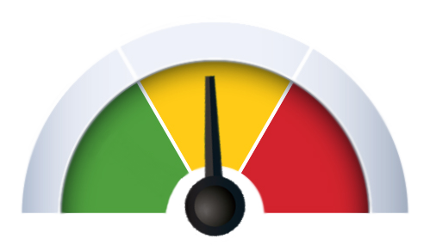
TCPdump TMM Details :nn (Low & Medium)
Medium Details
Flow ID: A number identifying a flow within TMM. The same flow ID can be used for different flows in different TMMs. Also, the same flow ID can be re-used for a different flow within the same TMM at a different time.
Peer ID: A number identifying the peer flow within TMM. Note that the same peer ID can be used for different flows in different TMMs. Also, the same peer ID can be re-used for a different flow within the same TMM at a different time.
Reset Cause: In BIG-IP 11.2.0 and later, the reset cause (if available) is included for TCP reset packets.
Connflow Flags: Diagnostic information used by F5 Technical Support.
Flow Type: Diagnostic information used by F5 Technical Support.
High Availability Unit: Diagnostic information used by F5 Technical Support.
Ingress Slot: Diagnostic information used by F5 Technical Support.
Ingress Port: Diagnostic information used by F5 Technical Support.
MEDIUM
Noise Amplitude
Notes:
https://support.f5.com/kb/en-us/solutions/public/13000/600/sol13637.html

Slide 15
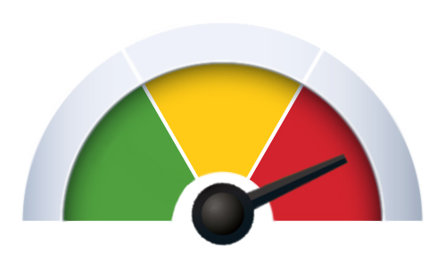
TCPdump TMM Details :nn (Low & Medium & High)
High Details
Peer IP Protocol: The IP protocol of the peer flow. This field is not populated prior to BIG-IP 11.0.0.
Peer VLAN: The VLAN ID number that is associated with the peer flow.
Peer Remote Address: The IP address of the host on the far end of the peer flow.
Peer Local Address: The IP address used by TMM for the peer flow.
Peer Remote Port: The protocol port of the host on the far end of the peer flow.
Peer Local Port: The protocol port used by TMM for the peer flow.
HIGH
Noise Amplitude
Notes:
https://support.f5.com/kb/en-us/solutions/public/13000/600/sol13637.html

Slide 16
Let’s take a quick look …
Notes:
tcpdump -nni 0.0
tcpdump -s 0 -i internal host 10.128.10.17
tcpdump -s 0 -ni internal host 10.128.10.17
tcpdump -s 0 -nni internal host 10.128.10.17
tcpdump -X -s 0 -nni internal host 10.128.10.17
tcpdump -s 0 -nni internal:nnn host 10.128.10.17 -w sacUG.cap –W 3 -C 1

Slide 17
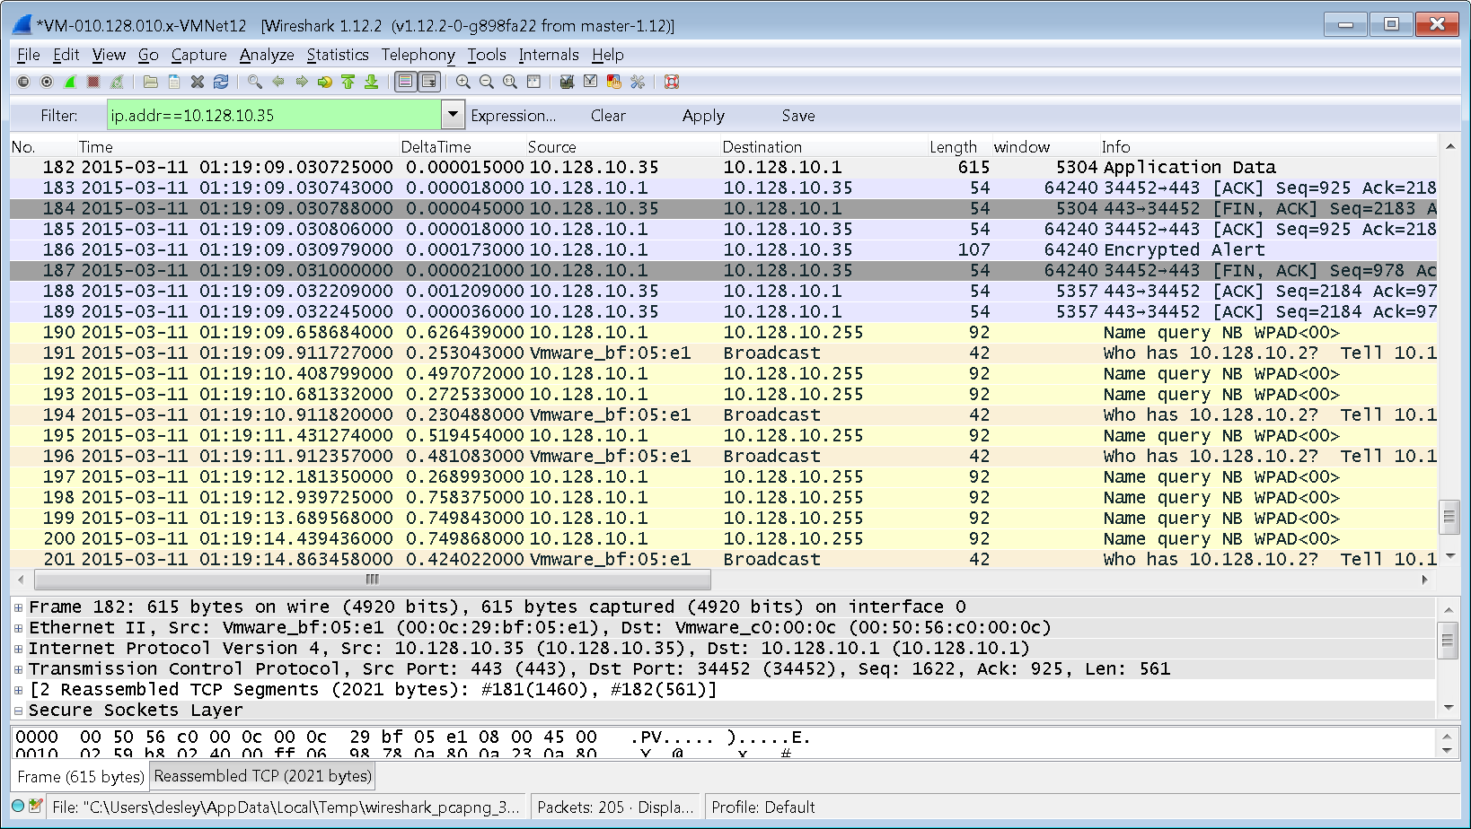

Wireshark Overview
Wireshark is a GUI network protocol analyzer for Unix and Windows

Slide 18
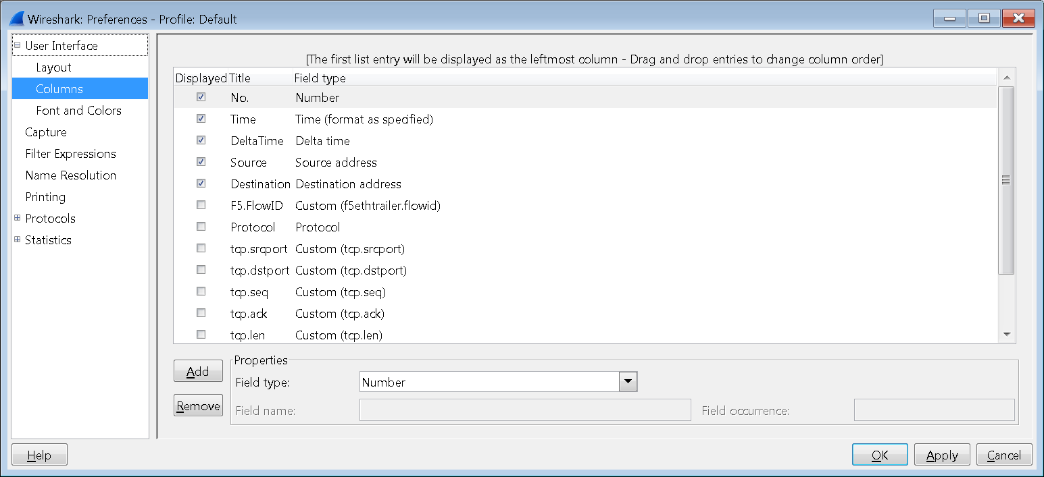
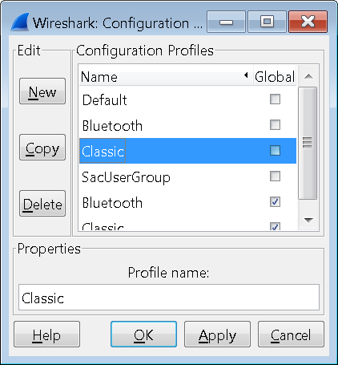
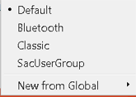
Brief Wireshark Overview
Display Filters
Displayed Flows
Header & Payload Details
Status
Bar & Info

Slide 19
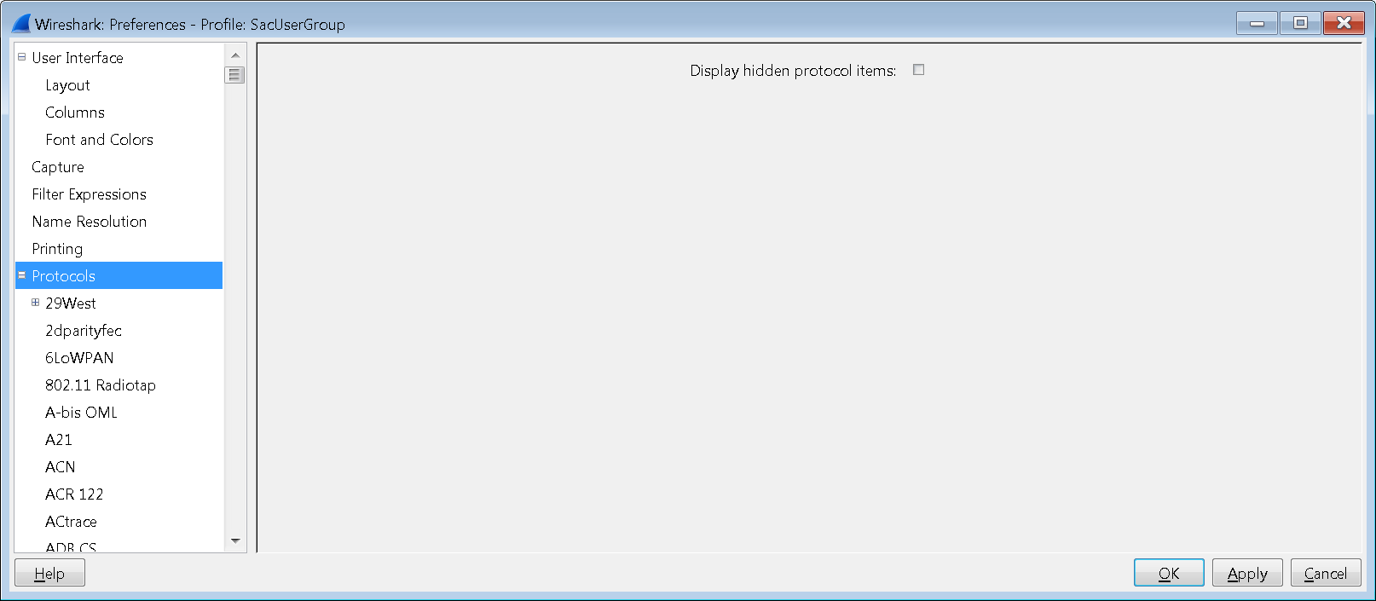
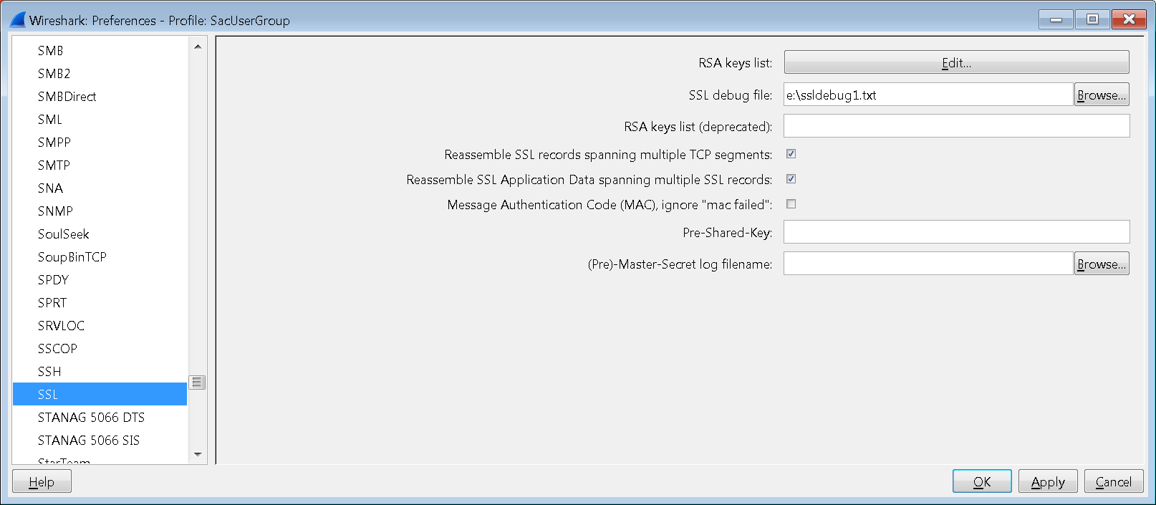

Add SSL Cert to Wireshark for Decryption
Edit > Preferences>Protocols>SSL > Click “Edit” button

Slide 20
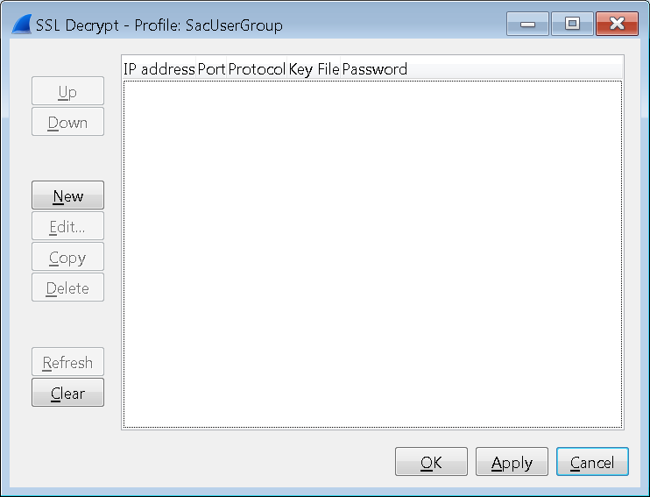
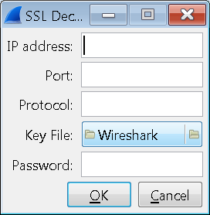
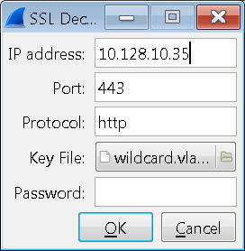
Add SSL Cert to Wireshark for Decryption (Cont.)
New> then “Apply”, “OK” when complete
Enter IP Address of target
Enter Port of WebServer (likely 443)
Enter protocol as “http”
Browse for and load Key file

Slide 21
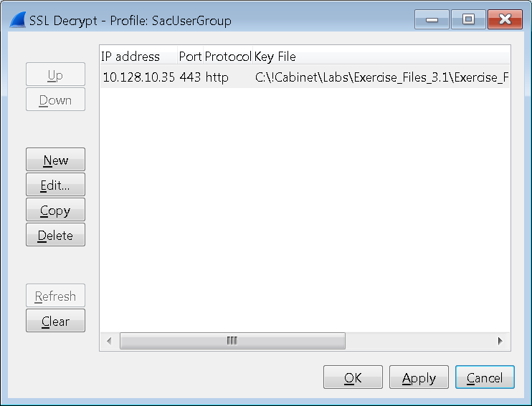
Add SSL Cert to Wireshark for Decryption (Cont.)
Click “Apply”, “OK”
You can have multiple SSL Certs
(Beware of order)

Slide 22
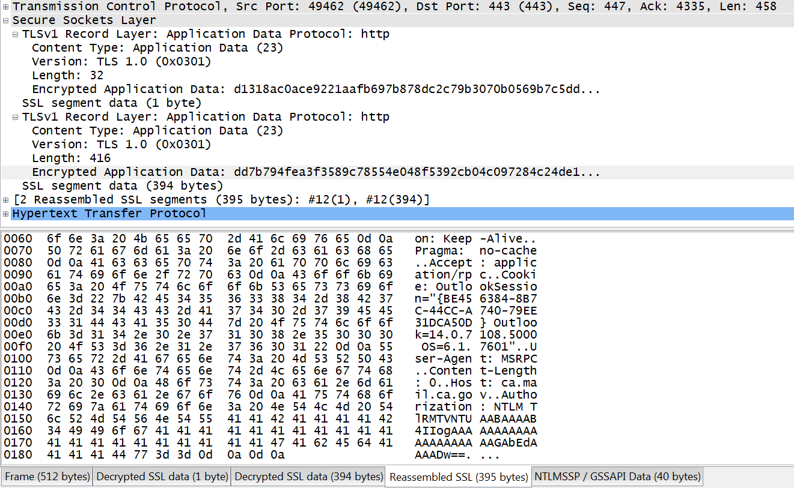
Decrypted SSL Payload
Encrypted Payloads
Decrypted Payloads

Slide 23

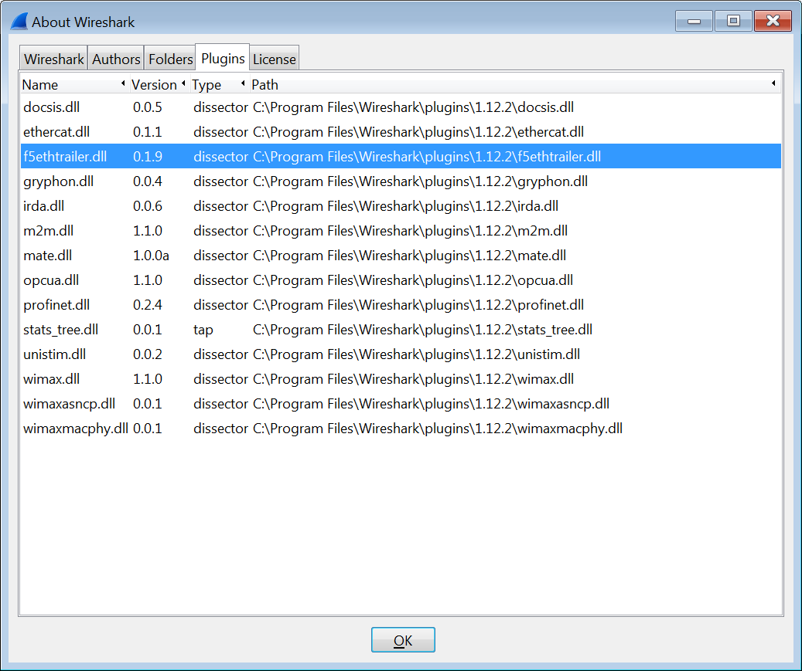
Dissector – Wireshark Plugin
Current Version
F5 Ethernet Trailer Plugin
Version 1.9 Oct 21, 2014
(c) F5 Networks, 2007-2014
New in version 1.9:
Filter connections through BIG-IP with main menu Analyze/Conversation Filter/F5 * menus
Added support for Wireshark 1.12 (dropped support for 1.6)
Ability to restrict slot data in info column to specific platforms (see preferences)
Ability to reduce the length of summary information in info column (see preferences)
Fixed display of "{peer}" flag in reset cause in the info column (the peer flag has always been correct in the packet details pane)
Notes:
https://devcentral.f5.com/wiki/AdvDesignConfig.F5WiresharkPlugin.ashx
Description
This plugin decodes the various additional diagnostic data that is encoded on tcpdump captures. Most of this information will be useful primarily to F5 support personnel, but this plugin is provided for the convenience and utility of our customer base. If there are not binaries supplied for your operating system, then installation will require an environment capable of compiling the Wireshark package.
Extract this package within the Wireshark source directory. The package contains a README.F5ETHTRAILER file with installation instructions.

Slide 24
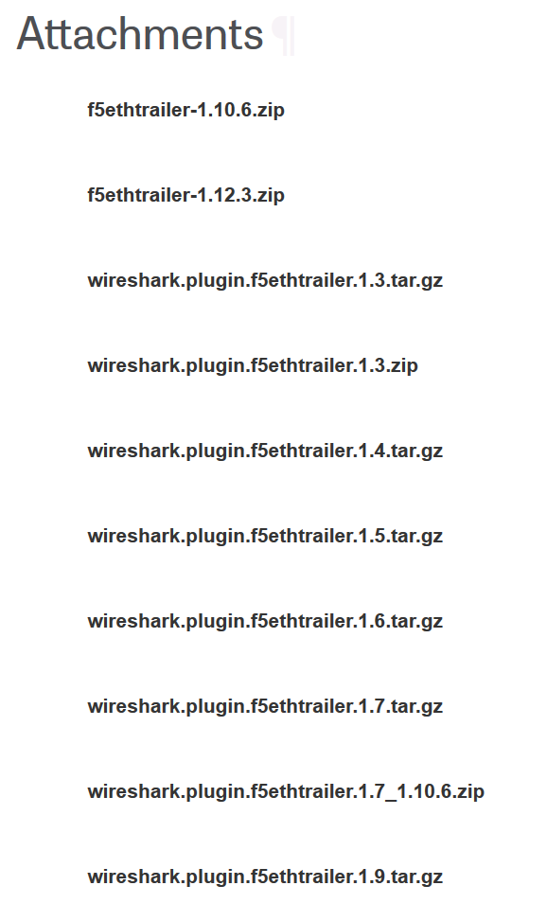
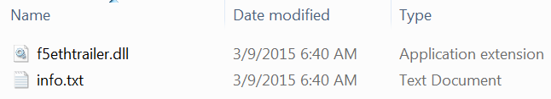
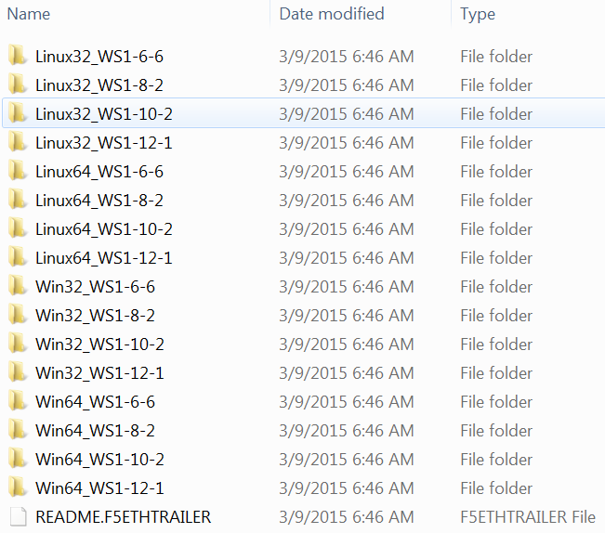


Wireshark - Dissector Installation
https://devcentral.f5.com/wiki/AdvDesignConfig.F5WiresharkPlugin.ashx
Linux
Windows
Notes:
https://devcentral.f5.com/wiki/AdvDesignConfig.F5WiresharkPlugin.ashx

Slide 25
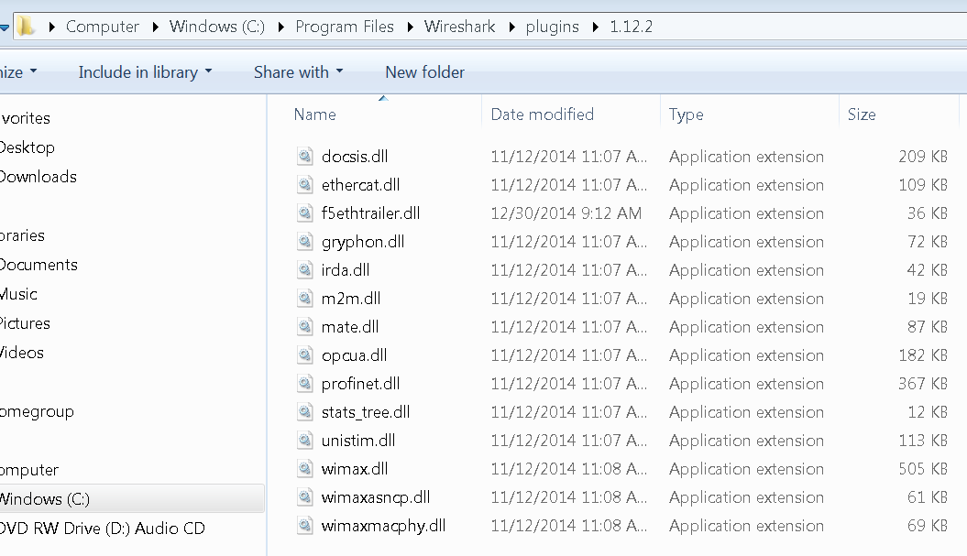


Simple Installation
Copy the .dll (windows) to the right directory
Notes:
https://support.f5.com/kb/en-us/solutions/public/0000/400/sol411.html
https://support.f5.com/kb/en-us/solutions/public/1000/800/sol1893.html

Slide 26
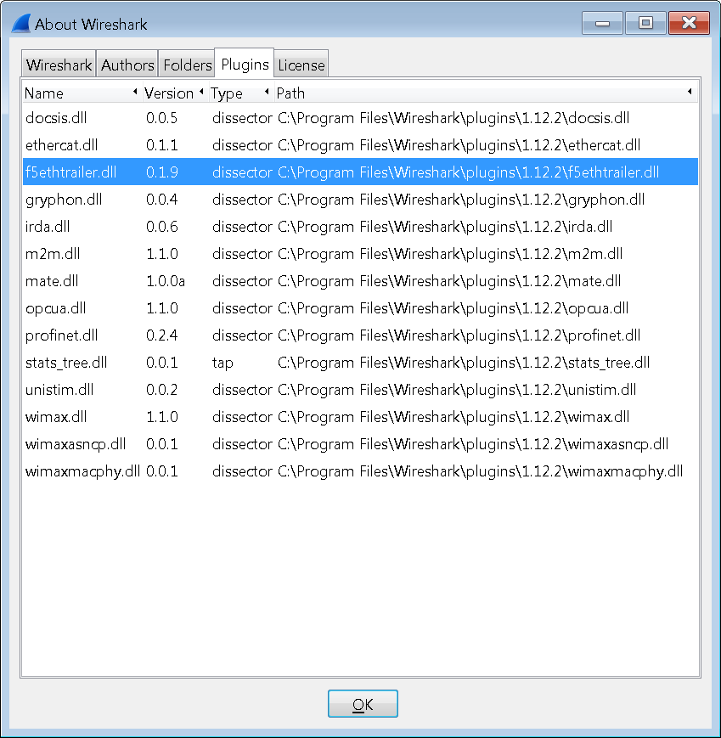
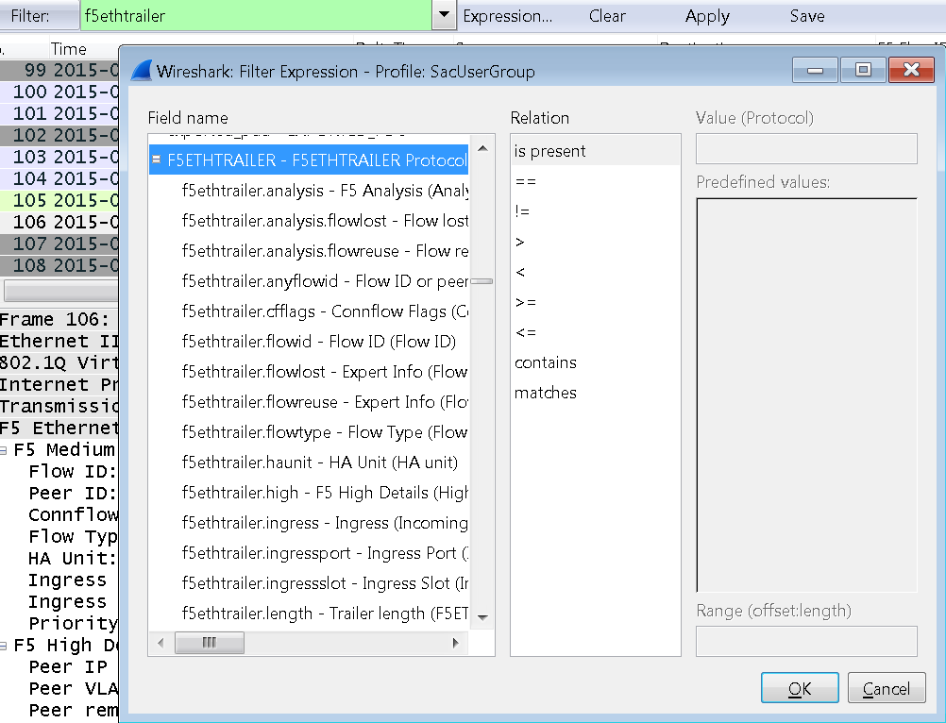
Verifying Dissector Installation
Help > About Wireshark > Plugins

Slide 27
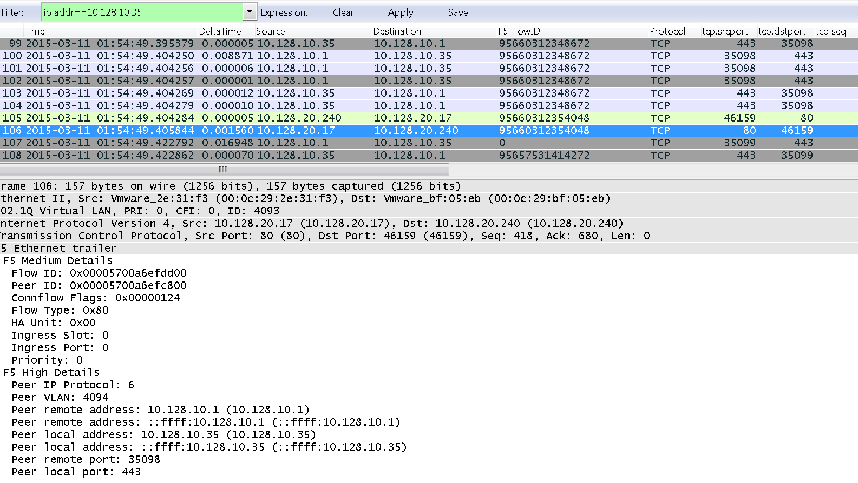
Dissector at Work…

Slide 28
Let’s take a quick look …

Slide 29
SSLdump
sol10209: Overview of packet tracing with the ssldump utility
Review SSL Handshake
View Encrypted Data
Probably use out of necessity in an immediate need
Likely to favor other tools
For General Review of SSL information
  SSL Handshake
  Other SSL Records
Create PMS
Read (-r) Previous tcpdump
Use –M to Create a PMS (Pre-Master Secret Log File) – doesn’t require sharing private key
View Data by refercing Private Key
n Do not resolve host names.
A Print all fields (ssldump, by default, prints only the most interesting).
e Print absolute timestamps.
d Display application data, including traffic before session initiates.
M Output a pre-master secret log file (v. 11.2.0 and later)
Notes:
https://support.f5.com/kb/en-us/solutions/public/10000/200/sol10209.html

Slide 30
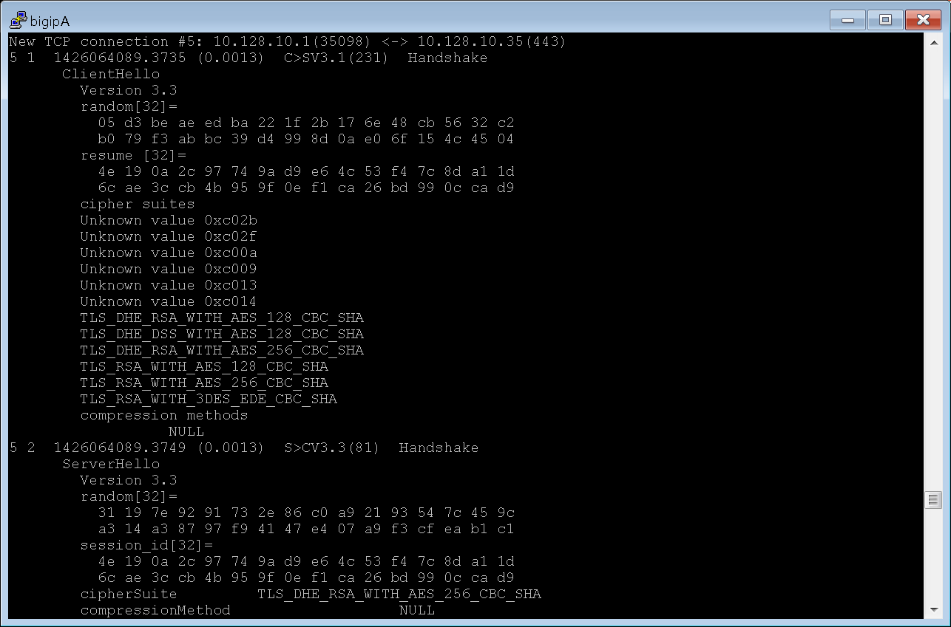
SSLdump – Let’s take a look …
Notes:
ssldump -nr /var/tmp/server.cap
ssldump -r /var/tmp/server.cap -k /config/filestore/files_d/Common_d/certificate_key_d/\:Common\:SacUserGroup.key_40449_1 -M /var/tmp/SacUsers.pms
ssldump -Aed -nr /var/tmp/server.cap -k /config/filestore/files_d/Common_d/certificate_key_d/\:Common\:SacUserGroup.key_40449_1

Slide 31
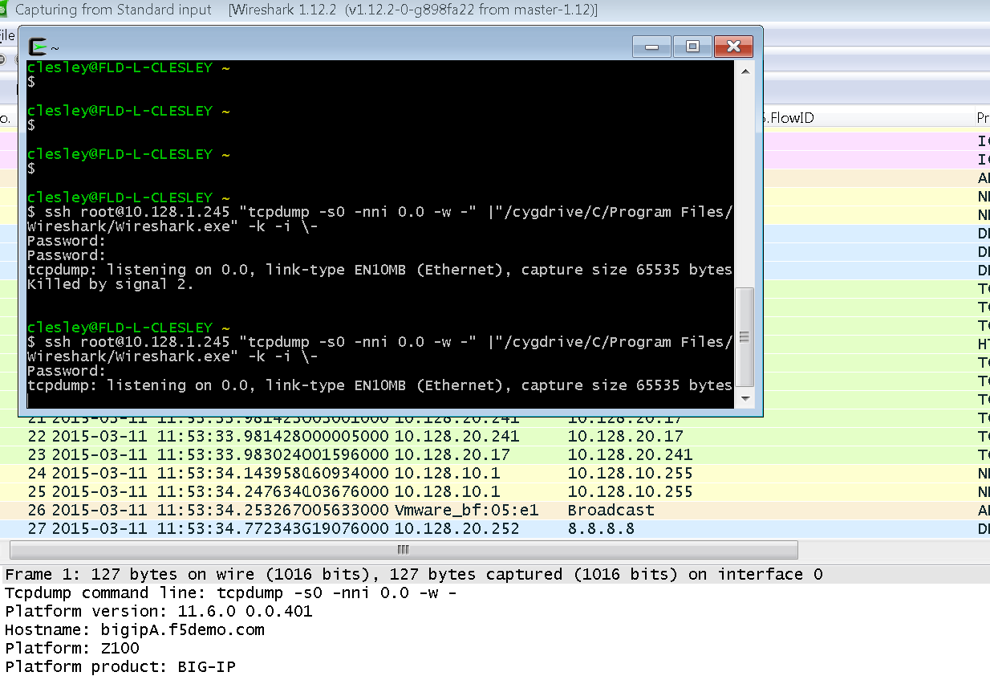

Wireshark – From to Local PC (Wireshark) via CygWin
Using Cygwin
Install Cygwin
  https://www.youtube.com/watch?v=CwYSvvGaiWU
Add open SSH client
Redirect TCPdump traffic from F5 to local Wireshark on PC
Sample Command
  ssh root@10.128.1.245 "tcpdump -s0 -nni 0.0 -w -" |"/cygdrive/C/Program Files/Wireshark/Wireshark.exe" -k -i \-
Notes:
https://www.youtube.com/watch?v=CwYSvvGaiWU
ssh root@10.128.1.245 "tcpdump -s0 -nni 0.0 -w -" |"/cygdrive/C/Program Files/Wireshark/Wireshark.exe" -k -i \-

Slide 32
CygWin – Let’s take a look…

Slide 33
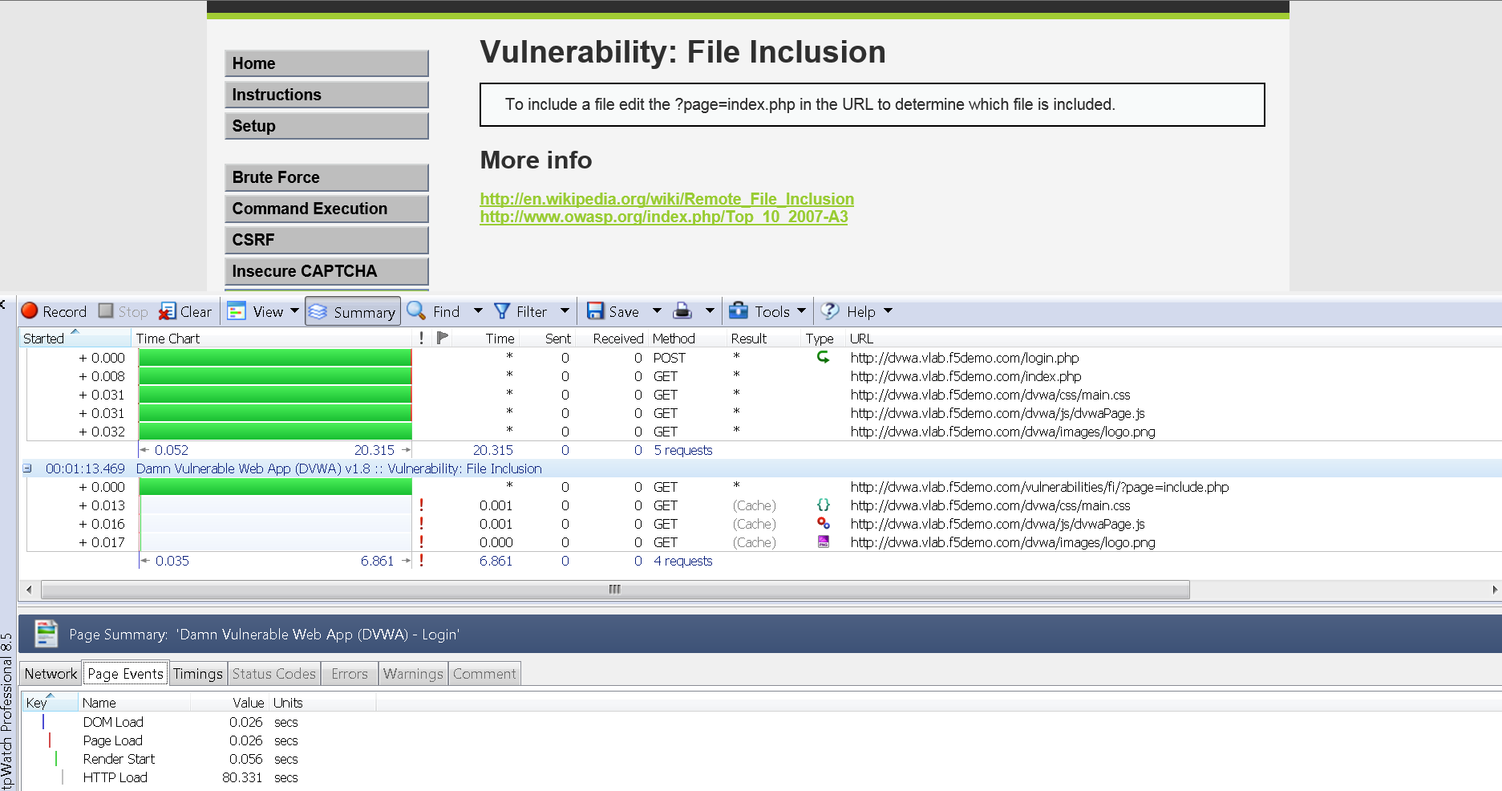
HTTPWatch Overview (Basic [free] & Pro)

Slide 34
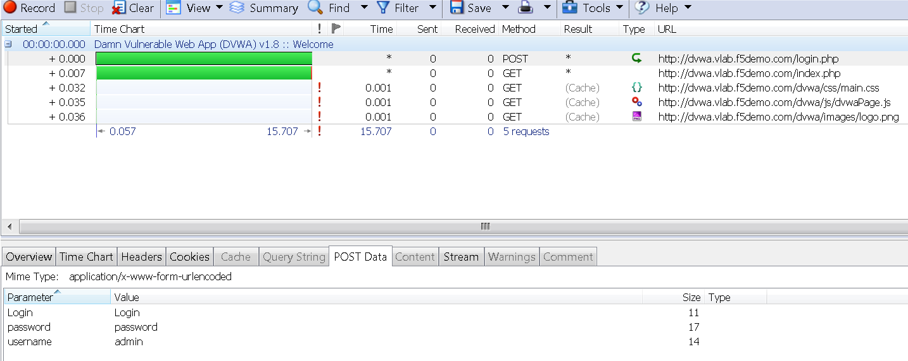
HTTPWatch Overview (Cont)
Notes:
http://www.httpwatch.com/download/
http://blog.httpwatch.com/tag/ssl/

Slide 35
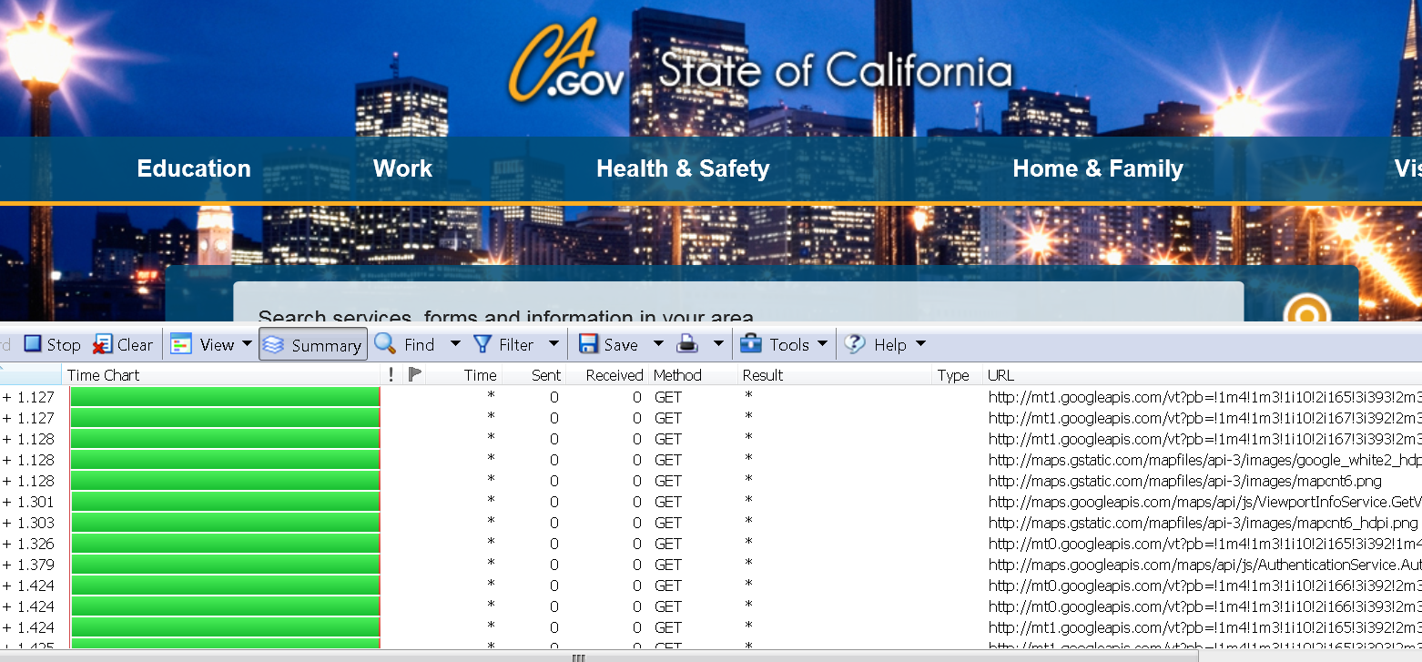
HTTPWatch Overview (Cont.)

Slide 36
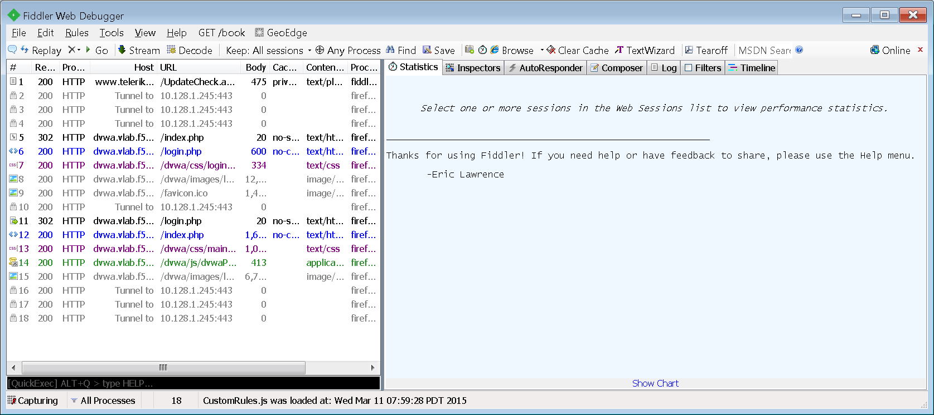
Fiddler (OpenSource)
Notes:
http://www.telerik.com/download/fiddler/fiddler4

Slide 37
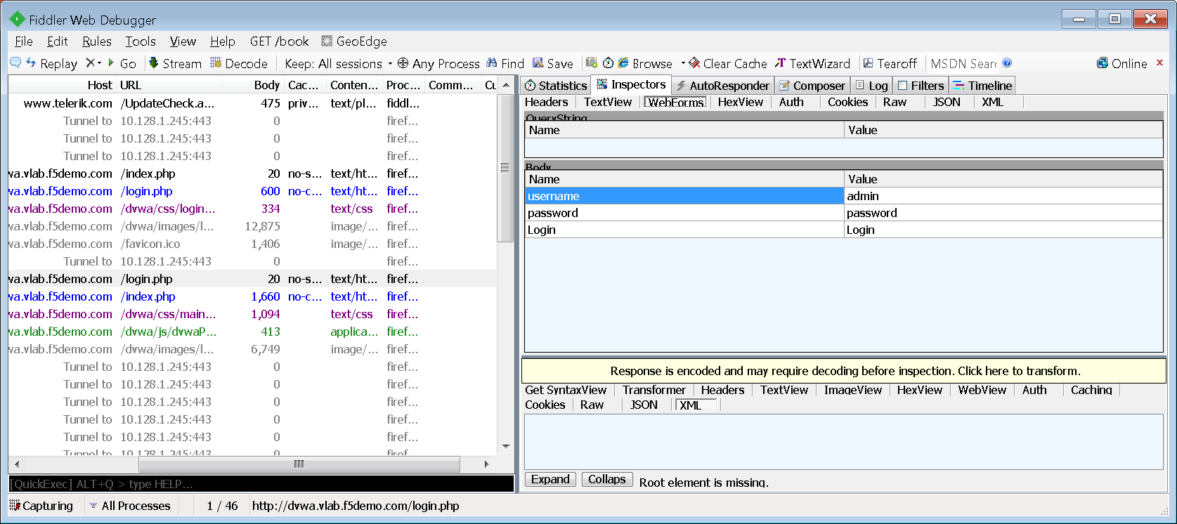
Fiddler (OpenSource)
Notes:
http://www.telerik.com/download/fiddler/fiddler4

Slide 38
HTTP/Web Debugging Tools
HTTPWatch
Fiddler
Basic Edition Free (limited use/Fundamental Features)
Pro Version (~$1K/per Seat)
  SSL Decryption
  Analytics
  Page/Content Errors
  Form fiel values
Good for Web Trouble Shooting
Open Source
Supports all fundamental features
Good for Web Troubleshooting
Personal Preference
Budget
Let’s take a quick look

Slide 39
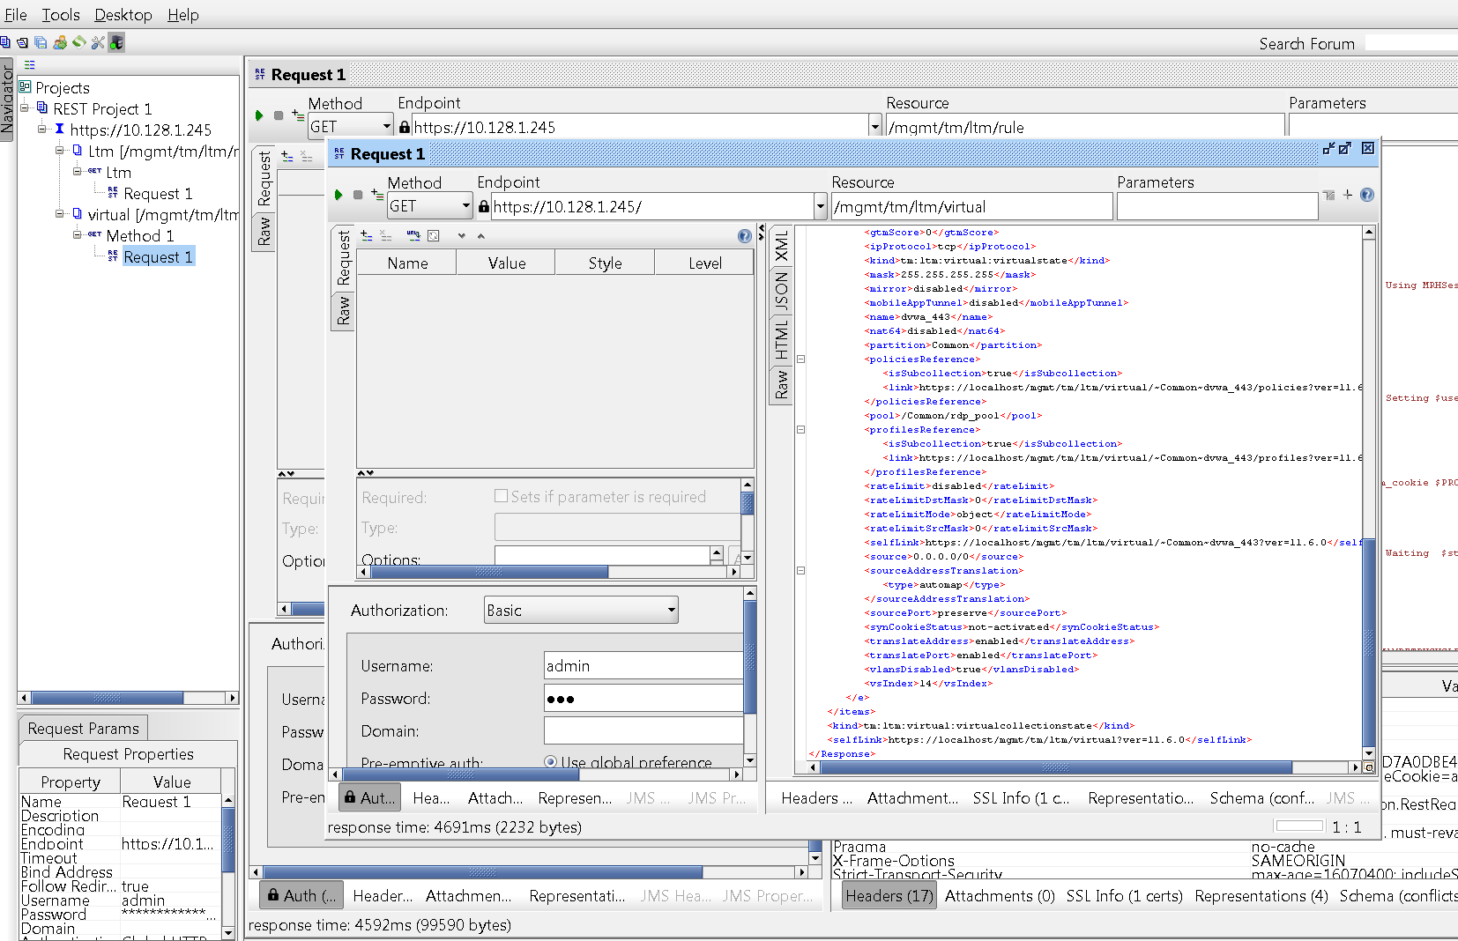
iControl
https://devcentral.f5.com/articles/icontrol-rest-101-getting-started
Let’s take a quick look
Notes:
https://devcentral.f5.com/articles/icontrol-rest-101-getting-started

Slide 40
Reference Links
TCPDump Overview: https://support.f5.com/kb/en-us/solutions/public/0000/400/sol411.html
TCPDump VLANs: https://support.f5.com/kb/en-us/solutions/public/7000/200/sol7227.html
TCPDump Recommended Methods & Limitations: https://support.f5.com/kb/en-us/solutions/public/6000/500/sol6546.html
TCPDump Overview: http://en.wikipedia.org/wiki/Tcpdump
Advanced Filters: https://support.f5.com/kb/en-us/solutions/public/2000/200/sol2289.html
TCPDump ManPage: http://www.tcpdump.org/manpages/tcpdump.1.html
Capture TMM: https://support.f5.com/kb/en-us/solutions/public/13000/600/sol13637.html
Packet Trace Analysis: https://support.f5.com/kb/en-us/solutions/public/1000/800/sol1893.html
SSLDump Overview: https://support.f5.com/kb/en-us/solutions/public/10000/200/sol10209.html

Slide 41

Questions
T

Slide 42
























F5 Overview (Your very brief one slide marketing syllabus)
F5 Enterprise Partner Ecosystem
Publicly traded on NASDAQ
(IPO 1999)
Leading provider of application and data delivery networking
3,300+ employees
Our products sit at strategic points of control in any infrastructure
DevCentral
160,000+ registered users, geeks, contributors from over 191 countries
Industry leading security platform for application delivery and web application firewall
References available upon request
Notes:
F5 is the global leader in Application Delivery Networking, and continues to be a solid provider and customer ally as we continue to grow and expand the entire ADC market.

Slide 43

Thank you for you time…
T

