Slide 1
F5 Monitoring & Reporting
Chas Lesley
Field Systems Engineer
Tony Ganzer
Territory Account Manager

Slide 2

If a tree falls in the forest and no one is watching does it make a noise?

Slide 3
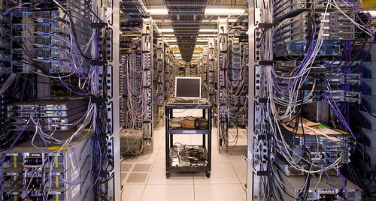
If a system fails in the network and no one is watching does it make a noise?

Slide 4

ABSOLUTELY!!!

Slide 5

Every environment is at different levels
We don’t know everything,
Everyone needs to contribute.

Slide 6


General Warning
IMPORTANT:
The BIG-IP system has many capabilities, functions and features. Avoid testing capabilities, functions and features or new concepts, confiugrations or designs on production systems unless the potential impact is understood and acceptable.
Liability Release Complete
As with any tool, understand it before you use it

Slide 7







Agenda
Cover general SNMP setup & configuration
Quick overview of function & configuration
Logging
sFlow
Review some of the available logging options
Quick look at integrations (Splunk)
SNMP
AddOns
Deeper dive into AVR & capabilities
iControl
Accounting, Visibility
& Reporting
Skunk Works

Slide 8
Logging
sFlow
SNMP
AddOns
iControl
Accounting, Visibility
& Reporting
Skunk Works

Slide 9
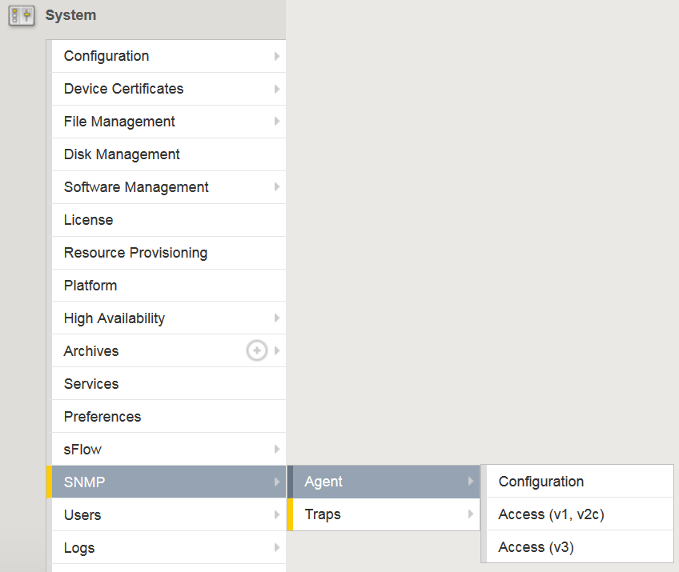
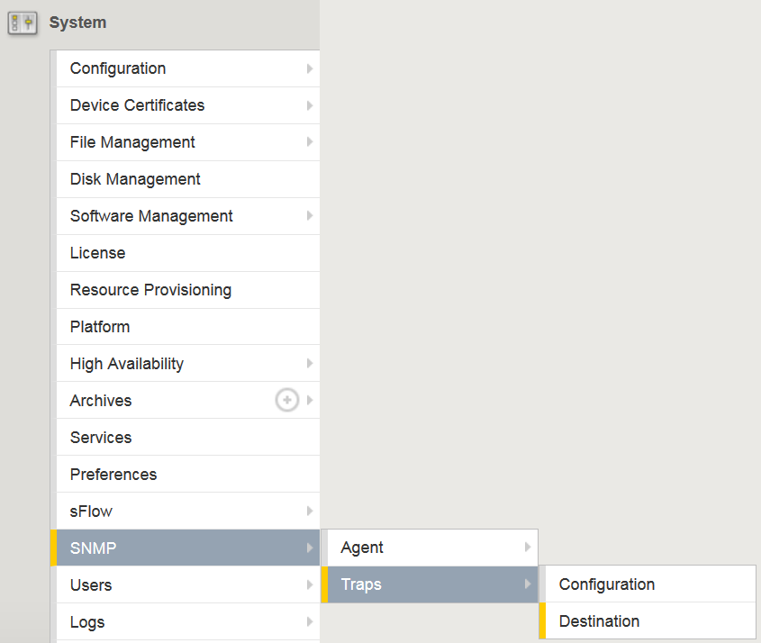
SNMP
Agents
Traps
System
https://support.f5.com/kb/en-us/products/big-ip_ltm/manuals/product/bigip-external-monitoring-implementations-11-6-0/11.html#conceptid
Notes:
Monitoring BIG-IP System Traffic with SNMP: https://support.f5.com/kb/en-us/products/big-ip_ltm/manuals/product/bigip-external-monitoring-implementations-11-6-0/11.html#conceptid

Slide 10
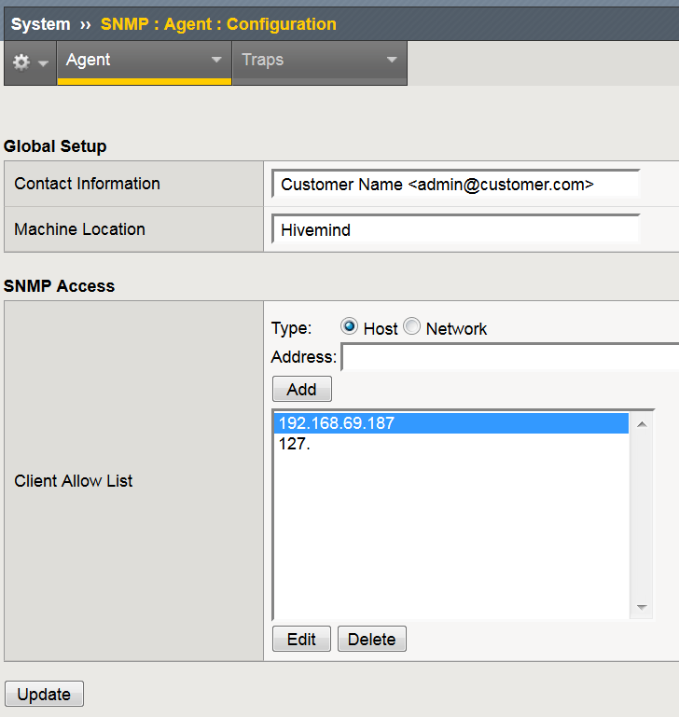
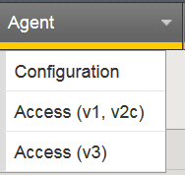
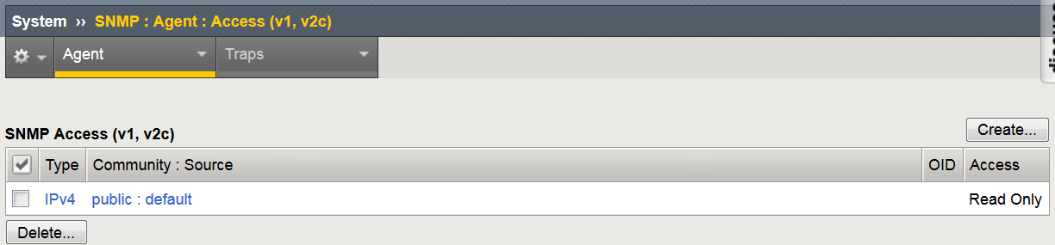
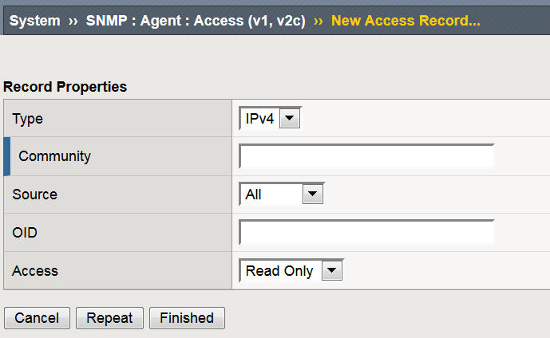
SNMP Setup - Agents
Access (v1, v2c)
Restrict access by IP
Read Only
Read/Write

Slide 11
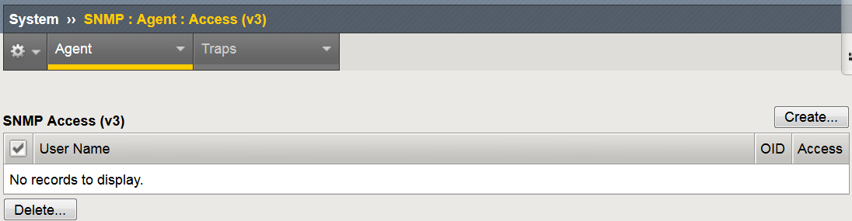
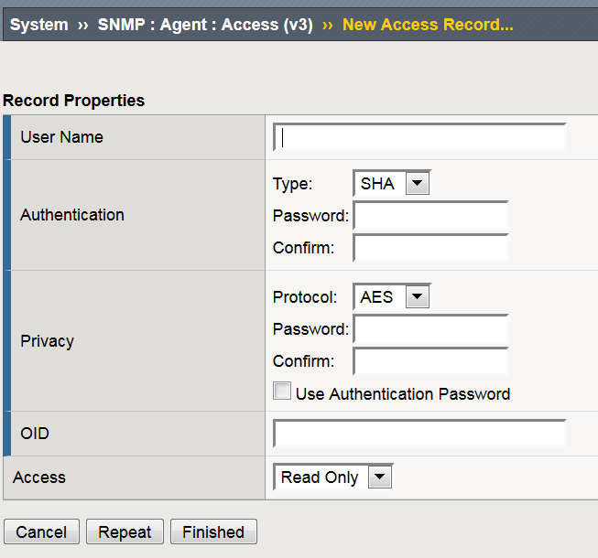
SNMP Setup - Agents
Access (v3)
MD5
SHA
None
AES
DES
None
Read Only
Read/Write

Slide 12
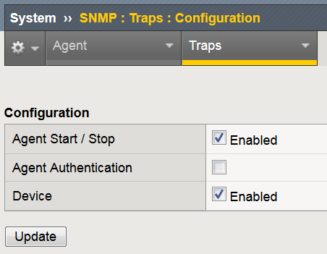
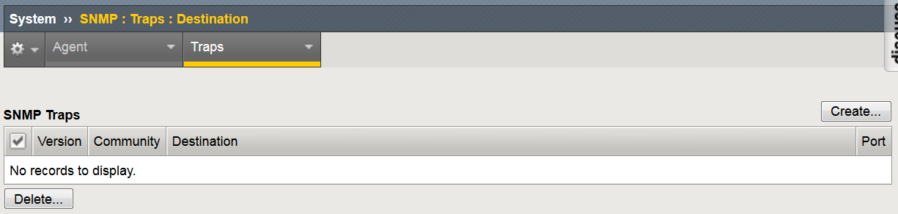
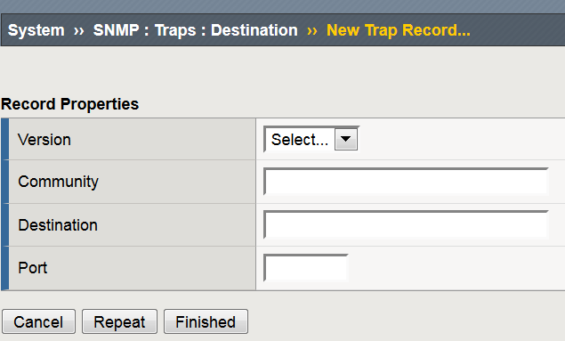
SNMP Setup - Traps
Agent Start/Stop:
Specifies, when checked (enabled), that the system sends a trap whenever the SNMP agent starts running or stops running. The default is enabled.
V1
V2c
V3
Agent Authentication:
Specifies, when checked (enabled), that the system sends authentication warning traps to the trap destinations. The default is disabled.
Device:
Specifies, when checked (enabled), that the system sends device warning traps to the trap destinations.
SNMP Trap Source Interface
Notes:
SNMP Trap Source Interface: https://support.f5.com/kb/en-us/solutions/public/7000/500/sol7530.html
Management Interface Routing: https://support.f5.com/kb/en-us/solutions/public/13000/200/sol13284.html

Slide 13
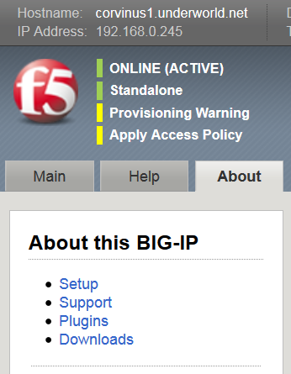
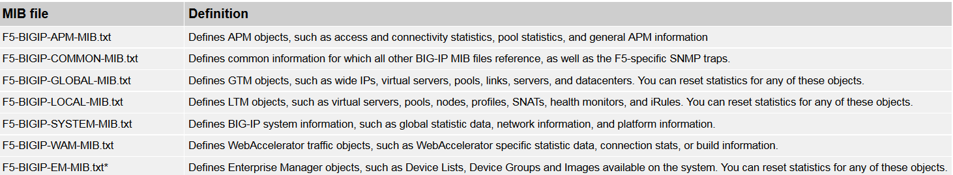
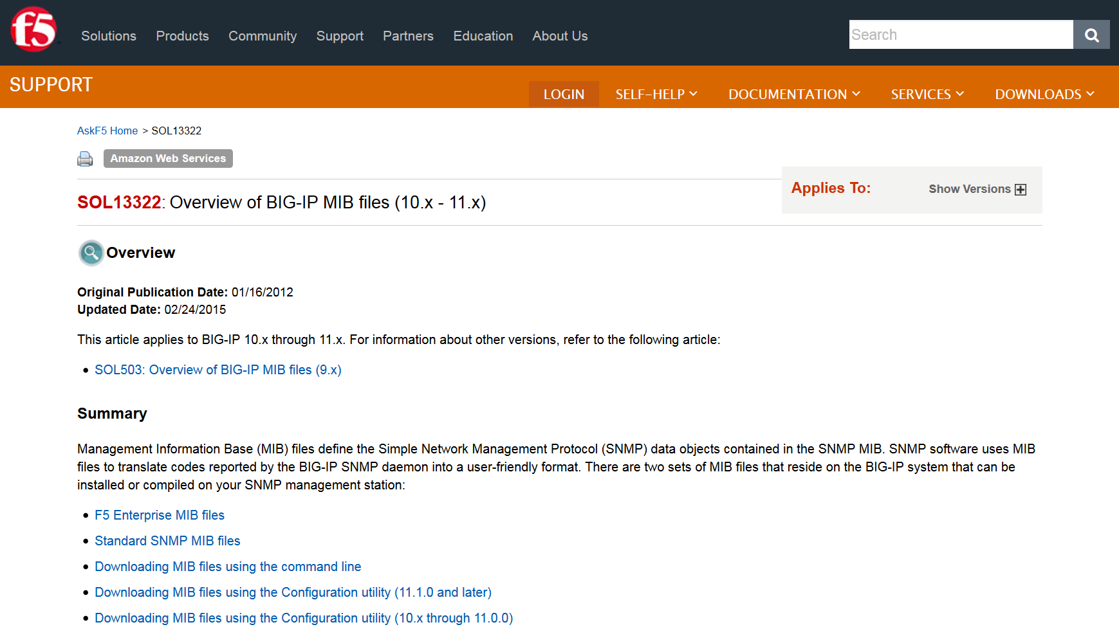
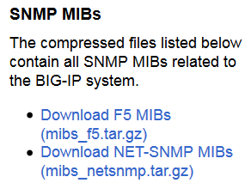
SNMP - MIBs
Overview of MIB Files: https://support.f5.com/kb/en-us/solutions/public/13000/300/sol13322.html

Slide 14
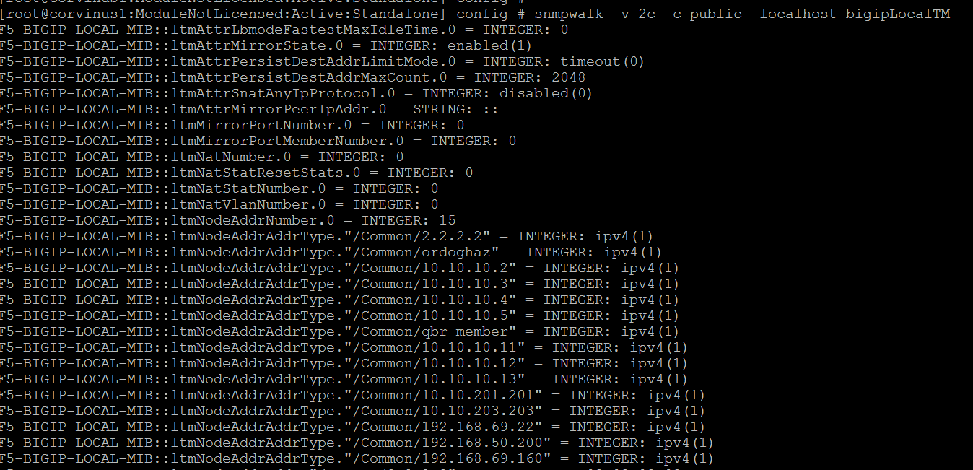
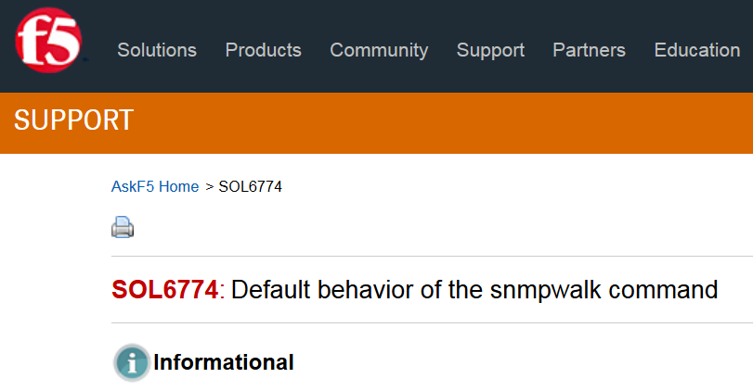
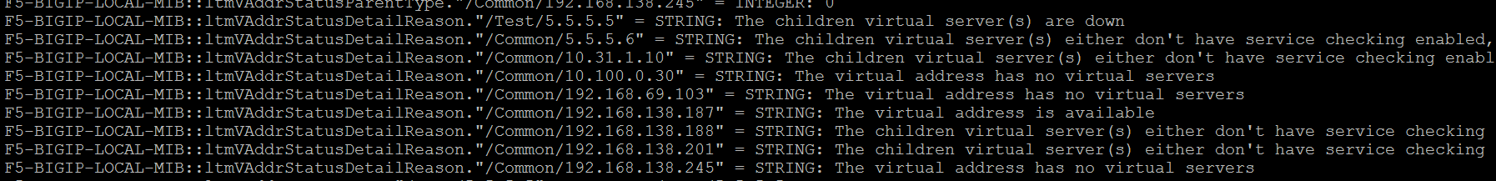
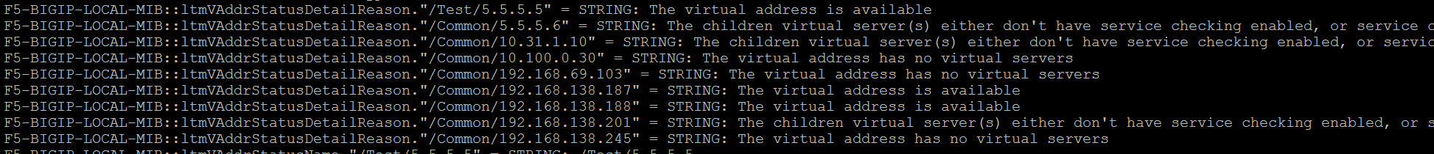
SNMPWalk (CLI) - Testing
Solution Article
snmpwalk -v 2c -c public localhost bigipLocalTM
Notes:
SNMPWalk: https://support.f5.com/kb/en-us/solutions/public/6000/700/sol6774.html
snmpget -c public 192.168.69.245 sysGlobalStat.sysStatMemoryUsed.0
snmpwalk -v2c -c public localhost hrSWRunName | egrep "\"tmm(.[0-9]+)?\"" | wc -l

Slide 15

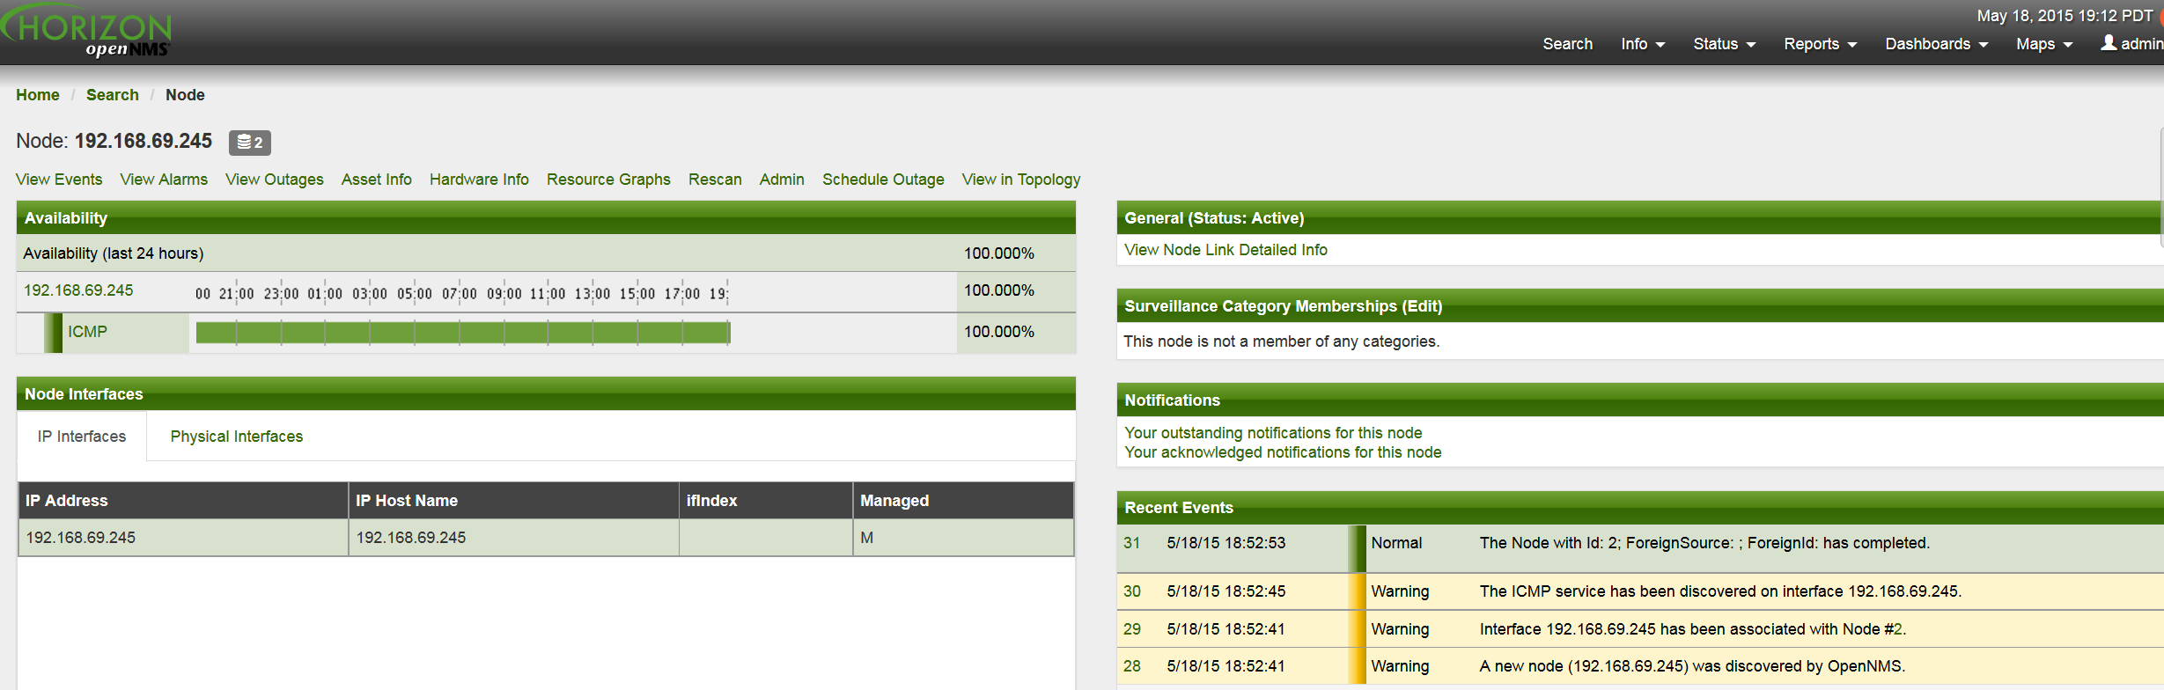
SNMP – NMS
Installation Instructions
http://www.opennms.org/wiki/Installation:Yum
Notes:
http://www.opennms.org/wiki/Installation:Yum
http://www.postgresql.org/download/linux/redhat/
rpm --import http://yum.opennms.org/OPENNMS-GPG-KEY
yum -y install opennms

Slide 16
Logging
sFlow
SNMP
AddOns
iControl
Accounting, Visibility
& Reporting
Skunk Works
Notes:
Managing Log Files: https://support.f5.com/kb/en-us/solutions/public/13000/300/sol13367.html

Slide 17
Logging (a quick three…)
Syslog
High-Speed Logging
Logging Local0.
Output all system log information
Configurable with Options & Filters
Provides a historical repository (audit regulations and compliance)
High Speed Logging was designed to be a high volume, low overhead logging mechanism. (<10% CPU)
Supports logging via TCP or UDP.
Log all HTTP requests & responses
Log the SSL cipher name, version, size for each session
Quick diagnostic evaluations
iRule troubleshooting & debugging
Did I say – EXTREMELY helpful in iRule Authoring!
Notes:
https://devcentral.f5.com/wiki/iRules.HSL.ashx?lc=1

Slide 18

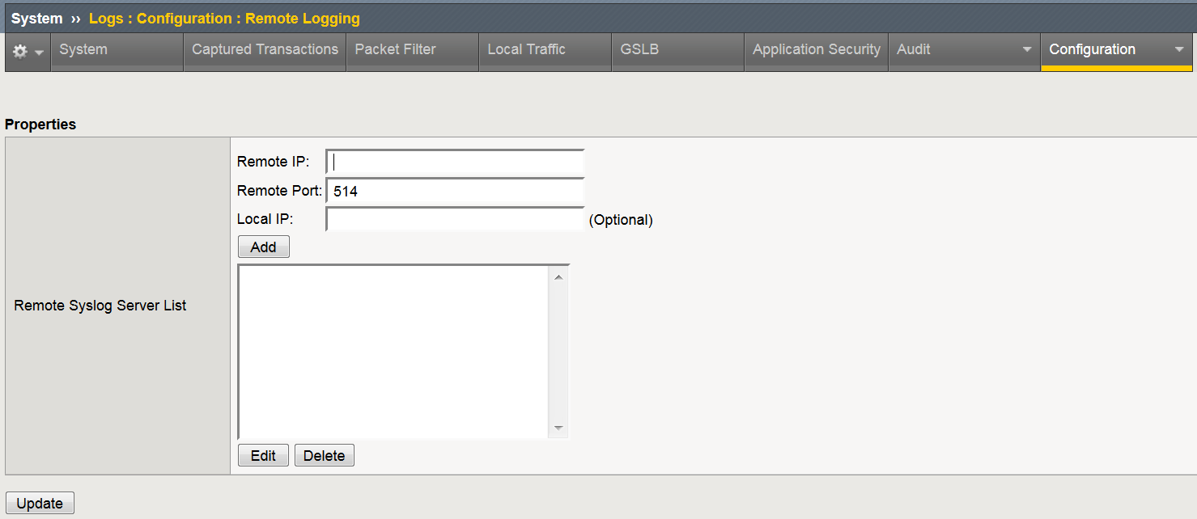
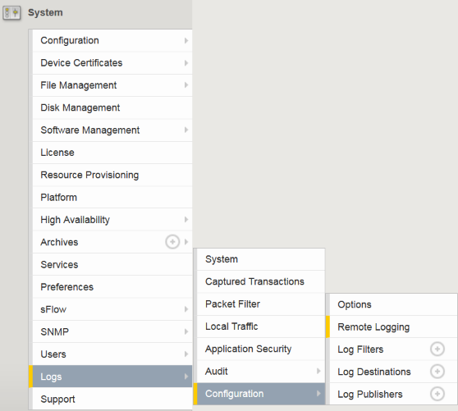
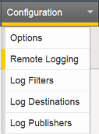
Logging – Syslog
( sol13080 )
Target IP
(syslog Server)
Syslog Server destination Port
SysLog Configuration: https://support.f5.com/kb/en-us/solutions/public/13000/000/sol13080.html
SysLog Filtering: https://support.f5.com/kb/en-us/solutions/public/13000/300/sol13333.html
Notes:
SysLog Configuration: https://support.f5.com/kb/en-us/solutions/public/13000/000/sol13080.html
SysLog Filtering: https://support.f5.com/kb/en-us/solutions/public/13000/300/sol13333.html

Slide 19
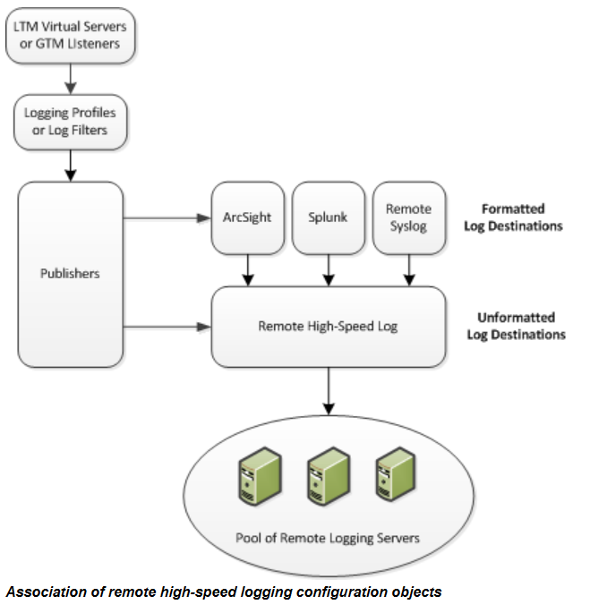
Logging – High Speed Logging (HSL)
Target a pool of logging servers
Address high speed logging needs
  Firewall Designs
  All HTTP Request/Responses
  Log all SSL Cipher information
“Replace” TCPDump (log decrypted content)
https://support.f5.com/kb/en-us/products/big-ip_ltm/manuals/product/bigip-external-monitoring-implementations-11-6-0/2.html
Notes:
High Speed Logging: https://devcentral.f5.com/wiki/iRules.HSL.ashx?lc=1
Configuration: https://support.f5.com/kb/en-us/products/big-ip_ltm/manuals/product/bigip-external-monitoring-implementations-11-6-0/2.html
HSL: https://support.f5.com/kb/en-us/solutions/public/14000/400/sol14459.html
iRule: https://devcentral.f5.com/articles/irules-high-speed-logging-spray-those-log-statements

Slide 20
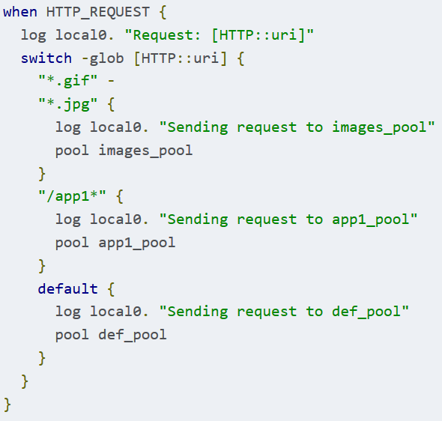
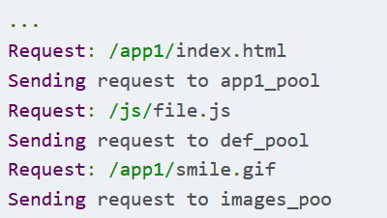
Logging – local0. (iRules)
99% of all cases you will use
log local0. "message goes here"
What you will see in your Local Traffic Log files
Notes:
https://devcentral.f5.com/articles/irules-101-09-debugging

Slide 21
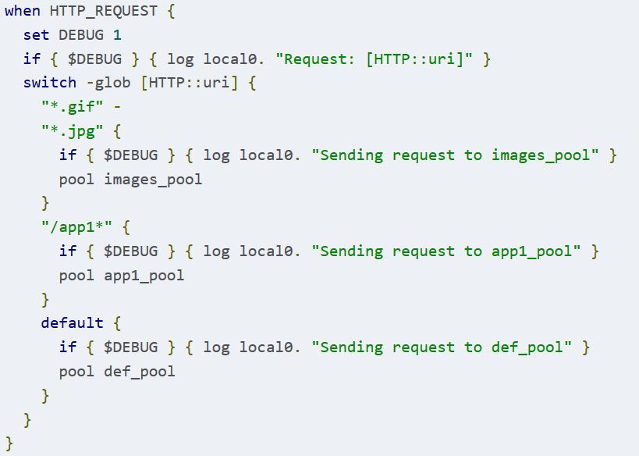
Logging – local0. (iRules - Debugging)
When done with logging statements you can
Delete
Comment out #
Add conditionals as shown with SET statements
1,2= No CPU hit
3= CPU hit depending on load

Slide 22
Logging
sFlow
SNMP
AddOns
iControl
Accounting, Visibility
& Reporting
Skunk Works

Slide 23
sFlow - Overview
sFlow “Sampled Flow” is an industry-standard technology for monitoring high-speed switched networks.
Netflow not supported
IPFIX supported (from Advanced Firewall Module (AFM)
As of 11.4 TMM interfaces are used (Prior to 11.4 mgmt. interface)
Flow Samples:
Based on a defined sampling rate, an average of 1 out of n packets/operations. (quantifiable accuracy)
Counter Samples
A polling interval defines how often the network device sends interface counters.
sFlow Datagrams
The sampled data is sent as a UDP (default port 6343)
( sol15193 )
Notes:
https://support.f5.com/kb/en-us/solutions/public/15000/100/sol15193.html

Slide 24
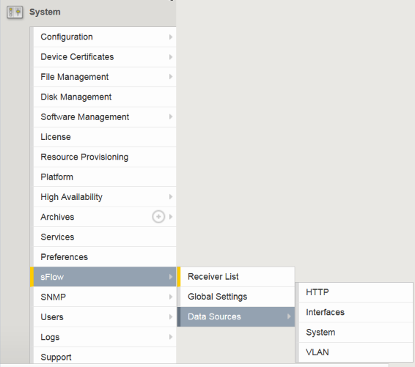
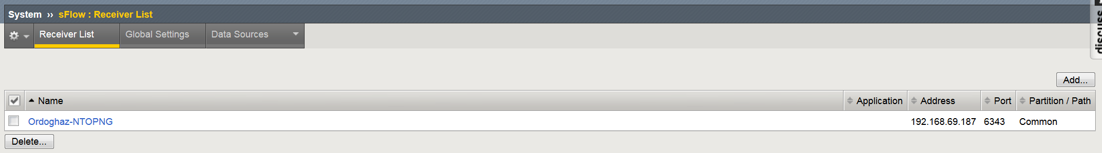
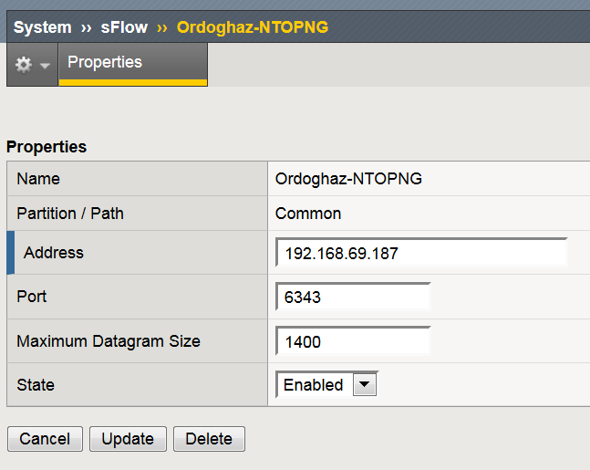
sFlow – Configuration (Receiver)

Slide 25
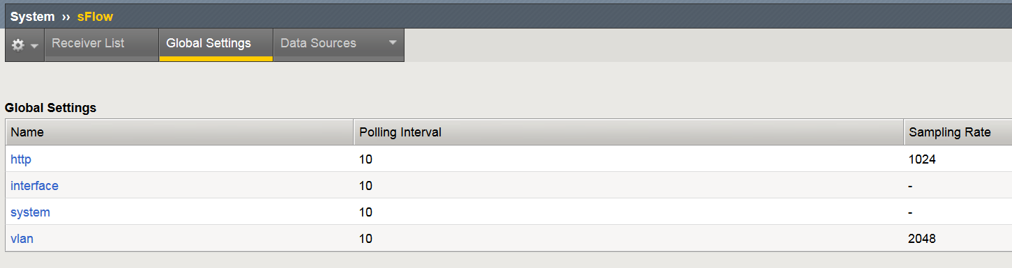
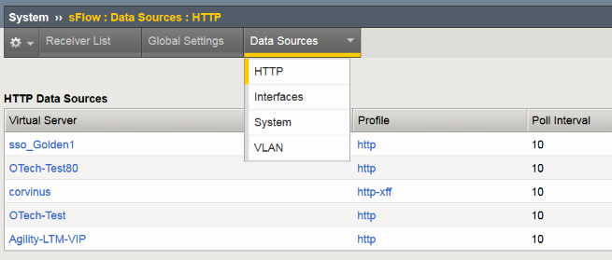
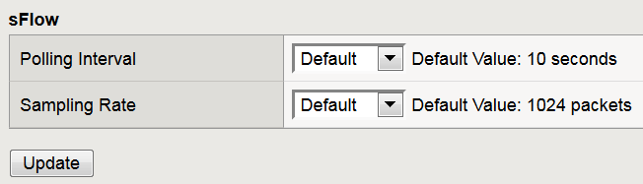
sFlow – Global Settings & DataSources
Globally modify Polling interval and Sampling Rate packet/# of packets
Cannot modify interface or System Sampling rates
Modify individual data sources through HTTP profile or VLAN
  Polling Interval
  Sampling Rate
dept1

Slide 26
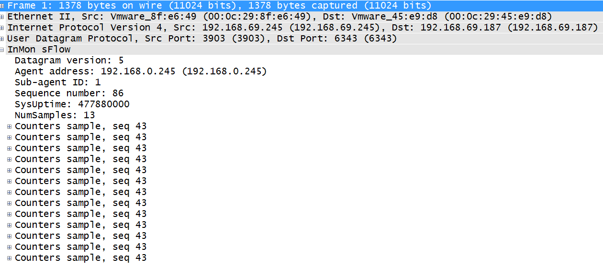
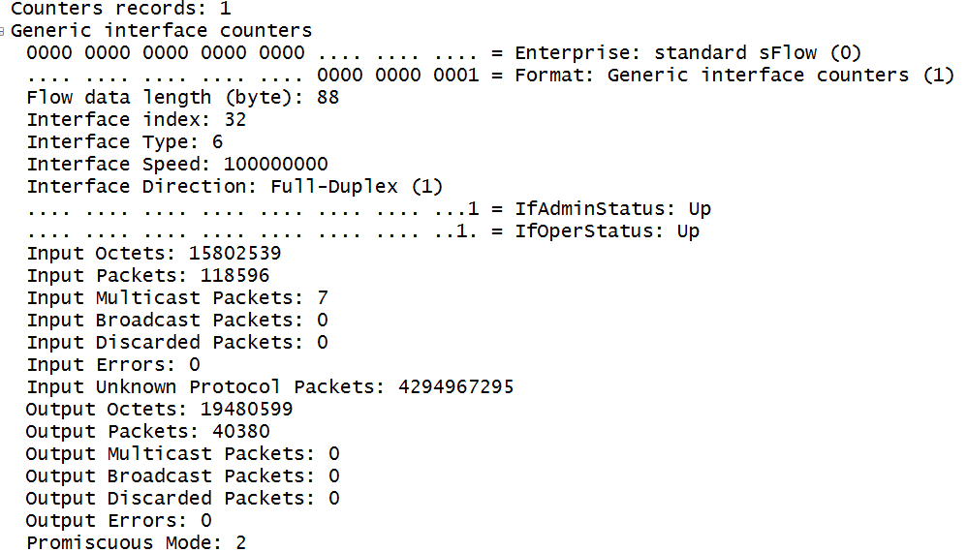
sFlow Closer Look
Wireshark inMon
sFlow dissector

Slide 27

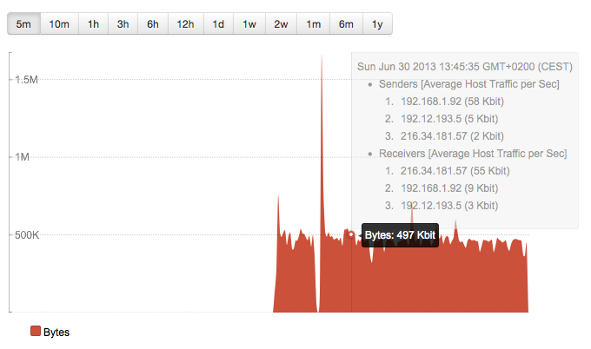
sFlow – Collectors

Slide 28
Logging
sFlow
SNMP
AddOns
iControl
Accounting, Visibility
& Reporting
Skunk Works

Slide 29

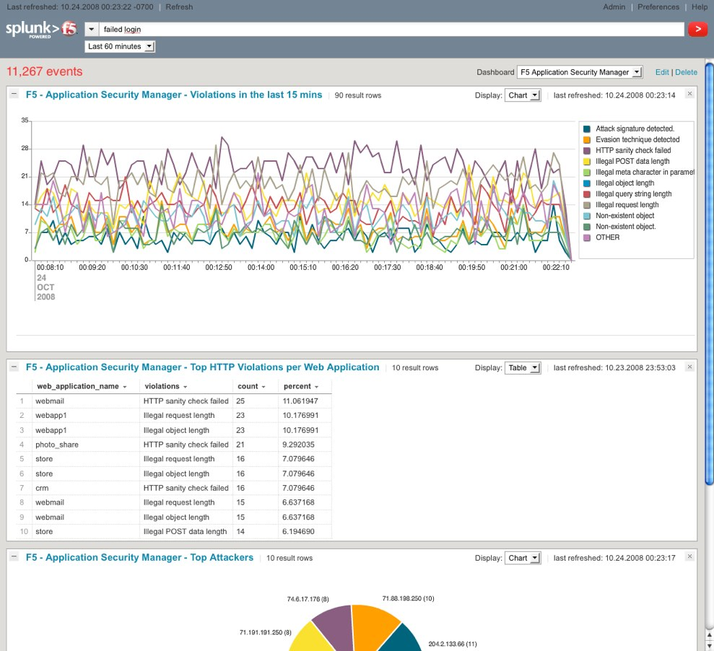
AddOns (Integrations)
https://devcentral.f5.com/articles/getting-started-with-splunk-for-f5
SPLUNK Integration detail: https://www.splunk.com/content/dam/splunk2/pdfs/fact-sheets/splunk-for-f5.pdf
SPLUNK Apps (extensions for F5)
https://splunkbase.splunk.com/app/812/
Getting Started with SPLUNK https://devcentral.f5.com/articles/getting-started-with-splunk-for-f5
SPLUNK for APM
https://www.f5.com/pdf/solution-center/splunk-templates-for-apm.pdf
SPLUNK for ASM
https://www.f5.com/pdf/solution-center/splunk-asm-sb.pdf

Slide 30
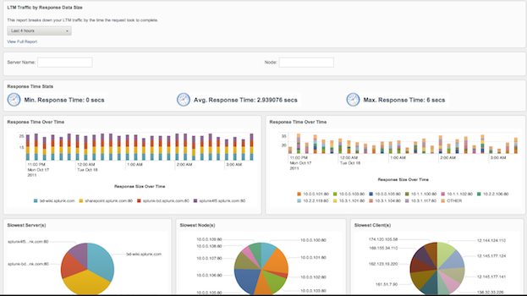
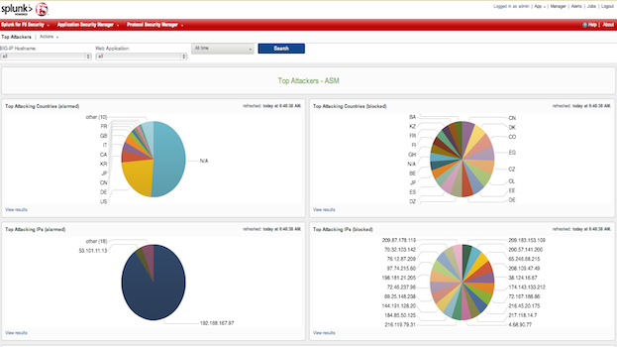
AddOns (Integrations)

Slide 31
Logging
sFlow
SNMP
AddOns
iControl
Accounting, Visibility
& Reporting
Skunk Works
Notes:
https://support.f5.com/kb/en-us/products/big-ip_analytics/manuals/product/avr-implementations-11-6-0/1.html

Slide 32
AVR (Availability, Visibility & Reporting)
Analytics (also called Application Visibility and Reporting) is a module on the BIG-IP® system that lets you analyze performance of web applications.
Provides metrics such as:
Transactions per second,
Server latency
Client latency,
Request throughput
Response throughput,
Sessions. Counts
Can view metrics for:
Applications
Virtual servers,
Pool members,
URLs,
Specific countries,
App traffic details
Transaction counters for:
Response codes,
User agents,
HTTP methods,
Countries
IP addresses
AVR also provides remote logging capabilities to consolidate statistics gathered from multiple BIG-IP appliances onto syslog servers or SIEM devices, such as Splunk.

Slide 33
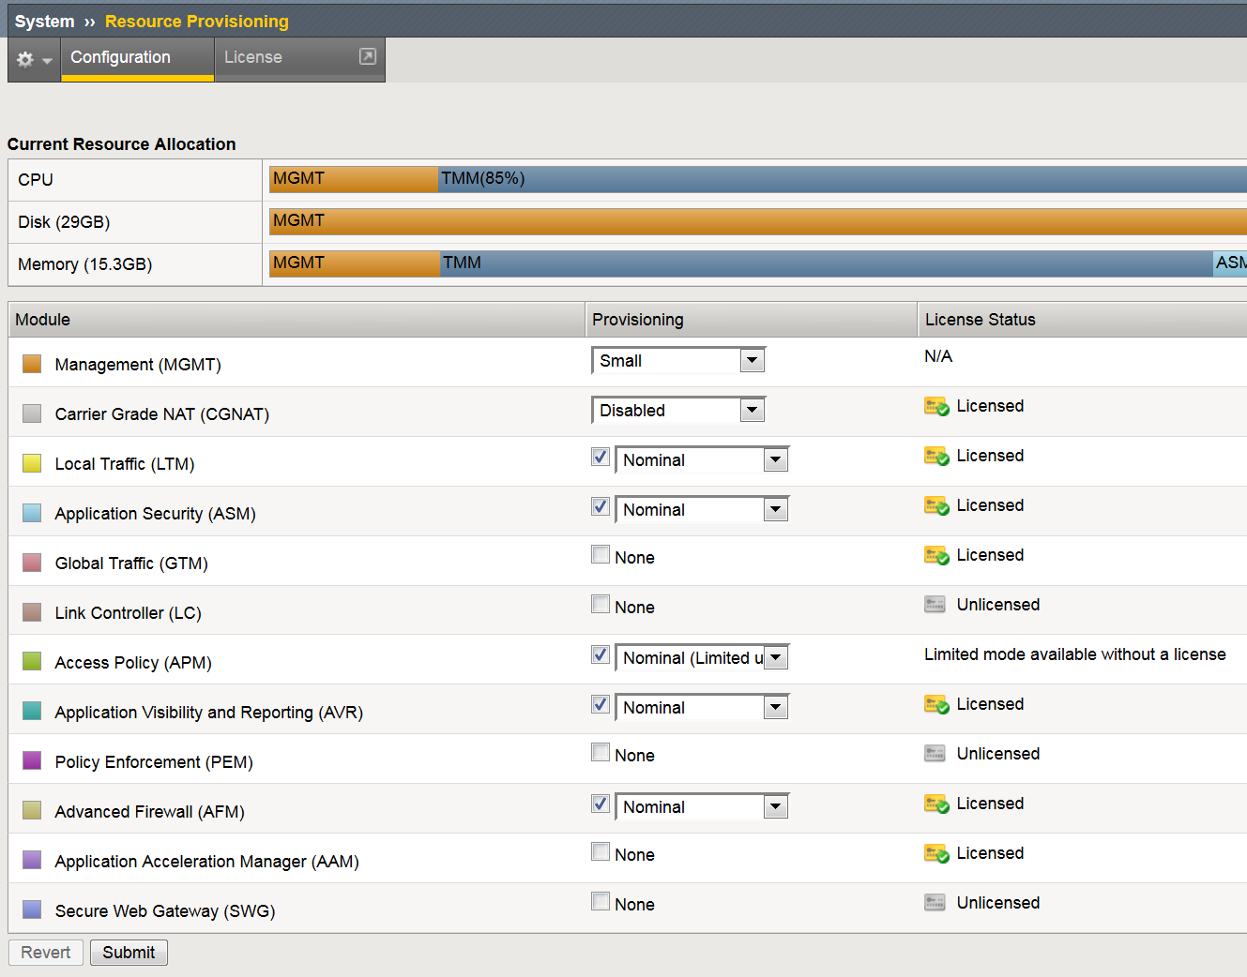
AVR Provisioning
Does require a system “restart” to provision
Does not count as a “module”
There is no license cost
There is CPU, Disk & Memory impact

Slide 34
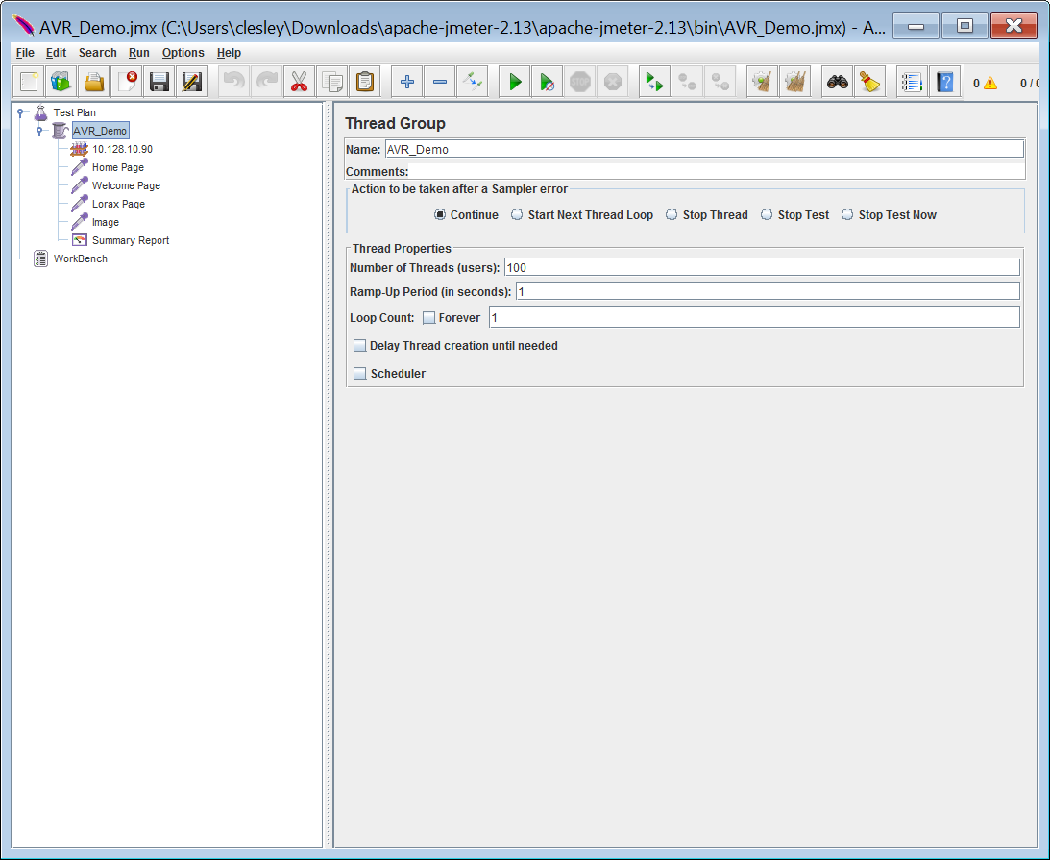

Quick Info
The Apache JMeter™ application is open source software, a 100% pure Java application designed to load test functional behavior and measure performance. It was originally designed for testing Web Applications but has since expanded to other test functions.
http://jmeter.apache.org/

Slide 35
Couple of iRules
random_agents_ip
server_delay (what?)
when CLIENT_ACCEPTED {
snat [expr int(rand()*255)].[expr int(rand()*255)].[expr int(rand()*255)].[expr int(rand()*254)]
virtual avr_vs2
}
when HTTP_REQUEST {
set my_index [expr int(rand()*10)]
set user_agent [class element -value $my_index random_agents]
HTTP::header replace user-Agent $user_agent
}
when LB_SELECTED {
if {([LB::server addr] equals "10.128.20.13") and ([HTTP::uri] equals
"/welcome.php")} {
after 500
}
elseif {[LB::server addr] equals "10.128.20.13"} {
after 200
}
}
This is not the “server team torture device” you have been looking for

Slide 36
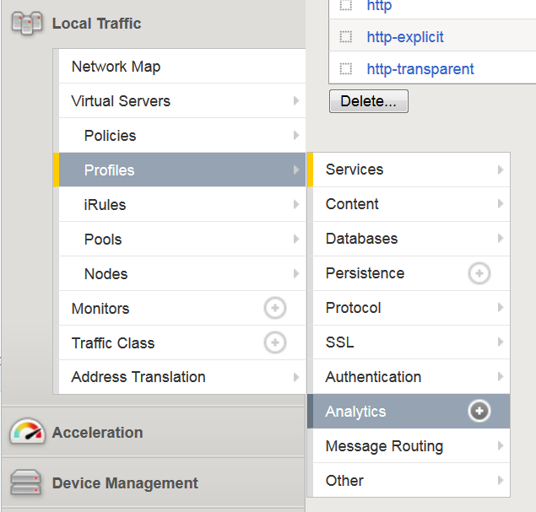
Getting Started – Analytics Profile
Build Analytics Profiles
Assign it to Virtual Server
Start Reporting

Slide 37
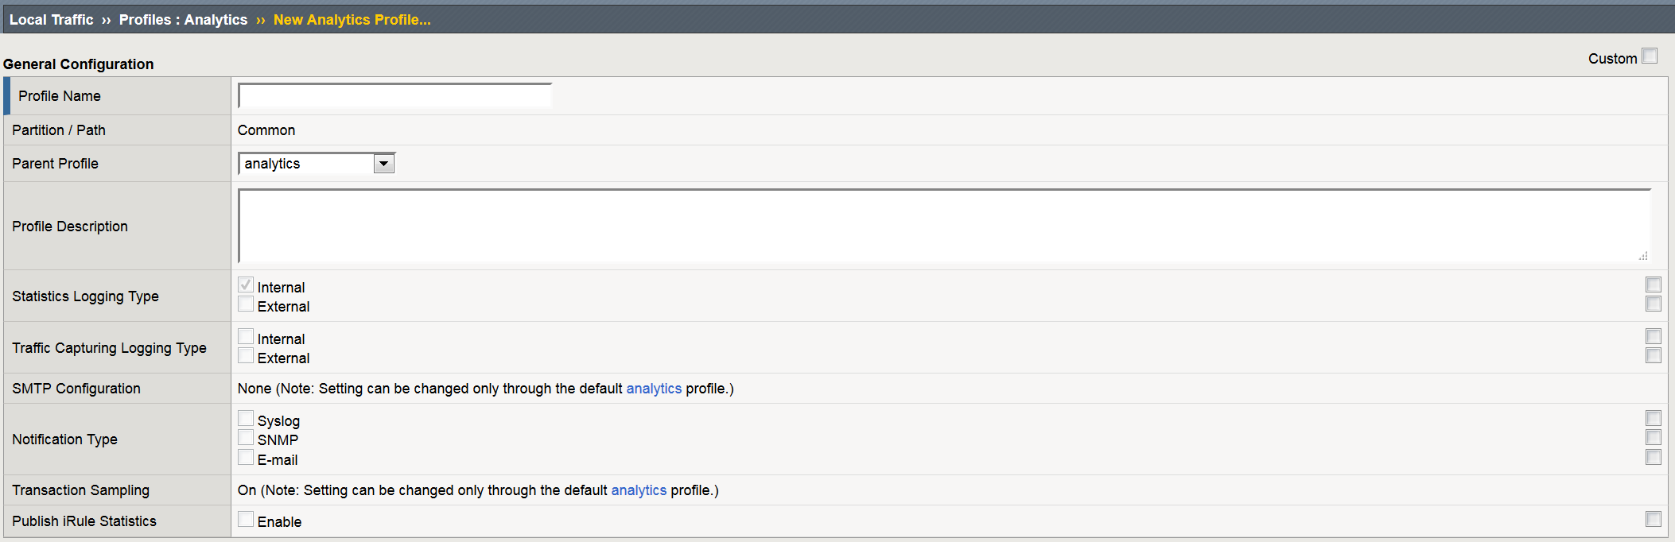
Setting up an Analytics Profile
Name
Internal or External Logging
Traffic Capture Logging Type
Notifications

Slide 38
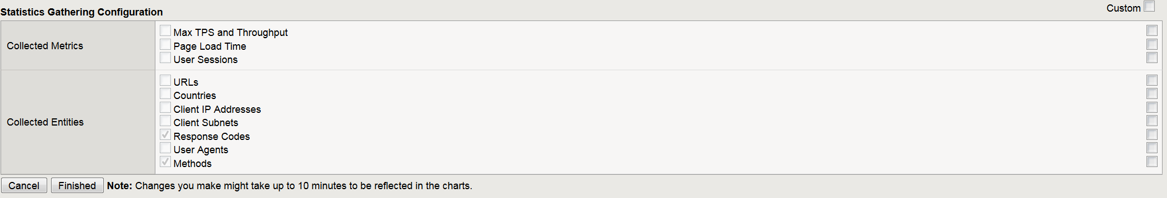
Getting Started – Analytics Profile
Applied Virtual Servers
Metrics
Max TPS & Throughput
Page Load Times
User Sessions
Collected Entities
Very cool pieces of information
Caution with
Page Load Times
Injects Java Script which can affect system performance & application functionality
Notes:
https://support.f5.com/kb/en-us/products/big-ip_analytics/manuals/product/avr-implementations-11-6-0/4.html

Slide 39
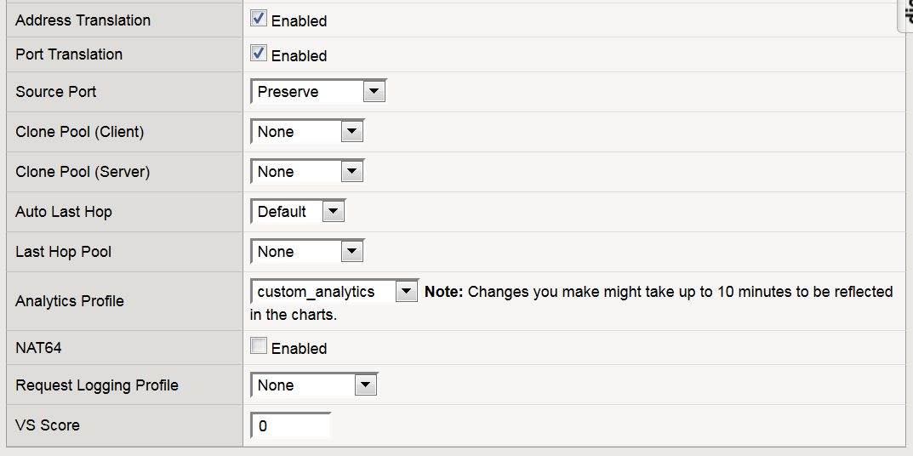
Applying Analytics Profile to Virtual Server
Change from
“Basic”
to “Advanced”

Slide 40
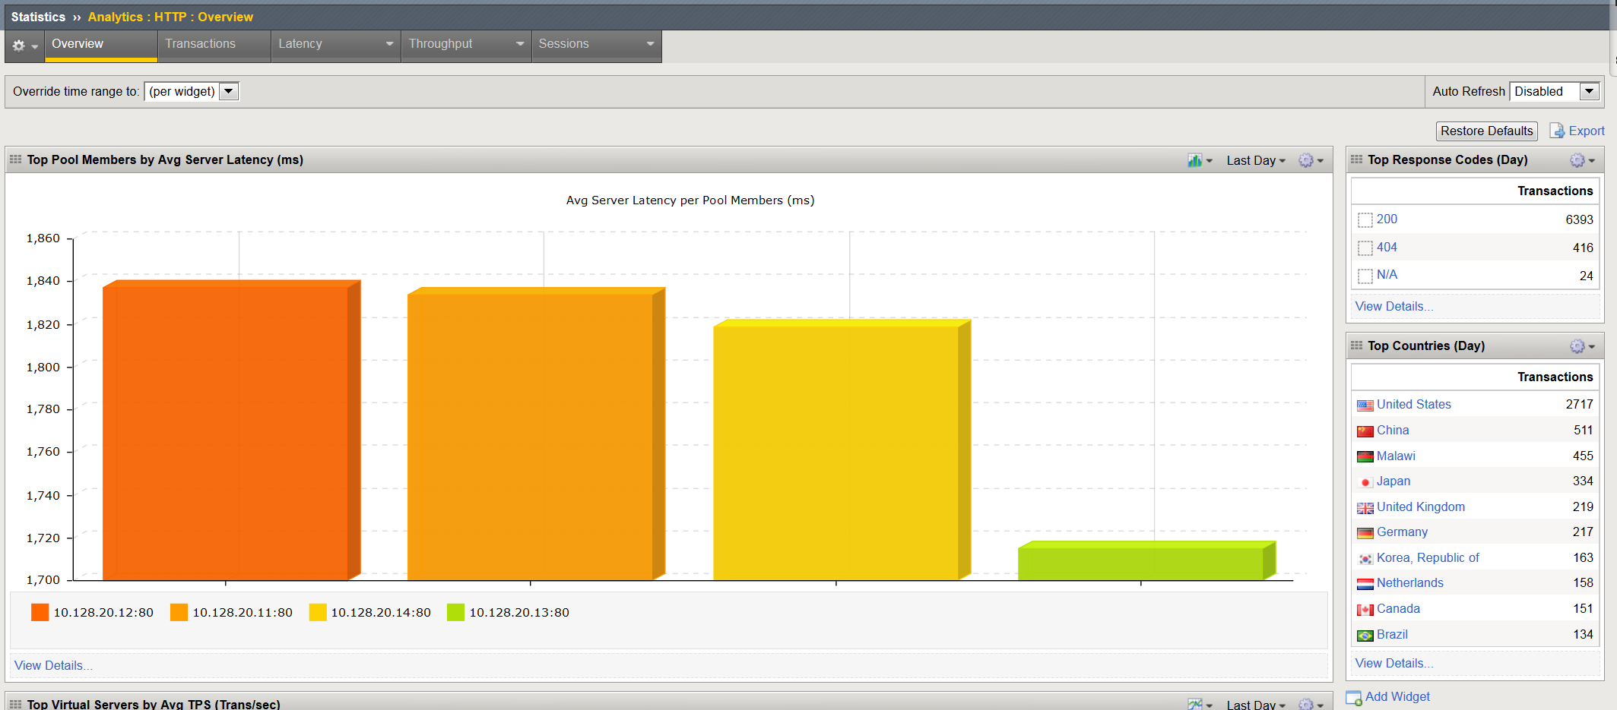
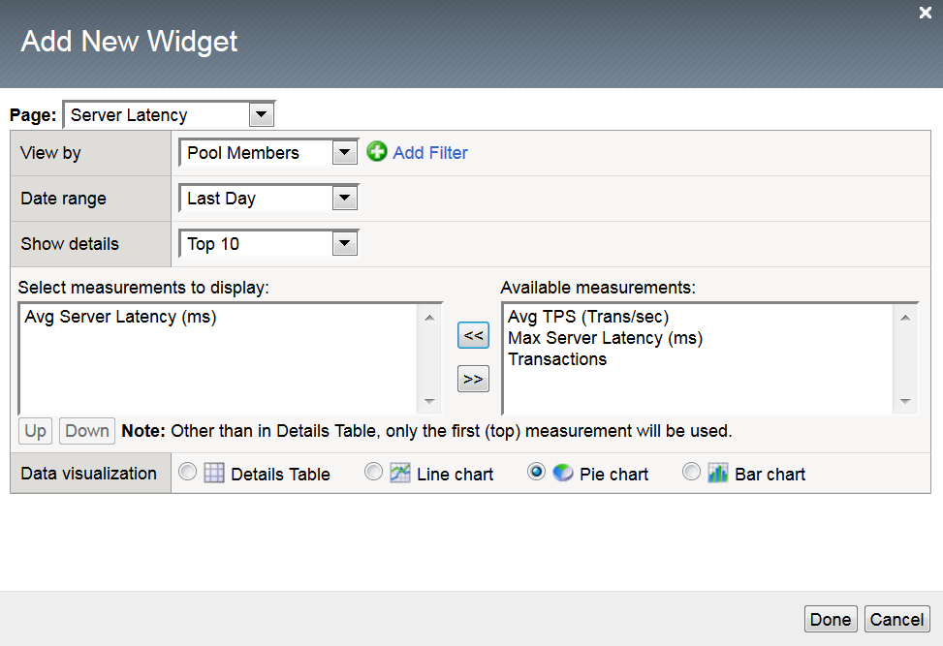
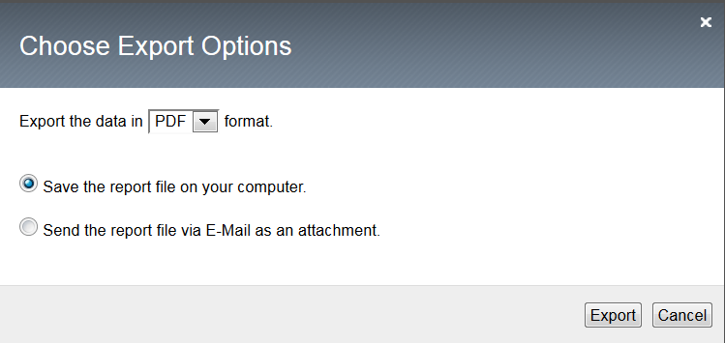
AVR Dashboard

Slide 41
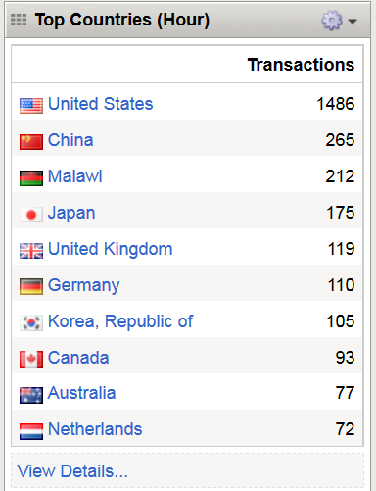


AVR Graphics
Drill into widgets for more details
Particularly the 404 Errors

Slide 42


AVR Graphics

Slide 43


AVR Graphics – My favorite
STOP: I know what you are thinking

Slide 44

Widget Detail – Server Latency
View by “Urls”
Detailed Information by URL
Avg Server Latency (ms)
Max Server Latency (ms)

Slide 45
Widget Detail – Track 404’s

Slide 46
Words of Caution …
Its not a historical tool it’s a visibility & troubleshooting tool
Data retention is based on your traffic loads (expect a week)
Its not the be all end all … there are things that could be better
It fills a need. Products like BIG-IQ (management) are intended for larger scale visibility and reporting

Slide 47

Let’s …

Slide 48
Provide you & your teams greater visibility
Provide another perspective on your traffic
Put more “information” in your hands
Save you time
Get more value out of your investment – the tools are there … use them

Slide 49
Logging
sFlow
SNMP
AddOns
iControl
Accounting, Visibility
& Reporting
Skunk Works

Slide 50

Skunk Works
function f5Data($url) {
$ch = curl_init();
curl_setopt($ch, CURLOPT_URL, $url);
curl_setopt($ch, CURLOPT_SSL_VERIFYPEER, false);
curl_setopt($ch, CURLOPT_HTTPAUTH, CURLAUTH_BASIC);
curl_setopt($ch, CURLOPT_USERPWD, "admin:#######");
curl_setopt($ch, CURLOPT_RETURNTRANSFER, 1);
$response = curl_exec($ch);
$errmsg = curl_error($ch);
$cInfo = curl_getinfo($ch);
curl_close($ch);
return $response;
}

Slide 51
Looking Forward …
Late June: TCPDump follow-up
Next User Group (BIG-IQ? / ASM?)
Santa Rosa User Group
NewsLetter Feedback
Code train…

Slide 52

Questions
T

Slide 53
























F5 Overview (Your very brief one slide marketing syllabus)
F5 Enterprise Partner Ecosystem
Publicly traded on NASDAQ
(IPO 1999)
Leading provider of application and data delivery networking
3,300+ employees
Our products sit at strategic points of control in any infrastructure
DevCentral
160,000+ registered users, geeks, contributors from over 191 countries
Industry leading security platform for application delivery and web application firewall
References available upon request
Notes:
F5 is the global leader in Application Delivery Networking, and continues to be a solid provider and customer ally as we continue to grow and expand the entire ADC market.

Slide 54
Thank you for you time…
T

