Slide 1
Access Policy - Federation
March 23, 2016
Chas Lesley, SE Norcal

Slide 2

Agenda – Usergroup
News & Updates
Intro - Cover Federation/SSO Concepts
Intro - Cover SAML Federation
  iDP Initiated
  SP Initiated
Demo– iDP/SP SAML
  Cover general troubleshooting
Cover SaaS SAML LAB – SaaS use case
Cover More Advanced SAML use cases
LAB – KerbSSO to SAML
Questions & Answers

Slide 3
Federation …

Slide 4
What is Federated SSO?
Single Sign On [SSO]
An umbrella term for any time a user can login to multiple applications while only authenticating once. It covers both federation and password vaulting which is more commonly known as “Enterprise SSO”
Federation
A trust established between two systems with the purpose if enabling the targeted system to accept or trust the asserted identity provided by the source system.
Federated SSO
A combining of Federation and SSO wherein a previously validated and verified identity is leveraged in order to provide seamless access to federated systems.
+
=
In 2013 Gartner said “Through 2016, Federated Single Sign-On Will Be the Predominant SSO Technology, Needed by 80% of Enterprises.” http://www.gartner.com/newsroom/id/2322215
Notes:
http://www.gartner.com/newsroom/id/2322215

Slide 5
Federation Standards & Additional Standards
WS-Federation is part of the Web Services Security (WSS) set of proposed and accepted standards which includes WS-Trust and WS-Security. Microsoft and IBM both contributed to the design of the standards and employ them in their federation software.
WS-Federation
SAML stands for Security Assertion Markup Language. The OASIS standard is composed of a set of specifications for assertions, protocols, bindings, profiles, metadata, etc. (Community developed edition by the Shibboleth Consortium)
SAML
OpenID is an identity federation protocol specification. Several major web vendors, including Google and Yahoo!, implement OpenID authentication systems
OpenID
OAuth is technically not a federated authentication protocol. Rather, it is an authorization framework. It is typically employed in situations where one user is granting limited access to his or her protected resources to another user.
OAuth
Notes:
http://blog.empowerid.com/blog-1/bid/164625/What-is-federation-And-how-is-it-different-from-SSO

Slide 6
SAML 2.0

Slide 7
SAML Definition & Versions
Security Assertion Markup Language (SAML) is an XML standard for exchanging authentication and authorization data between entities
Why SAML?
Cookies don’t do it –
  Cookie (signed with server’s private key) can be used for re-authentication at a particular server, but is of no use at a different server
Cross domain authentication currently requires proprietary SSO software
SAML intended as a Web standard that will bridge proprietary software
SAML 1.0 was adopted as an OASIS standard in Nov 2002
SAML 1.1 was ratified as an OASIS standard in Sep 2003
SAML 2.0 became an OASIS standard in Mar 2005
SAML is a product of the OASIS Security Services Technical Committee:
http://www.oasis-open.org/committees/security/

Slide 8
SAML Standards & Specification
SAML is built upon the following technology standards:
  Extensible Markup Language (XML)
  XML Schema
  XML Signature
  XML Encryption (SAML 2.0 only)
  Hypertext Transfer Protocol (HTTP)
  SOAP
A SAML specification defines:
  Assertions (XML)
  Protocols (XML + processing rules)
  Bindings (HTTP, SOAP)
  Profiles (= Protocols + Bindings)
Assertions and protocols together constitute SAML core (syntactically defined by XML schema (XSD))
Profiles define semantics of use cases
SAML must be used in the context of a trust relationship between asserting and relying parties

Slide 9
SAML Components
Profiles
Assertions: Authentication, Attribute and Authorization information
Protocol: Request and Response elements for packaging assertions
Bindings: How SAML Protocols map onto standard messaging or communication protocols
Profiles: How SAML protocols, bindings and assertions combine to support a defined use case
Bindings
In 2013 Gartner said “Through 2016,
Protocol
Assertions
In 2013 Gartner said “Through 2016,

Slide 10
SAML iDP & SP Initiated

Slide 11


SAML Architecture
2
iDP
1
The User/Client (Principal) who will be accessing an application via a URL.
2
The Identity Provider [iDP] which asserts identity and provides an Assertion for an application.
3
1
SAML Identity Provider
SAML Assertion
3
The Assertion generated by the iDP and to be used by the User/Client to gain access to an application.
4
User/Client
(Principal)
SP
4
The Service Provider [SP] which accepts Assertions and provides access to an application
Also PRESUMES that proper trust relationship has been established between iDP & SP (certificates)
SAML Service Provider

Slide 12
Service Provider [SP] Initiated SAML
iDP
1
User/Client (Principal) accesses Service Provider [SP] without any authentication.
3
4
SAML Assertion
2
SP creates access request for User/Client & redirects it to Identity Provider [iDP]
SAML Identity Provider
3
User/Client contacts iDP and provides identity
1
2
SAML Assertion
4
iDP asserts identity and provides User/Client SAML Assertion
User/Client
(Principal)
SP
5
5
Following receipt of SAML Assertion User/Client contacts SP and provides Assertion for access
SAML Service Provider

Slide 13
Identity Provider [iDP] Initiated SAML
iDP
1
User/Client (Principal) accesses “application” via URL which directs them to the Identity Provider [iDP] at which time the User/client provides identity.
1
2
SAML Assertion
SAML Identity Provider
2
iDP asserts identity and provides User/Client SAML Assertion based on the requested URL
SAML Assertion
User/Client
(Principal)
SP
3
Following receipt of SAML Assertion User/Client contacts SP and provides Assertion for access
3
SAML Service Provider

Slide 14
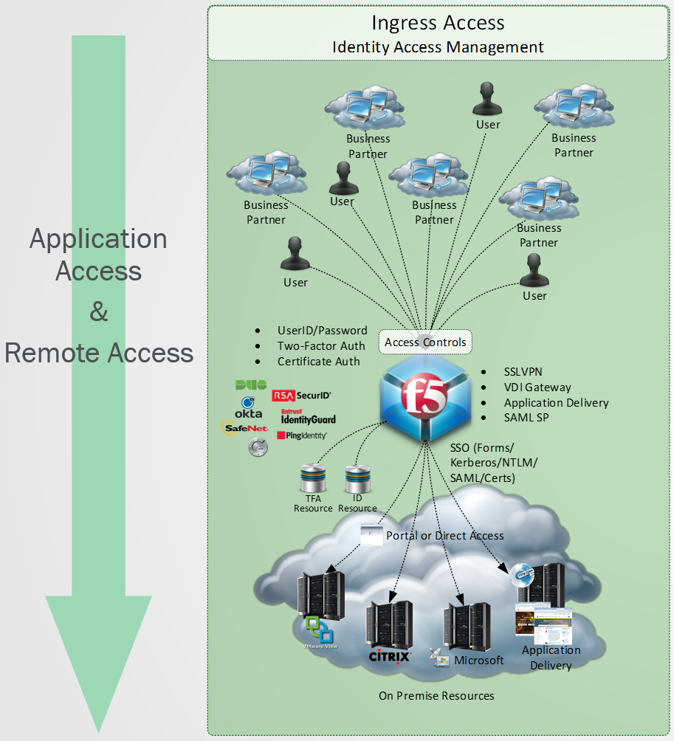
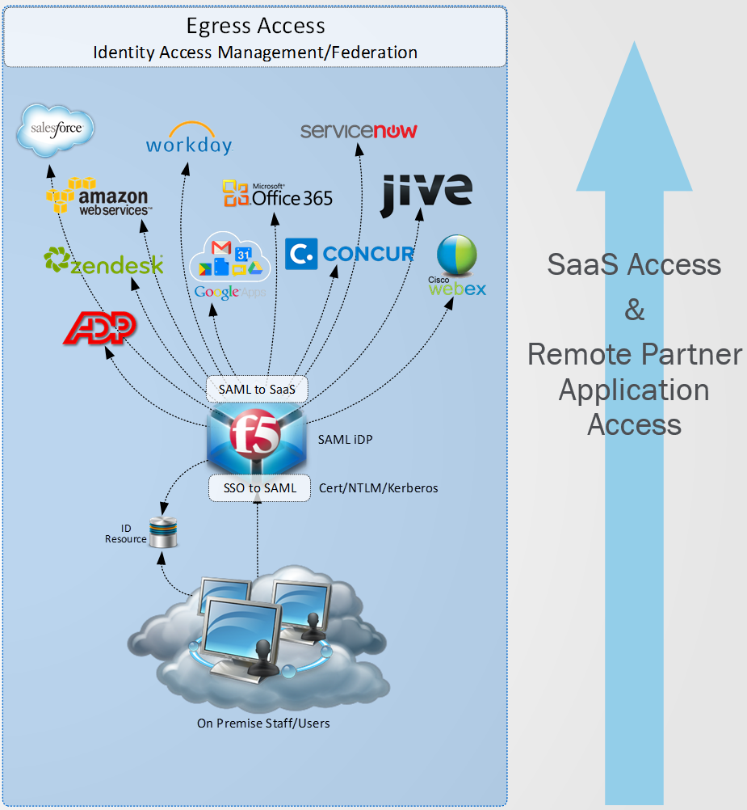
F5 & SAML (Ingress & Egress)

Slide 15
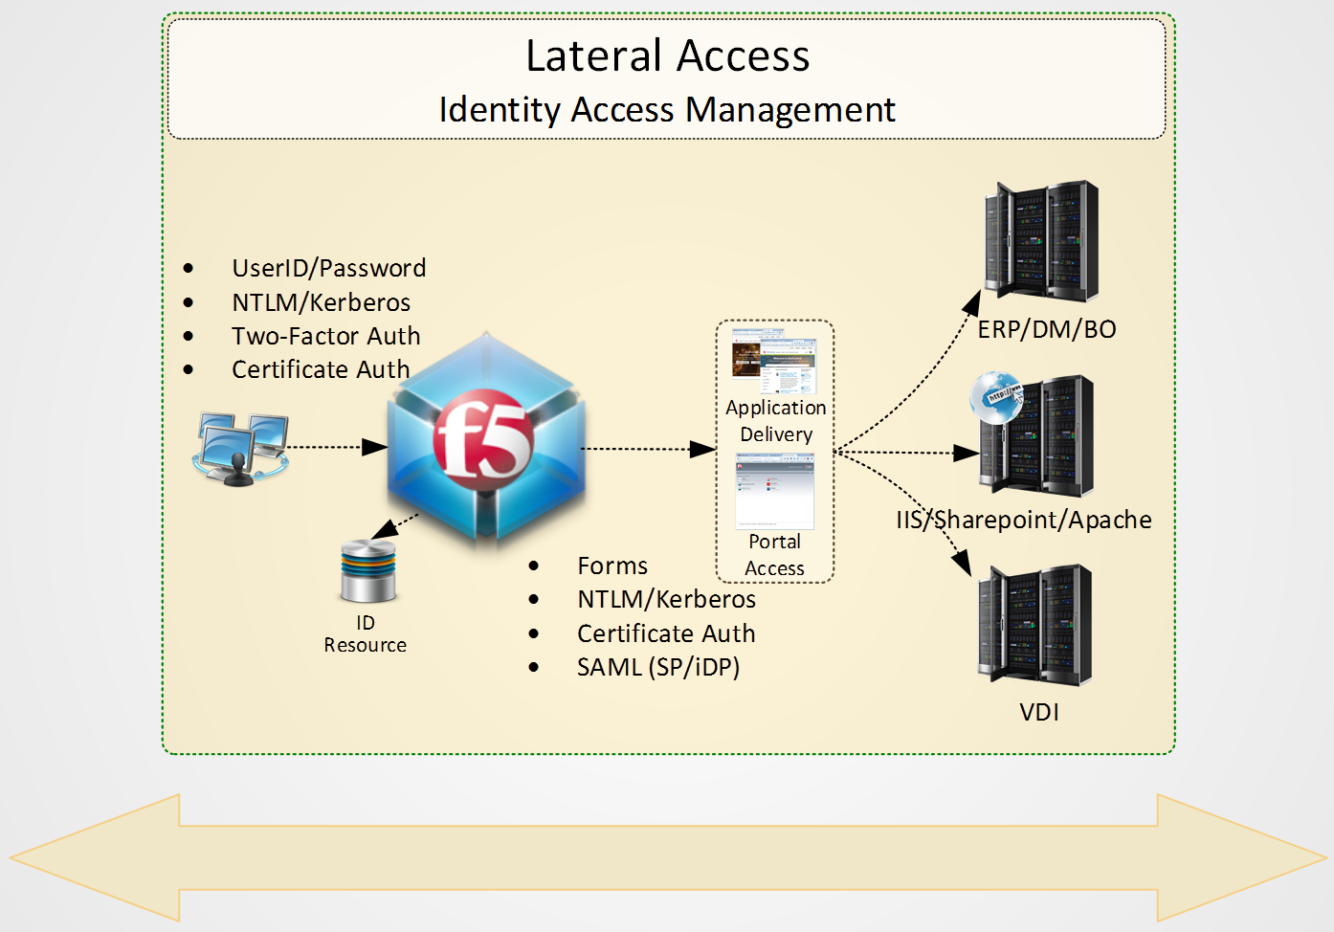
F5 & SAML (Lateral)

Slide 16
Demo: SAML Lab: SP & iDP

Slide 17

SAML Lab Requirements
Must have Access Policy Manager (APM) licensed and provisioned OR must have Access Policy Manager (APM) provisioned and using the “lite license” (10 User)
Hardware must support running APM. Generally applies to only smallest platforms and with already heavy usage. (Ask Us)
Custom iRules to host Web Pages on the F5. (included in SAML iDP/SP Guide)
Additional SAML Resource, tips & tricks available on DevCentral. Start there first!

Slide 18

SAML Lab Steps
Create a SAML IDP
Create a SAML SP
Create & Bind a SAML SP Connecter (for IDP via MetaData)
Create & Bind a SAML IDP Connecter (for SP via MetaData)
Create a SAML Resource
Create IDP/SP Access Policies
Attach to Virtual Servers & Test (Cross your fingers)

Slide 19
Demo: SaaS

Slide 20
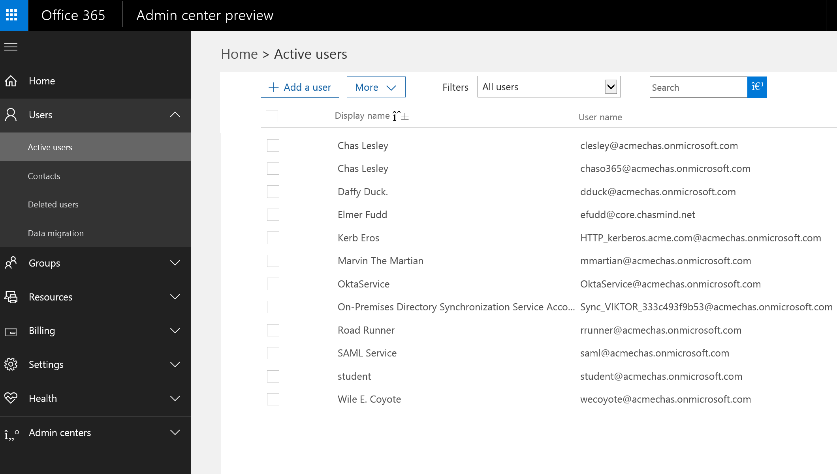
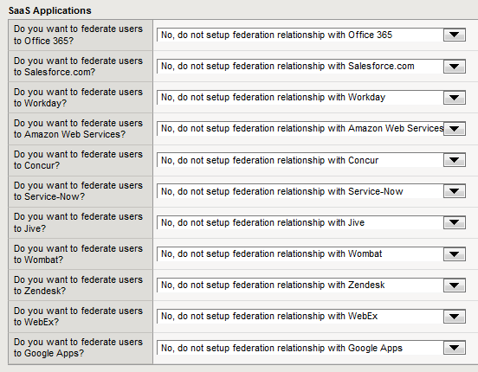
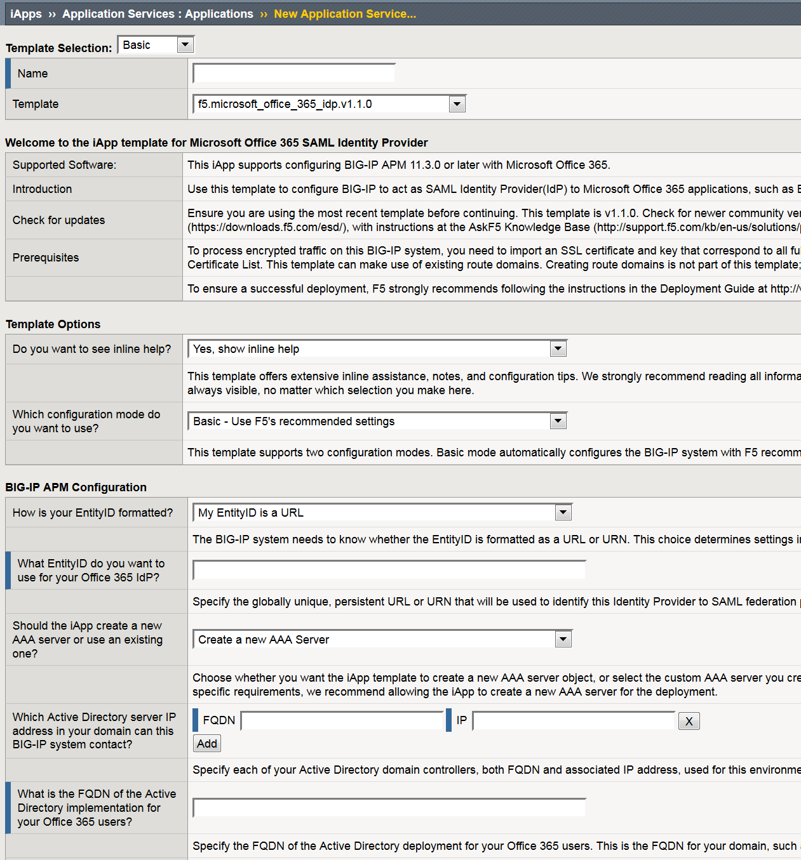
SaaS

Slide 21
Demo: Federated SSO

Slide 22
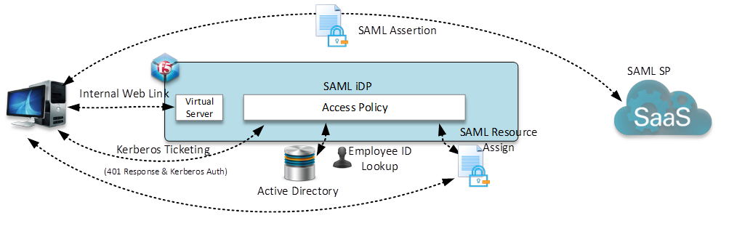
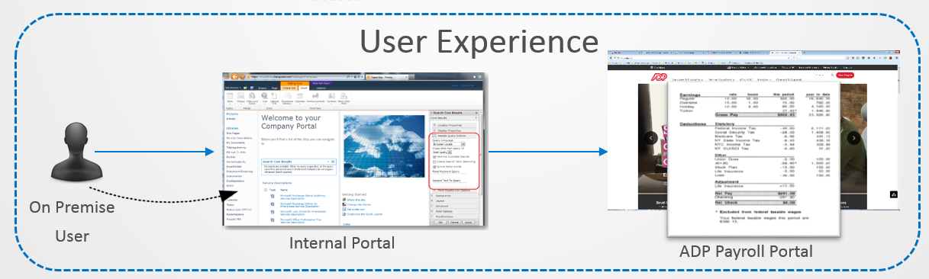

Egress SAML (iDP Initiated)
Streamlined Access without User Interaction
SAML eliminates the need for Authentication Synchronization

Slide 23
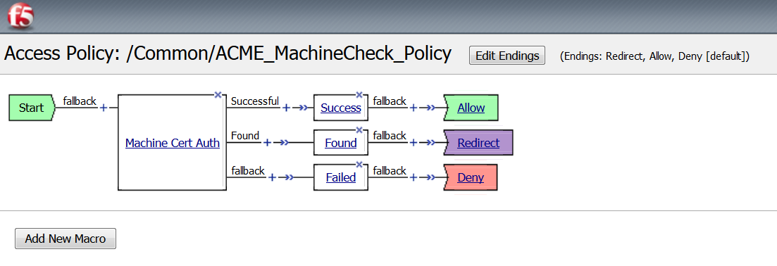
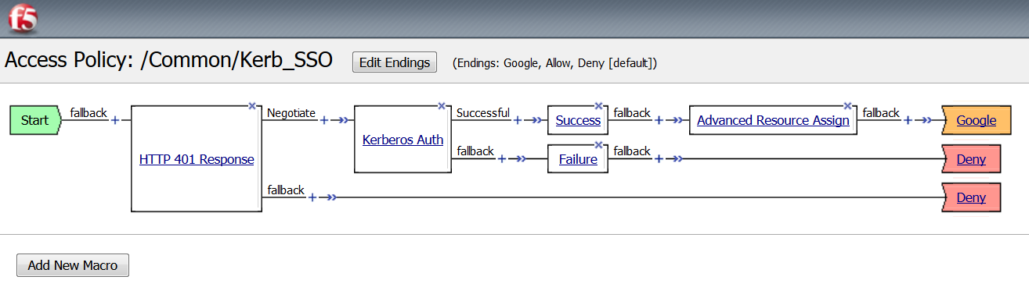
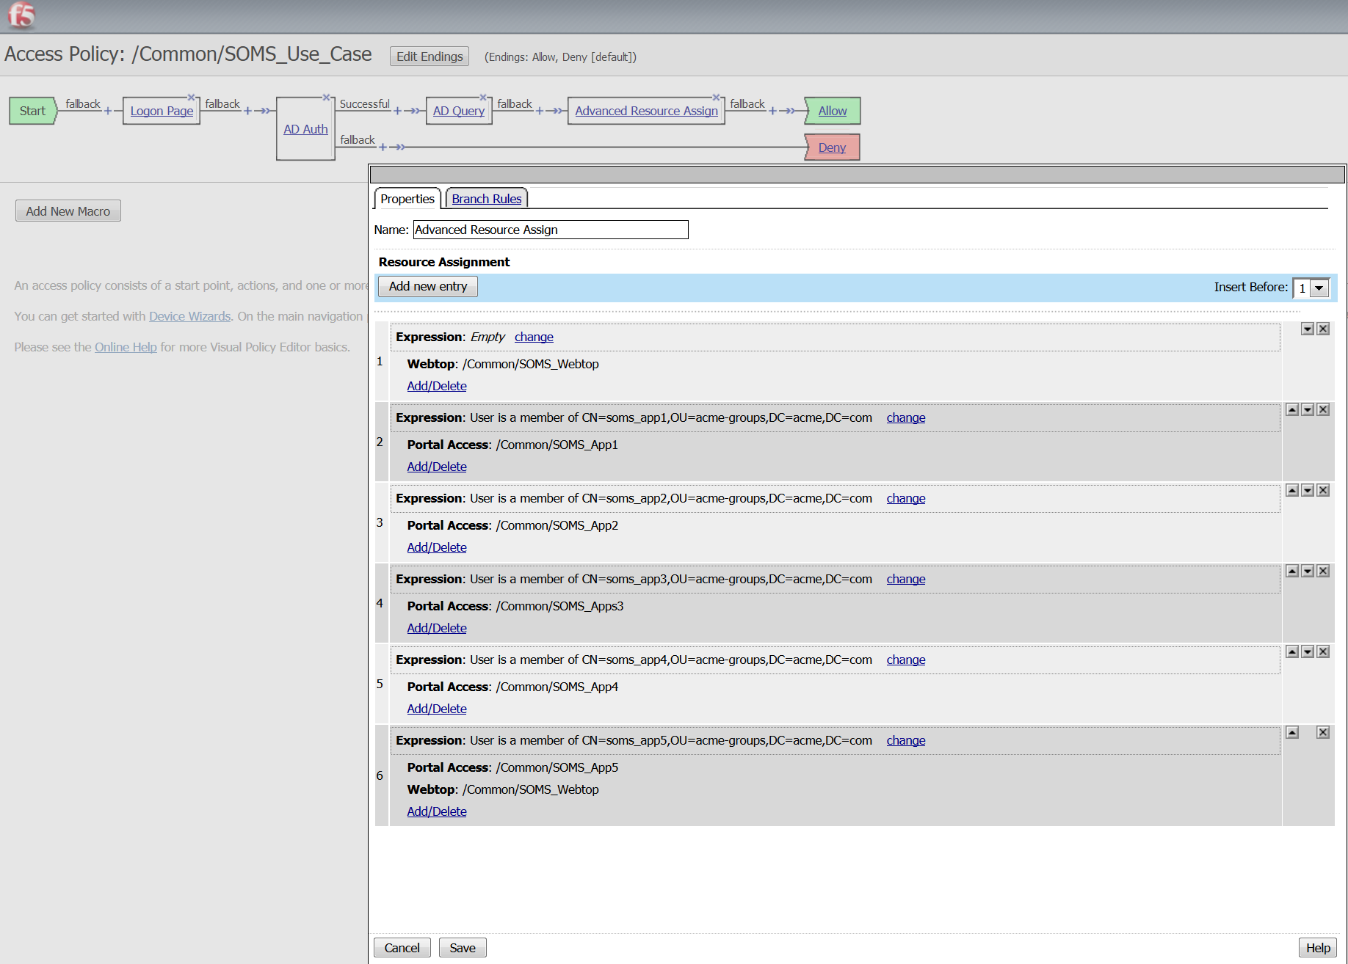
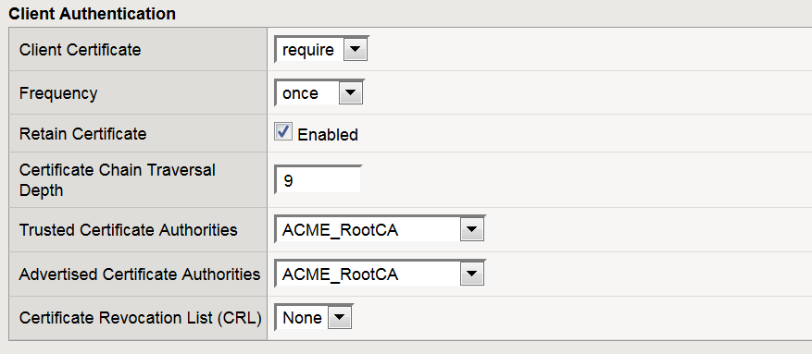
The Power of Visual Policy Editor
Additional Layers of Control

