Slide 1
SSL Everywhere & SSL Security
Chas Lesley
Field Systems Engineer
Tony Ganzer
Territory Account Manager
Notes:
The material for this presentation was based on:
Material found in the “SSL Deep Dive” presentation by Jim McCarron
(Intro) SSL Intercept slides from Kevin Stewart
Other customized content.
This presentation is based on 12.0HF1

Slide 2

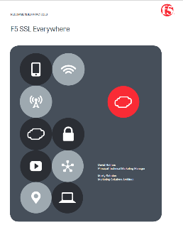
Introductions
SSL Background
Full Proxy & HUD Filter Chain
SSL Profile: Ciphers &Configuration
SSL Profile: Client Authentication
SSL Profile: Forward Proxy & SSL Intercept
Question & Answer
Wrap-Up (Next User Group)
AGENDA
Notes:
https://f5.com/Portals/1/Premium/Architectures/RA-SSL-Everywhere-deployment-guide.pdf

Slide 3

Every environment is at different levels
We don’t know everything,
Everyone needs to contribute.

Slide 4


SSL General Warnings
IMPORTANT:
F5’s TMOS is capable of rendering multiple SSL Cipher Suites. Configuring weaker suites should only be done for testing purposes only. These should be removed as soon as testing is complete.
IMPORTANT:
Depending on the elected cipher suites, the SSL TPS (Transactions Per Second) can be affected. Understand your specifc application and TPS requirements and ensure any cipher suite is compatible with the targeted application and capabilities of the platform.
IMPORTANT:
Altering SSL Cipher Suites impacts the breadth of browsers and platforms that can supported. Understand the impacts and plan accordingly.
Liability Release Complete
As with any system, understand it before you use it

Slide 5
Trajectory and Growth of Encryption
SSL growing ~30% annually. Entering the Fifth wave of transition (IoE)
E-Commerce
Privacy
Mobility
Snowden
IoE
Market AMPLIFIERS
Customer Trends:
  PFS/ECC Demanded
  SSL Labs Application Scoring
Emerging Standards:
  TLS 1.3, HTTP 2.0/SPDY
  RSA -> ECC
Thought Leaders and Influence:
  Google: SHA2, SPDY, Search Ranking by Encryption
  Microsoft: PFS Mandated
Millions of Certificates (CA)
Source: Netcraft
Years

Slide 6


Slide 7
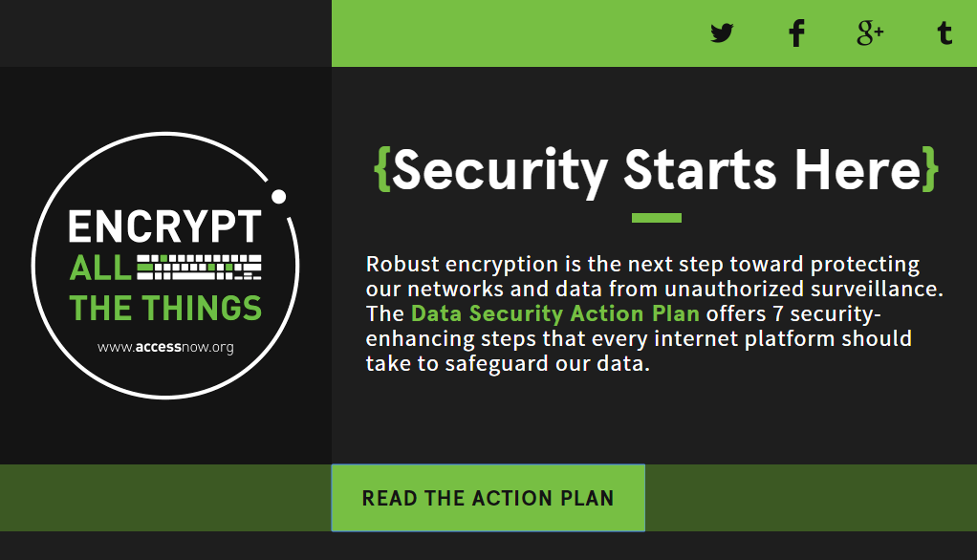
https://encryptallthethings.net/

Slide 8
2
http

Slide 9
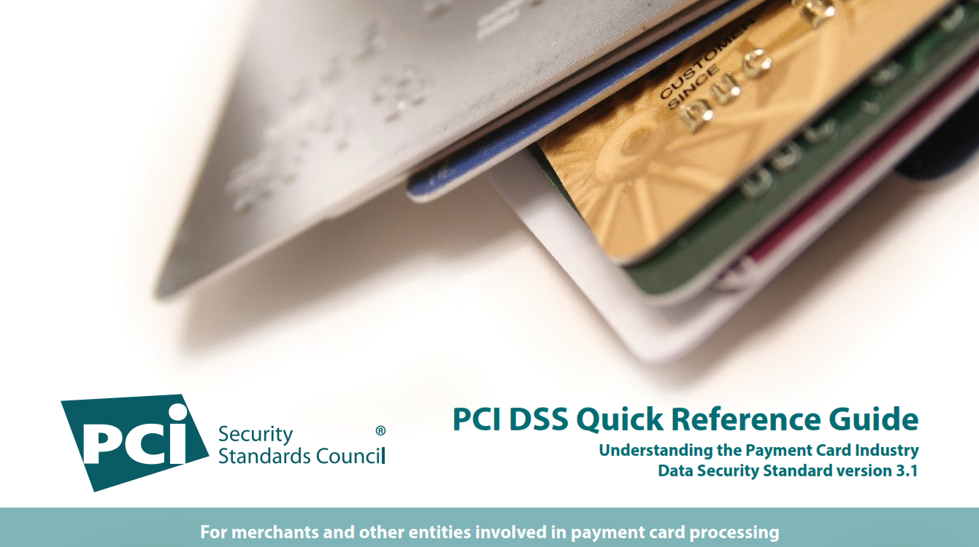
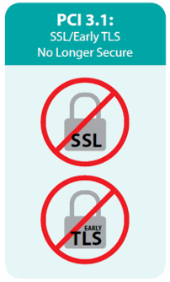


Slide 10
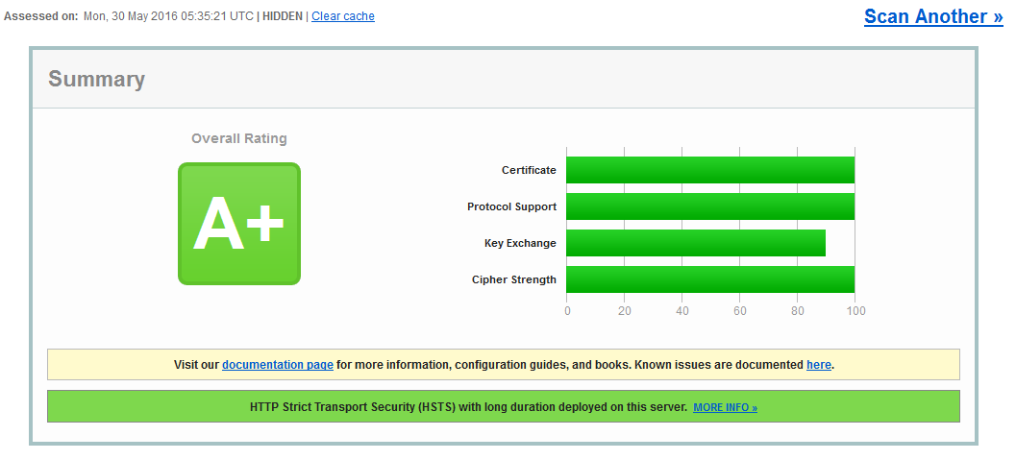
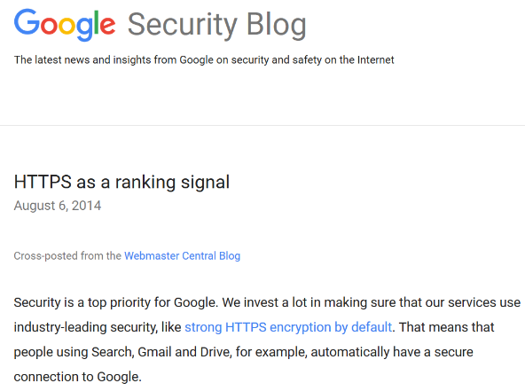
Notes:
https://webmasters.googleblog.com/2014/08/https-as-ranking-signal.html

Slide 11
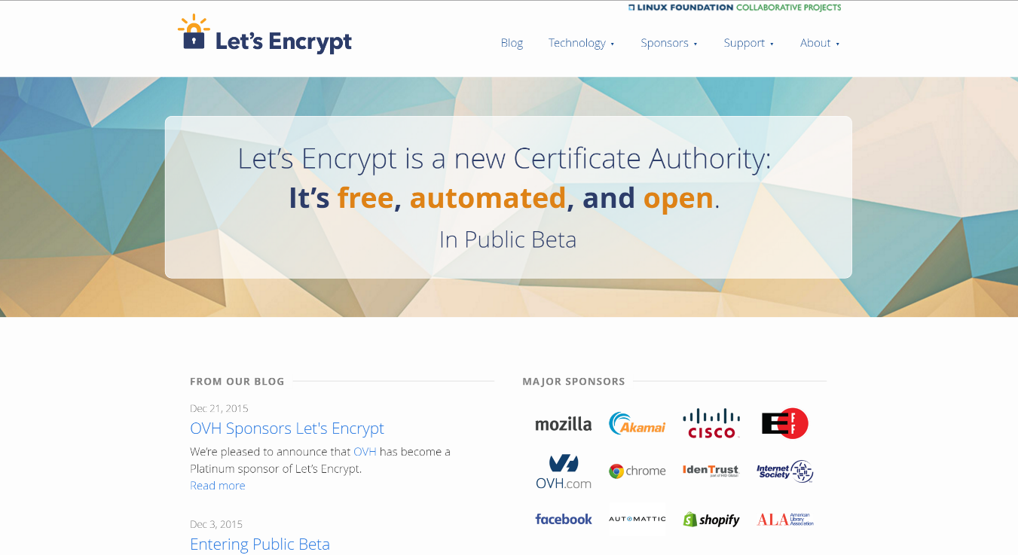
Notes:
https://letsencrypt.org/

Slide 12
The SSL Landscape is Changing, Rapidly…
98%
~26%
>33%
Support for SSLv3
SEP 2014
Support for SSL v3
Today
Support for Forward secrecy
David Holmes. RSA 2015. https://devcentral.f5.com/articles/rsa2015-ssl-everywhere-feat-holmes
Notes:
Source; David Holmes. https://devcentral.f5.com/articles/rsa2015-ssl-everywhere-feat-holmes
More on PFS later….

Slide 13
SSL & the FULL Proxy
… Some quick reminders

Slide 14
SSL Visibility/Intercept
A Reverse Proxy sits between the user and an application and can do things like caching, load balancing, and security on behalf of the app.
A Forward Proxy sits between the user and an application and does things like caching and stopping you from using Facebook at work.

Slide 15
BIG-IP Architecture – HUD Filter Chain (Proxy Chain)
Intelligent Full Proxy Benefits
Clients
Data Center
App “point of delivery & definition”
App Intelligence - layer 3- 7 visibility
Distinct client / server control
Unified services / context
Interoperability and gateway functions
BIG-IP Platform
HUD Filter Chain
T
C
p
S
S
l
H
T
T
p
P
R
O
X
y
H
T
T
p
S
S
l
T
C
p
HUD chains are a series of filters which implement the configuration.
The HUD chain is divided into two halves, client and server side.
Filters on HUD chains usually are arranged as client/server pairs.
The two halves are joined by the “proxy”.

Slide 16
BIG-IP Architecture – SSL Termination (SSL Offloading & SSL Bridging)
Intelligent Full Proxy Benefits
Clients
Data Center
App “point of delivery & definition”
App Intelligence - layer 3- 7 visibility
Distinct client / server control
Unified services / context
Interoperability and gateway functions
BIG-IP Platform
HUD Filter Chain
T
C
p
S
S
l
H
T
T
p
P
R
O
X
y
H
T
T
p
S
S
l
T
C
p
Each SSL filter handles connection to device on their side of the proxy.
Normally, the two SSL filters operate completely independently.
Between the two filters, all data is available unencrypted.
To fully offload the backend server, remove the server side SSL filter.

Slide 17
BIG-IP Architecture – Forward SSL
Forward SSL Proxy Benefits
Clients
Data Center
Inspect secure traffic at network edge
Transparent to the end user
Policy based bypass by:
  Source IP Address
  Destination IP Address
  Host Name (SAN,CN,SNI)
BIG-IP Platform
HUD Filter Chain
T
C
p
S
S
l
H
T
T
p
P
R
O
X
y
H
T
T
p
S
S
l
T
C
p
Forward SSL is used in Forward Proxy deployments.
“Just in time” certificate creation is used to decrypt SSL connections.
Enables policy based inspection of secure content.
Requires the ability to create trusted certificates to work.

Slide 18
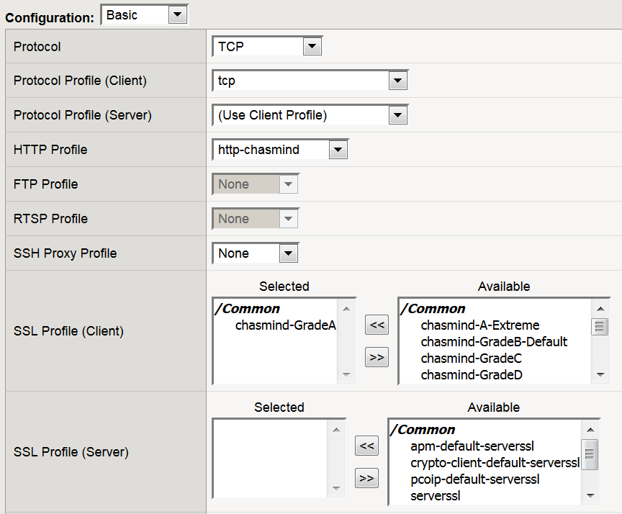
Where is the HUD Filter Chain in the GUI?
TCP Client and Server Profile
HTTP Profile
SSL Client and Server Profile
SSL Client and Server Profile

Slide 19
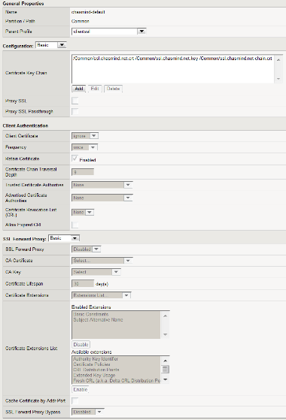
Exploring the SSL Profile (Client & Server)
Configuration
Spend most of our time here
We will cover:
Cipher Suites
Cipher Syntax
SSL Lab Scores
Client & Server Profiles
Client Authentication
Cover quick User Certificate Authentication
  PKI Cert use case
SSL Forward Proxy
General Overview of SSL Intercept and Forward Proxy use cases
Notes:
SOL 14783 https://support.f5.com/kb/en-us/solutions/public/14000/700/sol14783.html

Slide 20
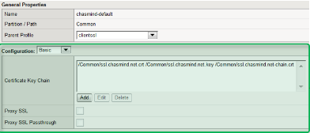
Ciphers Suites & Configuration

Slide 21
What is SSL? The history of SSL and TLS
SSL1 and SSL2
Created by Netscape and contained significant flaws
SSL3
Created by Netscape to address SSL2 flaws
TLS 1.0
Standardized SSL3 with almost no changes
RFC2246
TLS 1.1
Security fixes and TLS extensions
RFC4346
TLS 1.2
Added support for authenticated encryption (AES-GCM, CCM modes) and removed hard-coded primitives
RFC5246
1994
1995
1999
…
2006
2008
Crap hits the fan
First set of public SSL exploits

Slide 22
SSL isn’t perfect - SSL vulnerabilities exposed
August 2009
Insecure renegotiation vulnerability exposes all SSL stacks to DoS attack
RFC 5746
TLS extension for secure renegotiation quickly mainstreamed
BEAST & CRIME
Client-side or MITB attacks leveraging a chosen-plaintext flaw in TLS 1.0 and TLS compression flaws
Lucky 13
Another timing attack
RC4 Attacks
Weakness in CBC cipher making plaintext guessing possible
TIME
A refinement and variation of CRIME
Heartbleed
The end of the Internet as we know it!
August 2009
February 2010
September 2011
…
February 2013
March 2013
March 2013
April 2014
POODLE
Padding oracle attack on SSLv3
Dire POODLE
Padding oracle attack on TLS
FREAK
Implementation attack on export ciphers
LogJam
Implementation attack on weak DH

Slide 23
IETF TLS Best Practices [RFC 7525]
Must
Negotiate TLS v1.2
Support HSTS
Support SNI
Offer Forward Secrecy, such as DHE and ECDHE
Should
Prefer Strict TLS over StartTLS
Use HSTS (unless it weakens security or first contact not trusted)
Disable TLS encryption
Use public keys of at least 2048 bit
Should Not
Negotiate TLS v1.0 or v1.1
Negotiate less than 128 bit ciphers
Negotiate static RSA ciphers (TLS_RSA_WITH_*), no support for Forward Secrecy
Must Not
Negotiate SSL v2 or v3
Fall back to SSL v3 or older
Negotiate NULL cipher
Negotiate RC4*
Negotiate Export Grade crypto (min 112bit)

Slide 24
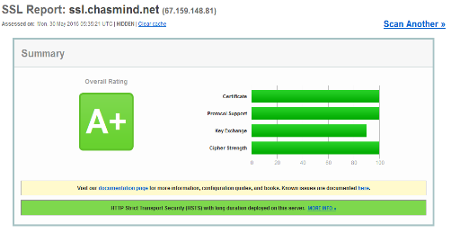
Getting an A+ on SSL Labs
Disable SSLv3 [B] & RC4 [B/C]
Replace any SHA1 Certs [A]
and sub-2k Certs [C]
Enable TLS_FALLBACK_SCSV [A]
Enable HTTP Strict Transport [A]
Enable and Prefer Perfect Forward Secrecy Compatible Ciphers [A-]
Do not use DHE ciphers (only ECDHE). DHE ciphers will cap the grade at [B] on BIG-IP.
Enable TLS1.2 [C]
Enable Secure Renegotiation [A-]
Patch for POODLE variants (TMOS 114.1 HF7+, 11.5.1 HF7+, 11.5.2 or 11.6.0) [C or F]
*There are a many more requirements such as validating cert chain, domain and so on that are not generally well understood. See the Guide for details:
Qualys SSL Labs Rating Guide: https://www.ssllabs.com/projects/rating-guide/index.html
Notes:
https://www.ssllabs.com/downloads/SSL_Server_Rating_Guide.pdf

Slide 25
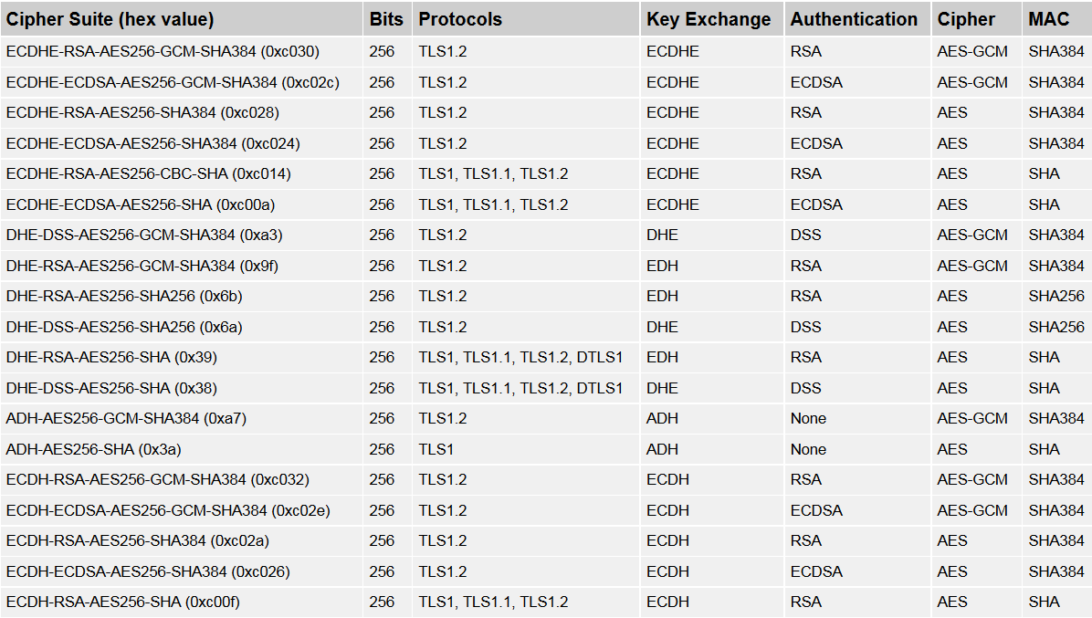
Cipher Suites – Broken Down
Key Exchange
Algorithm used to determine if and how the client and server will authenticate during the handshake.
Authentication
The algorithm used for key cryptography (ex RSA, DSS, ECDSA)

Slide 26
Cipher Suites – Broken Down
Cipher
The bulk encryption algorithm used to encrypt the message stream. It also includes the key size and the lengths of explicit and implicit initialization vectors.
Message Authentication Code
Used to create the message digest, a cryptographic hash of each block of the message stream.

Slide 27
Cipher Suites – Broken Down
Cipher Suite
A cipher suite is a named combination of key exchange algorithms, authentication, cipher encryption and message authentication code (MAC) used to negotiate the security settings for a network connection using the Transport Layer Security (TLS) / Secure Sockets Layer (SSL) network protocols.

Slide 28
Cipher Strings - Operators
Colon (:)
  The colon character “:” is the delimiter between two cipher string phases. When used as part of a list, it is simply the additive operator
  For example the cipher string “RSA:AES” means “All RSA-based ciphers plus all AES-based ciphers” and would include over 100 ciphers!
Plus (+)
  The plus sign operator “+” has two uses. When used between two cipher names, the + operator doesn’t mean add, it means “the intersection of”
  The cipher string “RSA+AES” means specifically just 11 ciphers that have RSA as the key exchange and AES as the encryption cipher

Slide 29
Cipher Strings - Operators
Leading Plus (:+)
  When used in front of a cipher name (that is, after a colon), the plus sign means “move these ciphers to the end of the list”
  For example, RSA:RC4 and RSA:+RC4 will provide the same list of ciphers, but the latter will order RC4-based ciphers at the end of the list as least preferred
Minus (-)
  The minus operator “-” deletes the ciphers from the list of supported ciphers while making sure that some or all of the ciphers can be added again with later options. The “!” operator is used more commonly than the minus
  For example , “RSA:-SHA:DHE+SHA” means “all RSA-based ciphers except those that use SHA” plus “all DHE-based ciphers that include SHA”
  Do not confuse the minus with the hyphen character”-”

Slide 30
Cipher Strings - Operators
Not (!)
  The not operator “!” permanently deletes ciphers from the list of the supported ciphers
  The ciphers deleted can never reappear in the list even if they are explicitly stated. For example, “RSA:!MD5:MD5” is effectively the same as “RSA”
At (@)
  The at operator ’@’ specifies that the following word will designate whether the cipher string is to order the list of cryptographic strength (@STRENGTH) or cryptographic performance (@SPEED)
No Symbol
  If none of the above symbols appears in the string, the string is interpreted as a list of ciphers to be appended to the current preference list
  If the list includes any ciphers already present, they will be ignored

Slide 31
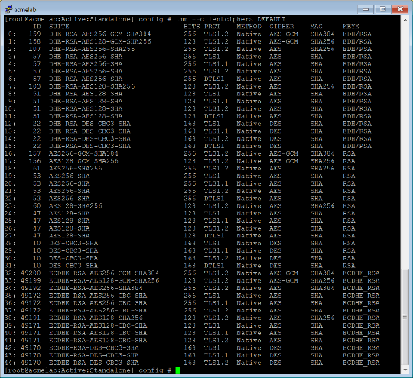
Cipher Strings - Special Keywords
DEFAULT
  This is the ordered list of preferred ciphers as determined by the F5 security engineering team
    It is different from the OpenSSL DEFAULT keyword
    F5 optimizes DEFAULT to be a reasonable compromise between high security and high performance
  The F5 engineering team agonizes over the list of ciphers that make up the DEFAULT in each release
    The main drawback to using a DEFAULT is that when it changes (as new ciphers are developed or old ones fall out of favor), administrators that use DEFAULT may be surprised when they upgrade versions.
    In version 12.0 of the BIG-IP system, the following unsafe ciphers are excluded from DEFAULT and are unlikely to comeback: EXPORT, SSL3, and NULL
tmm –clientciphers DEFAULT
Notes:
SOL 13156: https://support.f5.com/kb/en-us/solutions/public/13000/100/sol13163.html

Slide 32
Cipher Strings - Special Keywords
NATIVE (F5 SSL Stack)
  The NATIVE keyword specifies the set of ciphers that are specially accelerated either in hardware or software in the F5 SSL stack. The performance and support of NATIVE ciphers are much higher then non-NATIVE ciphers. The NATIVE cipher list includes ciphers that have since been shown to be inappropriately weak for modern use (such as RC4, MD5, and DES). These latter ciphers should be enabled with caution.
COMPAT (OpenSSL)
  The COMPAT cipher invokes a special mode for a handful of ciphers where the implementation is borrowed directly from the open source OpenSSL project to support legacy system that could not be upgraded. Today, COMPAT should only be used very rarely, under specific guidance, when there is no other alternative.

Slide 33
Cipher Strings - Special Keywords
HIGH, MEDIUM, and LOW
  These keywords are largely maintained only for the purposes of compatibility. The HIGH string includes ciphers with 128-bit keys or larger, but in reality, HIGH is less secure than DEFAULT.
  Note that HIGH includes anonymous Diffe-Hellman ciphers, which should not be used by production systems.
  The MEDIUM keyword includes export encryption algorithms, including 40- and 56- bit algorithms.
  These ciphers were defined to comply with U.S. export rules that have since been lifted.
  EXPORT
  The EXPORT keyword is most useful when preceded by the Not (!) operator.

Slide 34
Cipher Strings - Examples
This cipher string prioritizes elliptic-curve ciphers (EC). EC ciphers are thought to be easier on mobile devices
The Ephemeral Diffie-Hellman (DHE) cipher invokes forward secrecy
By specifying DHE+AES, some SSLv3 ciphers get brought back in. The final “-SSLv3:-RC4” removes them:
ECDHE+AES-GCM:ECDHE+AES:ECDHE+3DES:DHE+AES-GCM:
DHE+AES:DHE+3DES:RSA+AES-GCM:RSA+AES:RSA+3DES:
^{-MD5:-SSLv3:-RC4}

Slide 35
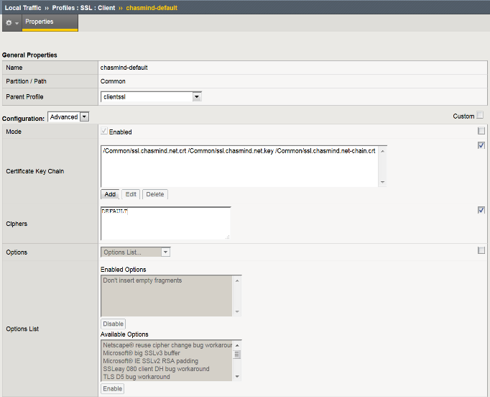

SSL Profile [“Envelope” for a Certificate/Key pair]
Two Profiles Types:
Client (Client to F5)
Server (F5 to pool member)
Requires:
Certificate
Key
[chain] (if needed)
“Advanced” for Cipher Suites
Note: You Can use the same SSL Cert/Key with multiple profiles

Slide 36
SSL Labs & Cipher Demo
SSL Client-Side

Slide 37
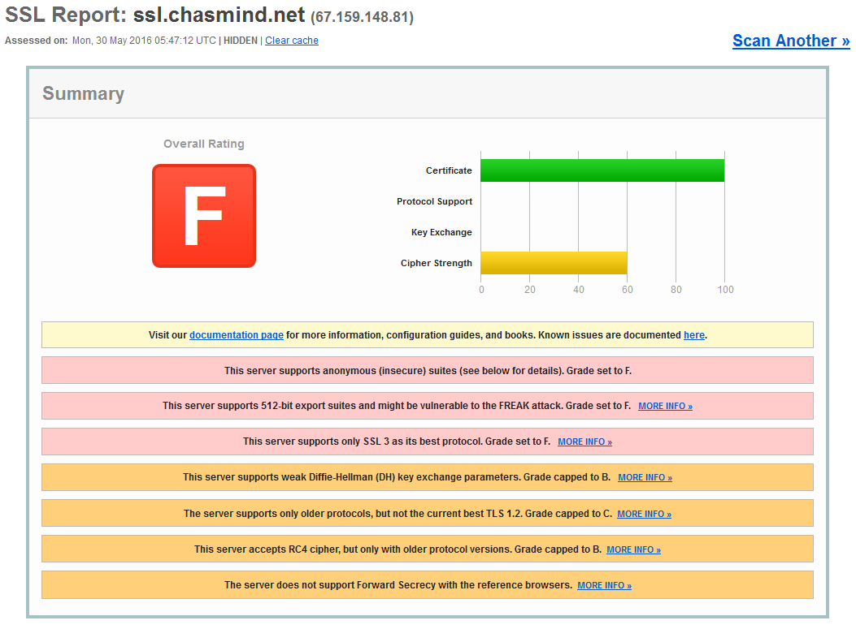
SSL Labs Score Card (https://www.ssllabs.com/ssltest/)
Really Bad Day at the Office
Took a little bit of work to disable native security (11.x/12.x)
Certainly not recommended
May be subject to configuration, version of code and hotfixes (older versions)
Cipher String Used
SSLv3:RC4:SSLv2:!TLSv1:!TLSv1_1:!TLSv1_2

Slide 38
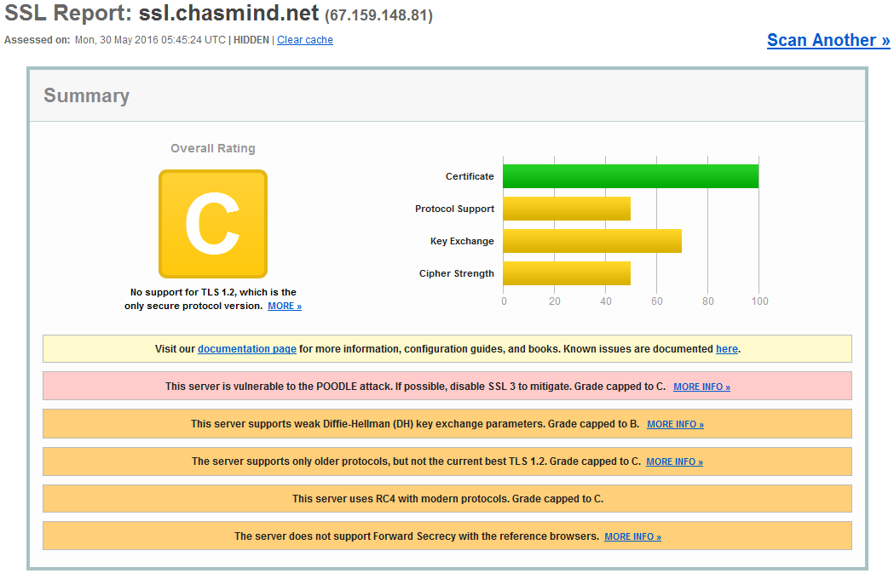
SSL Labs Score Card (https://www.ssllabs.com/ssltest/)
Bad Day at the Office
Better than a “F”
Took a little bit of work to disable native security (11.x/12.x)
May be subject to configuration, version of code and hotfixes (older versions)
Cipher String Used
SSLv3:RC4:SSLv2:TLSv1:TLSv1_1:!TLSv1_2

Slide 39
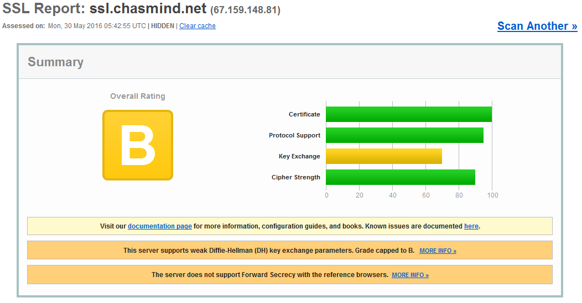
SSL Labs Score Card (https://www.ssllabs.com/ssltest/)
Better Day at the Office
Now we are above average!
No Work. DEFAULT cipher (12.x)
Good starting point
Cipher String Used
DEFAULT

Slide 40
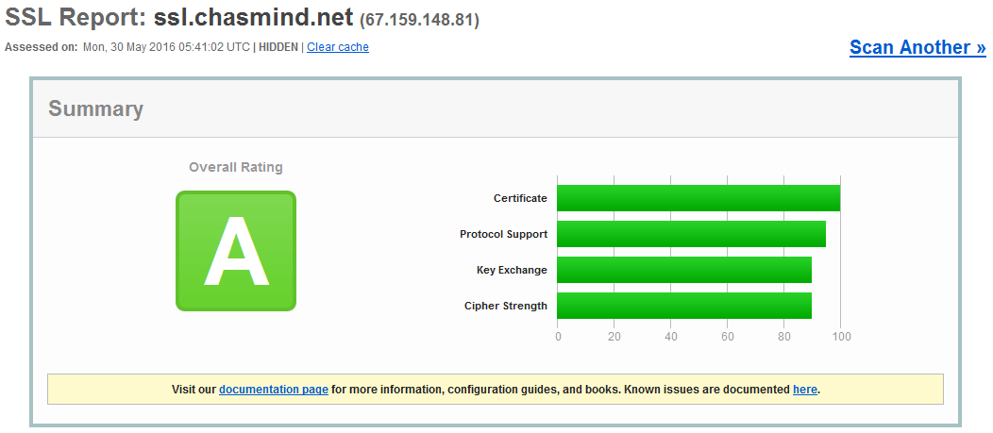
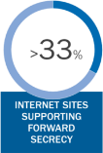
SSL Labs Score Card (https://www.ssllabs.com/ssltest/)
Good Day at the Office
Little Work. DEFAULT cipher (12.x) + ECDHE and removed DHE
Prioritizes Perfect Forward Secrecy (PFS)
Good coverage of browsers/OS
Perfect Forward Secrecy is a mechanism offered by Diffie-Hellman key exchange (DHE or ECDHE) and TLS that prevents decryption of SSL-protected communications if the server private key is compromised.
Cipher String Used
ECDHE:DEFAULT:!DHE

Slide 41
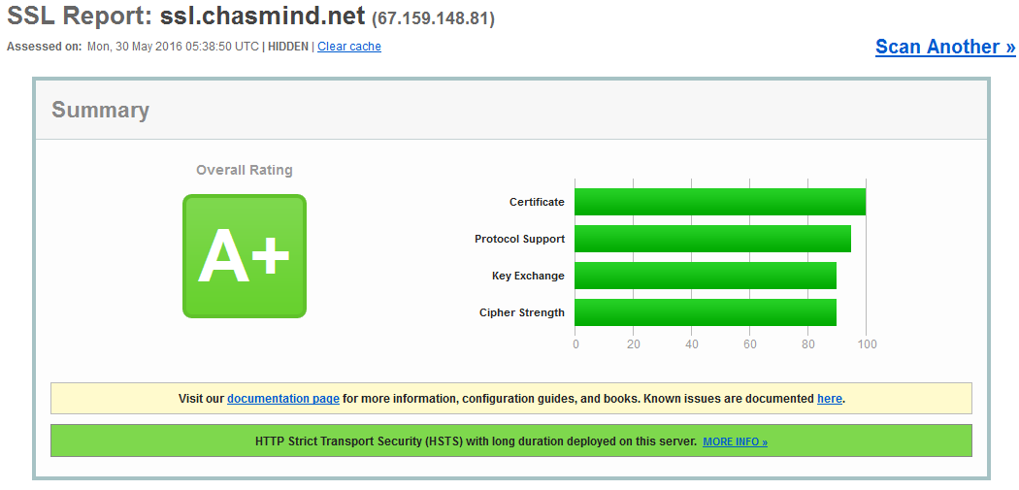
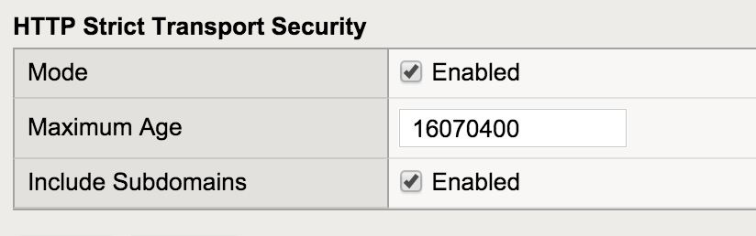
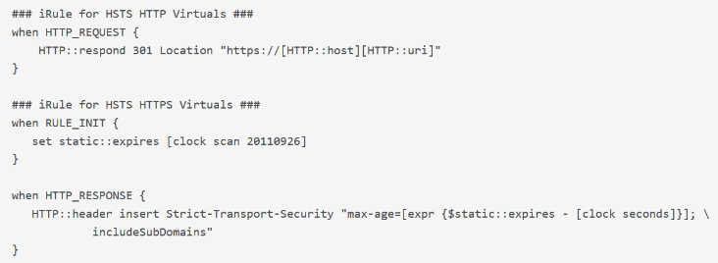

SSL Labs Score Card (https://www.ssllabs.com/ssltest/)
Way to Go Day at the Office
DEFAULT cipher (12.x) + ECDHE and removed DHE
Prioritizes PFS
Added HSTS
Good coverage of browsers/OS
Declares to browsers that they must use https to connect (browser convert all http links to https)
Stops users from clicking through certificate security warnings (disallows cert exemptions, self-signed, mismatch, etc)
Need for A+ on score card
Previously done via iRule, now in GUI (12.x)
HSTS Profile Endabled
Cipher String Used
ECDHE:DEFAULT:!DHE
RFC 6797
Notes:
Pre 12.x: https://devcentral.f5.com/questions/ssllabs-a-f5-ltm-114
Post 12.x: https://support.f5.com/kb/en-us/products/big-ip_ltm/manuals/product/ltm-profiles-reference-12-0-0/3.html

Slide 42
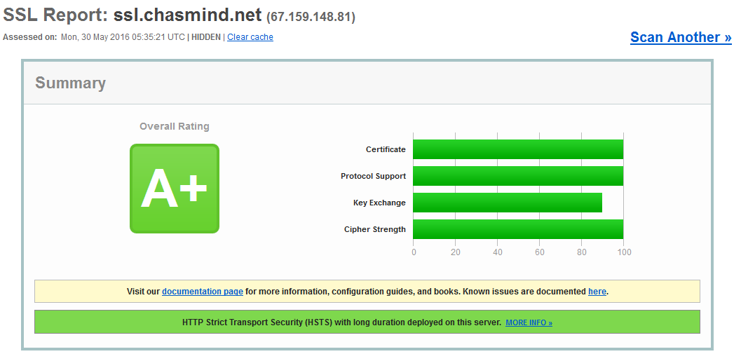
SSL Labs Score Card (https://www.ssllabs.com/ssltest/)
“Over Achiever”
Security versus compatibility
Significantly reduces browsers/OS coverage
4K Key required to score “100”.
LetsEncrypt only issues 2K Keys
HSTS Profile
ECDHE:DEFAULT:!DHE:!RSA:!SHA1:!SHA256:!TLSv1:!TLSv1_1:!ADH

Slide 43
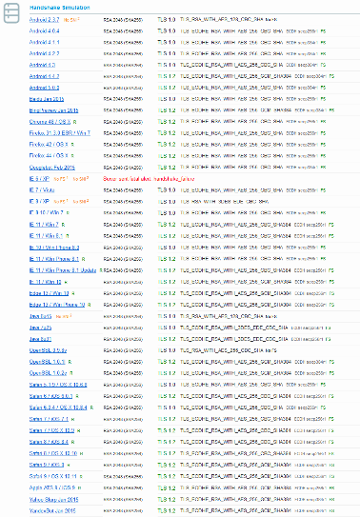
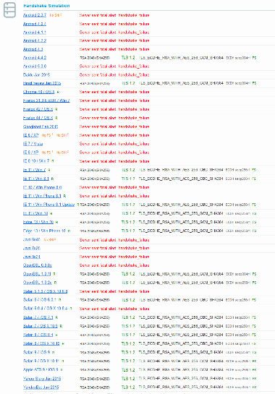


SSL Labs Score Card (https://www.ssllabs.com/ssltest/)
Normal
Extreme

Slide 44
Server-Side SSL
SSL Bridging

Slide 45
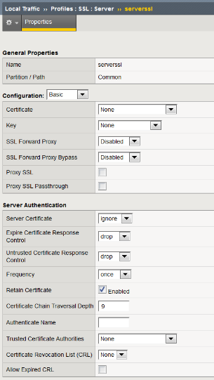


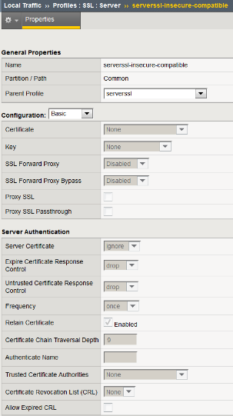

Server-Side SSL Profiles (SSL Bridging)
serverssl
No certs required in profile (auth)
Certs required on pool member
Can be internal PKI Certs
severssl-insecure-incompatible
More Security
More Accessibility
!SSLv2:!EXPORT:!DH:RSA+RC4:RSA+AES:RSA+DES:RSA+3DES:ECDHE+AES:ECDHE+3DES:@SPEED
Additional security available with server-side Certificate authentication

Slide 46
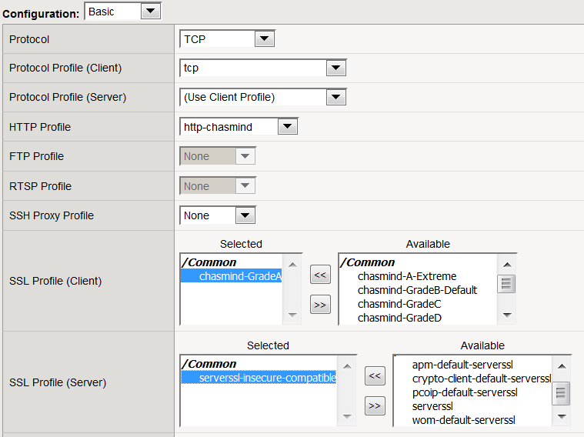
Server-Side SSL Profiles (SSL Bridging)
SSL Profile (Client-Side)
Required for SSL Termination
Referred to as “SSL Offloading”
SSL Profile (Server-Side)
Required for re-encryption to pool member
Generally recommend built-in profile unless there is a specific need
Referred to a “SSL Bridging”

Slide 47
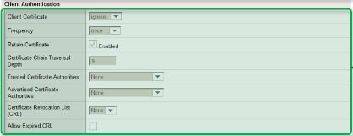
Certificate Authentication
SSL Bridging

Slide 48
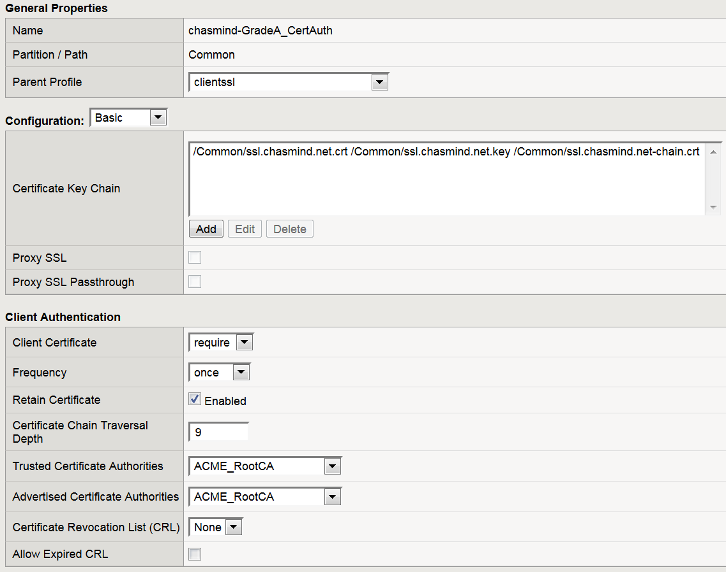
SSL Client Authentication
Client Certificate Requirement:
Require
Request
Ignore
Root/Issuing CA that will validate client certificate
Root/Issuing CA that will validate client certificate

Slide 49
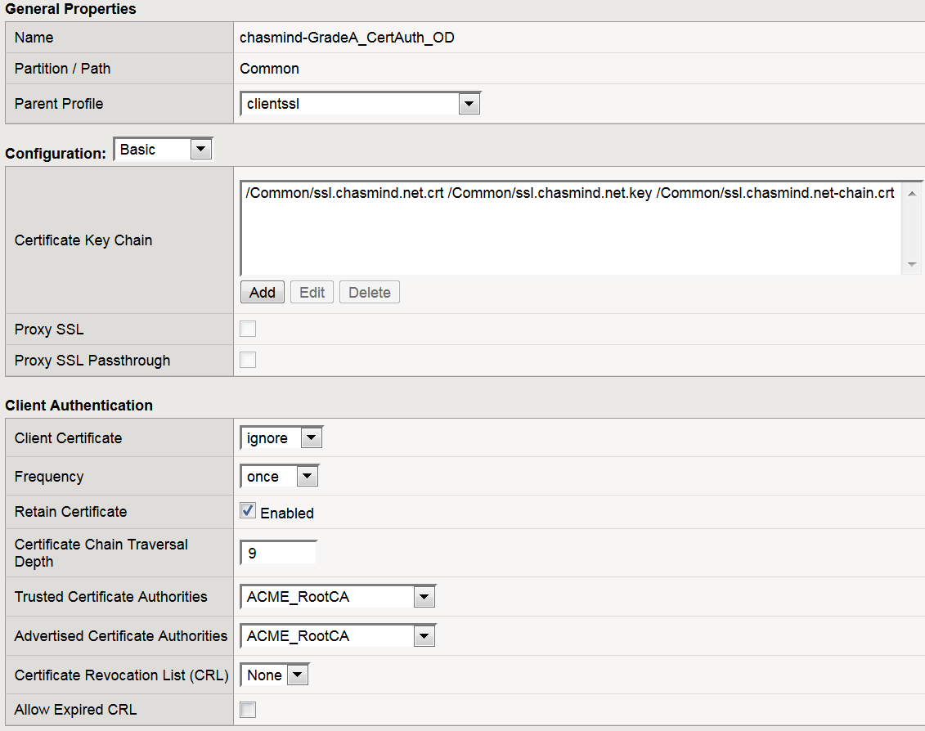
SSL Client Authentication – On Demand (APM)
Client Certificate Requirement:
Require
Request
Ignore
Root/Issuing CA that will validate client certificate
Root/Issuing CA that will validate client certificate

Slide 50
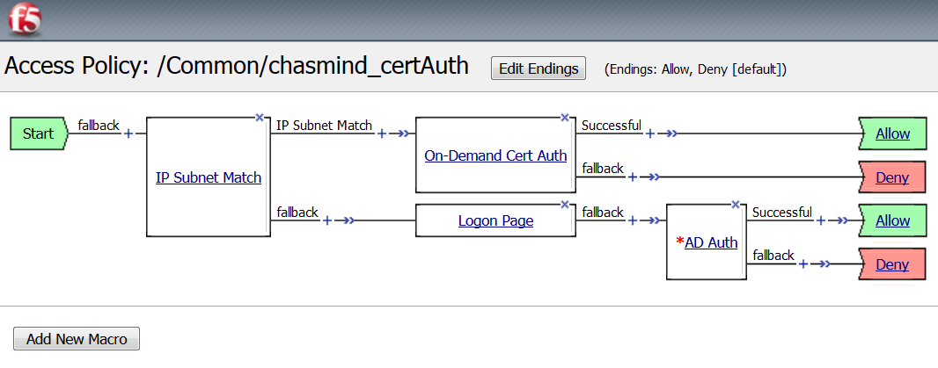
Access Policy – On Demand Certificate Authentication

Slide 51
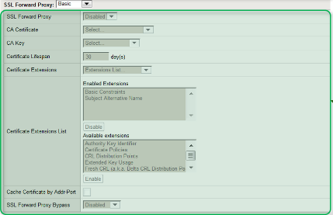
SSL Intercept (Forward Proxy)
Exsiting & Emerging Technologies

Slide 52
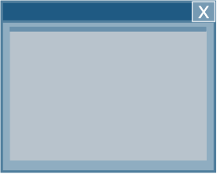







Without SSL Decryption – Security Solutions lack Visibility
Legitimate User
Allow tcp:80 [HTTP]
Allow tcp:443 [HTTPS]
Legitimate User
Malicious Attacker
Applications
at Risk
Hijacked Browser
SSL protects traffic from inspection (privacy), but also protects attacks from inspection
Notes:
http://www.csoonline.com/article/2917210/network-security/increased-encryption-a-double-edged-sword.html

Slide 53


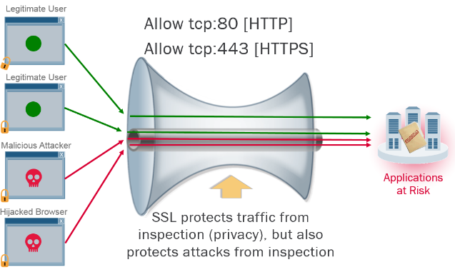
Perfect Forward Secrecy & Continued Visibility
IPS/IDS/WAF solutions that rely on MITM / RSA Ciphers are not going to work in the PFS world
Passive tap or layer 2 “bump in the wire” mode of deployments will not work in a PFS world
Will require inline reverse/full proxy implementation
Notes:
http://www.informationsecuritybuzz.com/articles/the-pitfalls-of-perfect-forward-secrecy/

Slide 54




SSL Visibility Solution Overview
Visibility and Control
Perimeter Services
Inspection Services
Application Services
Resources
SSL Decryption
+ Traffic Steering
SSL Visibility
SSL Encryption
+ Load Balancing
Legitimate
Users
Apps
Malicious Attackers
BIG-IP System
BIG-IP System
Scale SSL across multiple security devices that are either blind or challenged with SSL performance to defend against encrypted threats
Policy Enforcement
Security Services
Scale-Out
for Growth
IPS
DLP
SWG
Any Security
Defense-in-Depth

Slide 55
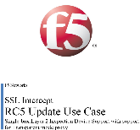

The first SSL Intercept implementation
Release Candidate 5 and version 1.0 (iApp)
One-box SSL Intercept
Client
BIG-IP
Out
Ingress
Egress
Inspection
Zone
HTTP header signaling from ingress to egress
Limited security service support in the iApp
Static “service chaining”
Simple and still valuable
The basis of many interesting customer solutions
L3
Services
Two-box SSL Intercept
Client
BIG-IP
Ingress
Inspection Zone
BIG-IP
Egress
Out
L2
Services
L3
Services
Notes:
The existing 1.0 architecture, implications, weaknesses and persistent uses

Slide 56
The first SSL Intercept implementation
Version 1.0 derivatives
Advanced Firewall
Secure Web Gateway
SSL Forward Proxy handshakes + Explicitly bypassed SSL traffic
Failure bypass
Failure bypass
Client
BIG-IP
Ingress
FireEye
Service
Point
Proxy
Chaining
BlueCoat
BIG-IP
Egress
Route ->
FireEye
BlueCoat
Out
FireEye
BlueCoat
Decryption
Re-encryption
Passive Tap
Devices
ICAP DLP
Devices
ICAP DLP
Devices
SSL Intercept is typically deployed as a single or HA pair of devices
It can also be deployed as separate devices, in which case the egress point is physically separated from ingress, providing an additional (physical) inspection zone and doubled SSL/TLS throughput
ICAP DLP
Devices
ICAP DLP
Devices
Reporting
Services
Notes:
Things you can build with the 1.0 version
Mentioning this because
the 1.0 iApp will exist in parallel
the 1.0 and 1.5 iApps exist for potentially different use cases
as you’ll see, there are things you can do here that you can’t do (as easily) in 1.5

Slide 57
Building an SSL Intercept solution
How decrypted inline traffic passes from ingress to egress
RD0
VLAN (source)
Self-IP (ex. 1.1.1.1/24)
Pool (1.1.1.2:0)
Inline L2
Services
RD1
VLAN (target)
Self-IP (ex. 1.1.1.2%1/24)
VIP (0.0.0.0%1:0)
Pool to target VLAN SELF-IP
Single
BIG-IP
Source
Target
Clients
Out
Route domain strict isolation disabled
Source VLAN connected to the inbound interface of the security device
Target VLAN connected to the outbound interface of the security device
Source and target self-IPs in the same unique subnet
Source-side pool that points to the target VLAN self-IP (without route domain ID)
Each L2 security device constitutes a separate set of VLANs, self-IPs, VIP and pool
Load balancing L2 devices is a function of adding all of the target self-IPs to a pool
Notes:
In order to handle L2 services in a burrito...

Slide 58
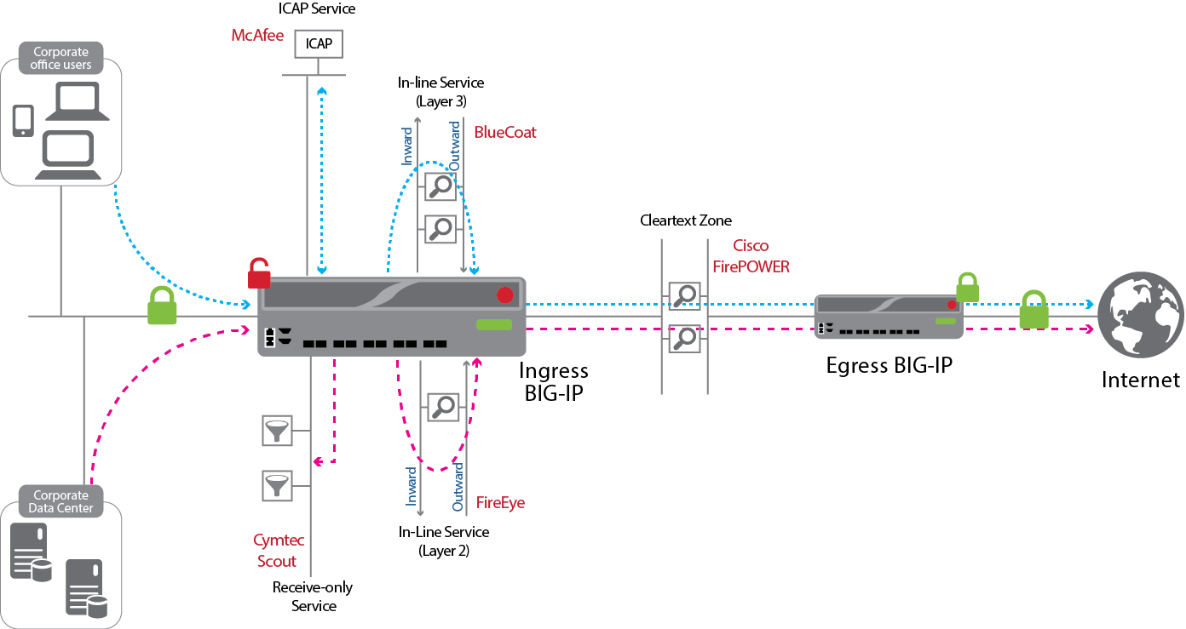
The new SSL Intercept implementation
Version 1.5 (iApp)
Notes:
The 1.5 iApp design

Slide 59
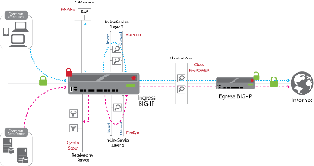
The new SSL Intercept implementation
Version 1.5 (iApp)
ICAP
Services
Inline L2
Services
Inspection
Zone
Clients
In
Out
BIG-IP
Egress
BIG-IP
Ingress
Cleartext Zone
Out
In
Out
Additional
Security
Services
Inspection
Zone
L3
Services
Inline L3
Services
Receive Only
Services
Notes:
The 1.5 iApp block diagram
Important at this point to understand that the various security services can be represented more simply by the way they work on the wire

Slide 60
The new SSL Intercept implementation
Version 1.5 (iApp)
ICAP
Services
Inline L2
Services
Protocol-agnostic signaling
Inspection
Zone
Clients
In
Out
BIG-IP
Egress
BIG-IP
Ingress
Cleartext Zone
Out
In
Out
Additional
Security
Services
Inspection
Zone
L3
Services
Classification Engine
Source IP
Destination IP
IP intelligence
IP geolocation
Domain name
URL filtering category
Destination port
Protocol
Inline L3
Services
Service Chaining
chainX
chainY
bypass
reject
Receive Only
Services
Notes:
The 1.5 iApp introduces some new features
built-in support for L2, L3, passive and ICAP services
a classification engine
c) service chaining
d) protocol-agnostic signaling (almost)

Slide 61
Building an SSL Intercept solution
How decrypted inline traffic passes from ingress to egress
Route
Route
Route
Route
Clients
Ingress
BIG-IP
Inline L3
Services
Egress
BIG-IP
Out
Route
Route
Route
Clients
Ingress
BIG-IP
Inline L2
Services
Egress
BIG-IP
Out
Inline L3
Services
Route
Route
Clients
Single
BIG-IP
Out
Inline L3
Services
Notes:
So before we get started on the 1.5 iApp, let’s step back and refresh on how the 1.0 works, as it’ll help you to appreciate what 1.5 is doing.

Slide 62
Building an SSL Intercept solution
How decrypted inline traffic passes from ingress to egress
Directly
Connected
ICAP
Services
Inline L2
Services
Route
Across
Inspection
Zone
Clients
In
Out
BIG-IP
Egress
BIG-IP
Ingress
Cleartext Zone
Out
In
Out
Additional
Security
Services
Inspection
Zone
L3
Services
Route
Across or through
Inline L3
Services
Route
Through
Directly
Connected
Receive Only
Services
Notes:
Service traffic flow directions

Slide 63
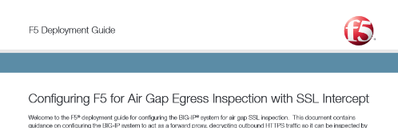
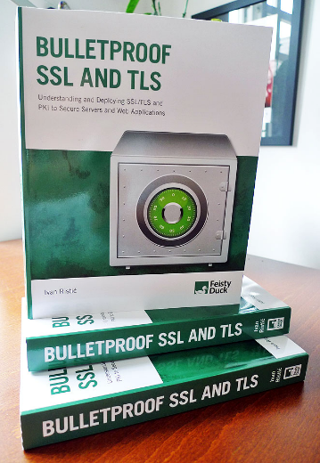
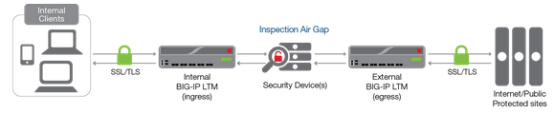
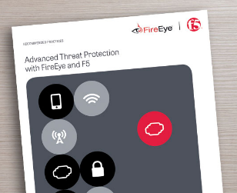
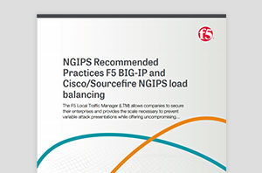
Validated Solutions and iApps
Good reads!
https://f5.com/solutions/enterprise/reference-architectures/ssl-everywhere
https://devcentral.f5.com/articles/high-performance-intrusion-prevention
Notes:
https://www.feistyduck.com/books/bulletproof-ssl-and-tls/

Slide 64


Slide 65

Questions
T

Slide 66

Thank you for you time…
T

