Slide 1
F5 Sacramento UserGroup Logging & Monitoring
Chas Lesley
System Engineer
Tony Ganzer
Territory Account Manager

Slide 2
Agenda
11:00am – 11:10am: Meet/Greet (Wait for stragglers)
11:10am – 11:15am: Intro/Business
11:15am – 12:00pm: Logging Presentation
12:00pm – 12:30pm: Lunch (THANK YOU JANET!)
12:30pm – 1:00pm: Logging Cont. Presentation
1:00pm – Wrap-up!
THANK YOU FOR COMING!

Slide 3
Agenda: Logging
System Logging
Facilities
Options
Rotation
Application Logging
Request/Response
Formats
iRule Logging
Module Logging
Analytics, Visibility & Reporting (AVR)
Access Policy Manager (APM)
Application Security Manager (ASM)
Advanced Firewall Manager (AFM)
Remote System Logging
Log Filters
Log Publishers
Log Destinations
High Speed Logging
iApps (f5.analytics)
F5 BIG-IQ
Reporting & Logging
Logging Nodes
Module Support

Slide 4
Logging

Slide 5

Logging = Confusing
(Somewhat)
~ so many options to choose from ~

Slide 6
Logging in Various Contexts
Client Information
+
Traffic Content
+
App Information

Slide 7

Full-Proxy Architecture – Logging Up & Down the Stack
WAF
WAF
HTTP
iRule
iRule
HTTP
SSL
iRule
iRule
SSL
TCP
iRule
iRule
TCP
Network Firewall

Slide 8
Client Information Logging
OS
Device
Operating system
Browser
Request/
Response
Information
IP Information
Note: All capabilities not listed
Notes:
Client context in security
(Client icon)
Device
Operating system
Geolocation
Antivirus definitions
Speaker notes: (Talk about what client context means for security.)

Slide 9

Traffic Content Logging
Access
Information
Threats
SSL Cipher
Information
Protocol Information
Detailed
Data/Metadata
Note: All capabilities not listed
Notes:
Traffic context in security
(Traffic icon)
Legitimate requests
Spam
XSS
SQL injection
(need best examples here)
Speaker notes: (Talk about what traffic context means for security.)

Slide 10
App Information Logging
v3.1
???
App health
Server status
Software type/version
App vulnerability
Resource capacity
Note: All capabilities not listed
Notes:
Application context in security
Application Health
Is the Web Server Running
Software Types/Versions
Application Vulnerability
Resource Capacity
Speaker notes: This is critical, and it’s where traditional firewalls fail. Availability is a core principle of security, yet if the app is down, a typical firewall will continue to send traffic to it.

Slide 11
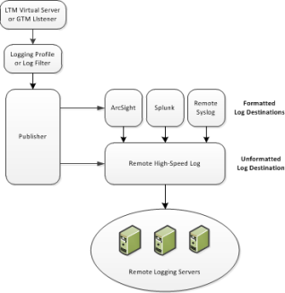
BIG-IP Logging Overview
BIG-IP can log locally to disk or remote, remote is preferred
Log through security services
High Speed Logging is supported
BIG-IP supports logging to a pool of servers
Different formats may be specified:
Remote Syslog
ArcSight
Splunk
IPFIX
iRules allow a programmatic interface to logs

Slide 12
Logging: System

Slide 13
Logging Destinations
The BIG-IP logging system provides two local logging destinations:
local-db: Causes the system to store log messages in the local MySQL database. Log messages published to this destination can be displayed in the BIG-IP Configuration utility.
local-syslog: Causes the system to store log messages in the local Syslog database. Log messages published to this destination are not available for display in the BIG-IP Configuration utility.
Note: Users cannot define additional local logging destinations. The BIG-IP system provides a default log publisher for local logging, sys-db-access-publisher; initially, it is configured to publish to the local-db destination and the local-syslog destination. Users can create other log publishers for local logging.

Slide 14
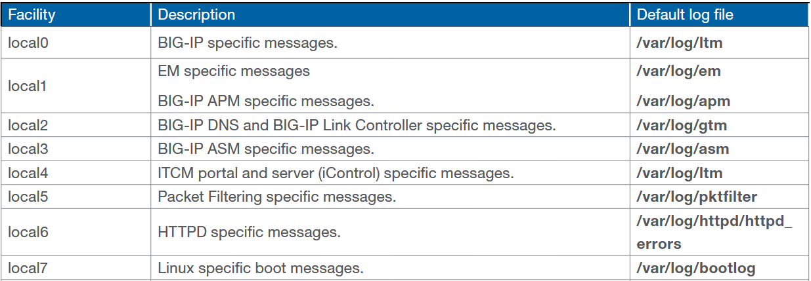
Log Facilities
The following facilities are available on the BIG-IP system. Each facility handles messages for specific elements of the system:

Slide 15
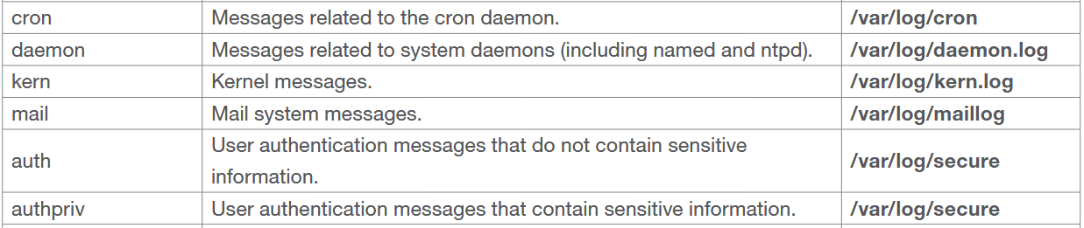
Log Facilities: Additional
Additional facilitates used in troubleshooting and diagnostics

Slide 16
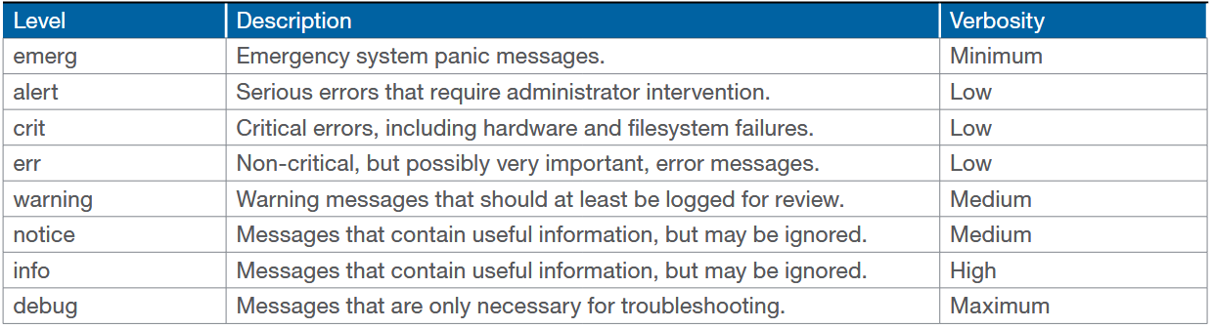
Log Options: Log Levels
Higher levels contain all the messages for lower levels. For example, the alert
level will generally also report all messages from the emerg level, and the debug level will generally report all messages for all levels.

Slide 17
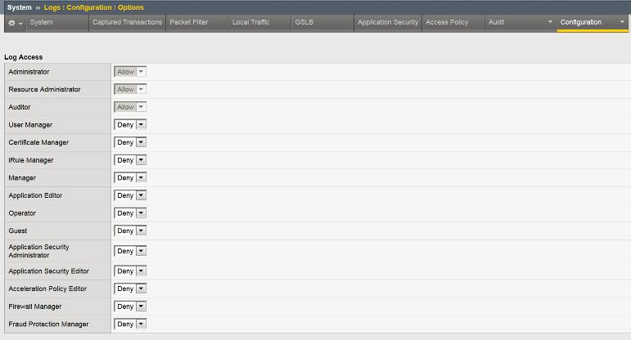
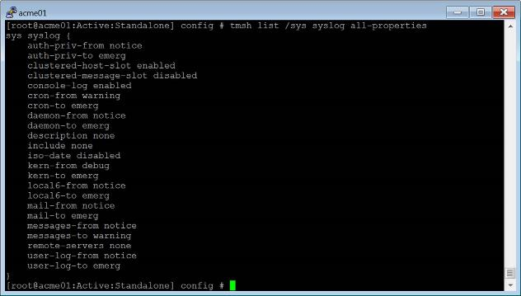
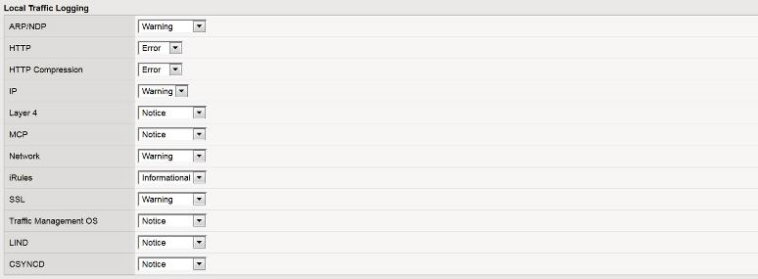
Log Options: Log Levels

Slide 18

Log Rotation: Changing Frequency
(Not supported through Upgrades)
Change the log rotation frequency
Move the logrotate script to the appropriate crontab directory by using the following command syntax: mv /etc/cron.daily/logrotate /etc/<cron directory>/
In this command, replace <cron directory> with one of the following directories:
cron.daily
cron.weekly
cron.monthly
The BIG-IP system will use the new setting the next time the crontab utility runs the logrotate script.
Logging defaults
Rotated every 24 hours or 1Gb of Data
>8 day Log deletion
Archive retention, 24 days
https://support.f5.com/csp/article/K13367

Slide 19
Log Rotation: Changing Log Removal
The logrotate script deletes log files older than the number of days specified by the Logrotate.LogAge database variable. By default, the variable is set to 8.
Impact of procedure: Performing the following procedure should not have a negative impact on your system.
You can modify the Logrotate.LogAge database variable by performing the following procedure:
Log in to the Traffic Management Shell (tmsh) by typing the following command: tmsh
Modify the age at which log files are eligible for deletion, by using the following command syntax: modify /sys db logrotate.logage value <value>
In this command syntax, note the following: Legal values range from 0 to 100
Save the change by typing the following command:
save /sys config
Logging defaults
Rotated every 24 hours or 1Gb of Data
>8 day Log deletion
Archive retention, 24 days
https://support.f5.com/csp/article/K13367

Slide 20
Log Rotation: Archive Retention
The tmsh log-rotate common-backlogs option specifies the maximum number of log files that the system retains for each log file. By default, the BIG-IP system is configured to retain up to a maximum of 24 archive copies of each log file.
Impact of procedure: Performing the following procedure should not have a negative impact on your system. You can modify the number of archived log files by performing the following procedure:
Log in to the tmsh utility by typing the following command: tmsh
Modify the number of archived logs that the system retains by using the following command syntax: modify /sys log-rotate common-backlogs <value>
In this command syntax, note the following: Legal values range from 0 to 100
Save the change by typing the following command:
save /sys config
Logging defaults
Rotated every 24 hours or 1Gb of Data
>8 day Log deletion
Archive retention, 24 days
Note: The system is unlikely to reach the maximum of 24 archive copies for a log file unless you change the log rotation frequency or the Logrotate.LogAge database variable.
https://support.f5.com/csp/article/K13367

Slide 21
Log Rotation: Max File Size
You can change the max-file-size log-rotate variable to a higher value. 102400 (1GB) is recommended. Setting it to zero (0) disables the setting. To do so, perform the following procedure:
Impact of workaround: Performing the following procedure should not have a negative impact on your system.
Log in to the Traffic Management Shell (tmsh) by typing the following command: tmsh
Set the max-file-size log-rotate variable to 102400 by typing the following command: modify /sys log-rotate max-file-size 102400
Save the change by typing the following command: save /sys config
Logging defaults
Rotated every 24 hours or 1Gb of Data
>8 day Log deletion
Archive retention, 24 days
support.f5.com/csp/article/K16015

Slide 22
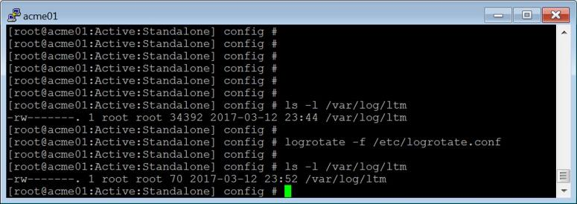
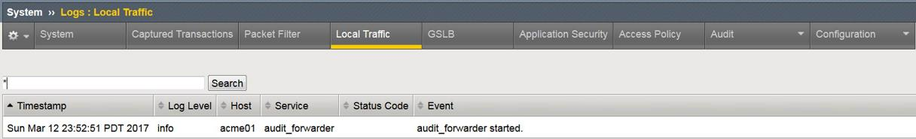
Log Rotation: Force Rotation
Force rotation of ALL system log files (ex /var/log/ltm viewed in the Config Utility System>Logs>Local Traffic
logrotate -f /etc/logrotate.conf

Slide 23
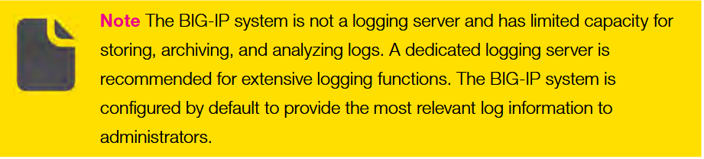
Local Logging: General Recommendation
Although local logging is not recommended, you can store log messages locally on the BIG-IP system instead of remotely. In this case, you can still use the high-speed logging mechanism to store and view log messages locally on the BIG-IP system.
When you use the high-speed logging mechanism to configure local logging, the system stores the log messages in either the local Syslog data base or the local MySQL data base. The storage database that the BIG-IP system chooses depends on the specific log destination you assign to the publisher
Notes:
Although local logging is not recommended, you can store log messages locally on the BIG-IP system instead of remotely. In this case, you can still use the high-speed logging mechanism to store and view log messages locally on the BIG-IP system.
When you use the high-speed logging mechanism to configure local logging, the system stores the log messages in either the local Syslog data base or the local MySQL data base. The storage database that the BIG-IP system chooses depends on the specific log destination you assign to the publisher

Slide 24
Logging: Application

Slide 25
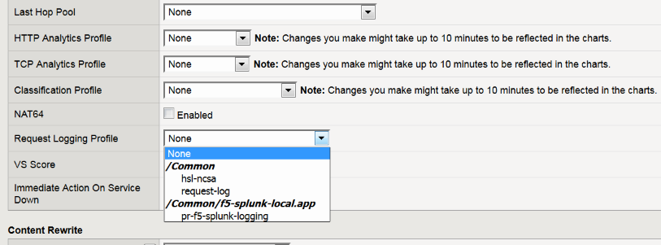
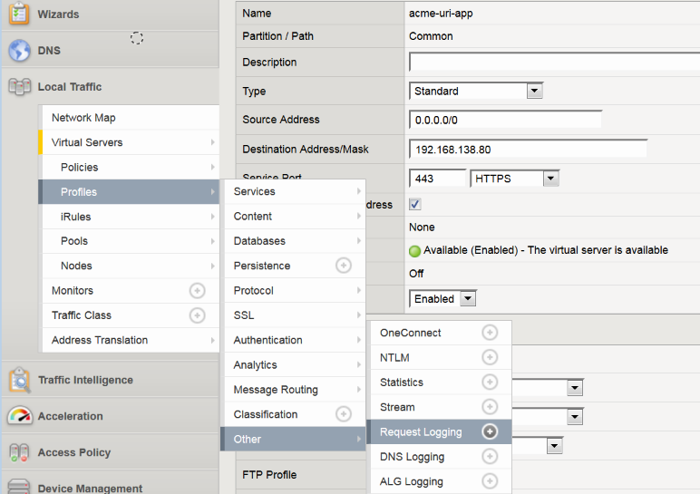
Request & Response Logging

Slide 26
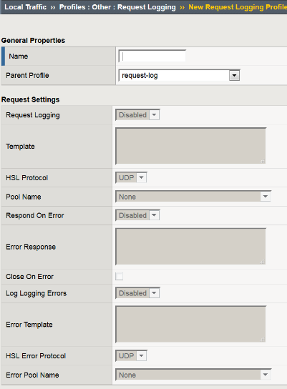
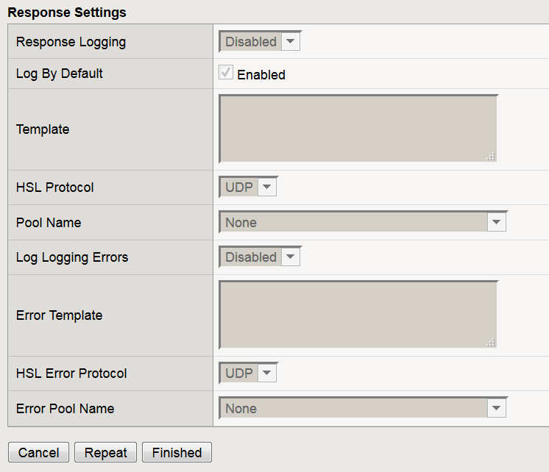
Request & Response Logging Profile

Slide 27
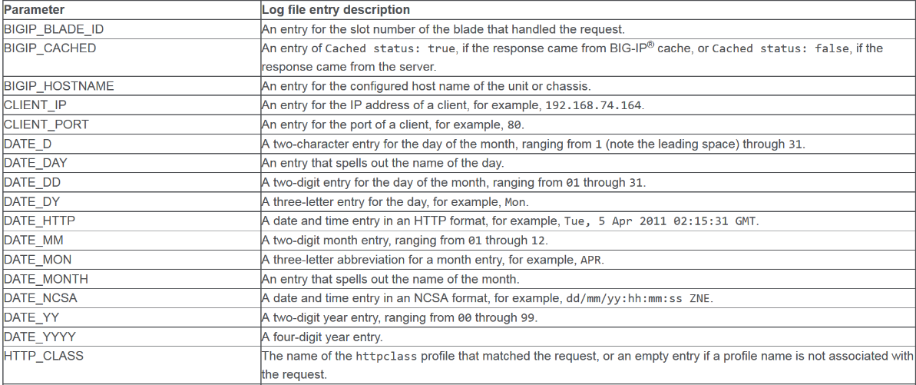
Request & Response Formats

Slide 28
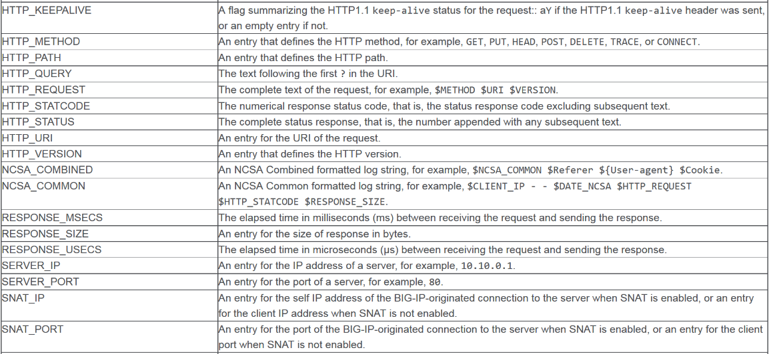
Request & Response Formats
$NCSA_COMMON = $CLIENT_IP - - $DATE_NCSA $HTTP_REQUEST $HTTP_STATCODE $RESPONSE_SIZE.
$NCSA_COMBINED = $NCSA_COMMON $Referer ${User-agent} $Cookie.

Slide 29
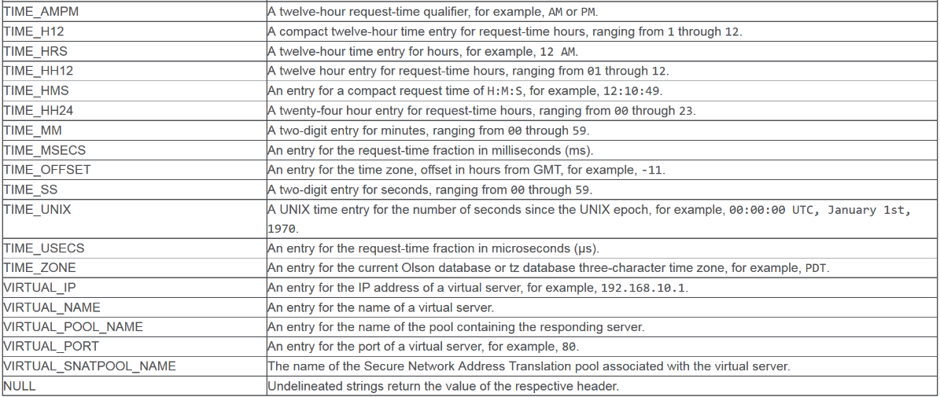
Request & Response Formats

Slide 30
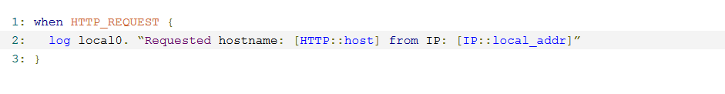
iRule Logging: Log
Local logging
Remote logging
Will be UDP (Can’t specify otherwise )
Notes:
https://devcentral.f5.com/wiki/iRules.log.ashx

Slide 31
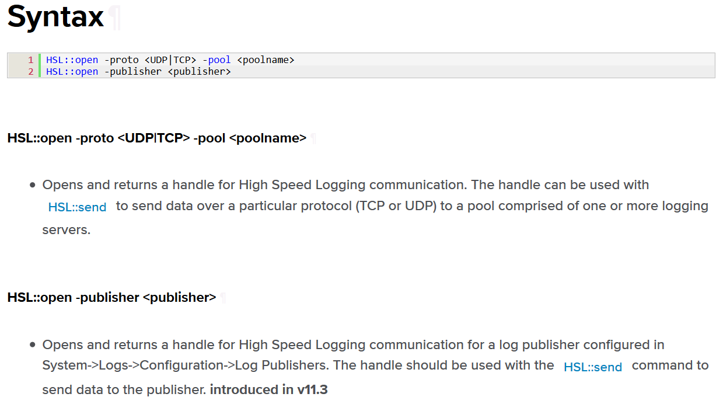
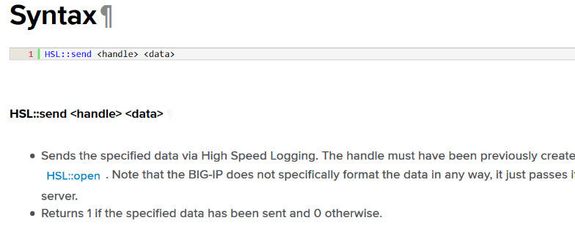
iRule Logging: HSL (High Speed Logging)

Slide 32
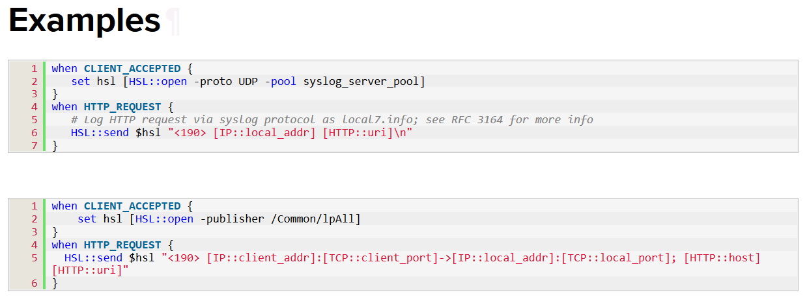
iRule Logging: HSL (High Speed Logging)

Slide 33
Logging: Module

Slide 34
Analytics Modules Analytics, Visibility & Reporting (APM)

Slide 35
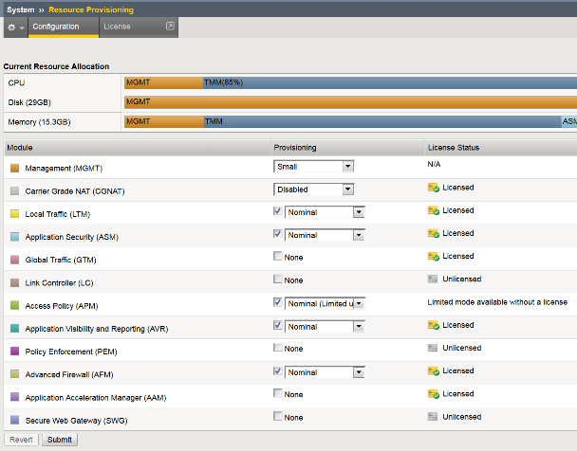
AVR Provisioning
Does require a system “restart” to provision
Does not count as a “module”
There is no license cost
There is CPU, Disk & Memory impact

Slide 36
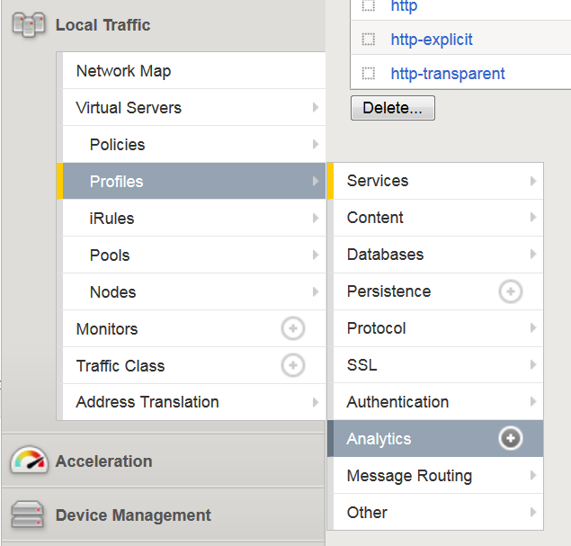
Getting Started – Analytics Profile
Build Analytics Profiles
Assign it to Virtual Server
Start Reporting

Slide 37
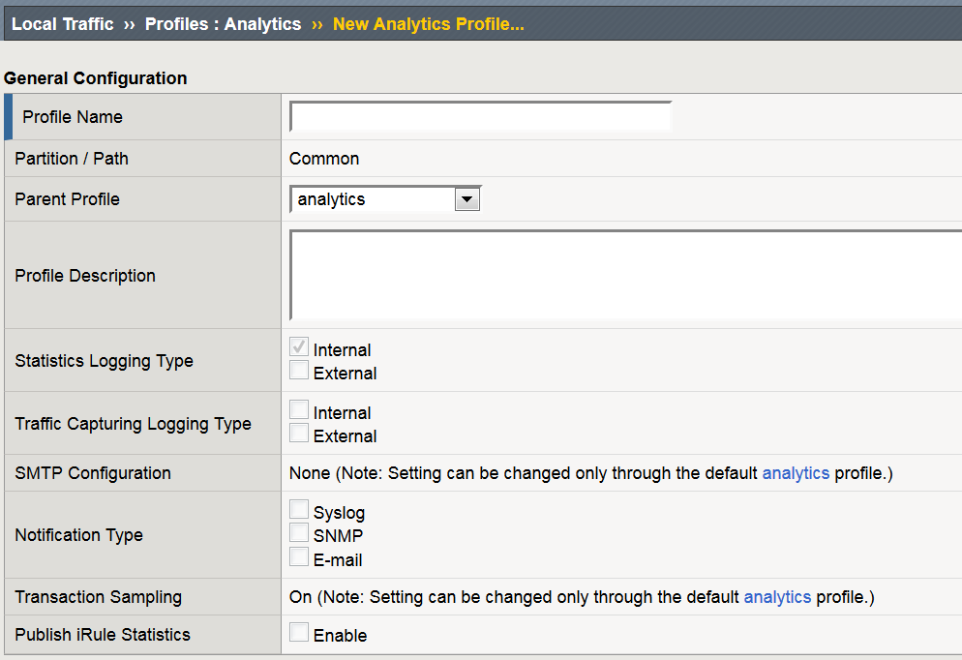
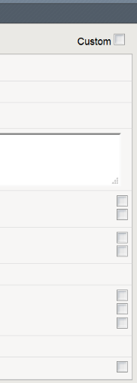
Setting up an Analytics Profile
Name
Internal or External Logging
Traffic Capture Logging Type
Notifications

Slide 38

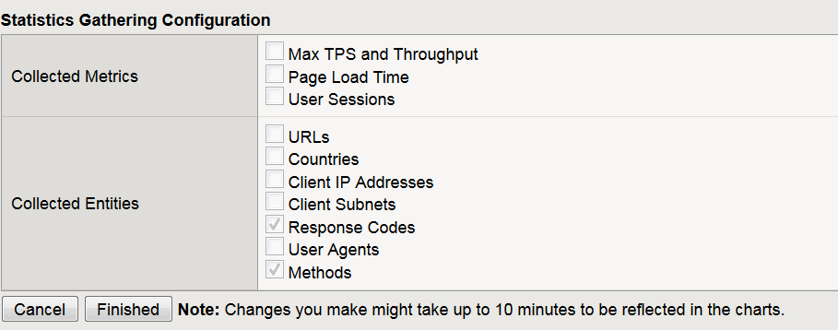
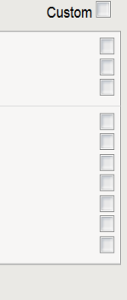
Getting Started – Analytics Profile
Applied Virtual Servers
Metrics
Max TPS & Throughput
Page Load Times
User Sessions
Collected Entities
Very cool pieces of information
Caution with
Page Load Times
Injects Java Script which can affect system performance & application functionality
Notes:
https://support.f5.com/kb/en-us/products/big-ip_analytics/manuals/product/avr-implementations-11-6-0/4.html

Slide 39
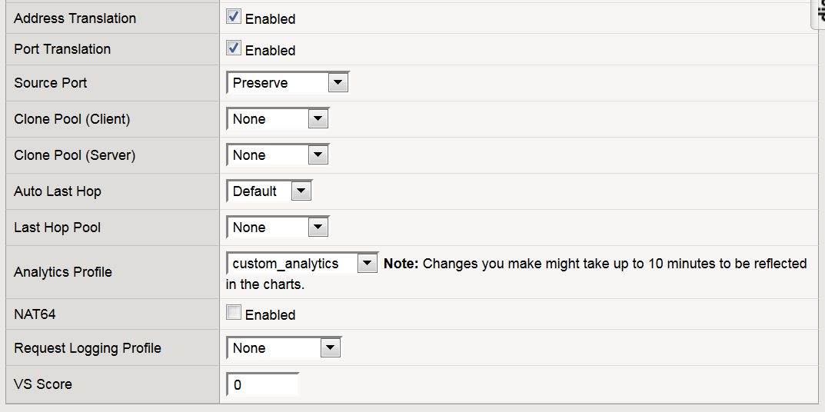
Applying Analytics Profile to Virtual Server
Change from
“Basic”
to “Advanced”

Slide 40
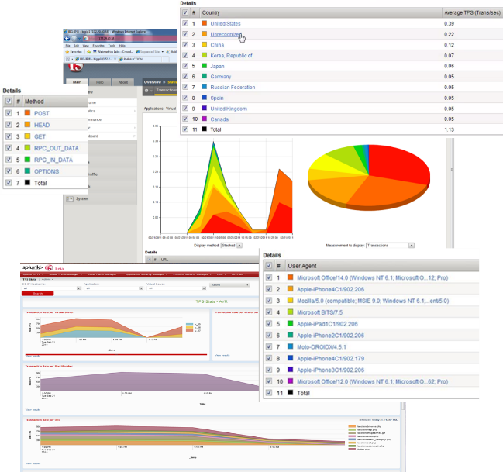
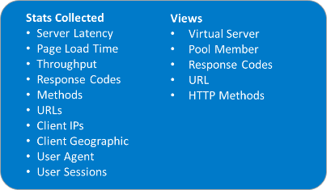
Application Analytics
Stats grouped by application
Capture HTTP Requests/Responses
External Logging
Provides
Business Intelligence
Capacity Planning
Troubleshooting
Performance

Slide 41
AVR (Availability, Visibility & Reporting)
Analytics (also called Application Visibility and Reporting) is a module on the BIG-IP® system that lets you analyze performance of web applications.
Provides metrics such as:
Transactions per second,
Server latency
Client latency,
Request throughput
Response throughput,
Sessions. Counts
Can view metrics for:
Applications
Virtual servers,
Pool members,
URLs,
Specific countries,
App traffic details
Transaction counters for:
Response codes,
User agents,
HTTP methods,
Countries
IP addresses
AVR also provides remote logging capabilities to consolidate statistics gathered from multiple BIG-IP appliances onto syslog servers or SIEM devices, such as Splunk.

Slide 42
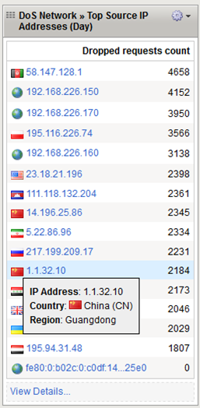
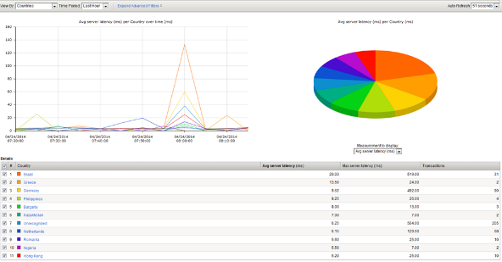
Geo-Location Visibility at Network and Application Level
Geo-location Information
Who’s accessing my site?
Who’s attacking my site?
Notes:
https://hive.f5.com/docs/DOC-16305

Slide 43
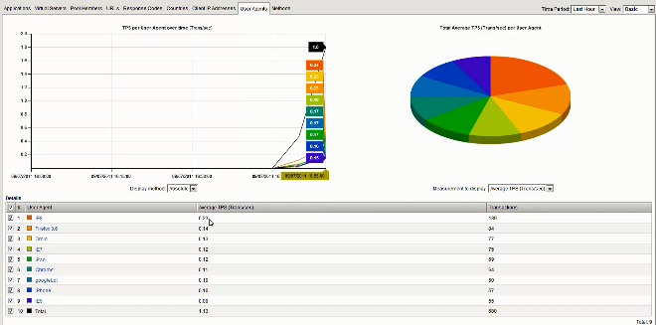
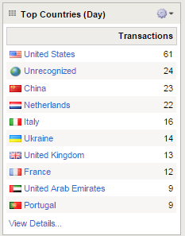
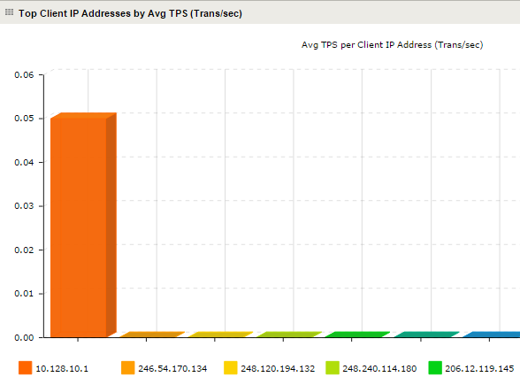
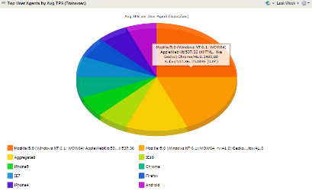
Tracking Clients – User Agent, Client IP, Geography
What type of clients are accessing your site?
Reports on User-Agent Field
Drill downs per virtual server, pool etc…

Slide 44
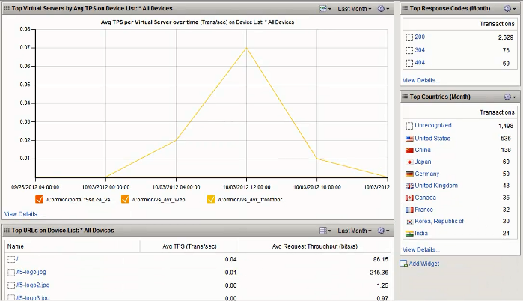

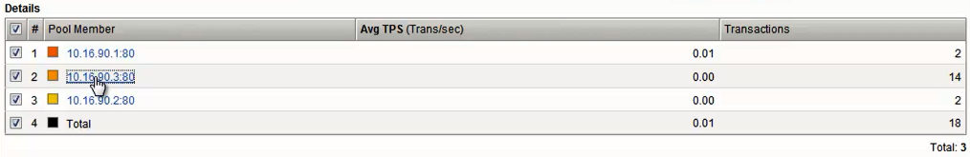
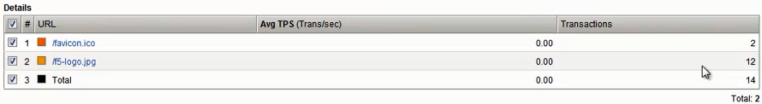
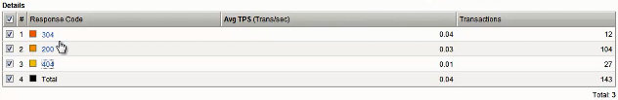
Response Code Checking

Slide 45
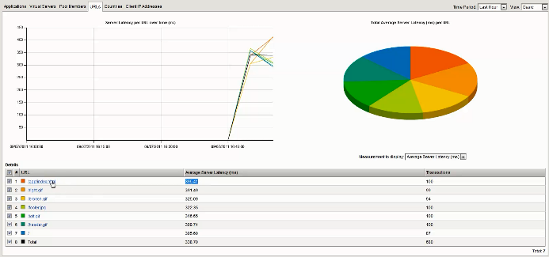
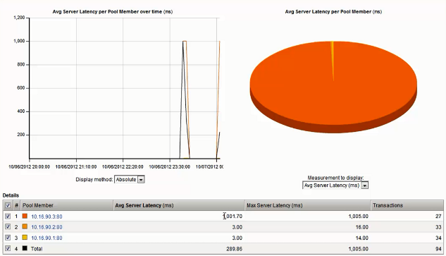
Is it the Application or the Network that is Slow? Tracking Server Latency
Latency per URL
AVR Tracks Response times of Servers
Latency per Pool Member

Slide 46
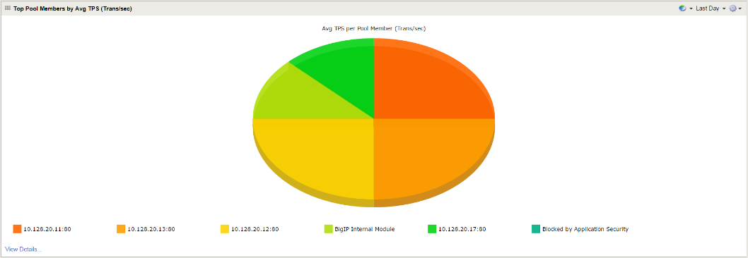
How is Load Balancing Performing within the Pool?

Slide 47
Security Modules – General

Slide 48
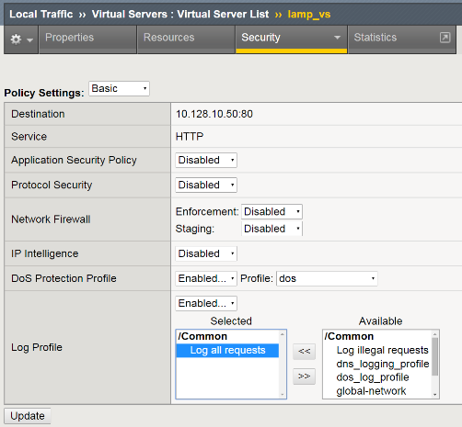
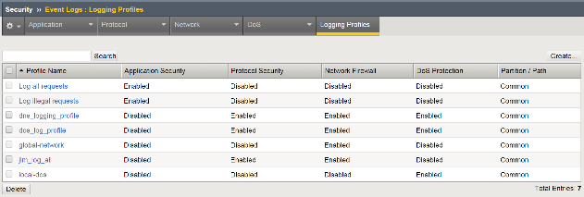
Unique Logging per Application w/Per Virtual Server Logging
Each Virtual Server can have its own unique Log Profile
Logging Profiles can log:
Application Security
Protocol Security
Network Firewall
Dos Protections

Slide 49
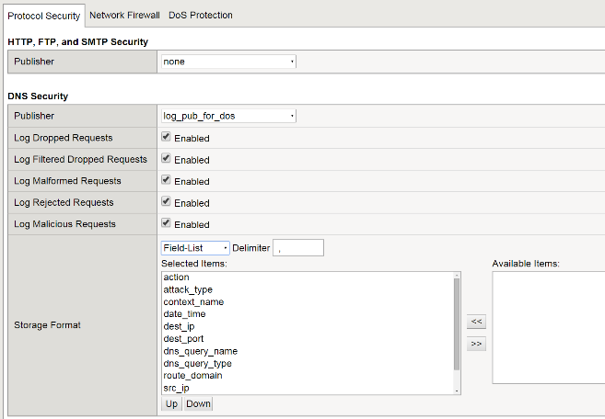
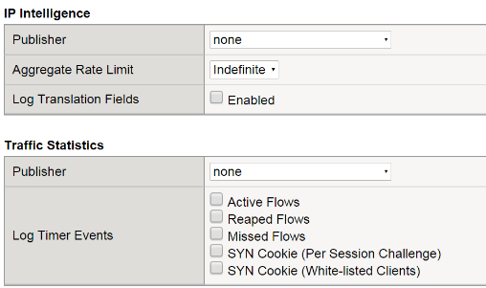
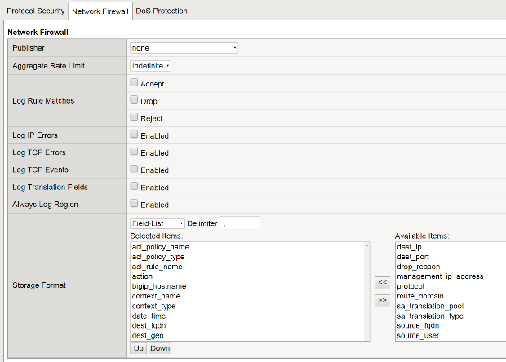
Choose What Fields Get Logged at Protocol or Network Level

Slide 50
Security Modules Advanced Firewall Manager (AFM)

Slide 51
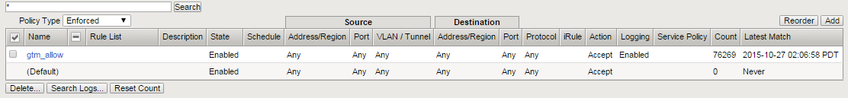
Network Firewall Granular Logging – Per ACL
The Network Firewall event logs can be enabled/disabled on a per ACL basis
As Rule matches are identified the values associated with the traffic are sent to the log publisher

Slide 52
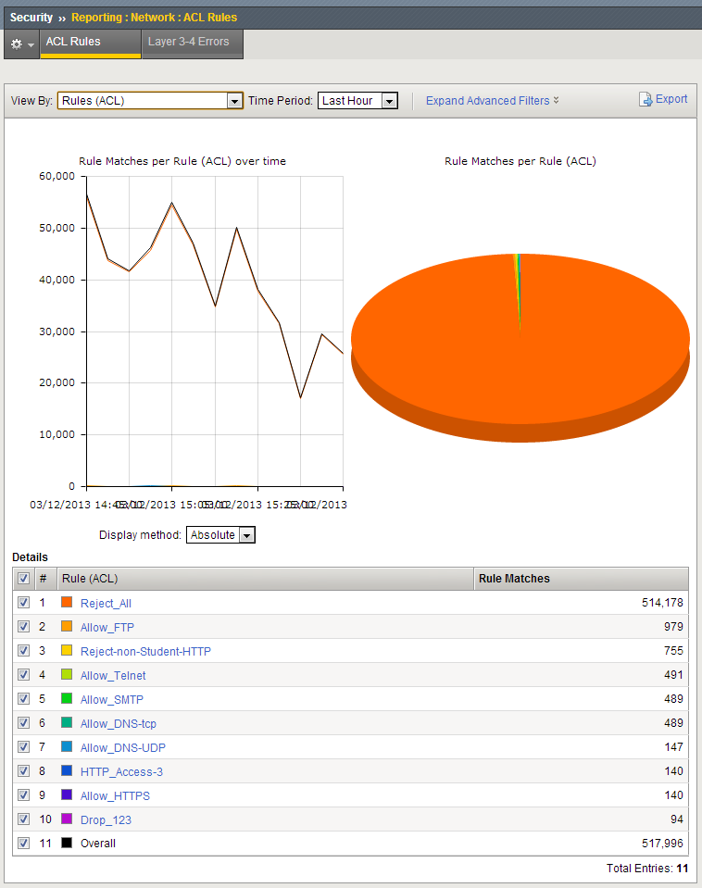




Network Firewall Visibility

Slide 53


AFM: Stateless DoS Detection & Mitigation L2-L4 stateless dos vectors
When to report an attack
Absolute Number in PPS Detection Threshold
DOS
Vectors
When to report an attack
Relative Percent Increase in PPS Detection Threshold
When to mitigate an attack
Absolute Number in PPS Mitigation Threshold
DOS Categories

Slide 54

Network DoS Event Logs
Dos Event Logs with have entries for:
Each time a DoS event is detected, An Attack ID is assigned
Each time the event is sampled
When the DoS attack ends
Dos Throttling

Slide 55




Network Level DoS Visibility
The Attack ID value is a number assigned by AFM for each unique attack that is identified.

Slide 56

HTTP Transaction Capture Logging

Slide 57
Security Modules Application Security Manager (ASM)

Slide 58



ASM Captured Transaction Detail

Slide 59


ASM Enhanced visibility and analysis
Application analytics for assured availability
ASM logs provide deeper intelligence grouped by application and user
Rules can be applied based on user behavior
Latency monitoring provides:
Business intelligence/capacity planning
Troubleshooting and performance tuning
Anomalous behavior detection
Statistics collected
URLs | Methods
Server/client latency | Client IPs and geos
Throughput | User agents
Response codes | User sessions
Views
Virtual server
Pool member
Response codes
URLs and HTTP methods
Notes:
Stats Collected
URLs
Server Latency
Client-Side Latency
Throughput
Response Codes
Methods
Client IPs
Client Geographic
User Agent
User Sessions
Views
Virtual Server
Pool Member
Response Codes
URL
HTTP Methods
Monitors URIs for Server Latency - ASM monitors and reports the most requested URIs and every URI for server latency. BIG-IP ASM obtains visibility to slow server scripts and troubleshoots server code that causes latency. We basically monitor top accessed pages for a web application, for last hour, last day and last week. For these pages we provide average TPS and average latency. In addition for every web application, we also provide a list of top accessing source IP address, with TPS and throughput for every IP address. These monitoring capabilities allow the admin visibility on how the application is being accessed and how it is behaving.

Slide 60


Detailed Logging with Actionable Reports Application Level Visibility
At-a-glance PCI compliance reports
Drill-down for information on security posture
Notes:
Full Visibility with BIG-IP ASM
Terminates http traffic and logs the full http message – enabling forensics
Identifies and logs all web application attacks, including requests that cause web server errors
Easy to deliver to application team for troubleshooting
Equipped with high speed and customized syslog logging
Integrates with leading SIEM vendors such as ArcSight, Splunk, RSA Envision, Nitro Security, and more

Slide 61



Application Layer Attack Expert System
1. Click on info tooltip
Notes:
Online guide for description. Network guy challenged with application security and now has violation and attack type description.
Attack expert system provides knowledge, testing and reporting of attacks and policies:
Attack profiles - Every attack is now explained, every violation includes detailed description of the exact check that ASM performs
Staging – policies are staged so tightening changes are made before enforcement
Superior reporting - detailed review of vulnerabilities allowing for fast mitigation and easy management

Slide 62



Application Attack Violation Ratings

Slide 63


How Do You Detect Attacks that Are Legitimate Traffic? “Heavy URL” - URL Latencies

Slide 64

Application Layer Security Charts Scheduler
You may configure:
Which email addresses are configured to receive charts
The name of the chart
How often the system sends the charts
The last time a chart was sent to that email address

Slide 65



Application Layer Security Charts Scheduler
Pre-defined Filters:
Top alarmed URLs
Top alarmed and blocked policies
Top alarmed policies
Top attackers for alarmed requests
Top attackers for blocked requests
Top attacks in last day
Top attacks in last hour
Top attacks in last week
Top blocked URLs
Top blocked policies
Top high-rated IPs
Top high-rated URLs
Top high-rated policies
Top policies
Top policies with GET method
Top policies with POST method
Top policies with Response Code 200
Top policies with Response Code 404
Top sessions
Top usernames
Top violations in last day
Top violations in last hour
Top violations in last week
Top violations with critical severity
Top viruses detected

Slide 66





Exporting ASM Widgets
All widgets can be modified
You may export and individual widget or all widgets to a file or email
Export all widgets
Export an individual widget

Slide 67
Security Modules Access Policy Manager (APM)

Slide 68

View All Access Sessions

Slide 69

View Details by Access Session

Slide 70

View Individual Session Variables

Slide 71
Other Modules BIG-IP DNS (Domain Name Services)

Slide 72
DNS Metrics
AVR can also be used to view DNS data being processed by BIG-IP. NOTE* - DNS profile needs to be configured to enable DNS metric collection.
DNS Requests
DNS Responses
Malformed Packets
Malicious Packets
Suspends
GTM Requests
DNS Cache Requests
DNS Express
IPv6 to IPv4
Unhandled Query Actions
Query Types (A, AAAA, CNAME, MX, PTR, NS, etc)
Response Details (AA, NXDomain, ServFail, Refused, etc)

Slide 73



Visualize Your DNS Deliver with Analytics
DNS Analytics
Applications
Virtual Servers
Query Name
Query Type
Client IP

Slide 74



DNS Visibility – Client, Record Type, Domain Name etc..
Notes:
Here we see the 5 basic views available: we can view by application, Virtual Server, Domain name, Query Types, and Client IP address

Slide 75


Detailed High Speed Logging and Overview Statistics
High Speed Logging for all DNS Logs
Query Logging and Response Logging
High level usage data and inflight DNS query volume information.
Customizable Fields for Log output.
Notes:
BIG-IP DNS Save Interval Configuration
By default, configuration changes to the BIG-IP DNS are saved in the bigip_gtm.conf file every 15 seconds. You can configure how often BIG-IP DNS saves configuration changes.
DNS Remote High-Speed Logging
You can now configure BIG-IP system to log information about DNS traffic and send the log messages to remote high-speed log servers. You can choose to log either DNS queries or DNS responses, or both. In addition, you can configure the system to perform logging on DNS traffic differently for specific resources.
DNS Detailed Statistics
You can now view DNS AVR and DNS global statistics on the BIG-IP system to help you manage and report on the DNS traffic in your network. DNS AVR statistics include DNS requests per: virtual server, query name, query type, client IP address. DNS Global Statistics include: total DNS requests and responses, details about the DNS queries and responses, number of wide IP requests, number of DNS Express requests and notifies, number of DNS cache requests, number of DNS IPv6 to IPv4 requests, rewrites, and failures, and number of unhandled query actions per specific actions.
Common/Unified Logging
You can now configure the BIG-IP system to send specific log messages to multiple destinations, including remote, high-speed log servers, using publishers and log destinations.

Slide 76


DNS Traffic Statistics
Drill-down capability to identify per-profile query volumes.
Covers IPv4, IPv6 and DNS64.
Statistics for each engine; DNS Express, Cache, DNS64 and unhandled queries
Statistics for each type of DNS query
Statistics can be monitored through:
GUI
SNMP
iControl
TMSH

Slide 77
Logging: Remote System

Slide 78

Remote Syslog (Standard)
Remote Syslog versus High Speed Syslog
Remote Logging (Syslog) traffic must flow from the data plane, to the management plane (where the Syslog service lives), and then out.
High Speed Syslog (HSL) traffic stays in the data plane (no management planes overhead)

Slide 79

F5 Remote Logging Facilities

Slide 80
F5 Remote Logging Facilities
Log Filter | A log filter is a mechanism for setting minimum log levels for various system-level events. A log filter references a log publisher.
Log Publisher | A log publisher references the formatted and unformatted log destinations for log messages.
Log Destination | Either a Formatted destination or a pool of targeted resources
Logging Profile | A logging profile pertains to the type of events that you want to log. For example, for logging Protocol Security events, you create a Protocol Security logging profile. For Network Firewall events, you create a Network Firewall profile. A logging profile references a log publisher.

Slide 81

F5 Remote Logging Facilities

Slide 82

F5 Remote Logging Facilities

Slide 83


Unformatted Log Destinations
adaptive: Connections to pool members will be added as required to provide enough logging bandwidth. This can have the undesirable effect of logs accumulating on only one pool member when it provides sufficient logging bandwidth on its own.
balanced: Sends each successive log to a new pool member, balancing the logs among them according to the pool's load balancing method.
replicated: Replicates each log to all pool members, for redundancy.

Slide 84

Formatted Log Destinations

Slide 85

F5 Analytics iApp
SPLUNK
F5-BIG-IQ
F5-Analytics*
F5-Risk Engine*

Slide 86

F5 Analytics iApp

Slide 87

F5 Analytics iApp

Slide 88













Sampling of 3rd Party Analytics/Monitoring Solutions for BIG-IP

Slide 89

Guided Deployments
F5 Analytics iApp
https://devcentral.f5.com/codeshare/f5-analytics-iapp
SPLUNK F5 App
https://apps.splunk.com/apps/id/f5

Slide 90

Device Overview

Slide 91

Network Security

Slide 92

Home Screen – Key Alerts

Slide 93




Splunk Reporting for WAF
Displays attacks based on GeoIP
Displays attacks based on Type
Displays attacks based on Violation, Signature
Displays attacks based on Country
Displays attacks based on IPs
Heatmap for Attack Type Distribution by Type, Country, Violation
Security Stats table for displaying chronological attack requests and locations

Slide 94



Splunk Reporting for User Access
BIG-IP APM Dashboard
Geolocation by state
Geolocation by country
Geolocation by region
ActiveSync by User
ActiveSync by Device
Max Concurrent Sessions
Session Throughput
Access by User Agent
Access Types
Top Users by login
Top Users by throughput
Client Type over Platform
Auth Success vs. Failed
Access by IP
https://www.f5.com/pdf/solution-center/splunk-templates-for-apm.pdf

Slide 95
Logging: BIG-IQ

Slide 96



BIG-IQ Security – Centralized Access to ASM Violation Data

Slide 97

Centralized Firewall Management & Visibility w/ BIG-IQ

Slide 98

Centralized Firewall Management & Visibility w/ BIG-IQ

Slide 99

Centralized Firewall Management & Visibility w/ BIG-IQ

Slide 100

WAF/L7 DDoS Management & Visibility w/ BIG-IQ

Slide 101

WAF/L7 DDoS Management & Visibility w/ BIG-IQ

Slide 102

WAF/L7 DDoS Management & Visibility w/ BIG-IQ

Slide 103

Future WAF/L7 DDoS Management & Visibility w/ BIG-IQ

Slide 104


BIG-IQ Access Overview
Ease of Policy Management: Centralized
Import configuration from ‘Source’ BIG-IP APM
View Policy in VPE-IQ on BIG-IQ
Edit Location Specific Objects (LSO) on BIG-IQ
Show difference to current configuration
Deploy to multiple BIG-IPs
Visibility: Centralized Reporting and Logging
BIG-IP APM reports and SWG Reports
Dashboard
Analytical Reports
Device-group-wide logs

Slide 105

Centralized Management: APM Device Grouping
Access Device Discovery
Access Group Creation and Importing Configuration from Source BIG-IP
Removing a Device (RMA)

Slide 106

Centralized Management: APM Configuration Management
Object Explorer
Location Specific Object Editing
Viewing Access Policy
Deployment / Change Management
Re-Importing Configuration from Source Device
Changing Source Device

Slide 107

Reporting and Logging: Access Session Reports and Dashboards
APM Session Reports
Session Reports
Sessions By Geo Location
Browser Reports
Bad IP Reputation
ACL Reports
Access Dashboard
Sessions Trend line
License Usage
Top Users and Countries by Session Count
Mini-Dashlets (Total Sessions, Active Sessions, Sign-in Failures)

Slide 108

Reporting and Logging: Centralized Logs; Taking Actions
Log Reports
Filter by severity, time, etc
Taking Actions on Reports
Kill sessions

Slide 109
Addressing Analytics Challenges with SSL Visibility

Slide 110
SSL Visibility
A Reverse Proxy sits between the user and an application and can do things like caching, load balancing, and security on behalf of the app.
A Forward Proxy sits between the user and an application and does things like caching and stopping you from using Facebook at work.
Notes:
You’ve probably talking about inbound case. Now remind customer about the outbound use case.
Clarify that outbound is not HTTP response, it’s your employee initiating web traffic from within enterprise to internet

Slide 111




SSL Visibility Solution Overview
Visibility and Control
Perimeter Services
Inspection Services
Application Services
Resources
SSL Decryption + Traffic Steering
SSL Visibility
SSL Encryption + Load Balancing
Legitimate
Users
Apps
Malicious Attackers
BIG-IP System
BIG-IP System
Scale SSL across multiple security devices that are either blind or challenged with SSL performance to defend against encrypted threats
Policy Enforcement
Security Services
Scale-Out
for Growth
IPS
DLP
SWG
Any Security
Defense-in-Depth

Slide 112
Perfect Forward Secrecy Sidebar: Security Design Implications
Passive SSL Inspection technologies (IPS/WAF/NGFW/etc) require RSA-style session establishment because they work by doing a MITM using the server private key!
Implementing PFS better protects your data, but it will probably blind your security appliances.
This includes all passive span-mode devices.
This includes almost all passive bridge-mode devices—because they typically use the same a clone and decrypt model in bridge- and span- mode to inspect a copy of the traffic for inspection.
Only devices (including BIG-IP) that terminate SSL and then re-encrypt the traffic in a new, internal session will provide SSL Visibility if PFS is enabled.
At a bare minimum, providing adequate confidentiality for sensitive data will require you to re-architect your security infrastructure.

