Slide 1
F5 Sacramento User Group iRules & Policies
Ed Rabago, Channel SE
Chas Lesley, SuperHero SE

Slide 2
Why Irule

Slide 3
iRules — what is it?
I - Immediate
R – Relaxation
U – Until
L – Lesley
E – Engages

Slide 4
iRules — data plane flexibility
Allows for flexibility to handle traffic in ways not available natively
A mechanism providing the ability to intercept, inspect, transform, direct and track inbound and outbound application traffic between OSI layers
Supported by F5…kind of

Slide 5
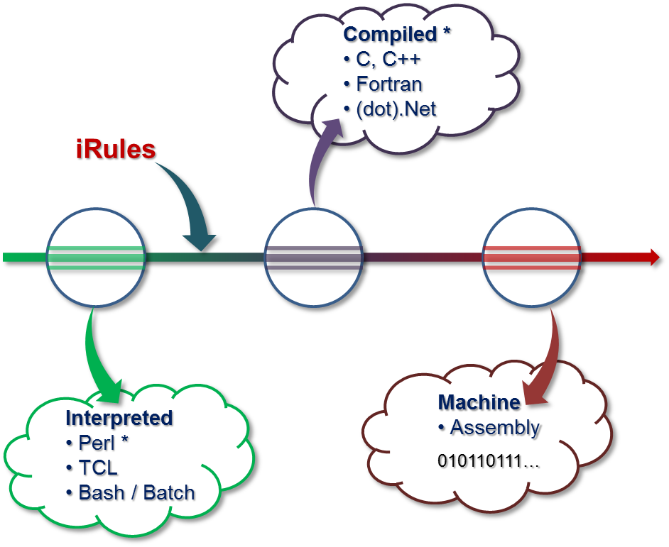

iRules — TCL integrated into TMOS
Pre-compiled into byte code - high performance
Easy for humans
Hard for computers
Slow
Hard for humans
Easy for computers
Fast
110110
100100

Slide 6
iRules — the answer is probably on DevCentral
https://devcentral.f5.com/wiki/iRules.HomePage.ashx
https://devcentral.f5.com/codeshare/Topic/irules

Slide 7
iRule Basics

Slide 8

iRules: Core Concepts
Event driven
Largely broken down by protocol (TCP, UDP, HTTP, etc)
When it happens in the connection flow is important
Physical
Data Link
Network
Transport
Session
Presentation
Application
SSL offload
CLIENTSSL_HANDSHAKE
Load Decision
LB_SELECTED
LB_FAILED
TCP handshake
CLIENT_ACCEPTED
HTTP request
(after headers)
HTTP_REQUEST
HTTP response
(after headers)
HTTP_RESPONSE
TCP handshake
SERVER_CONNECTED
BIG-IP
Notes:
https://devcentral.f5.com/articles/getting-started-with-irules/getting-started-with-irules-technology-terms-20395

Slide 9
iRules: Core Concepts
Variables
Local
Created per connection per iRule
No need to worry about memory management – deleted when connection closes
Global
Just don’t do it (VS is demoted from CMP)
Commands
Set, unset, append, incr, info exists
set hostname [HTTP::host]
log local0. "Host: $hostname"
Variables can be retrieved by appending the $ symbol
Notes:
https://devcentral.f5.com/articles/getting-started-with-irules/getting-started-with-irules-technology-terms-20395

Slide 10
iRules: Core Concepts
Controls
If, else, elseif, switch
If/elseif/else for 1-3 comparisons
Switch for 3-10 comparisons
Class for >10 (part of Intermediate section)
Comparison Operators
Equal (“$x eq $y” or “$x == 5”)
Not Equal (“$x ne $y” or “$x != 5”)
Contains ([HTTP::uri] contains “abc”)
Starts With ([HTTP::uri] starts_with “/app1”)
Ends With ([HTTP::path] ends_with “.jpg”)
Notes:
https://devcentral.f5.com/articles/getting-started-with-irules/getting-started-with-irules-technology-terms-20395

Slide 11
iRules: Core Concepts
Syntax
# log a message when a specific hostname is encountered
when HTTP_REQUEST {
# use a variable to store the host name
set hostname [HTTP::host]
if { [$hostname contains ”chas"] } {
log local0. "Host: $hostname"
}
}
Notes:
https://devcentral.f5.com/articles/getting-started-with-irules/getting-started-with-irules-basic-concepts-20397
Spend time looking at the rule and what it does.

Slide 12
Demo

Slide 13
LTM Traffic Policies

Slide 14
When not to use an iRule?
A general rule of thumb is: Any time you can do something from within the standard config options, profiles, GUI or CLI – do it there first.
For equivalent functionality, an iRule is about 20% slower
Notes:
Spend some time talking about performance, making upgrades easier, etc.

Slide 15
What is a Traffic Policy
Traffic policies were introduced in version 11.4 and redesigned in 12.1
Replaced HTTP Class profile
Traffic policies can replace majority of IF=>THEN type statements
Notes:
https://devcentral.f5.com/articles/to-irule-or-not-to-irule-introduction-to-local-traffic-policies-20384

Slide 16
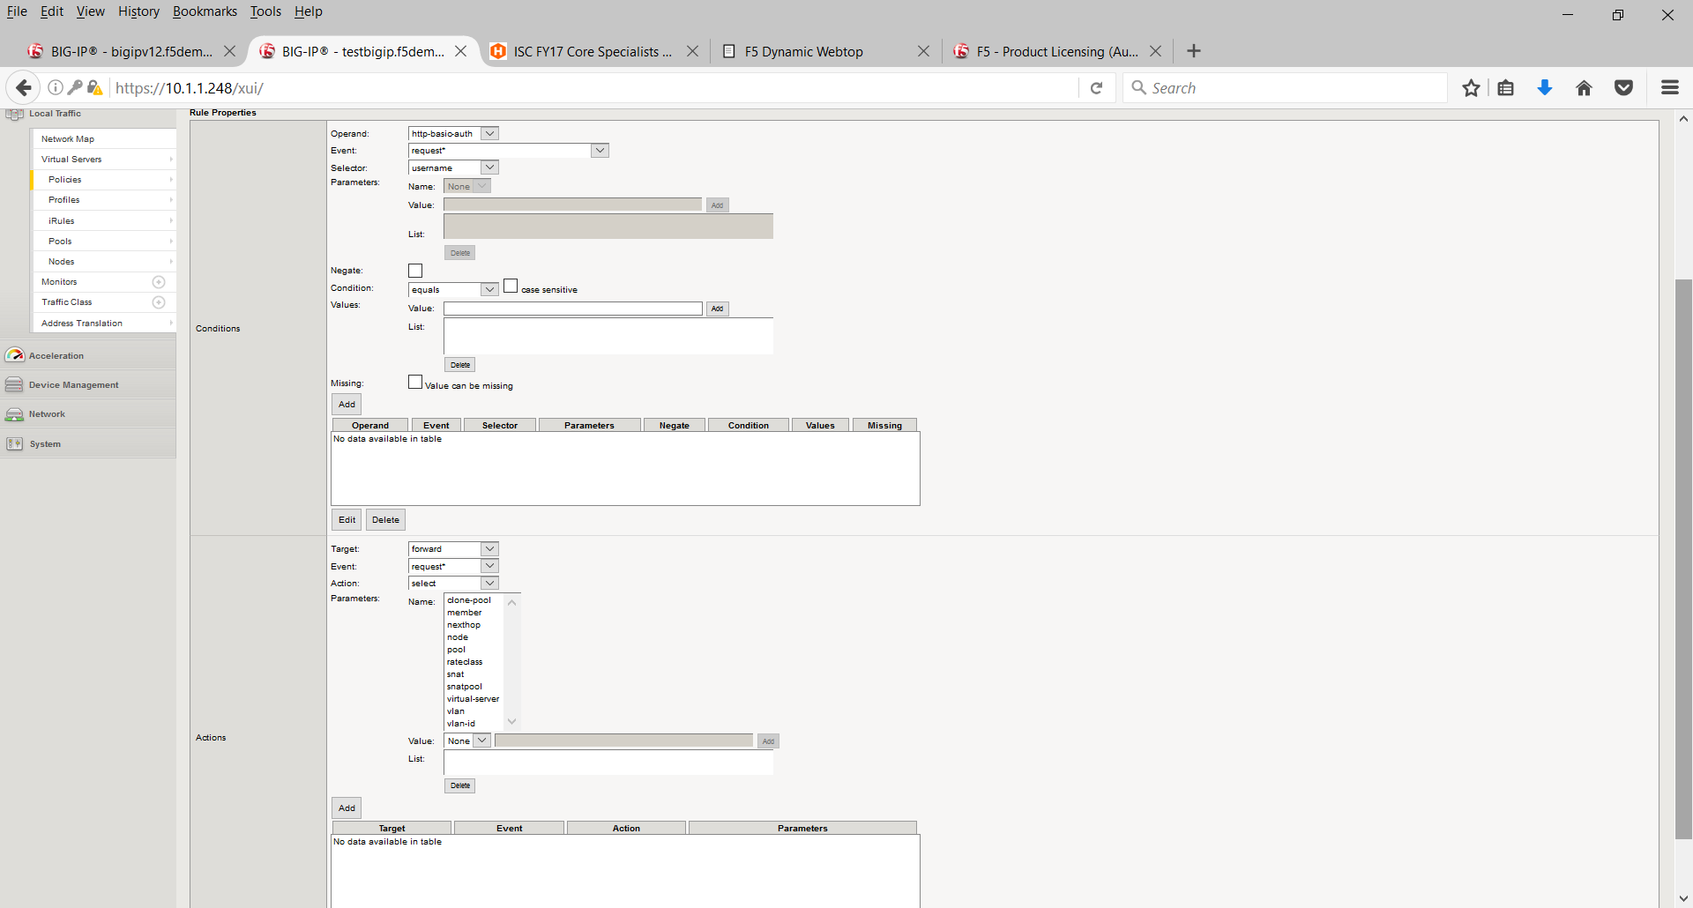
Traffic policies or traffic chaos
Prior to version 12.1 traffic policies were chaotic

Slide 17
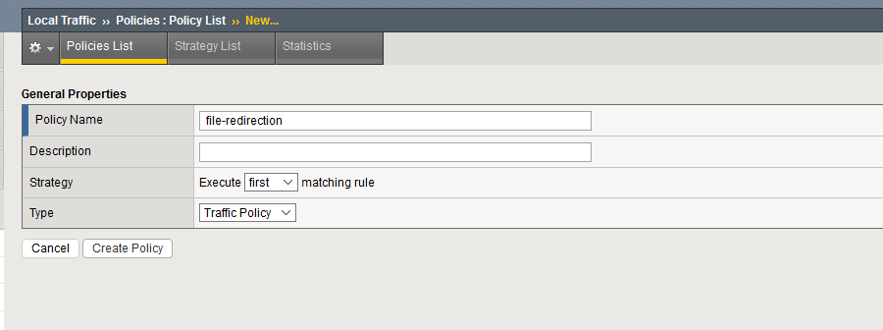
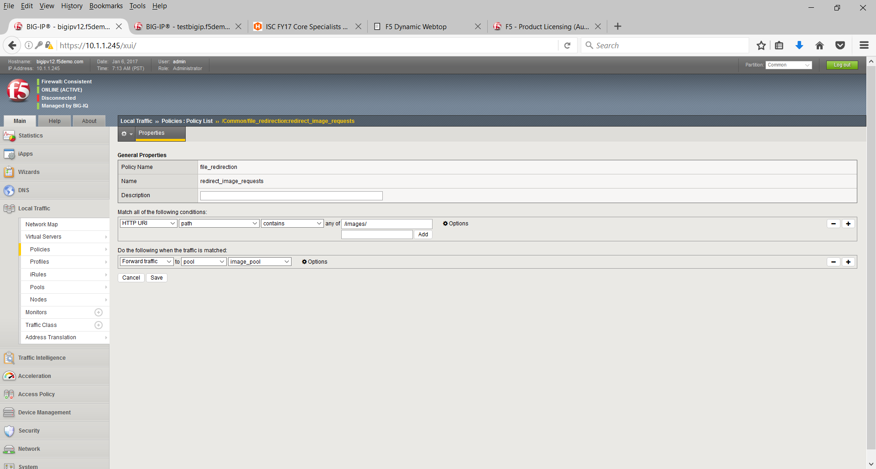
Traffic Order

Slide 18
Local Traffic Policy Pros and Cons
Pros
Nominal performance overhead for traffic processing
12.1 interface simplified
Upgrades will not break local traffic rule
Cons
Prior to 12.1 (Remember traffic chaos)
Moves traffic policies outside of iRules, which could split-brain your traffic processing if you’re not careful
Limited to static condition sets which may not meet all of your traffic manipulation requirements
Notes:
https://devcentral.f5.com/articles/to-irule-or-not-to-irule-introduction-to-local-traffic-policies-20384

Slide 19
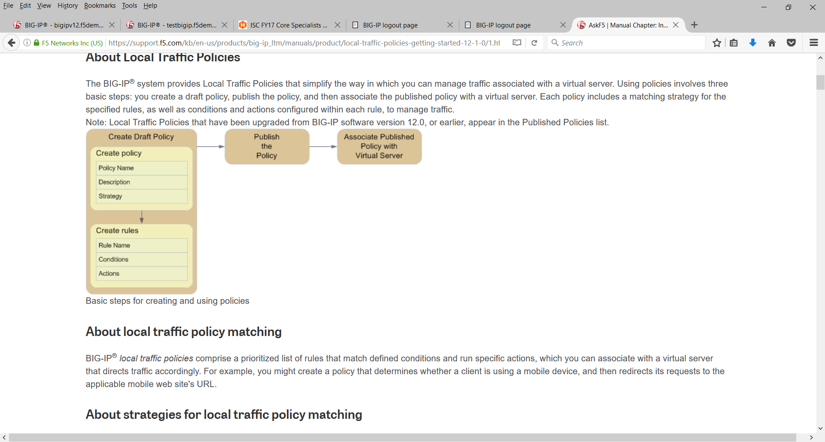
Also new in 12.1
Policies are now created in three basic steps
Create draft policy
Publish policy
Associate the policy with Virtual Server

Slide 20
Demo

Slide 21
iRules Intermediate

Slide 22
Procedures
Essentially a ‘function’ or ‘method’ in other languages
Used to encapsulate functionality
May be called with parameters
May return data

Slide 23
Example Procedure
when CLIENT_ACCEPTED {
set x [call randomNumberGenerator 10]
}
proc randomNumberGenerator {length {chars "0123456789"}} {
set range [expr {[string length $chars]-1}]
set txt ""
for {set i 0} {$i < $length} {incr i} {
set pos [expr {int(rand()*$range)}]
append txt [string range $chars $pos $pos]
}
return $txt
}

Slide 24
Data Groups
List of Keys or Key-Value pairs
Stored in permanent device configuration
Within bigip.conf (internal)
Separate file (external) – better for larger files
Cannot be modified by iRule (read-only)
Indexed, Hashed format = high performance with 1000’s of entries

Slide 25
Example Internal Data Group file
ltm data-group internal localusers_dg {
records {
192.168.1.1/32 { }
192.168.1.2/32 {
data "host 2"
}
192.168.2.0/24 { }
192.168.3.0/24 {
data "network 2"
}
}
type ip
}

Slide 26
Example External Data Group file
ltm data-group external ext_localusers_dg {
external-file-name ext_localusers
type ip
}
Files stored in /config/filestore
See https://devcentral.f5.com/articles/v11-irules-data-group-updates for info on manipulating external file

Slide 27
Example Data Group iRule
when HTTP_REQUEST {
if { [class match [IP::client_addr] equals "localusers_dg" ] } {
COMPRESS::disable
}
}

Slide 28
Side-band Connections
Create a connection to outside resource
Send request, get response, process data
Make iRule decisions based on:
Surrounding Applications
APIs
Databases

Slide 29
Example Sideband iRule
when HTTP_REQUEST {
set conn [connect -timeout 3000 -idle 30 -status conn_status vs_test]
log local0. "Connect returns: <$conn> and conn status: <$conn_status> "
set conn_info [connect info -idle -status $conn]
log local0. "Connect info: <$conn_info>"
set data "GET /mypage/myindex2.html HTTP/1.0\r\n\r\n"
set send_info [send -timeout 3000 -status send_status $conn $data]
log local0. "Sent <$send_info> bytes and send status: <$send_status>"
set recv_data [recv -timeout 3000 -status recv_status 393 $conn]
log local0. "Recv data: <$recv_data> and recv status: <$recv_status>"
close $conn
log local0. "Closed; conn info: <[connect info -status $conn]>"
}

Slide 30
Tables and Subtables
Table command allows access to session table
Subtable can be used as data structure stored in memory
Data storage can be persistent (not based on connection)
High performance – based on LTM session table
Easy to use – timeout and lifetime options
Memory management not required
Table cleanup not required

Slide 31
Example Tables iRule
# Limit each client IP address to 20 concurrent connections
when CLIENT_ACCEPTED {
# Check if the subtable has over 20 entries
if { [table keys -subtable connlimit:[IP::client_addr] -count] >= 20 } {
reject
} else {
# Add the client IP:port to the client IP-specific subtable
# with a max lifetime of 180 seconds
table set -subtable connlimit:[IP::client_addr] [TCP::client_port] "" 180
}
}
when CLIENT_CLOSED {
# When the client connection is closed, remove the table entry
table delete -subtable connlimit:[IP::client_addr] [TCP::client_port]
}

Slide 32
Demo

Slide 33
iRules LX
What is iRules LX -
iRules Language Extensions - Allows for running Node.JS on the BigIP
Why ?
TCL is limited
Tap into the versatility of Node modules.
Allow for languages other than TCL
Meet the needs of application owners and developers
Officially GA in 12.1
TCL iRules are not going away.

Slide 34

What is NodeJS
An asynchronous event driven server side environment for running JavaScript.
Node components are –
The open source Google V8 JavaScript Engine (optimizing compiler makes JS very fast)
The LibUV asynchronous I/O library
For security reasons Javascript on the browser has many limitations. No local file operations. Limited network operations, Not allowed to touch Cookies if they are marked ‘HTTPonly’.
On the server side, I/O is crucial. This is why LibUV was added. With LibuV I/O operations are non-blocking. You can start a read from a file at the same time you receive data from the network.
The Node Package Manager (NPM)
NPM is a package repository of NodeJS libraries (similar to perl CPAN, Python PyPI)

Slide 35

Node Package Manager (NPM)
Node Package Manager (NPM) is the most valuable component of Node.js -
Use NPM to install, share, and distribute code; manage dependencies; and share & receive feedback with others.
NPM has more 300,000 packages
You can find packages for most popular use cases
Responsibility is on the user to make sure the module does not crash Node.js process or the BigIP

Slide 36
Use Cases
Replacement for TCL sideband –
Protocol implementation is the most difficult issue with iRules TCL.
Database lookup – SQL, LDAP, Memcached/Redis
HTTP or other API Calls – CAPTCHA, RESTful, SSO mechanisms
Data parsing –
JSON,
XML,
Binary protocols
Radius
LDAP
Reporting/Heuristics – Sending stats to an external service

Slide 37
Operational Model
TMM
Node.js Process(es)
RPC Handle
LX Plugin
when HTTP_REQUEST {
set RPC_hdl [ILX::init my_plugin my_extension]
set result [ILX::call $RPC_hdl my_func <arg1>]
if { $result eq 'something' }{
# Do something
} else {
# Do something else
}
}
ilx.addMethod('my_func', function myFuncCB(req, res){
typeof req.params()[0] // 'string'
<…ADDITIONAL_PROCESSING…>
res.reply('<some_reply>');
}

Slide 38
iRulesLX Workspace
Development and Staging for
Node.js code (in a folder called Extensions)
iRule TCL code (in a folder called Rules)
Does not affect running config
Can be exported/imported

Slide 39
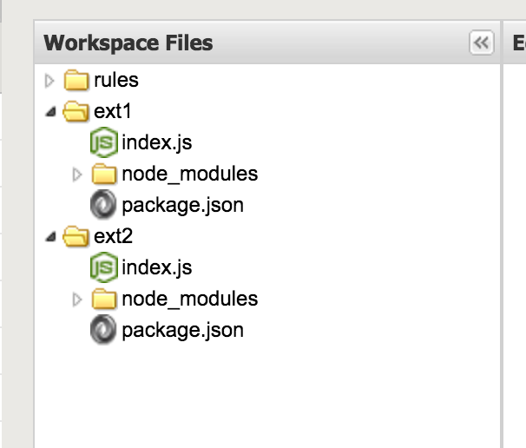
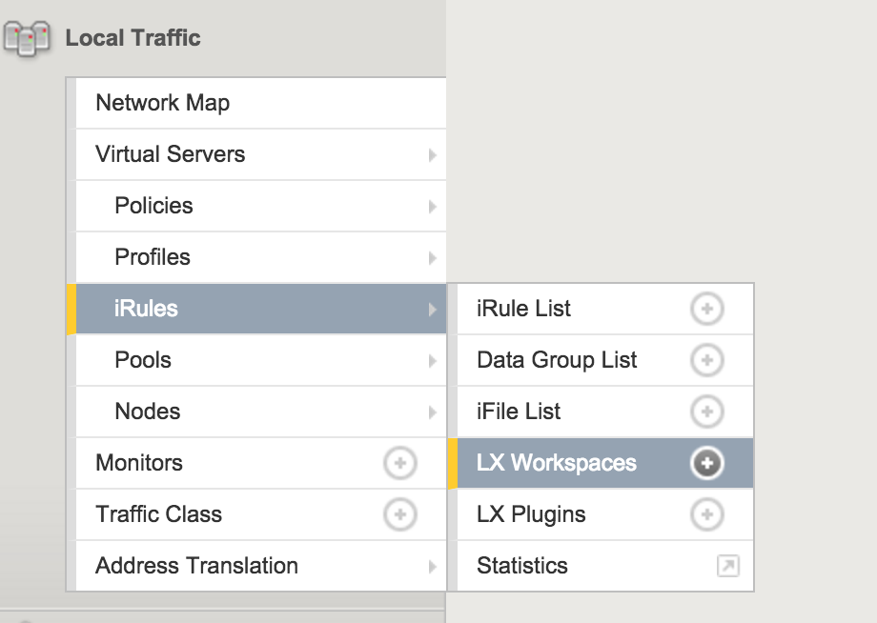
ILX Configuration Objects
LX Workspace – A directory with files for extensions and TCL iRules
Code is not actively running (saved config, not running config)
Can be exported/imported as a TGZ file
Extension – Folder of Node.JS code in a workspace
LX Plugin – The active code from a published extensions running in the Node processes
TCL iRules
Extensions
Any folder other than “rules”.
Extension names can be anything but name will be part of ILX::init command.
Workspaces & Plugins

Slide 40
iRulesLX Extensions
Can have any name
But it matters as it’s how it gets called
Must be unix friendly and not named “rules”
Each extension will have these files and folders to start off with.
index.js - This file is the Node.js code that will eventually run on your BIG-IP.
node_modules - This folder will contain node modules you install from NPM.
package.json - This is the standard package.json file that is use to store various information and package dependencies about a Node.js program.

Slide 41
iRulesLX Plugin
An LX Plugin is the production code from the LX Workspace that is actively running on the data plane of the BIG-IP.
iRule is not parsed until Plugin is created
TCL iRule gets created and can be applied to Virtual Server

Slide 42
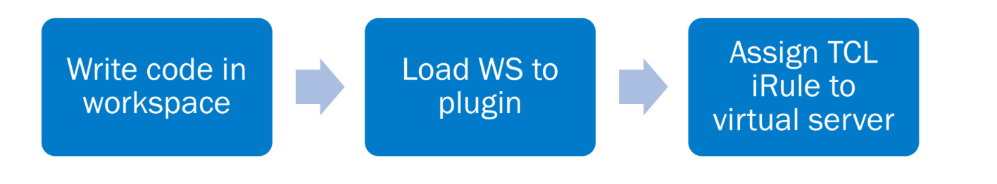
iRulesLX Workflow

Slide 43
Demo

