Slide 1
Top Ten Tools … Making your troubleshooting day easier
F5 Sacramento User Group
Chas Lesley

Slide 2









The agenda ….
TCPdump
Wireshark
Developer Tools
cURL
Tool Day
OWASP Zap
XCA
Logging
Burp Suite
SAML Tracer
SAML
Postman

Slide 3
As we know, there are known knowns. There are things we know we know.
We also know there are known unknowns. That is to say we know there are some things we do not know.
But there are also unknown unknowns, The ones we don't know, we don't know.
Secretary of Defense, Donald Rumsfeld, February 12, 2002, Department of Defense news briefing

Slide 4

Every environment is at different levels
I/We don’t know everything,
Everyone needs to contribute.

Slide 5

Some days feeling like this, just goes with the job …
Today’s objectives:
Provide you tools & knowledge
Speed diagnosis & resolution
Increase your visibility into applications/services
Enhance and improve the security of your applications
Shorten your time on the rope

Slide 6

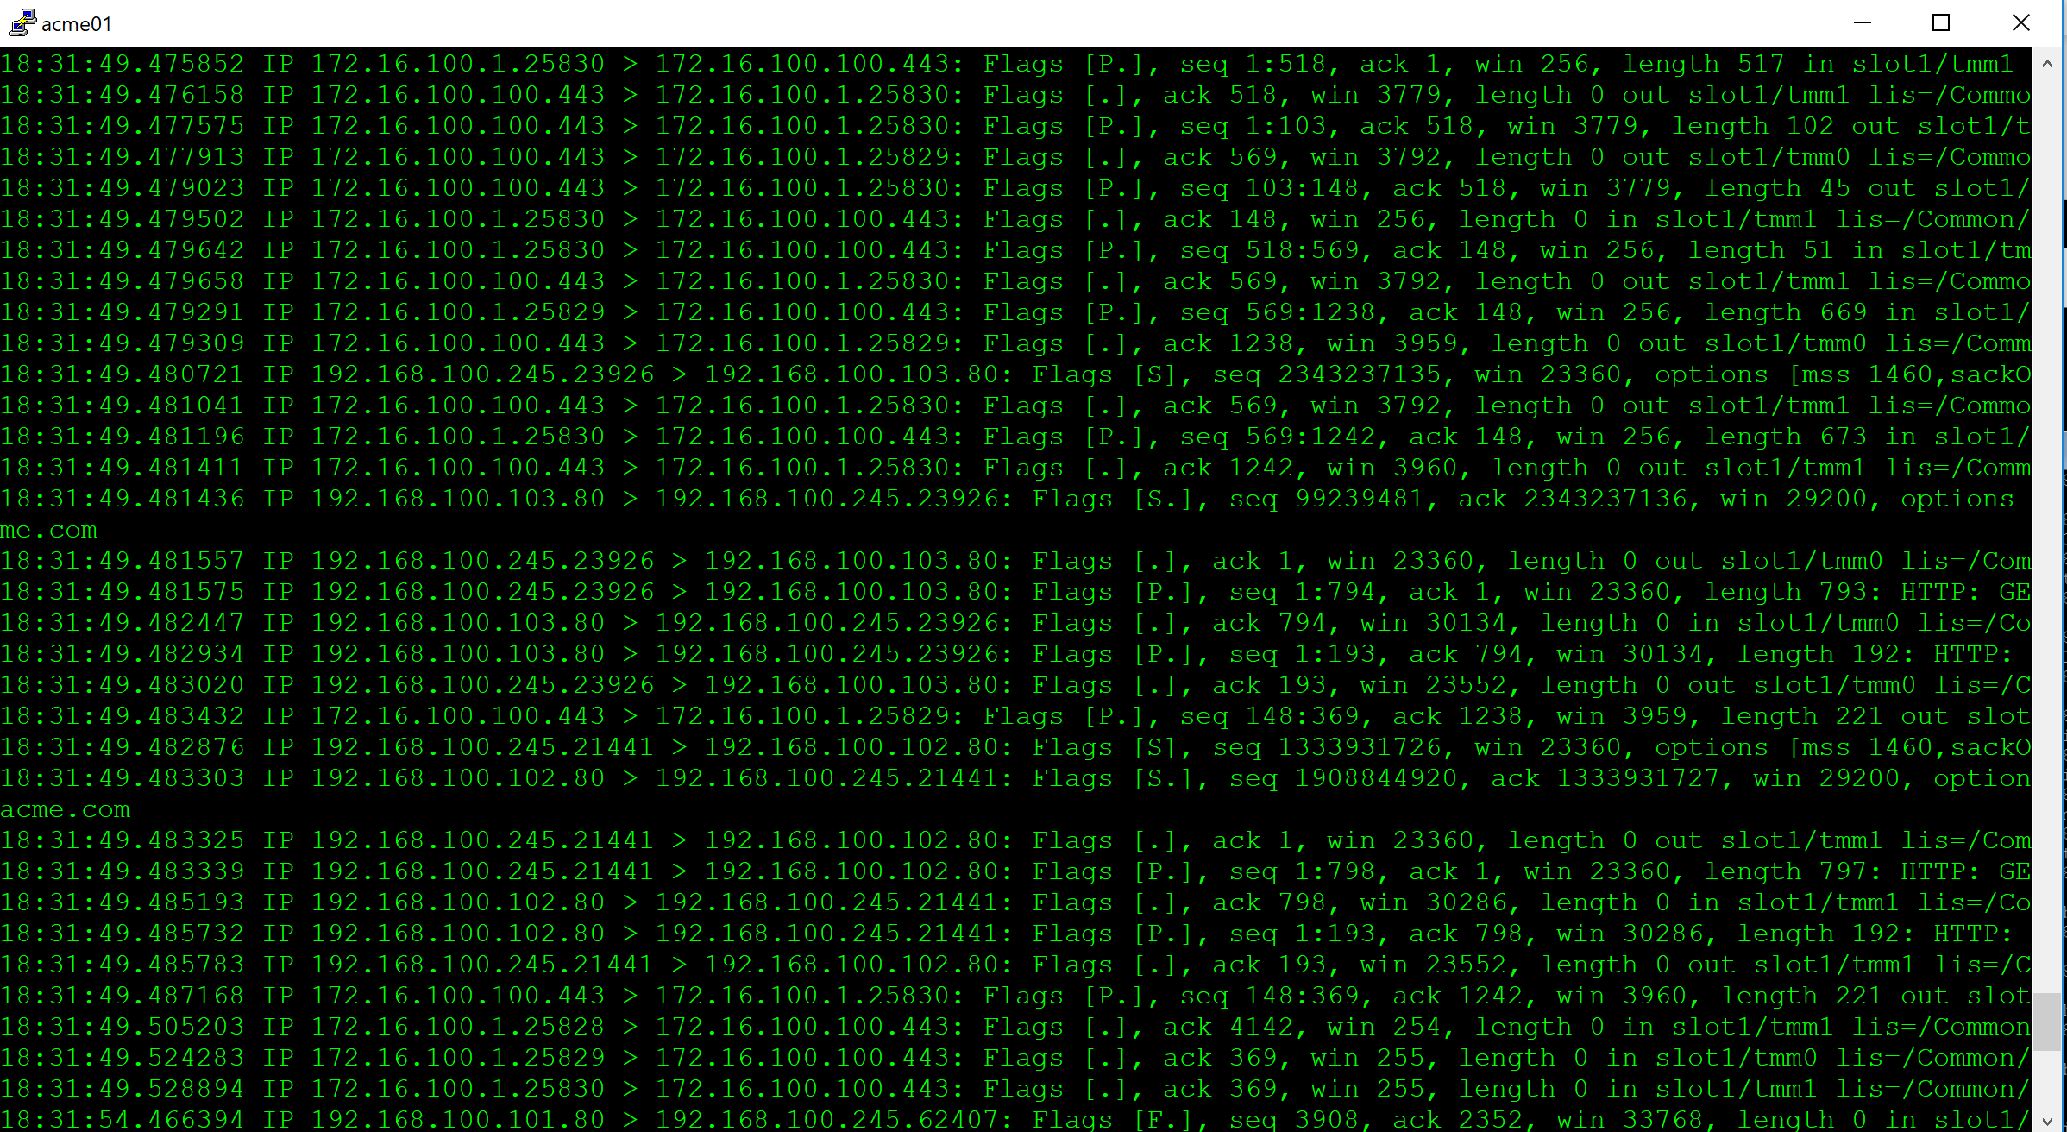
TCPdump
Introduction
tcpdump is a common packet analyzer that runs under the command line. It allows the user to display TCP/IP and other packets being transmitted or received over a network

Slide 7
What can TCPdump tell us ???
TCPdump
21:28:48.565492 IP 10.128.10.1.137 > 10.128.10.255.137: NBT UDP PACKET(137): QUERY; REQUEST; BROADCAST in slot1/tmm0 lis=
21:28:48.808374 IP 10.128.20.241.47597 > 10.128.20.17.80: S 1774880053:1774880053(0) win 14600 <mss 1460,sackOK,timestamp 14962386 0,nop,wscale 7> out slot1/tmm1 lis=
21:28:48.810025 IP 10.128.20.17.80 > 10.128.20.241.47597: S 3738641472:3738641472(0) ack 1774880054 win 14480 <mss 1460,sackOK,timestamp 113402217 14962386,nop,wscale 7> in slot1/tmm1 lis=
21:28:48.812804 IP 10.128.20.241.47597 > 10.128.20.17.80: . ack 1 win 115 <nop,nop,timestamp 14962389 113402217> out slot1/tmm1 lis=
21:28:48.812831 IP 10.128.20.241.47597 > 10.128.20.17.80: P 1:19(18) ack 1 win 115 <nop,nop,timestamp 14962389 113402217> out slot1/tmm1 lis=
21:28:48.814551 IP 10.128.20.17.80 > 10.128.20.241.47597: . ack 19 win 114 <nop,nop,timestamp 113402218 14962389> in slot1/tmm1 lis=
21:28:48.817797 IP 10.128.20.17.80 > 10.128.20.241.47597: P 1:1225(1224) ack 19 win 114 <nop,nop,timestamp 113402218 14962389> in slot1/tmm1 lis=
21:28:48.817799 IP 10.128.20.17.80 > 10.128.20.241.47597: F 1225:1225(0) ack 19 win 114 <nop,nop,timestamp 113402218 14962389> in slot1/tmm1 lis=
21:28:48.820345 IP 10.128.20.241.47597 > 10.128.20.17.80: . ack 1225 win 134 <nop,nop,timestamp 14962397 113402218> out slot1/tmm1 lis=
21:28:48.820347 IP 10.128.20.241.47597 > 10.128.20.17.80: F 19:19(0) ack 1226 win 134 <nop,nop,timestamp 14962397 113402218> out slot1/tmm1 lis=
21:28:48.822016 IP 10.128.20.17.80 > 10.128.20.241.47597: . ack 20 win 114 <nop,nop,timestamp 113402220 14962397> in slot1/tmm1 lis=
Source IP
Source Port
Destination IP
Destination Port
Host to Host Communication
Data Payload and other information
Clearly, enough to get us in trouble

Slide 8

TCPdump on
TCPdump
VLANs
Interfaces
Route Domains
Recommended for in-depth troubleshooting
Processed by TMM
Special considerations for non-default partitions -i /<partition_name>/<vlan_name>
Special considerations for systems containing PVA ASICs (not processed by TMM) tmsh show /sys hardware | grep –I pva disable PVA Acceleration (temporary)
Recommended for only basic troubleshooting
Packet copied by SCCP/AOM
Rate-limited 200 pckts/sec
Interface of trunk captures entire trunk
On VIPRION, must be on blade of TCPdump interface
Run TCPdump from the default Route Domain (0)
tcpdump –nni 0.0
Limitation: TCPdump does not capture traffic when run from a non-default Route-Domain
Default Route Domain rdsh:0
Notes:
Switch Card Control Processor (SCCP)
Always-On Management (AOM)
https://support.f5.com/kb/en-us/solutions/public/6000/500/sol6546.html

Slide 9

Primary Command Options
TCPDump
tcpdump -nni <interface>:nnnp -s 0 -w <filename>
n: No address translation
n: No port translation
i: Interface
:nnn
(Noise Amplitude)
“TMM Details”
-w (output file)
<filename> (*.cap)
<interface>
VLAN
Interface
Route Domain
:p (Peer Flow)
“Copies matching peer flow”(Can be used together or separate :nnnp or :p
-s (snarf/Snap Length)
0 = Full Packet
>1 = Number of bytes
Supports most of the standard TCPdump options

Slide 10

Other Cool Options
TCPdump
-X: ASCII format to screen
-r: Read a saved TCPdump file (You can apply filters)
> Pipe to a text file (human readable)
-W: Number of files in ring (used with –w)
-C: Number of millions of bytes per each file (used with –W –w)
ie: 1MB = -C 1
-vvv: Verbosity
-e: Show Ethernet
iCall TCPdump on Event: https://devcentral.f5.com/wiki/iCall.Run_tcpdump_on_event.ashx
Perl Script on Log Action: http://devcentral.f5.com/wiki/default.aspx/AdvDesignConfig/ActionOnLog.html

Slide 11
Capture Filters
TCPDump
Common
host <ip address>
net <network/bit mask>
port <port number>
Portrange <port-port>
Modifiers
src/dst
Operators
Negation (`!' or `not').
Concatenation (`&&' or `and').
Alternation (`||' or `or').
Negation has highest precedence. Alternation and
concatenation have equal precedence and associate left to right.
tcpdump -nni internal -w /var/tmp/capture.cap
tcpdump -nni external host 4.2.2.1
tcpdump -nni internal net 10.10.10.0/24 and port 80
tcpdump -nni 0.0 src host 172.16.101.20 and dst port 80
tcpdump –X –s 0 -nni 0.0 -w /var/tmp/new.cap host 172.16.101.20 and port 162

Slide 12
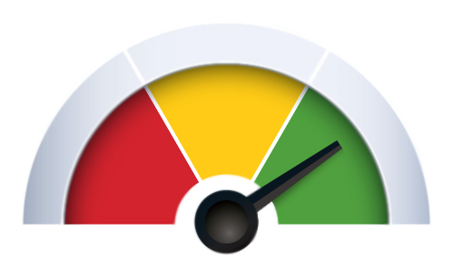
TCPdump
TCPdump TMM “ Noise” Details
Low Details
Ingress: A flag indicating whether TMM is sending or receiving the packet. A zero (0) indicates that TMM is sending the packet, while a non-zero number indicates that TMM is receiving the packet.
Slot: The chassis slot number of the TMM that is handling the packet. TMM: The number of the TMM that is handling the packet.
VIP: The name of the virtual server that is handling the connection. Prior to BIG-IP 11.2.0, the name was limited to 16 characters. In BIG-IP 11.2.0 and later, the name is limited to 96 characters.
LOW
:n
Noise Amplitude
Notes:
https://support.f5.com/kb/en-us/solutions/public/13000/600/sol13637.html

Slide 13
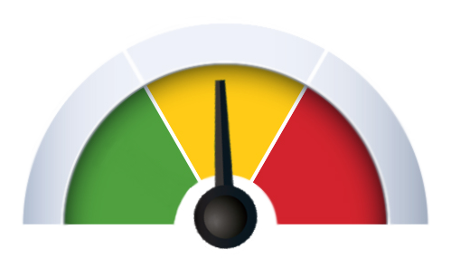
TCPdump
TCPdump TMM “ Noise” Details
Medium Details
Flow ID: A number identifying a flow within TMM. The same flow ID can be used for different flows in different TMMs. Also, the same flow ID can be re-used for a different flow within the same TMM at a different time.
Peer ID: A number identifying the peer flow within TMM. Note that the same peer ID can be used for different flows in different TMMs. Also, the same peer ID can be re-used for a different flow within the same TMM at a different time.
Reset Cause: In BIG-IP 11.2.0 and later, the reset cause (if available) is included for TCP reset packets.
Connflow Flags: Diagnostic information used by F5 Support.
Flow Type: Diagnostic information used by F5 Support.
High Availability Unit: Diagnostic information used by F5 Technical Support.
Ingress Slot: Diagnostic information used by F5 Support.
Ingress Port: Diagnostic information used by F5 Support.
MEDIUM
:nn
Noise Amplitude
Includes LOW
Notes:
https://support.f5.com/kb/en-us/solutions/public/13000/600/sol13637.html

Slide 14
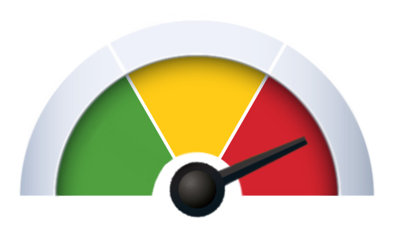
TCPdump
TCPdump TMM “ Noise” Details
High Details
Peer IP Protocol: The IP protocol of the peer flow. This field is not populated prior to BIG-IP 11.0.0.
Peer VLAN: The VLAN ID number that is associated with the peer flow.
Peer Remote Address: The IP address of the host on the far end of the peer flow.
Peer Local Address: The IP address used by TMM for the peer flow.
Peer Remote Port: The protocol port of the host on the far end of the peer flow.
Peer Local Port: The protocol port used by TMM for the peer flow.
HIGH
:nnn
Noise Amplitude
Includes LOW & MEDIUM
Notes:
https://support.f5.com/kb/en-us/solutions/public/13000/600/sol13637.html

Slide 15
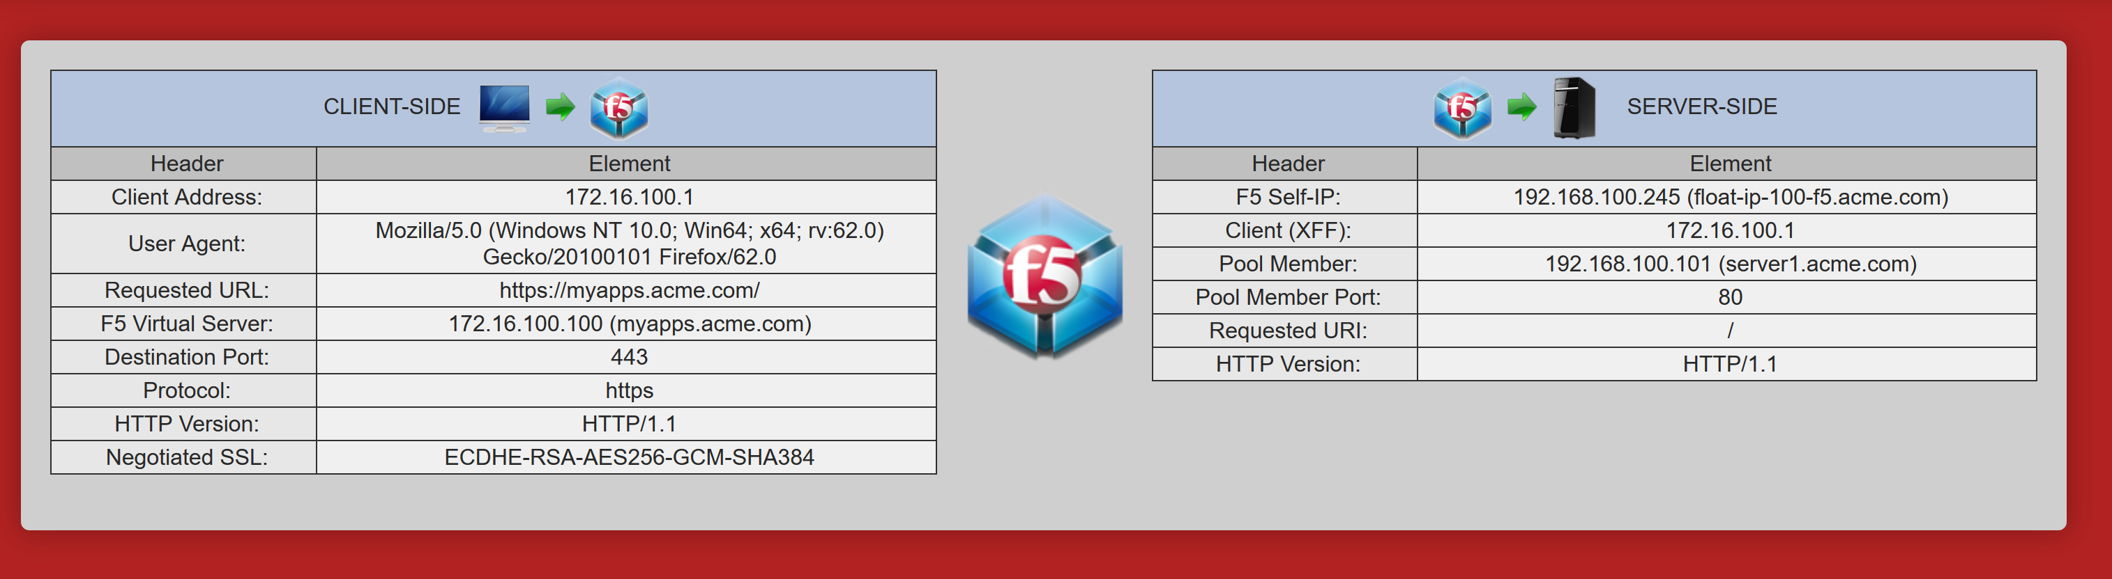
TCPdump

Slide 16
TCPdump
… in the beginning
tcpdump –nni 0.0:p host 172.16.100.100
Source IP
Source Port
Destination IP
Destination Port
18:31:49.464891 IP 172.16.100.1.25830 > 172.16.100.100.443: Flags [S], seq 833257974, win 64240, options [mss 1460,nop,wscale 8,nop,nop,sackOK], length 0 in slot1/tmm1 lis=
18:31:49.464977 IP 172.16.100.100.443 > 172.16.100.1.25830: Flags [S.], seq 1019957271, ack 833257975, win 14600, options [mss 1460,nop,wscale 2,sackOK,eol], length 0 out slot1/tmm1 lis=/Common/ACME_myapps.acme.com
18:31:49.466604 IP 172.16.100.1.25830 > 172.16.100.100.443: Flags [.], ack 1, win 256, length 0 in slot1/tmm1 lis=/Common/ACME_myapps.acme.com
18:31:49.475852 IP 172.16.100.1.25830 > 172.16.100.100.443: Flags [P.], seq 1:518, ack 1, win 256, length 517 in slot1/tmm1 lis=/Common/ACME_myapps.acme.com
18:31:49.476158 IP 172.16.100.100.443 > 172.16.100.1.25830: Flags [.], ack 518, win 3779, length 0 out slot1/tmm1 lis=/Common/ACME_myapps.acme.com
TCP Handshake (Client-side)
SYN
SYN/ACK
ACK

Slide 17
TCPdump
… reaching the pool (member)
18:31:49.479502 IP 172.16.100.1.25830 > 172.16.100.100.443: Flags [.], ack 148, win 256, length 0 in slot1/tmm1 lis=/Common/ACME_myapps.acme.com
18:31:49.479642 IP 172.16.100.1.25830 > 172.16.100.100.443: Flags [P.], seq 518:569, ack 148, win 256, length 51 in slot1/tmm1 lis=/Common/ACME_myapps.acme.com
18:31:49.479658 IP 172.16.100.100.443 > 172.16.100.1.25830: Flags [.], ack 569, win 3792, length 0 out slot1/tmm1 lis=/Common/ACME_myapps.acme.com
18:31:49.480721 IP 192.168.100.245.23926 > 192.168.100.103.80: Flags [S], seq 2343237135, win 23360, options [mss 1460,sackOK,eol], length 0 out slot1/tmm0 lis=/Common/ACME_myapps.acme.com
18:31:49.481041 IP 172.16.100.100.443 > 172.16.100.1.25830: Flags [.], ack 569, win 3792, length 0 out slot1/tmm1 lis=/Common/ACME_myapps.acme.com
18:31:49.481196 IP 172.16.100.1.25830 > 172.16.100.100.443: Flags [P.], seq 569:1242, ack 148, win 256, length 673 in slot1/tmm1 lis=/Common/ACME_myapps.acme.com
18:31:49.481411 IP 172.16.100.100.443 > 172.16.100.1.25830: Flags [.], ack 1242, win 3960, length 0 out slot1/tmm1 lis=/Common/ACME_myapps.acme.com
18:31:49.481436 IP 192.168.100.103.80 > 192.168.100.245.23926: Flags [S.], seq 99239481, ack 2343237136, win 29200, options [mss 1460,nop,nop,sackOK], length 0 in slot1/tmm0 lis=/Common/ACME_myapps.acme.com
18:31:49.481557 IP 192.168.100.245.23926 > 192.168.100.103.80: Flags [.], ack 1, win 23360, length 0 out slot1/tmm0 lis=/Common/ACME_myapps.acme.com
lis=/Common/ACME_myapps.acme.com
The power of :p

Slide 18
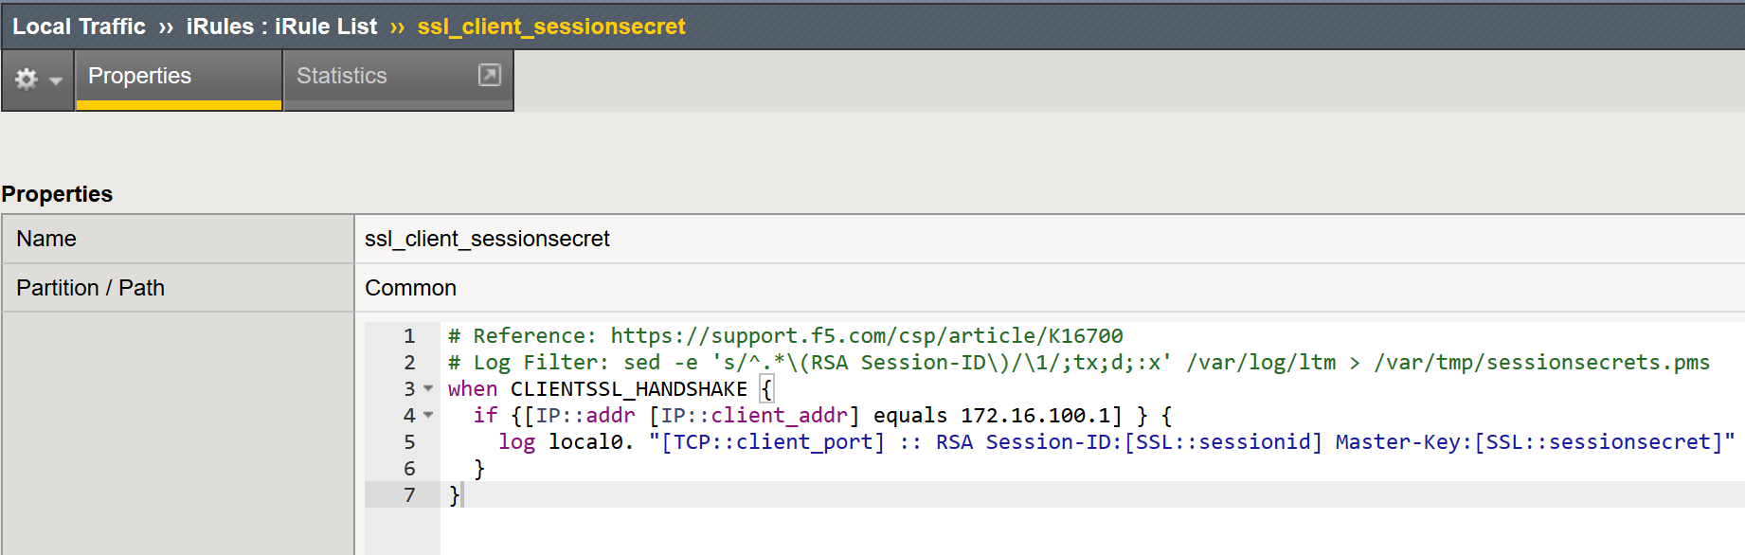
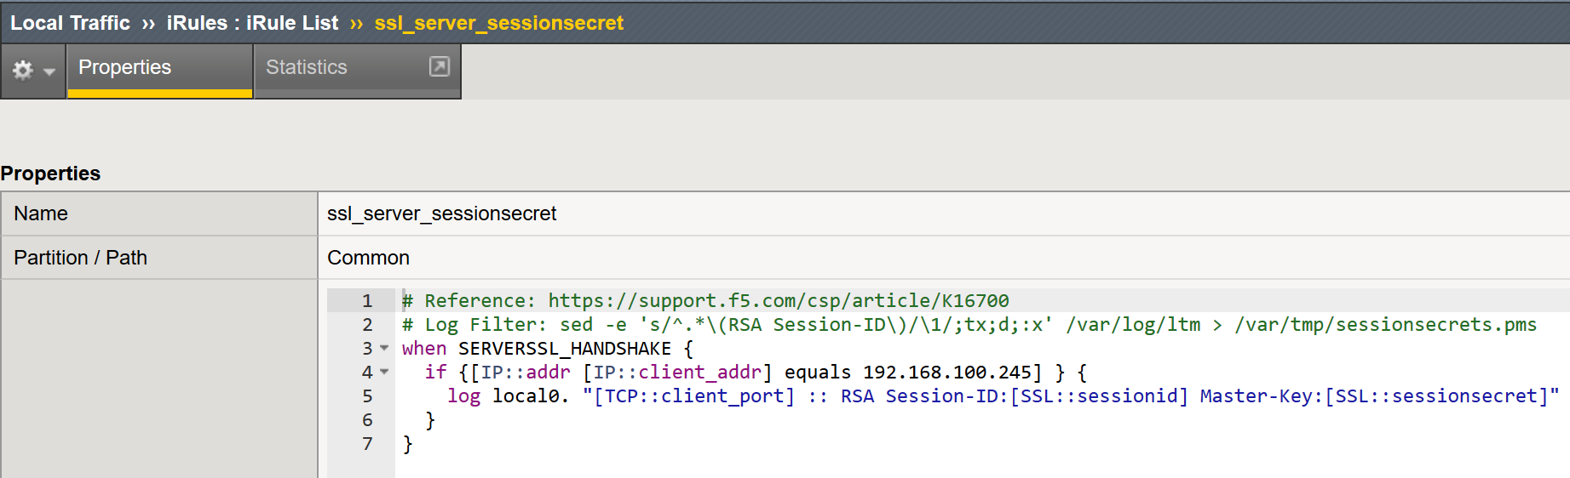
TCPdump
what about decrypting SSL???
Client Side iRule
SSL Decryption with iRules
Client & Server Side
AskF5: K16700
Requires SSL Cache
Doesn’t Require Cipher Reduction
Works with PFS
Requires that SSL session cache feature is enabled in the SSL profile [Default] AskF5: K6767
Server Side iRule
SSL Dump(CLI) AskF5: K10209

Slide 19
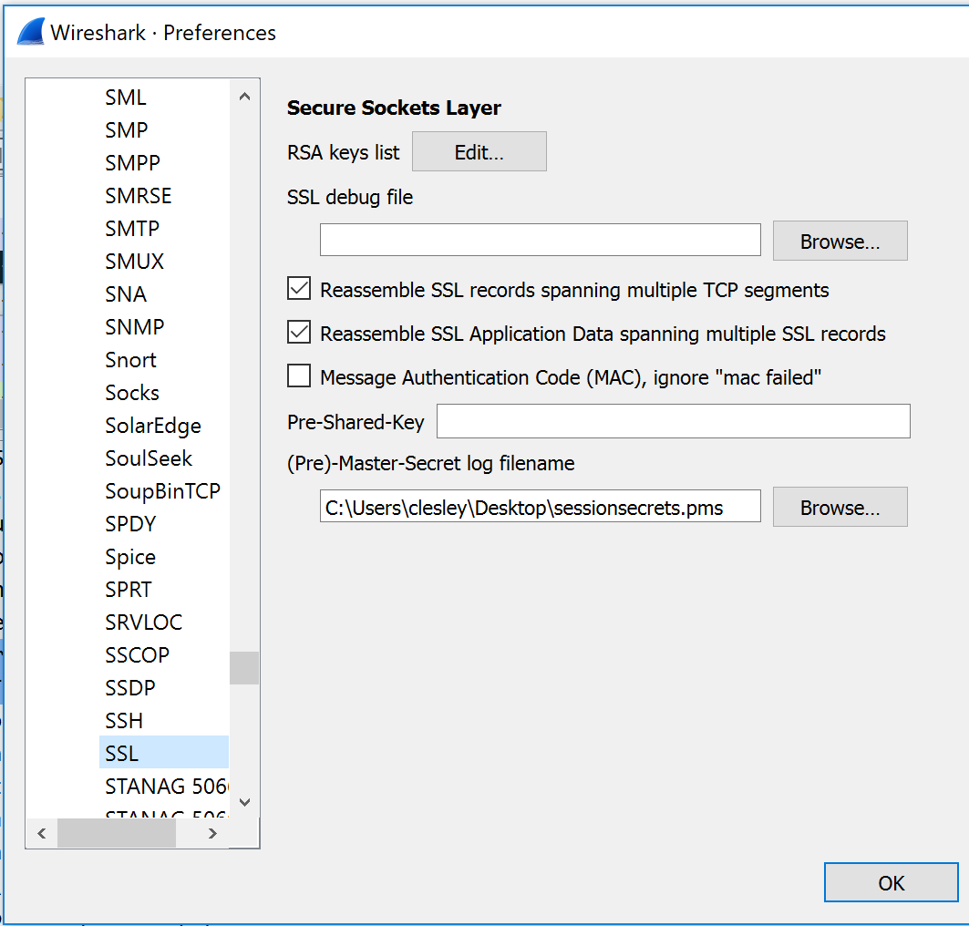
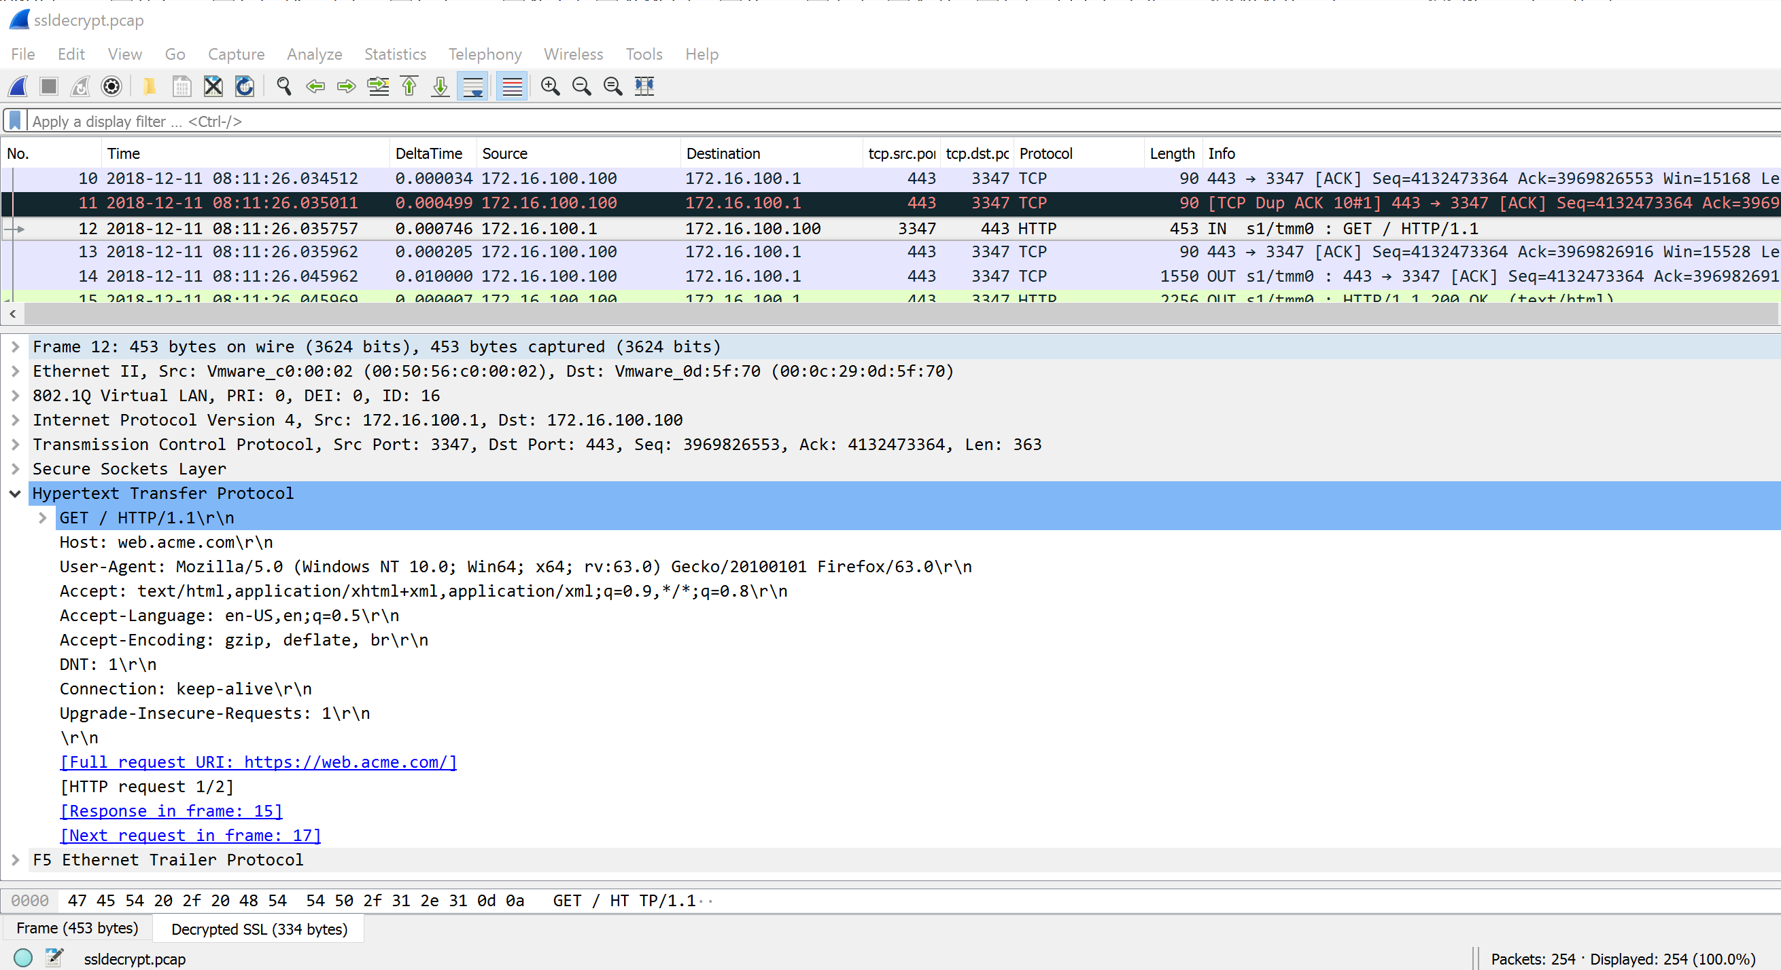
TCPdump
what about decrypting SSL???
Configure Preferences: Open SSL and load the SessionSecrets file
Open Capture file

Slide 20
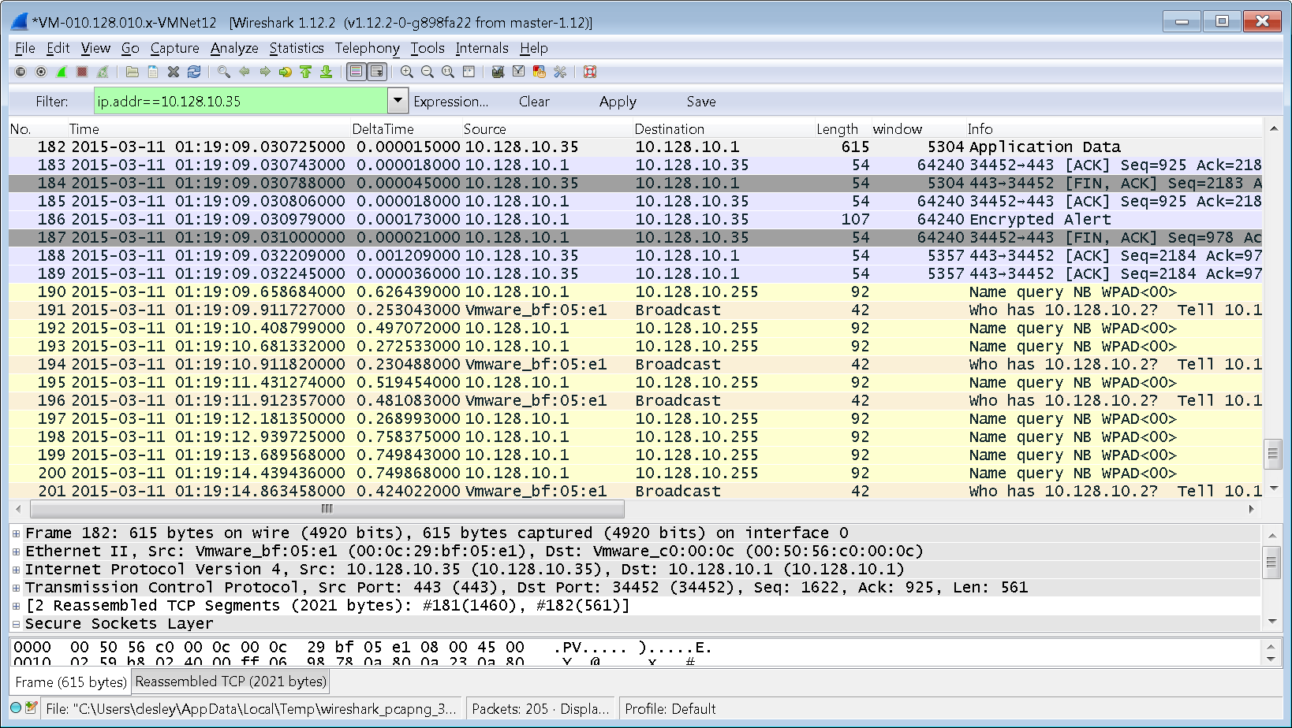

Wireshark
Introduction
Wireshark is a GUI network protocol analyzer for Unix and Windows

Slide 21
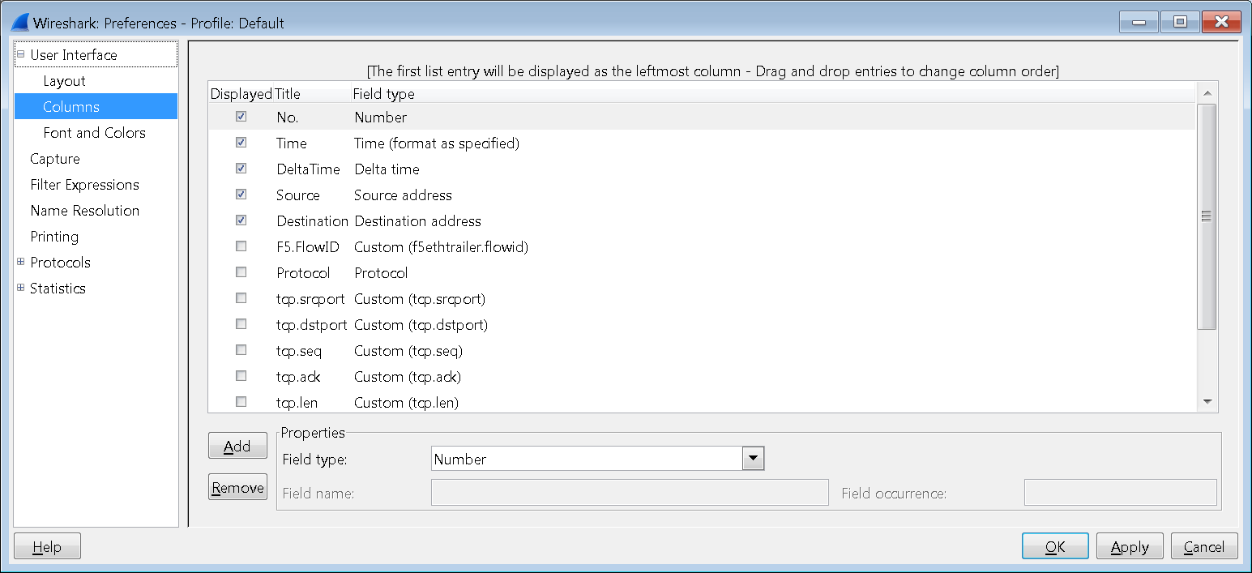
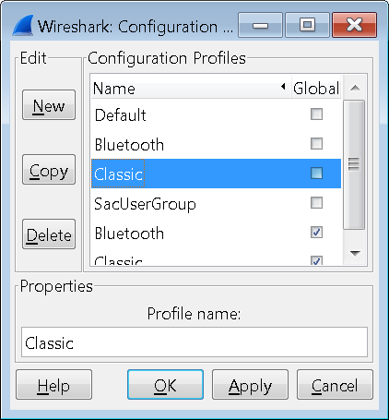
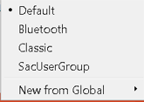
Wireshark
Wireshark Overview
Display Filters
Displayed Flows
Header & Payload Details
Status
Bar & Info

Slide 22

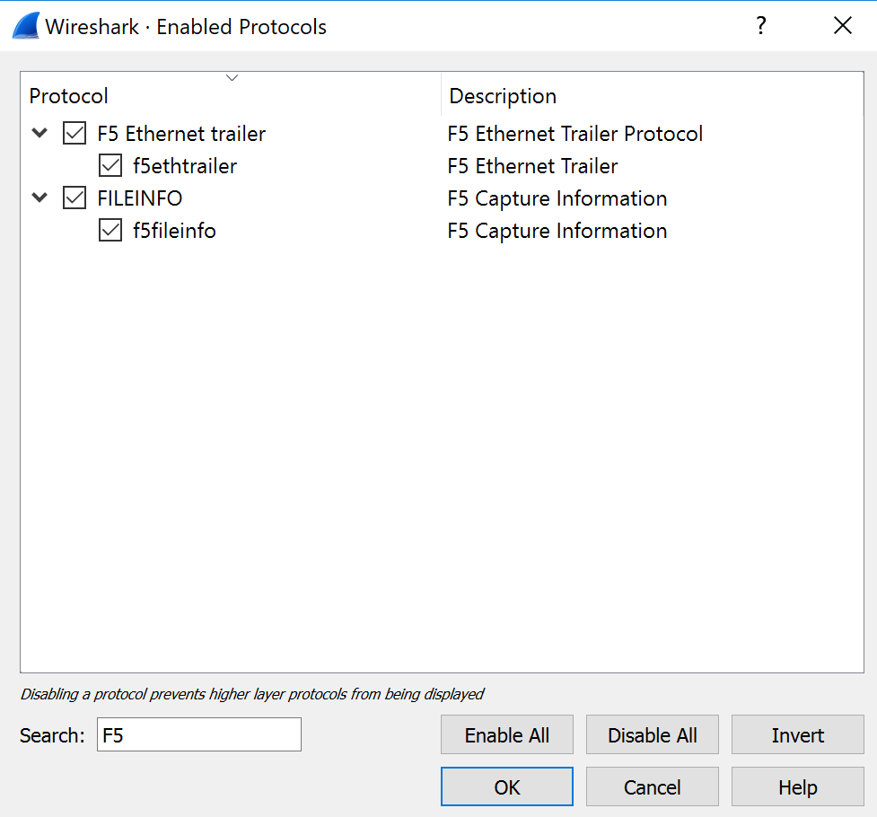
Wireshark
Wireshark Dissector
As of Wireshark 2.6.0 (rel. 4/24/2018) the 1.11 version of the f5ethtrailer dissector is included as a built-in. It is no longer necessary to use the plugin do decode f5ethtrailer information. It is disabled by default. To enable it, from the menu select "Analyze" : "Enabled Protocols...". Then search for f5ethtrailer and enable the dissector. https://www.wireshark.org/news/20180424.html
Notes:
https://devcentral.f5.com/wiki/AdvDesignConfig.F5WiresharkPlugin.ashx
Description
This plugin decodes the various additional diagnostic data that is encoded on tcpdump captures. Most of this information will be useful primarily to F5 support personnel, but this plugin is provided for the convenience and utility of our customer base. If there are not binaries supplied for your operating system, then installation will require an environment capable of compiling the Wireshark package. Extract this package within the Wireshark source directory. The package contains a README.F5ETHTRAILER file with installation instructions.

Slide 23
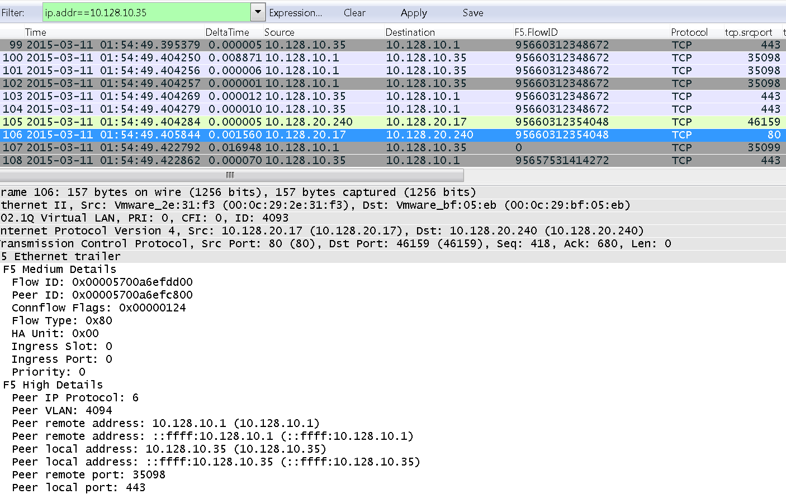
Wireshark
Wireshark Dissector at work
The F5 Wireshark Dissector provides a lot of information regarding how the connection moves across the BIG-IP TMOS.
FlowID/PeerID
Noise

Slide 24
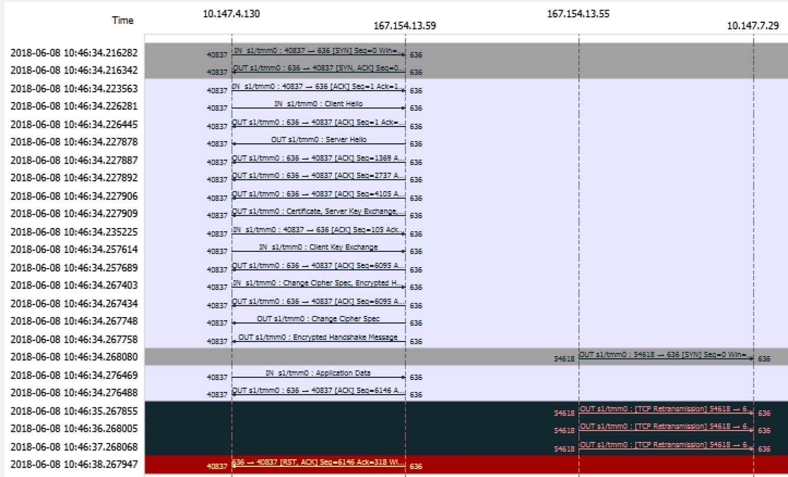
Wireshark
Importance these visual tools
The visual aspects of Wireshark help sift through mountains of packet data quickly.
Here we have a non-responsive server that eventually replies (with a RESET)

Slide 25
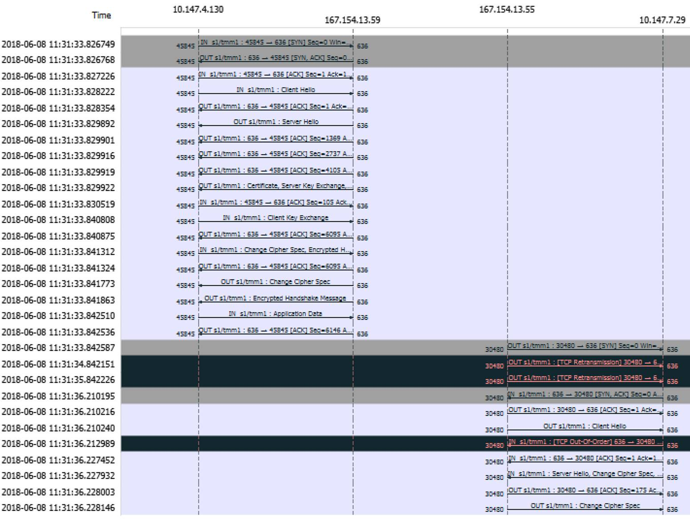
Wireshark
Importance these visual tools
This is the same server … recovering naturally.
Server was impacted by port handling by the server itself
Remedy was a OneConnect Profile.

Slide 26
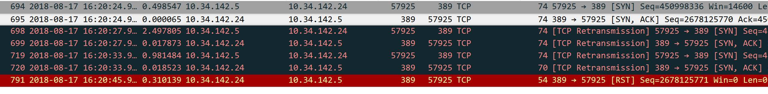
Wireshark
It’s you not me …..
Here is the view from the BIG-IP
Here is the view from one of the pool members (All pool members showing same behavior)
Why is the F5 dropping the response???

Slide 27
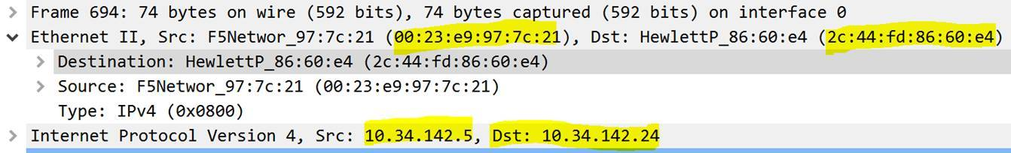
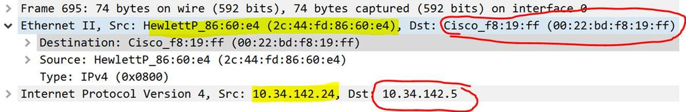
Wireshark
What did we quickly find …..

Slide 28
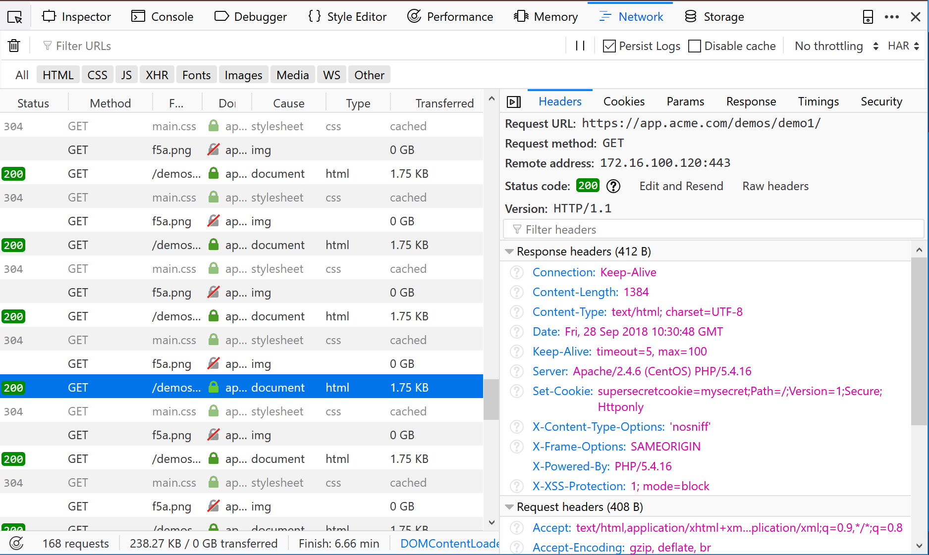


Developer Tools
Introductions
An awesome feature in Firefox and Chrome! Use it.
Similar tools…
HTTPWatch
Fiddler

Slide 29
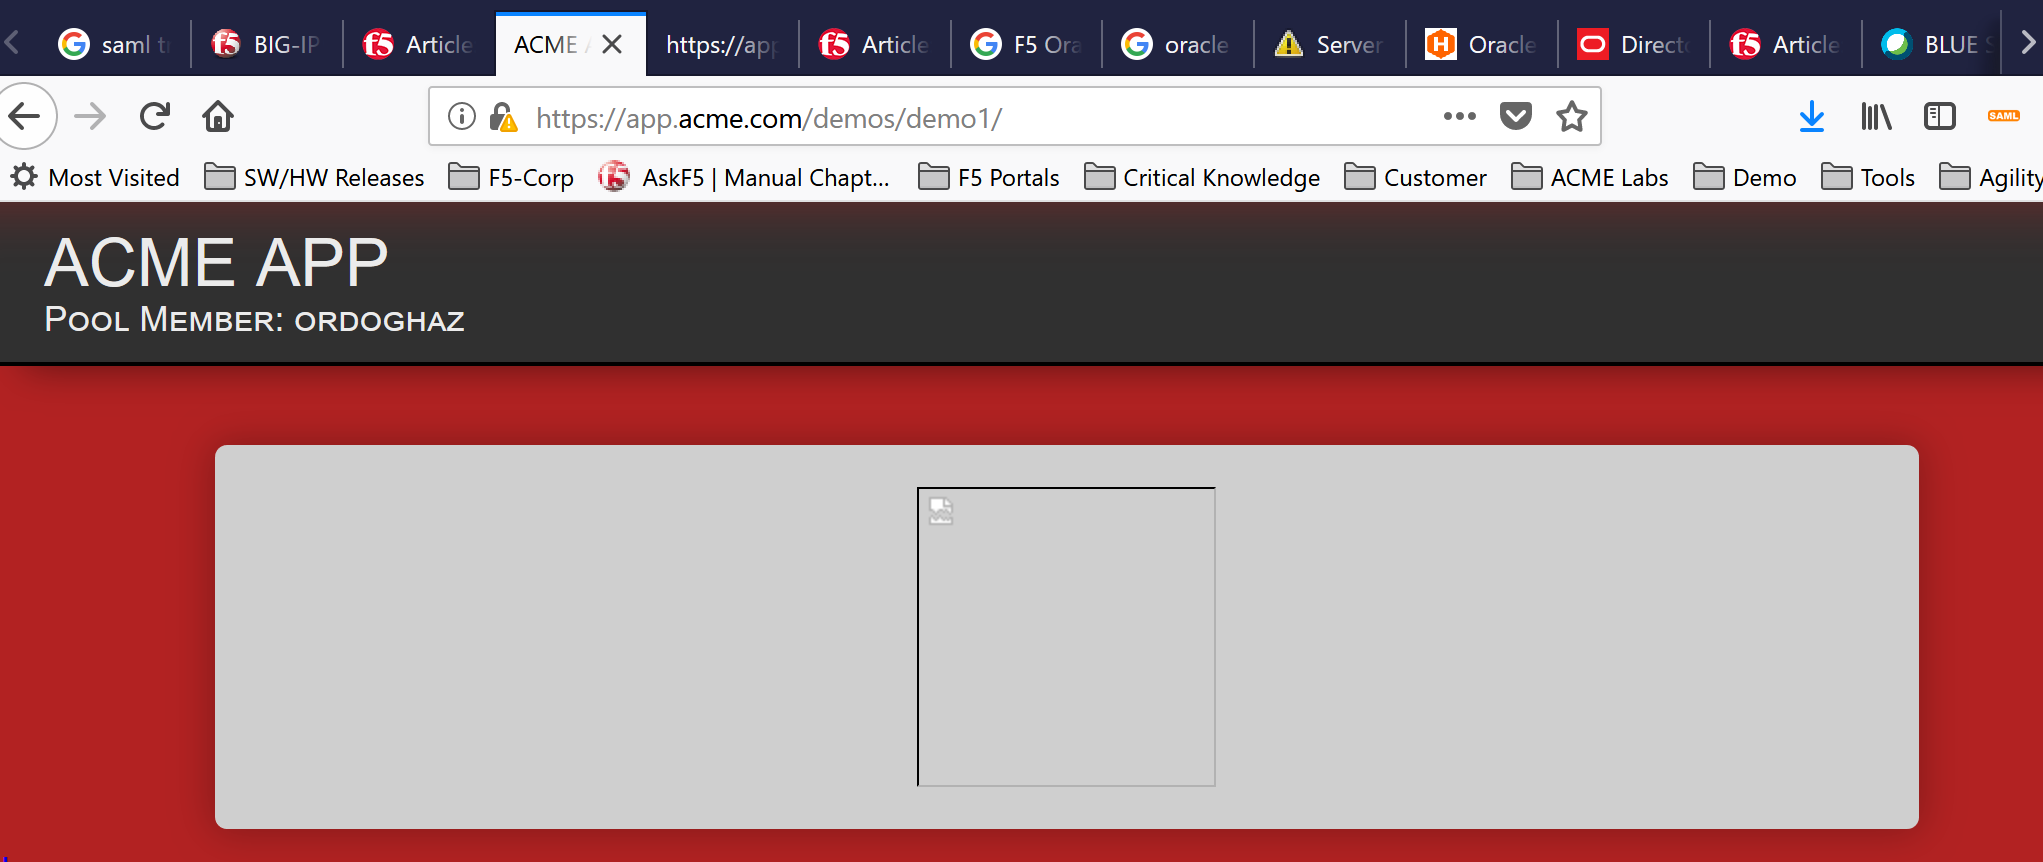
Developer Tools
Mixed Mode Content
A lovely occurrence when embedded content is directly referenced as http versus https
Manifests differently in different browsers
Can be MITIGATED through stream profiles

Slide 30
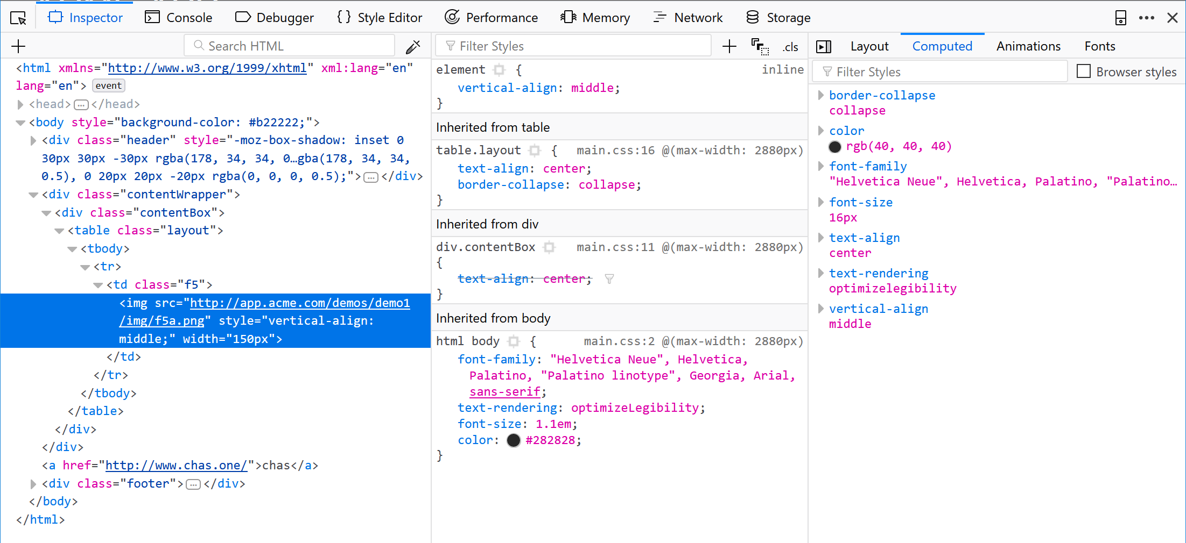
Developer Tools
Mixed Mode Content
Directly declared content. Use relative links to correct or stream profiles to mitigate
Inspect element

Slide 31
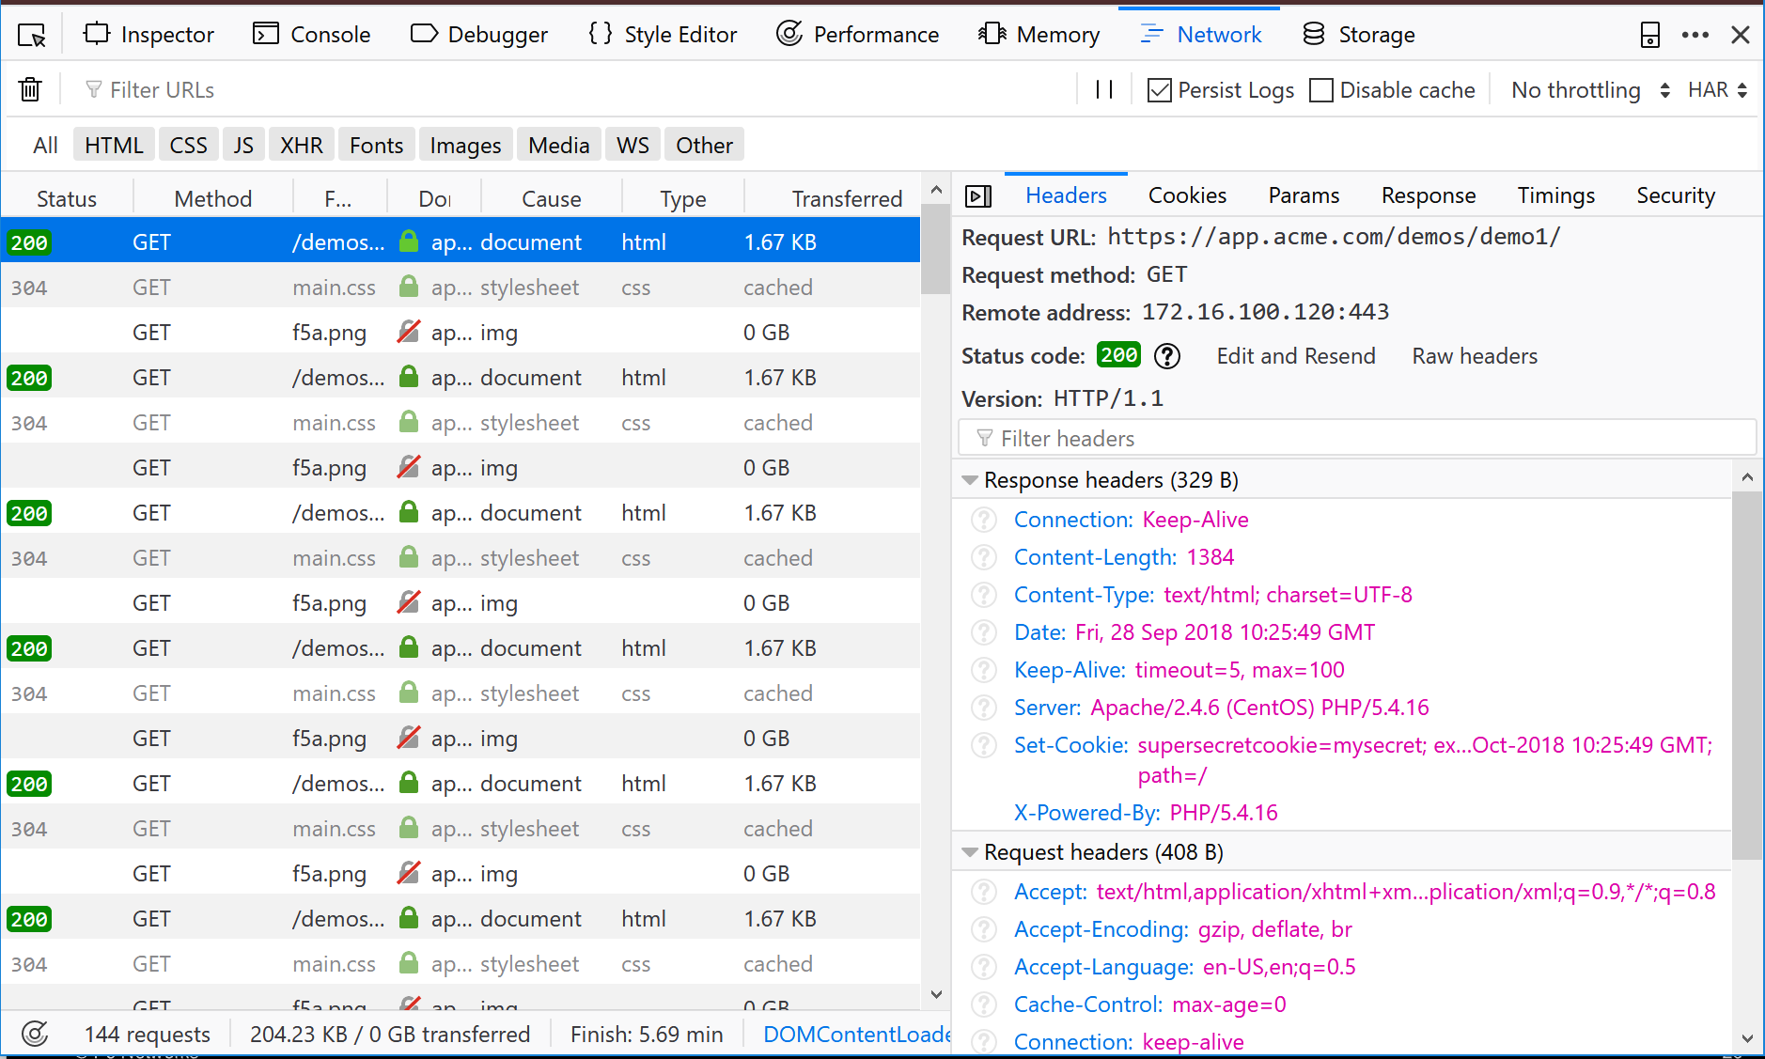
Developer Tools
View Headers
Using Developer Tools we can look at the header our browser is receiving.
No enhanced HTTP security
Network/Waterfall Diagram + Headers

Slide 32

Developer Tools
View Headers (Secure)
Inserting additional headers to improve HTTP Security
Right from the last NorNor F5 Newsletter

Slide 33
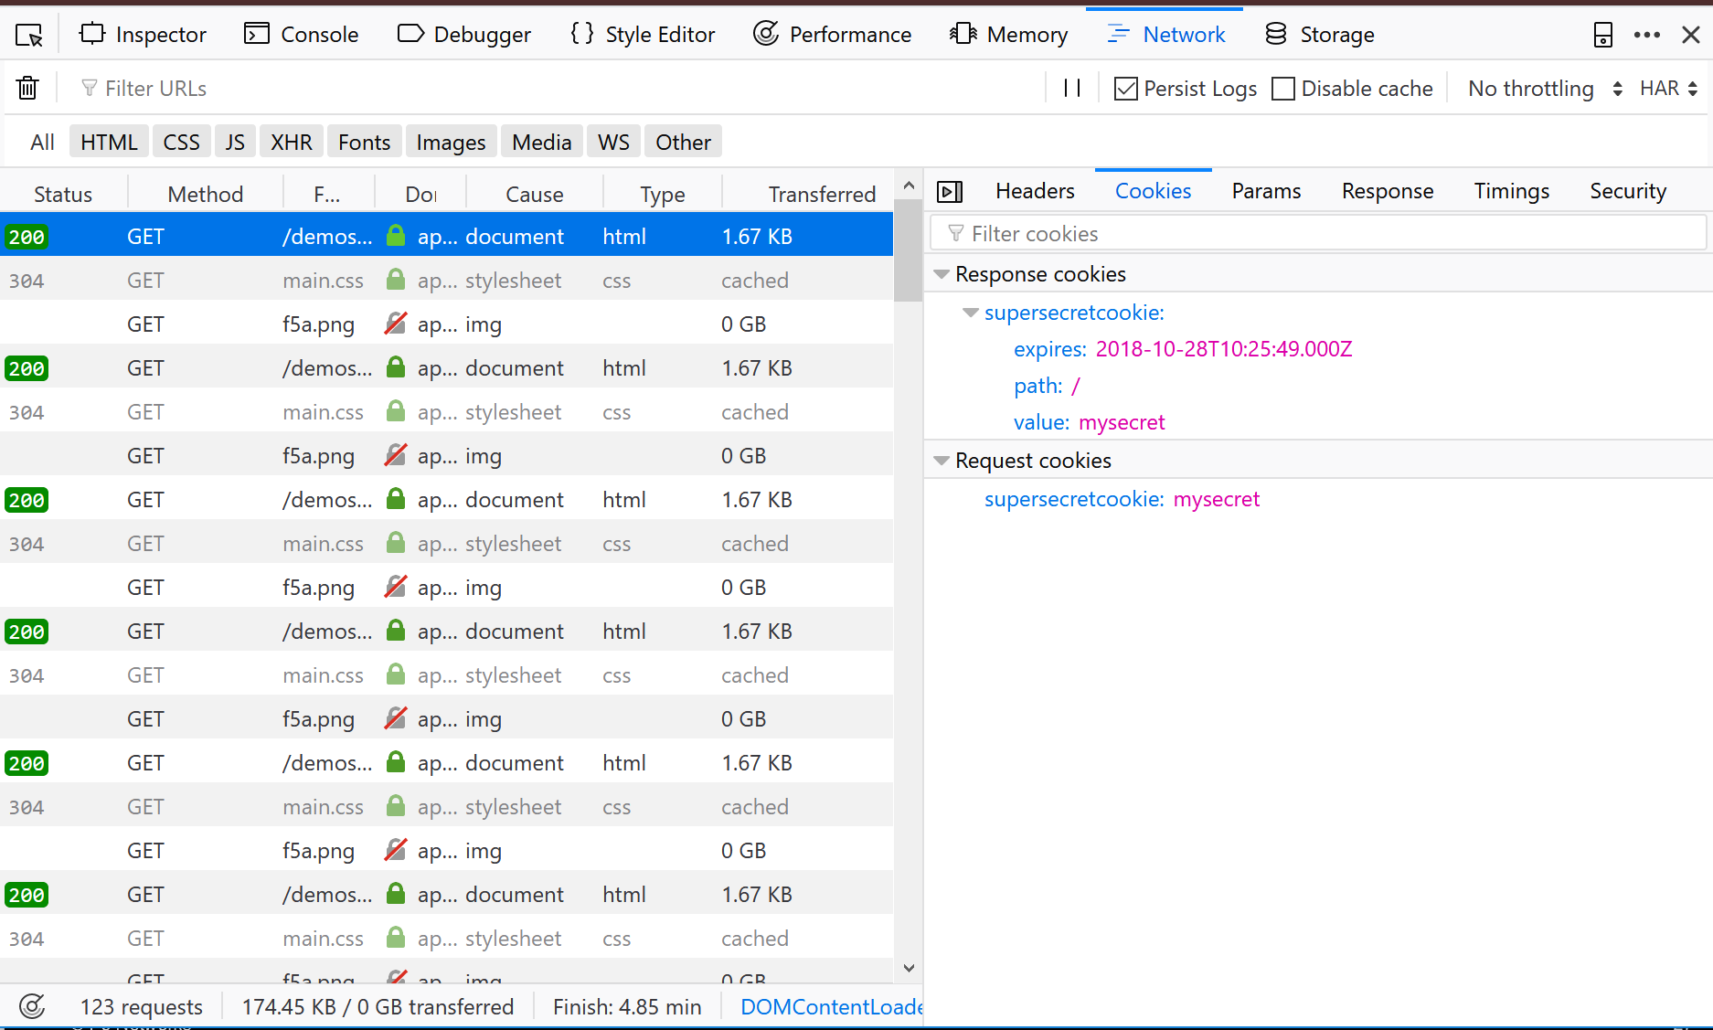
Developer Tools
View Cookies
Using Developer Tools we can look at the cookies our browser is receiving.
Not HTTPOnly
Not Secure

Slide 34
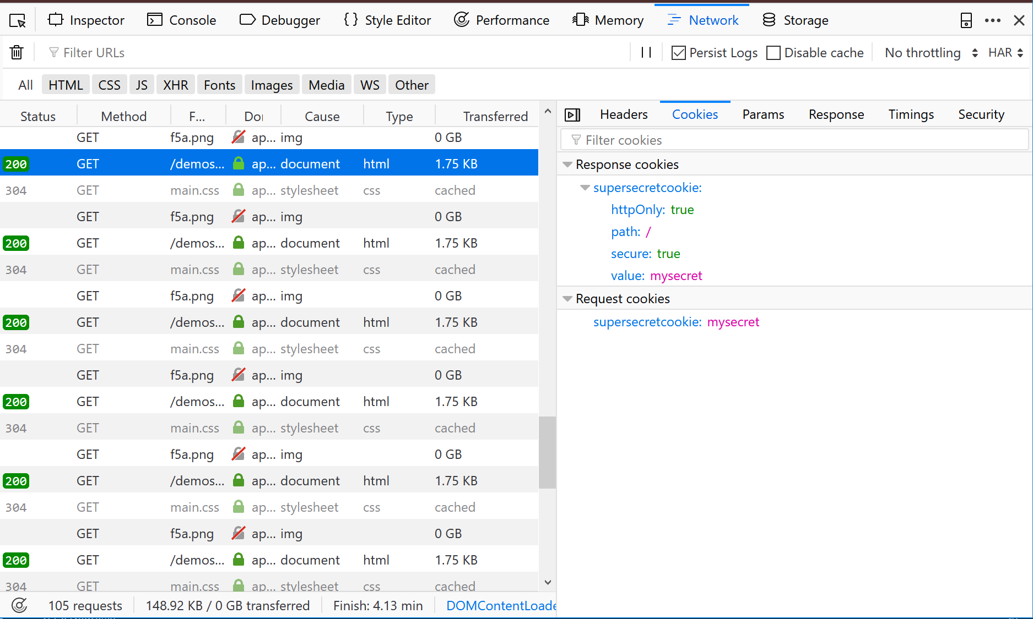
Developer Tools
View Secure Cookies
Adjusting cookies to improve Security
Right from the last NorNor F5 Newsletter

Slide 35
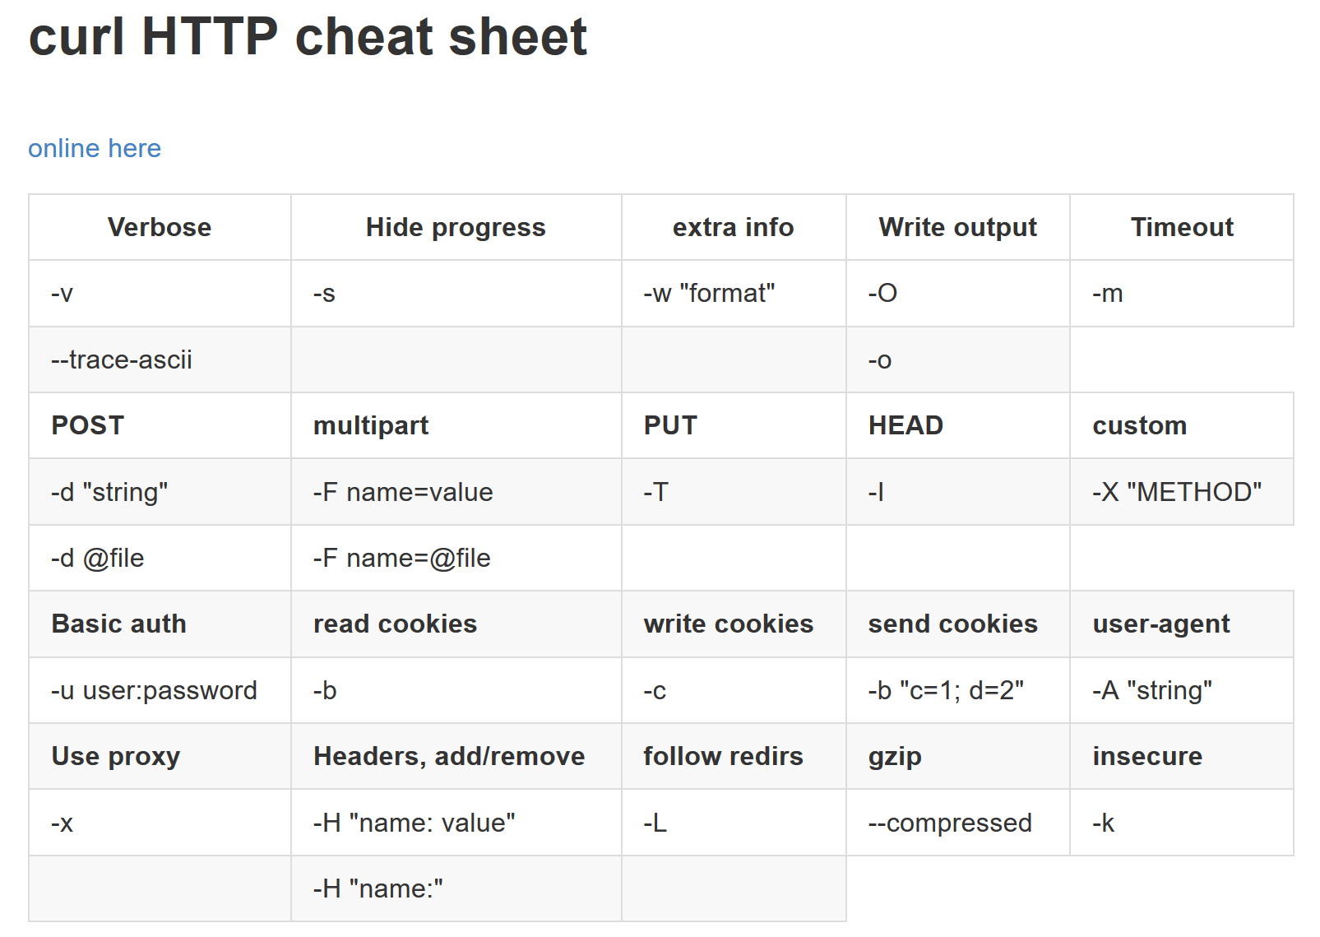
cURL
Trust but Verify!
cURL is a command-line tool for getting or sending files using URL syntax.
It is basically a CLI based browser. Great for testing:
Web Servers
Monitors

Slide 36
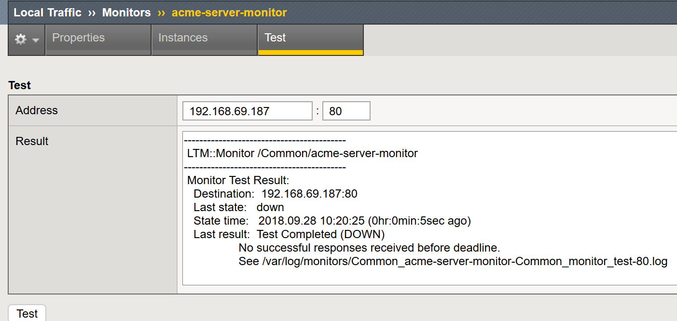
13.1.x Looky, Looky …

Slide 37
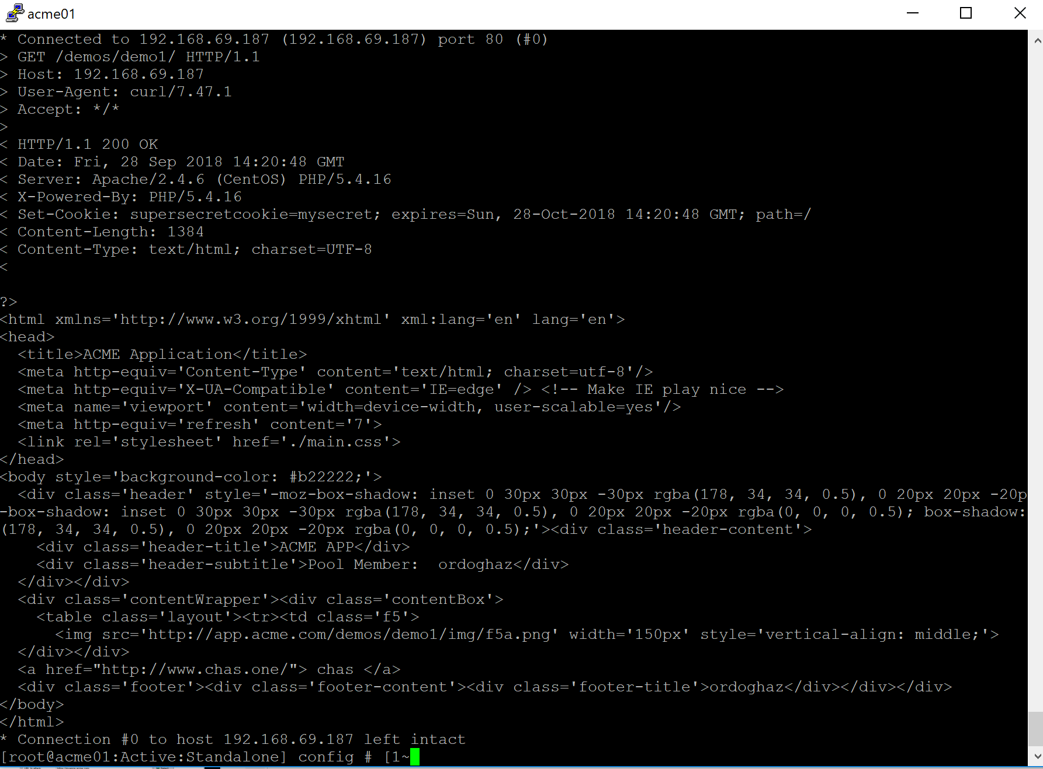
cURL
Trust but Verify!
Common curl’s …
curl -vk http://www.domain.com
curl -I http://www.domain.com
curl -vkX POST https://www.example.com/foo/bar -d 'user=admin&password=admin'

Slide 38
cURL
Trust but Verify!
> GET /demos/demo1/ HTTP/1.1
> Host: 192.168.69.187
> User-Agent: curl/7.47.1
> Accept: */*
>
< HTTP/1.1 200 OK
< Date: Fri, 28 Sep 2018 14:20:06 GMT
< Server: Apache/2.4.6 (CentOS) PHP/5.4.16
< X-Powered-By: PHP/5.4.16
< Set-Cookie: supersecretcookie=mysecret; expires=Sun, 28-Oct-2018 14:20:06 GMT; path=/
< Content-Length: 1384
< Content-Type: text/html; charset=UTF-8

Slide 39
cURL
Trust but Verify!
<html xmlns='http://www.w3.org/1999/xhtml' xml:lang='en' lang='en'>
<head>
<title>ACME Application</title>
<meta http-equiv='Content-Type' content='text/html; charset=utf-8'/>
<meta http-equiv='X-UA-Compatible' content='IE=edge' /> <!-- Make IE play nice -->
<meta name='viewport' content='width=device-width, user-scalable=yes'/>
<meta http-equiv='refresh' content='7'>
<link rel='stylesheet' href='./main.css'>
</head>
<body style='background-color: #b22222;'>
<div class='header' style='-moz-box-shadow: inset 0 30px 30px -30px rgba(178, 34, 34, 0.5), 0 20px 20px -20pgba(0, 0, 0, 0.5); -webkit-box-shadow: inset 0 30px 30px -30px rgba(178, 34, 34, 0.5), 0 20px 20px -20px rgba(0, 0, 0.5); box-shadow: inset 0 30px 30px -30px rgba(178, 34, 34, 0.5), 0 20px 20px -20px rgba(0, 0, 0, 0.5);'iv class='header-content'>
<div class='header-title'>ACME APP</div>
<div class='header-subtitle'>Pool Member: ordoghaz</div>
</div></div>
<div class='contentWrapper'><div class='contentBox'>
<table class='layout'><tr><td class='f5'>

Slide 40
cURL
Trust but Verify!
> GET /demos/demo2/ HTTP/1.1
> Host: 192.168.69.187
> User-Agent: curl/7.47.1
> Accept: */*
>
< HTTP/1.1 302 Found
< Date: Fri, 28 Sep 2018 14:26:52 GMT
< Server: Apache/2.4.6 (CentOS) PHP/5.4.16
< X-Powered-By: PHP/5.4.16
< location: ./main.php
< Content-Length: 0
< Content-Type: text/html; charset=UTF-8

Slide 41
cURL
Trust but Verify!
> GET /demos/demo2/mylogin.php HTTP/1.1
> Host: 192.168.69.187
> User-Agent: curl/7.47.1
> Accept: */*
>
< HTTP/1.1 404 Not Found
< Date: Fri, 28 Sep 2018 14:29:24 GMT
< Server: Apache/2.4.6 (CentOS) PHP/5.4.16
< Content-Length: 221
< Content-Type: text/html; charset=iso-8859-1
<
<!DOCTYPE HTML PUBLIC "-//IETF//DTD HTML 2.0//EN">
<html><head>
<title>404 Not Found</title>
</head><body>
<h1>Not Found</h1>
<p>The requested URL /demos/demo2/mylogin.php was not found on this server.</p>
</body></html>

Slide 42
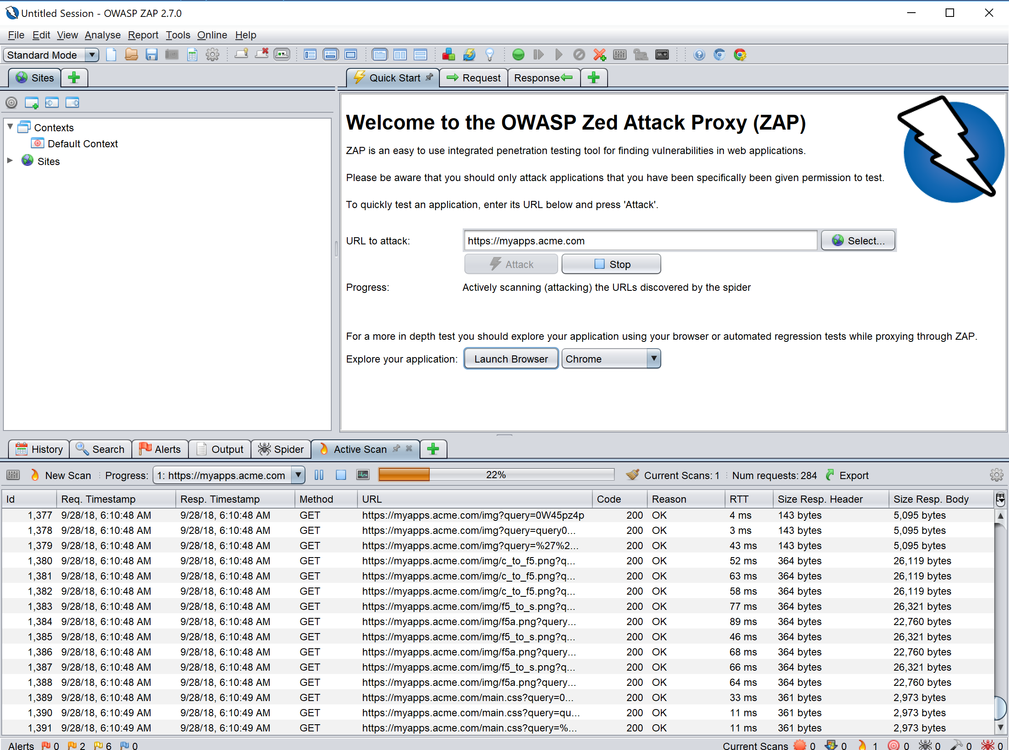
OWASP Zap
A WAF Security Tool
Quick tool to run attacks and generate vulnerability data and develop security policies

Slide 43
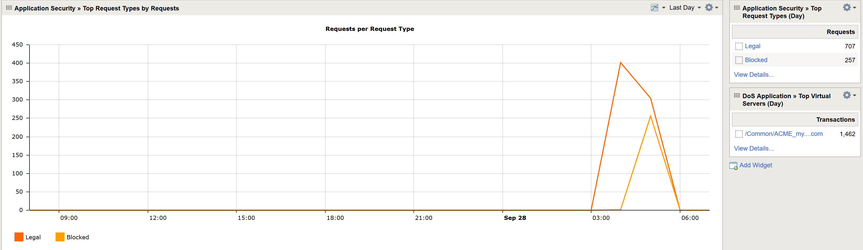
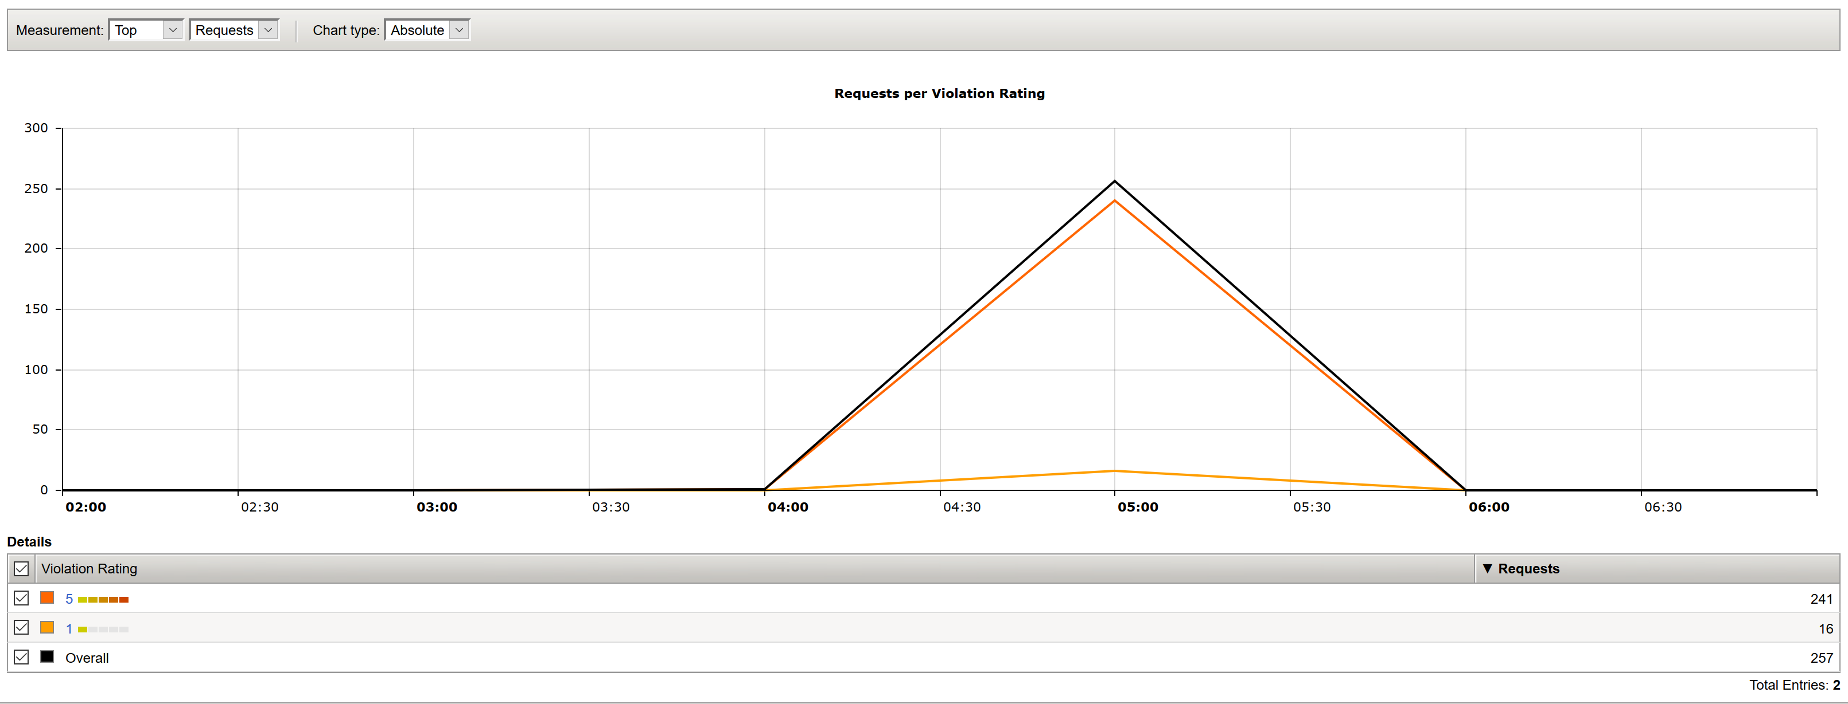
OWASP Zap
WAF Building/Understanding

Slide 44
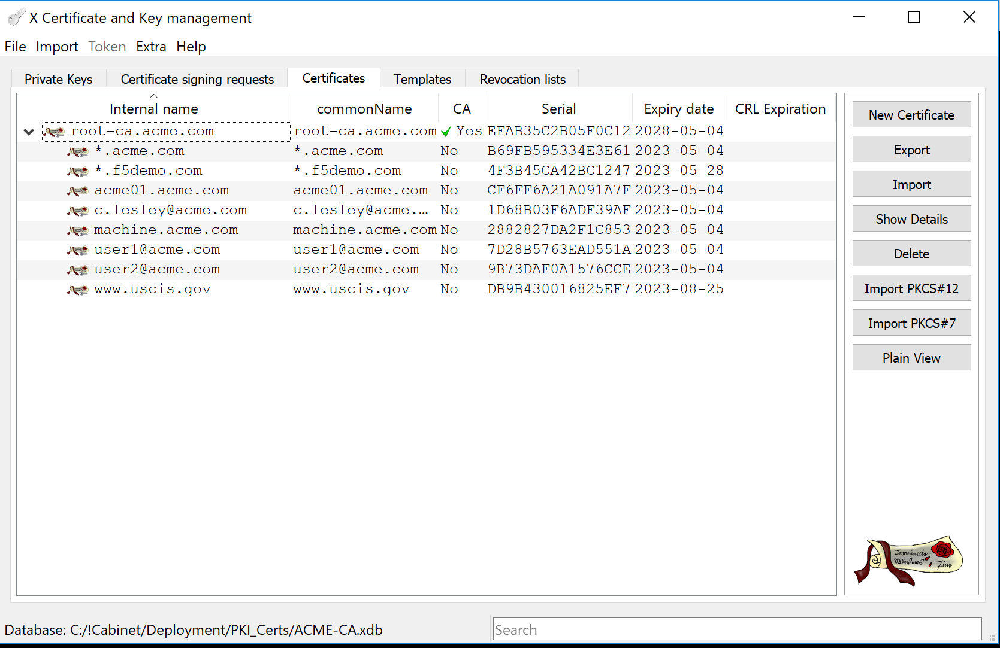
XCA
Be your own CA!
XCA allows you to create you own CA and issue certificates. Great for
Testing SSL Ciphers & Configurations
Impersonating
Performing Certificate Auth

Slide 45
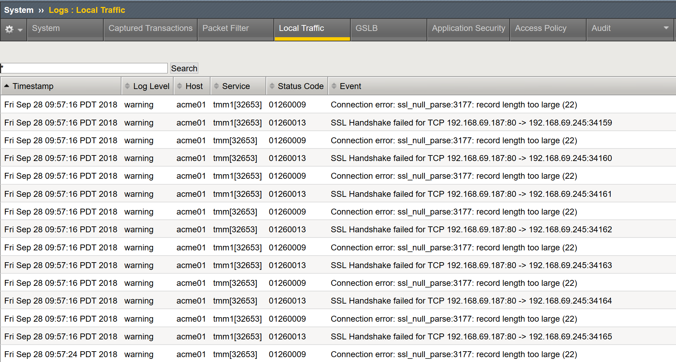
Logging
Its there – use it!!!!

Slide 46
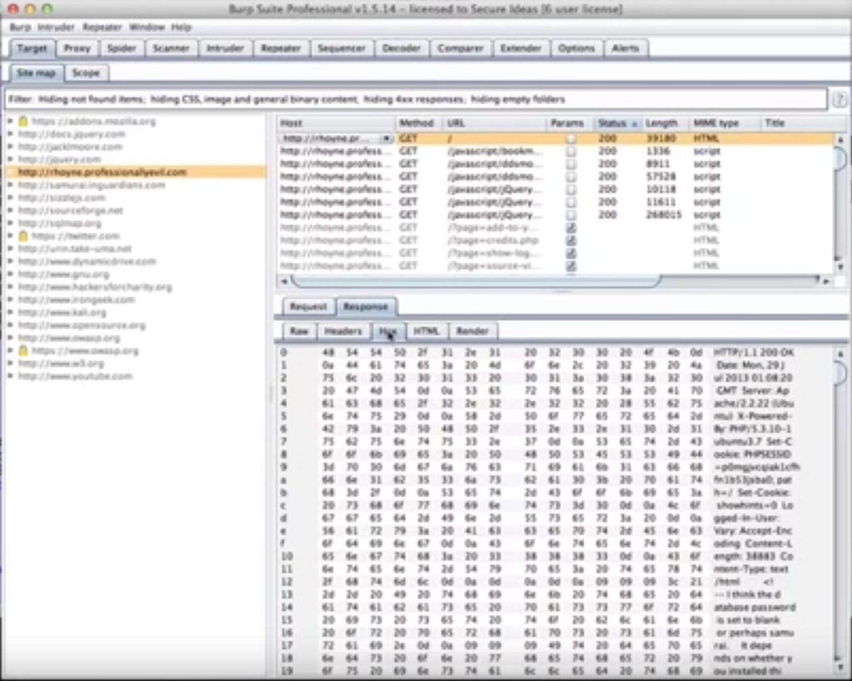
Burp Suite
Getting in the weeds …
Awesome tool if you want to pause, inject, control HTTP/HTTPS payloads from your client.
Testing/Penetrating Applications
Altering Payloads

Slide 47
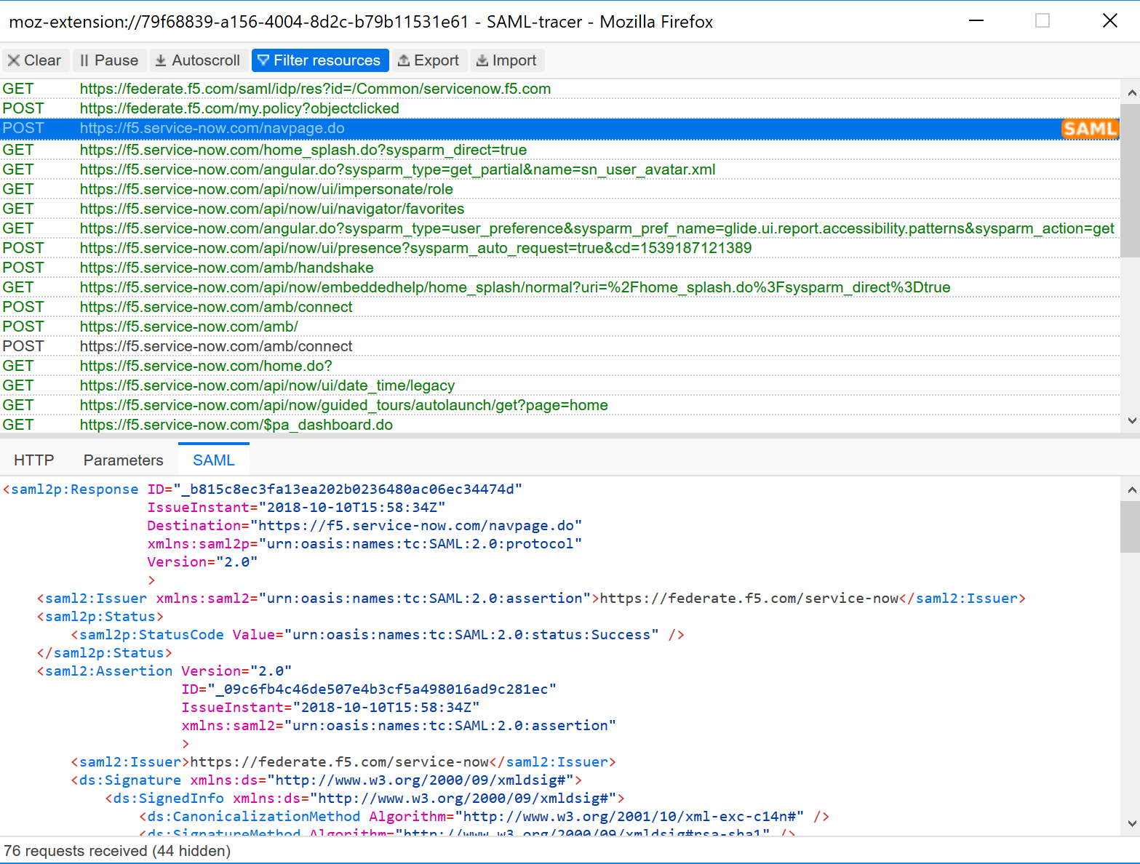
SAML Tracer
Federation
SAML
Awesome tool if you want to pause, inject, control HTTP/HTTPS payloads from your client.
Testing/Penetrating Applications
Altering Payloads

Slide 48
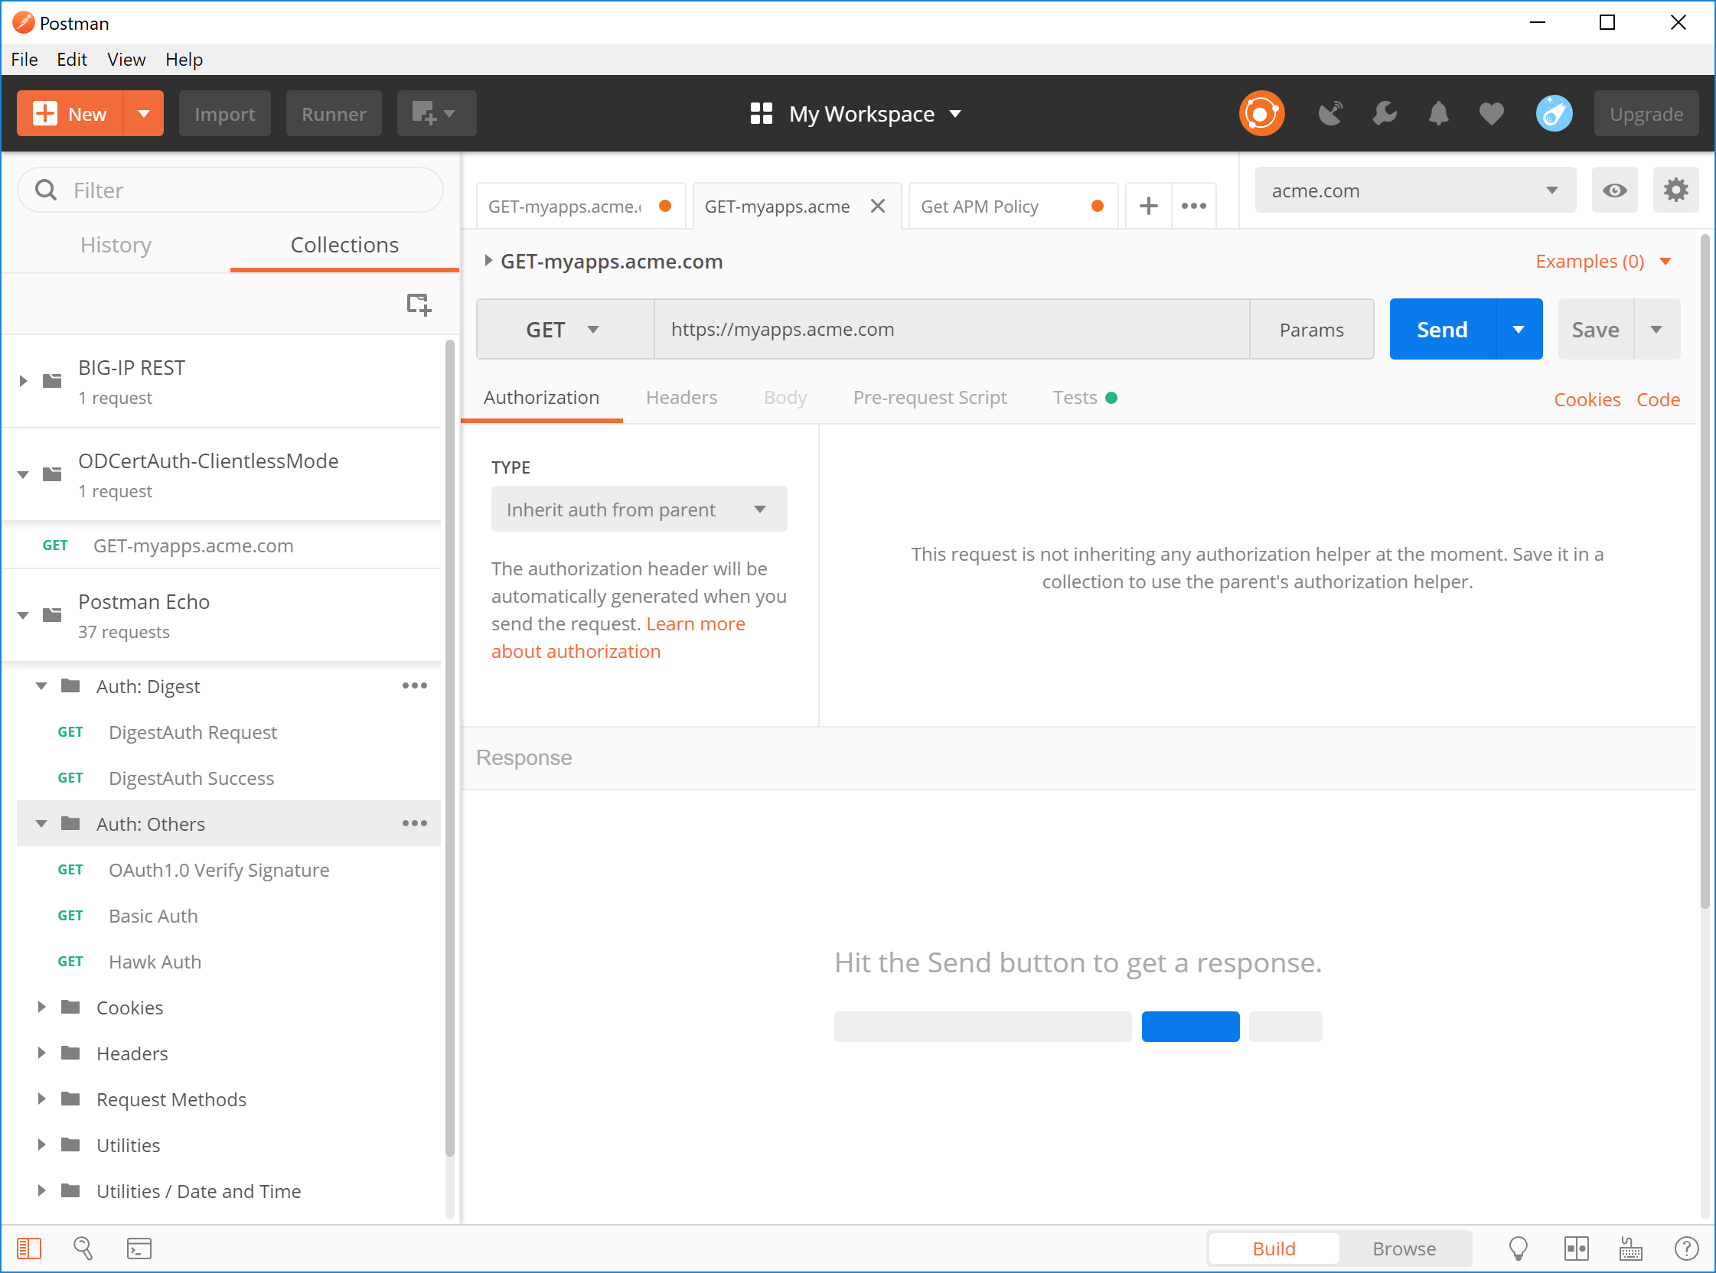

Postman
API’s & Tasks
GREAT for REST/Automation testing
Great for Repetitive Tasks
Great for Testing APIs
iMacros

Slide 49
Thank You

