Slide 1
Application Delivery and Security in AWS - Best practices for deploying F5 in the AWS cloud
Ted Byerly – Channel SE

Slide 2
Shared Security Model
Notes:
When you move to the cloud (specifically IaaS) you still incur liabilities
The CSP will be responsible for THEIR infrastructure, but you are still responsible for yours. Your infrastructure includes the virtualized data plane, how security requirements are met, how you deliver high availability as well as the application reequipments.
For example THEIR network is not YOUR logical network – these are two different forwarding planes.
This means that everything in BLUE is the customers liability. Another way to think of is a Data Center Hypvervisor – just because you put an OS on vSphere does not automatically improve the OS. You still have to manage it.

Slide 3
Why F5 in AWS
Hybrid and Multicloud
Consistent Features and Services
Enhancing Security
Protocol Sanitization and Enforcement
IPS/IDS integrations and designs
Deep Packet Inspection L3-L7
Federating Name Space
Increased DNS intelligence
Programmable Data plane
Building infrastructure that matches application requirements – Algorithms, Persistence…..
F5 has been solving problems in apps for years. The cloud will not automagically fix the apps…
Notes:
The reality is most organizations are already and will continue to be hybrid / multicloud.
Many times the native tools security tools provide a lower amount of protocol validation than the than firewalls have for the last 20 years.
Introducing data plane IDS/IPS services and building out the logical constructors to deliver them.
Low acquisitions costs do not mean decreased operational costs; especially when we are talking about the appl and security stacks.
Our own data tells us that greater than 60% expect that ADCs and security products will have a robust and programmable data plane – iRules currently have nearly 180 events
All applications have specific requirements - ensuring the tool set is present to meet them is critical to your companies operational excellence, and thus your operational success.

Slide 4
AWS Infrastructure Components
VPC = Data Center
AZ = DC Zone and L3 boundary
IAM = Who, What, Where
Instance = Deployed AMI
AMI = VM ready to deploy
CFT = Template for deployment
CloudWatch = metrics
NAT and Blackfoot
Overlay Networking
The API
EC2 Endpoints

Slide 5
What about the Natives
Features, functions, operations vary between clouds.
Feature set is limited
Many times the features that application is consuming from BIG-IP may not be visible to the application operators
ASSUMPTIONS!
Requirements
Does the native service support the correct – Load Balancing Algo, Persistence, Proxy function, security function, integration with other services….
Notes:
Native services are vast but when it comes to application delivery they are usually basic and if you are pursuing a multi or hybrid cloud story they will create new silos, increasing overall operational complexity.
AWS - +3 Types of systems
Azure + 2 types
GCP + 2 Types
Oracle?
Alibaba?
Additionally some of the features available in one region may not yet be available in other regions – in a nutshell they do not simply the matrix of an organization – they complicate it.

Slide 6
Considerations Integrating AWS into you IT Infrastructure
What is the scale of the application?
What type of instances?
Where is it moving?
Why is it moving?
How much is moving?
How we are going to stitch it together?
Per App or Aggregated?
Which Cloud? Which Region(s) How many AZ(s)? How is it connected to the DC?
Application and dependencies – in part? All?
How will it work with the existing DNS systems, controls etc
Notes:
Early cloud movement was organic, but as organizations mature the pattern needs to mature along with it.
Interdependencies
Complexities
Federation across environments
Along with this maturity there is usually a gap between what services are being consumed in one environment compared to what is available in the portal of the other environment.

Slide 7
Licensing
AWS Marketplace
Pay-as-you-go – AWS
Pay-as-you-go – Private Offer
Perpetual
F5
Pay-as-you-go – Private Offer
Subscription
Enterprise License Agreement
Perpetual
Flexible consumption models
Rent vs. Own

Slide 8
Modules an Features
Which F5 Modules Can you Run in AWS
LTM
AFM
ASM
DNS
APM
Future….
What Problems do the address
Advanced and intelligent application delivery
Enhancing the security posture
Bringing security to web apps
Integrating, federating security DNS
AAA for traffic management, security with client side inspections

Slide 9
F5 Use cases in the Shared Security Model
LTM
ASM
APM
DNS
ASM
AFM
LTM
LTM
LTM
AFM

Slide 10
But not Everything is Applicable!
Multicast Peer Group
Gratuitous ARP
MAC Masquerade
AOM
LACP
SDN License
Serial Cable Failover
VLAN Tagging
Connection Mirroring - Failover takes too long. Interactive Console access
Extra Engineering
Clone Pools (Has to be done over a tunnel)
HA Scoring (common use cases)
RHI (unless BIG-IP is a Transit device or VPN Device)

Slide 11
Deployment Tools
CloudFormation Templates
Manual (Why? Just use a CFT)
Other Automation tools that can integrate with AWS
Ansible, Chef, Terraform etc

Slide 12
Automation and Orchestration
CFT
AS3
Declarative Interface for App Services
Ansible/Terraform
Functional – F5 has examples you must create your own WF
BIG-IQ CM/Cloud Edition
BYOA&O
Bring/Buy/Build Your Own Automation and Orchestration

Slide 13
Migrating
Single App?
Entire Configuration?
Modernization or simple lift and shift?
Full Requirements and mapping?
HA Topology?
App Type – Features?
App Audience?
Security Requirements?
Actions
Holistic View
Understand that there will be changes in
SSL Performance
Control of Forwarding Plane
Expectations / Developer Autonomy

Slide 14
Baselining Instances
AWS supports many instance types and the types may very be region.
F5 Runs on a subset of the types.
Performance is impacted by
Instance Generation
Network Interface type
CPU Count
Autoscaling WAF services
T2.x – more, less per
C.x/M.x – fewer – more per
Per App Deployment
Per APP is a license model – not an instance size.
C.x/M.x – larger – higher SSL TPS
T2 – small / low SSL TPS
Larger Format
M/3/4/5 C/3/4/5

Slide 15
Understanding Network Interfaces
AWS has multiple network interface types
ENA
VF
ENA variants
AWS ENA and Intel (VIF)
Better packet performance greater capacity and TPU
Different Instances support different interface types
Align performance requirements to instance type
Notes:
When we think of AWS performance we need to think in what I like to call the “dimensions of constraint” – while this is not unique to AWS – moving to the cloud presents a new challenge – the “DC Hypvervisor” is a black box.
Network Performance Ratings – what is my instance supposed to do.
Instance Bursting patterns
Bandwidth of single vs. multiflow
The generation of the instance – for example newer instances run on the AWS nitro system.
Placement Groups
VPC internconnect
VPN Capacity
Internet Capacity
Security Group Capacity
The network driver (VF, VIF, ENA) in use
The flow limit across a Direct Connect
No support for ECMP
Bandwidth limits for VPC Peering

Slide 16
Bandwidth – Who, What, Where, Why, How…
Burst?
Soak?
Internet?
Cross VPC?
Cross Direct Connect?
VPN?
Flow Count?
Instance Type?
Interface Type?
Remote Instance Type?
Flow Count?
Concurrency?
Notes:
Let’s be clear – just because we are running in AWS – it does not mean we will not see packet loss or we will not see variance in flows. It is still a data center and the data center problems of flows, queuing, contention as well as the impact of policing and shaping are still in play.
When the Dev team asks for help with bandwidth it is more complex that what do we see with ethtool or ifconfig.
You need to ask questions.
You need to define the flow
You need to think outside of the box

Slide 17
Bring Security to the VPC
Baseline – VPC Security Tools
NACL
Security Group (SG)
Shield/Shield Advanced
Cloud
Why you need more
NACL = Stateless
SG – Stateful but no DPI
Shield/Shield Advanced – great for volumetric attacks. Surgical, behavioral and advanced attacks need more
Notes:
Introducing Security tools that are supportive of
Deep and Broad IP intelligence
Behavioral vectors
Fraud Protection (IE financial apps – protecting the user and password all the way to the browser)
BOT Protection that goes beyond Headers and hidden URLS.
The reality is that solving security problems in the application code is a momentous task. Complex frameworks, integration, new frameworks every couple of years, diversion of resources from revenue generation or ongoing maintenance of existing applications.
Securing an end to end data path – beyond log monitoring
Reconnaissance is automated, on going, and ever present. AWS will do an excellent job of the volumetric attacks – the trained, targeted and disciplined attacks – those are on you to solve.

Slide 18
How F5 Enhances Cloud Security
Protocol Validation, Sanitization
LTM, AFM, ASM, DNS
Deep Packet Inspection
Full Proxy – create segregation
Filtering Outgoing Data
Intelligent BOT mitigations
Protection against the surgical
Tooling for Day 0 – security in the cloud is YOUR problem

Slide 19
SSL
Cipher
CPU Density
Network Driver
Network Performance Characteristics
Latency
Notes:
SSL is probably the number one constraint you will find in the migration from HW based platforms to VE – cloud or not. RSA ciphers are expensive in CPU. Prior to moving know the metrics you need to meet.
SSL Capacity can be expanded by having greater CPU density, but flow diversity will impact the total numbers.
The SSL Cipher is important to evaluate when you move to the cloud. ECC is far superior in performance.
### Follow up
SSL handshakes are a 5 phase exchange SYN, SYN/ACK, ACK, Client Hello, Server Hello, Client Certificate (Optional), Change Cipher Spec and then bulk crypto
You look at all that overhead the performance of the instance network driver will add to the latency of the overall packet flow – look at instances that have ENA interfaces such as the C4/M4/C5/M5

Slide 20
High Availability
L2 or Not to L2 That is the Question
Notes:
Moving to the cloud has great benefits but it introduces some constraints on us that we need to work with or work around.
Network topology – we can no longer span the same L2 across DC zones – AWS forces an L3 separation – unless we use alien address space.
We lose control of the routing for any in VPC CIDR address – the default gateway is no longer a device – it is a process running in the hypervisor.
HA and failover is no longer a network event of flood and learn – we are API driven – and thus constrained to the API speed.

Slide 21
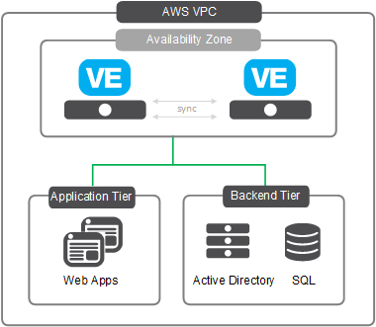
Clustered Deployment of 2 BIG-IP VE’s (Same AZ – 2NIC)
For deploying BIG-IP’s in parallel in the same AZ for increased availability
Launches and configures two BIG-IP VE’s in a single availability zone in an Active-standby arrangement for high availability, such that should one BIG-IP fail, traffic is automatically re-directed to the unaffected device until the issue is resolved.
The BIG-IP instance operates with 2 network interfaces:
One for management & data-plane traffic from the internet
Another for traffic from the AWS network
BYOL (Perpetual, ELA & Sub) and PAYG templates available
Pre-requisites to this template can be found here
Manual Deployment ~ 8+ hours
Templated Deployment ~ 40 mins
Link to GitHub
Notes:
Closest to the model most Net Eng folks know today. The systems share L2 and L3 space and operationally it looks the same.

Slide 22
Clustered Deployment of 2 BIG-IP VE’s (Same AZ – 3NIC)
For deploying BIG-IP’s in parallel in the same AZ for increased availability
Launches and configures two BIG-IP VE’s in a single availability zone in an Active-standby arrangement for high availability, such that should one BIG-IP fail, traffic is automatically re-directed to the unaffected device until the issue is resolved.
The BIG-IP instances operate with 3 network interfaces:
One for management, one for front end data-plane traffic from the internet and another for back end application traffic
BYOL (Perpetual, ELA & Sub) and PAYG templates available
Pre-requisites to this template can be found here
Manual Deployment ~ 8+ hours
Templated Deployment ~ 40 mins
Link to GitHub

Slide 23
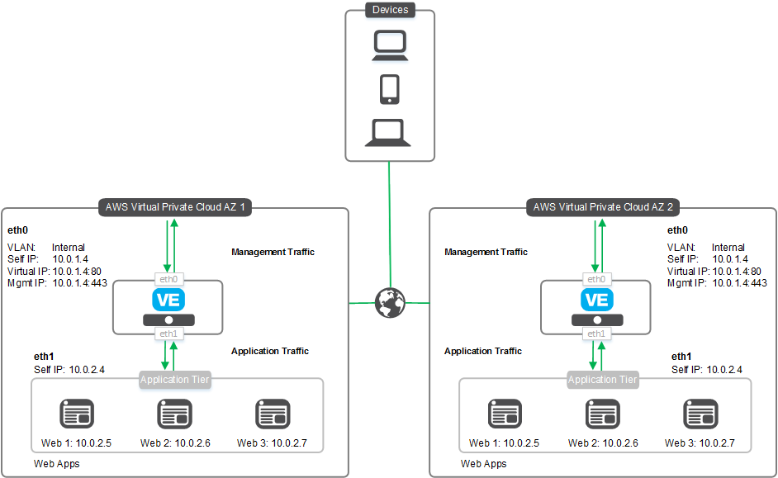
Clustered Deployment of 2 BIG-IP VE’s on AWS (Across AZ)
For deploying BIG-IP’s in parallel across AZ’s for further enhanced availability
Launches and configures two BIG-IP VE’s in 2 separate availability zones (AZ) in an active-standby arrangement for high availability, such that should one AZ fail, public traffic is automatically re-directed to the unaffected one.
The BIG-IP instance operates with 2 network interfaces:
One for management & one for data-plane traffic from the internet
BYOL (Perpetual, ELA & Sub) and PAYG templates available
Pre-requisites to this template can be found here
Manual Deployment ~ 8+ hours
Templated Deployment ~ 40 mins
Link to GitHub

Slide 24
Autoscale – moving faster than a snail
ELB – Traffic DAG
Supported Template
Single DNS Name
BIG-IQ or Native Metrics
Pay for bandwidth plus ELB
DNS – Traffic DAG
Experimental Template
Notes:
AWS has several flavors of Autoscale – App services, Entire App stacks. F5 supports both being an Autoscale member as well as dynamic discovery of the application services.
## TEST DNS AUTOSCALE. ##
When we want to Autoscale F5 services such as advanced WAF there are two ways to consider – both with benefits and drawbacks.
ELB – Simple – supported template. Scales in and out.
DNS – More aligned to how we should actual scale in the cloud.

Slide 25
Example Security and Services VPC
Similar to Transit VPC
Allows for the chaining of security services
Provider / Tenant Relationship
Inter or Intra Org applicability
Supports Service Discovery and AutoScale

Slide 26



Security and Services VPC
SSL Inspection + IPS Functionality + Intelligent Traffic Management
User
SSL/TLS Traffic
AFM
Attackers
F5 Virtual Edition
Apps
Apps

Slide 27
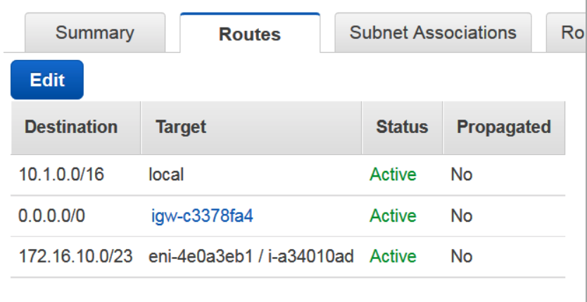
RHI when you don’t have a Router
Requires “Alien” address space.
Impacts your direct connect, VPC Peering, and VPN back hauls.
Allows for you to expand beyond the IP limits of a given instance type
Allows the breaking of the L3 barrier in AZ’s
Notes:
I would like to think Eric Chen for the image – I unceremoniously borrowed it from one if his blogs without express consent.

Slide 28
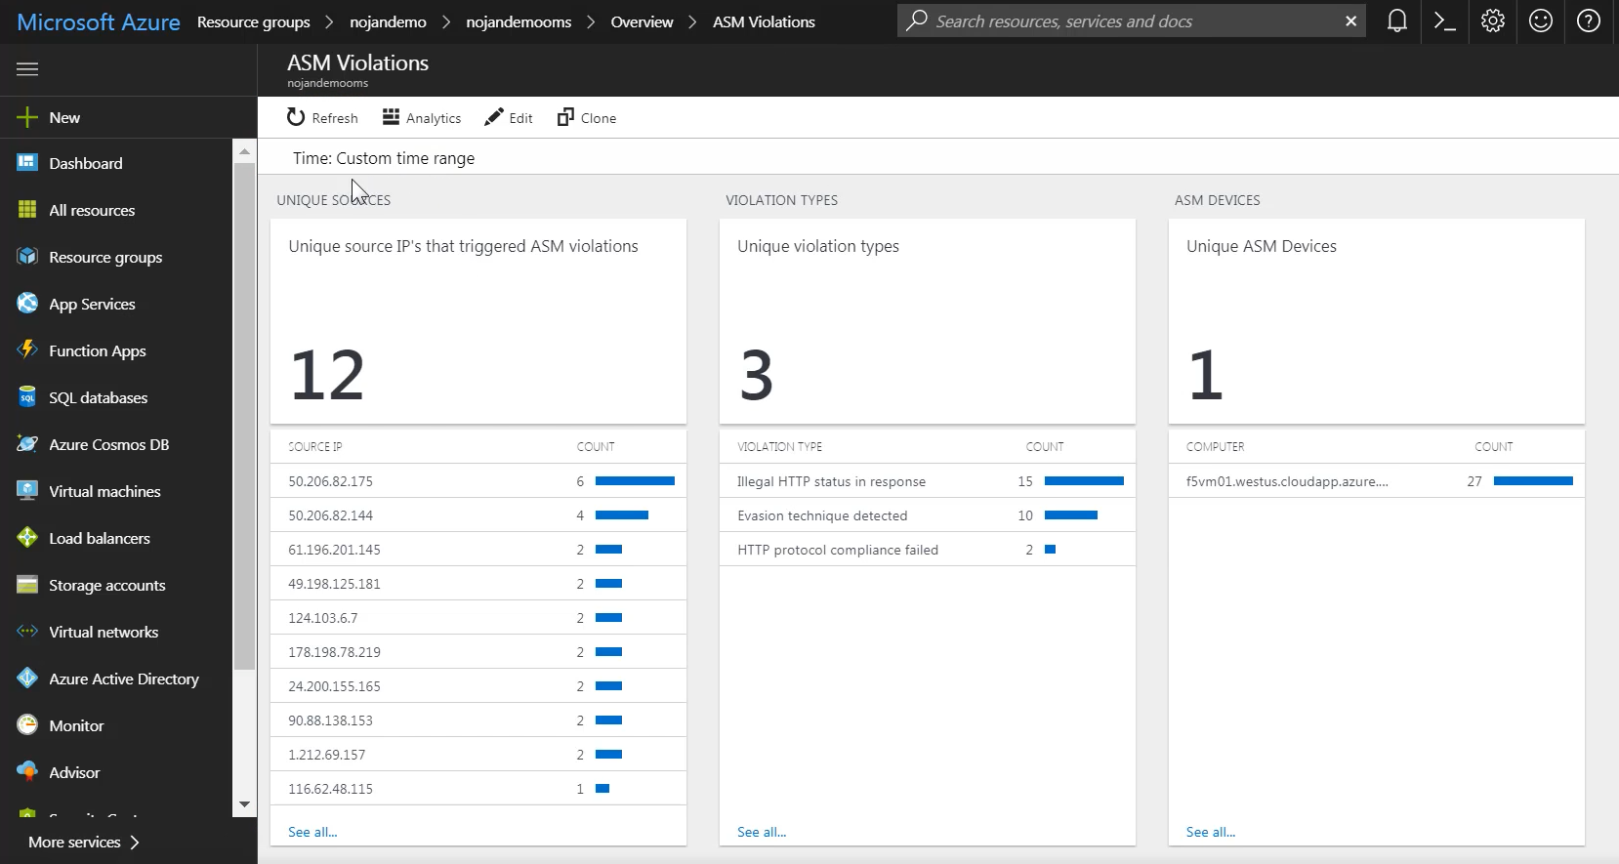

Cloud Logging in AWS & Azure With F5’s ‘Cloud-Logger’ iApp
Unique ASM Devices
Violation Types
Violation Sources
Automatically exports logs via json to cloud services including Azure OMS and AWS S3
All CFT and ARM templates deploy BIG-IP VE’s with the iApp pre-loaded
iApp manages logging profiles for various BIG-IP services (request logging for virtual services, ASM policies, system logs, etc.)
Example - BIG-IP ASM Logs in Azure OMS

Slide 29
Integrating with On Prem
Connectivity
Direct Connect
VPN
Route Propagation
VPC CIDR
Alien Address Space
VPC Peering
Transit VPC
Points of Ingress/Egress
Massive expansion of Attack Surface
DNS name space – is it flat or hierarchical with new apps
Capabilities
DNS Persistence
Dependencies
Metrics
BCDR requirements and behavior

Slide 30
Overcoming Connectivity Filters
VPC Peering
Direct Connect
VPN
By default will only announce the CIDR assigned to the VPC.
Static routes in the route table will not traverse
In some instances there is an IP filter (VPC peering)
VPN (CGW)/Tunneling is the workaround -

Slide 31
Learning More
https://Clouddocs.f5.com
https://Github.com/f5networks
https://github.com/F5DevCentral
awsteam@f5.com

Slide 32
Closing
Know the What
Know the Why
Engage Early
Pick the Topology for the What and the Why
Pick the Instance for the What and the Why
Pick the license for the What and the Why
Use Automation and Declarative Interfaces wherever possible
Start Adopting Cattle Methodology
Focus on the BIG PICTURE
A given APP is tactical
End state is strategic

Slide 33
Thank You

Slide 36
Trouble Shooting

Slide 37
Deployment – The CFT
Did the user subscribe to the image (PayG)
Does the user have enough resources in AWS
Elastic IPs
Certain Instance Types
Total Instances
S3
VPC Structure
EIP or NAT
Access Github
Access the license server
Access to the EC2 API
Access to S3

Slide 38
Cloud Init Process
Vadc-init runs
Cloud-init starts
System downloads files or writes files to disk
iAPPs, SDK, cloud-libs etc
Scripts Run
2018-04-27 10:37:10,220 [INFO] Command 000-disable-1nicautoconfig succeeded
2018-04-27 10:37:10,284 [INFO] Command 010-install-libs succeeded
2018-04-27 10:37:10,287 [INFO] Command 020-generate-password succeeded
2018-04-27 10:37:10,290 [INFO] Command 030-create-admin-user succeeded
2018-04-27 10:37:10,302 [INFO] Command 040-network-config succeeded
2018-04-27 10:37:10,474 [INFO] Command 050-onboard-BIG-IP succeeded
2018-04-27 10:37:10,477 [INFO] Command 060-custom-config succeeded
2018-04-27 10:37:10,486 [INFO] Command 065-cluster succeeded
2018-04-27 10:37:10,488 [INFO] Command 070-rm-password succeeded

Slide 39
Files of Interest
Main logging file /var/log/cloud/*CSP*/
Boot.log (did VADC-init run? Did it call Cloud-init?)
Overall event log /var/log/cfn-init.log
Headers from outgoing calls /var/log/cfn-wire.log
/etc/vadc-init/
/var/log/ltm
/usr/libexec/aws/ - failover controls
/config/cloud
/config/cloud/aws/node_modules/@f5devcentral/

Slide 40
The Scripts
Cloudinit
Vadc.init
Userdata.sh
Generatepassword.sh
Create-Admin user
NetworkConfig
Onboard.js
Cluster.js
Customconfig.js
Util.js
aws-failover_tgactive.sh
aws-failover-util.sh
Service-discovery-iAPP

Slide 41
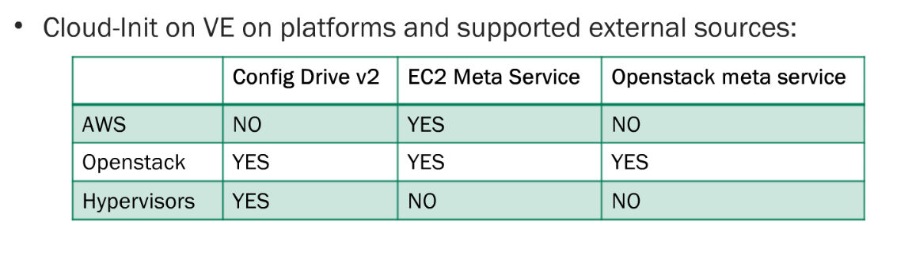
Cloud-Init on all VE's
Feature Supports:
Cloud-Init version 0.7.2 and ~ 20 Dependent Python packages (/etc/cloud/cloud.cfg)
Cloud-Init pulls from two sources, either the Metadata provided by EC2 / Openstack, or a Config Drive v2
What it does:
Cloud-Init allows for BIG-IP to instance boot time data from external resources.
http://cloudinit.readthedocs.io/en/latest/topics/modules.html
Common things are:
Hostname, Password, Network Settings, Run Custom Scripts, Updating Packages, Injecting SSH Keys

Slide 42
Cloud-init
Jun 15 14:58:25 ip-10-0-0-207 info plymouthd: Initializing cloud-init
Jun 15 14:58:25 ip-10-0-0-207 info plymouthd: vadc-init - DONE
Jun 15 14:58:25 ip-10-0-0-207 info plymouthd: Starting cloud-init: Cloud-init v. 0.7.2 running 'init-local' at Fri, 15 Jun 2018 14:58:16 +0000. Up 52.80 seconds.
Jun 15 14:58:25 ip-10-0-0-207 info plymouthd: Starting cloud-init: Cloud-init v. 0.7.2 running 'init' at Fri, 15 Jun 2018 14:58:17 +0000. Up 53.35 seconds.
Jun 15 14:58:25 ip-10-0-0-207 info plymouthd: ci-info: ++++++++++++++++++++++++++Net device info++++++++++++++++++++++++++
Jun 15 14:58:25 ip-10-0-0-207 info plymouthd: ci-info: +--------+-------+------------+---------------+-------------------+
Jun 15 14:58:25 ip-10-0-0-207 info plymouthd: ci-info: | Device | Up | Address | Mask | Hw-Address |
Jun 15 14:58:25 ip-10-0-0-207 info plymouthd: ci-info: +--------+-------+------------+---------------+-------------------+
Jun 15 14:58:25 ip-10-0-0-207 info plymouthd: ci-info: | lo | True | 127.0.0.1 | 255.255.255.0 | . |
Jun 15 14:58:25 ip-10-0-0-207 info plymouthd: ci-info: | mgmt | True | 10.0.0.207 | 255.255.255.0 | 06:16:2e:d5:df:84 |
Jun 15 14:58:25 ip-10-0-0-207 info plymouthd: ci-info: | lo:1 | True | 127.2.0.2 | 255.255.255.0 | . |
Jun 15 14:58:25 ip-10-0-0-207 info plymouthd: ci-info: | eth1 | False | . | . | 06:37:db:f7:dd:82 |
Jun 15 14:58:25 ip-10-0-0-207 info plymouthd: ci-info: | eth0 | True | . | . | 06:16:2e:d5:df:84 |
Jun 15 14:58:25 ip-10-0-0-207 info plymouthd: ci-info: +--------+-------+------------+---------------+-------------------+
Jun 15 14:58:25 ip-10-0-0-207 info plymouthd: ci-info: ++++++++++++++++++++++++++++++Route info++++++++++++++++++++++++++++++
Jun 15 14:58:25 ip-10-0-0-207 info plymouthd: ci-info: +-------+-------------+----------+---------------+-----------+-------+
Jun 15 14:58:25 ip-10-0-0-207 info plymouthd: ci-info: | Route | Destination | Gateway | Genmask | Interface | Flags |
Jun 15 14:58:25 ip-10-0-0-207 info plymouthd: ci-info: +-------+-------------+----------+---------------+-----------+-------+
Jun 15 14:58:25 ip-10-0-0-207 info plymouthd: ci-info: | 0 | 0.0.0.0 | 10.0.0.1 | 0.0.0.0 | mgmt | UG |
Jun 15 14:58:25 ip-10-0-0-207 info plymouthd: ci-info: | 1 | 10.0.0.0 | 0.0.0.0 | 255.255.255.0 | mgmt | U |
Jun 15 14:58:25 ip-10-0-0-207 info plymouthd: ci-info: +-------+-------------+----------+---------------+-----------+-------+
Jun 15 14:58:25 ip-10-0-0-207 info plymouthd: Starting cloud-init: Cloud-init v. 0.7.2 running 'modules:config' at Fri, 15 Jun 2018 14:58:18 +0000. Up 54.11 seconds.
Jun 15 14:58:25 ip-10-0-0-207 info plymouthd: Starting cloud-init: Cloud-init v. 0.7.2 running 'modules:final' at Fri, 15 Jun 2018 14:58:18 +0000. Up 54.43 seconds.
Jun 15 14:58:25 ip-10-0-0-207 info plymouthd: Cloud-init v. 0.7.2 finished at Fri, 15 Jun 2018 14:58:18 +0000. Datasource DataSourceEc2. Up 54.52 seconds
Jun 15 14:58:25 ip-10-0-0-207 info plymouthd: Starting sshd:[ OK ]
Jun 15 14:58:25 ip-10-0-0-207 info plymouthd: Starting ntpd: [ OK ]
Jun 15 14:58:25 ip-10-0-0-207 info plymouthd: Current management-ip configuration mode is: Static.
Jun 15 14:58:25 ip-10-0-0-207 info plymouthd: Starting httpd: [ OK ]
Jun 15 14:58:25 ip-10-0-0-207 info plymouthd: Starting crond: [ OK ]
Jun 15 14:59:13 ip-10-0-0-207 notice aws-init[3708]: aws-init[3708]: Successfully posted autoscale iApp template

Slide 43
VADC-INIT
A cloud specific library and a set of functions
Fetches Keys, Sets metadata route
aws-init
azure-init
cloudinit-prepare
dp-add-volume
functions
openstack-init
oracle-init
password-init
vcloudair-init
vmware-customize

Slide 44
Generate password (and remove password)
Generates a password to cluster the devices
Stores the password in an S3 Bucket
Dependencies
IAM Role
S3 Access

Slide 45
Create Admin user
Creates the Admin user on the systems – uses the password from the S3 Bucket created for Generate password
Dependcies
IAM Role
Access to S3

Slide 46
Network-Config
Parses the metadata service and builds out the network configuration of the system
Dependencies
Access to the metadata service
Util.js

Slide 47
Onboard
Sets NTP, DNS, SSL Port for MGMT
Changes default root password
Licenses the system
Provisions modules
Ping Test
ASM signature uddate
Dependcies
Access to the metadata service
Access to the license server
Accesso egress (ping test)
Util.js

Slide 48
Cluster.js
Creates the device group, sync groups and related objects for a cluster
Dependencies
Onboard has completed
Access to S3
Access to metadata services

Slide 49
Customconfig
Creates VIPs, iAPPs
Disables DHCP if necessary
Dependencies
Access to metadata service
User input

Slide 50
EC2 API Access
"PolicyDocument": { "Statement": [ { "Action": [ "ec2:DescribeInstances", "ec2:DescribeInstanceStatus", "ec2:DescribeAddresses", "ec2:AssociateAddress", "ec2:DisassociateAddress", "ec2:DescribeNetworkInterfaces", "ec2:DescribeNetworkInterfaceAttributes", "ec2:DescribeRouteTables", "ec2:ReplaceRoute", "ec2:assignprivateipaddresses", "sts:AssumeRole" ], "Effect": "Allow", "Resource": [ "*" ] } ],

