Slide 1


Work Anywhere:The New Norm
Access Policy Manager: Solutions & Strategies
Tony Ganzer, F5 Account Manager
Chas Lesley, F5 Sr. Solution Engineer

Slide 2
Many thanks to all of you either in or covering those in the frontlines during this unprecedented modern-day event.
F5’s top concern and priority remains
the health and safety of employees, the employees of our customers and those whom they serve.
May each of you, your families and loved ones
be safe and healthy.

Slide 3
Today’s Agenda
What is F5’s Access Policy Manager (APM)
What are the common deployments:
  VDI Overview & Demo
  Portal/SSLVPN Overview & Demo
  Identity Aware Proxy Overview & Demo
Compromised Credentials
Key Performance Strategies

Slide 4
Access Solutions Overview
Three keys concepts

Slide 5

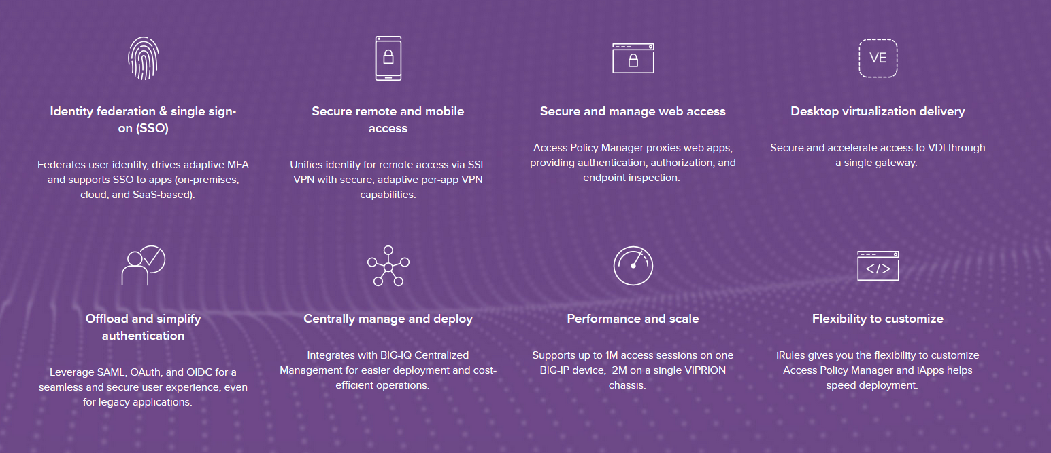

Slide 6
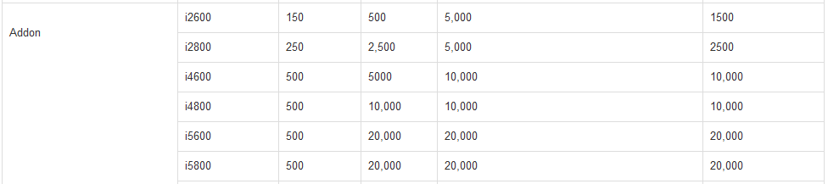
  License Capacity
1
2
SSLVPN/CCU:
  Layer 3 Traditional Client/Component based VPN
  Per App VPN
  Portal Rewrite (Portal Access)
Access Sessions:
  Identity Aware Proxy
  VDI Delivery
  Federation (SAML/oAuth)
1
2
K15624537: BIG-IP APM platform session capacity
K44058292: BIG-IP APM licensing for BIG-IP VE instances (license V18 and later)
K95135311: The BIG-IP APM platform session capacity for iSeries and Virtual Edition (license V16 and earlier)
K01151630: BIG-IP APM licensing for BIG-IP Appliances
K41332981: BIG-IP APM licensing for VIPRION

Slide 7
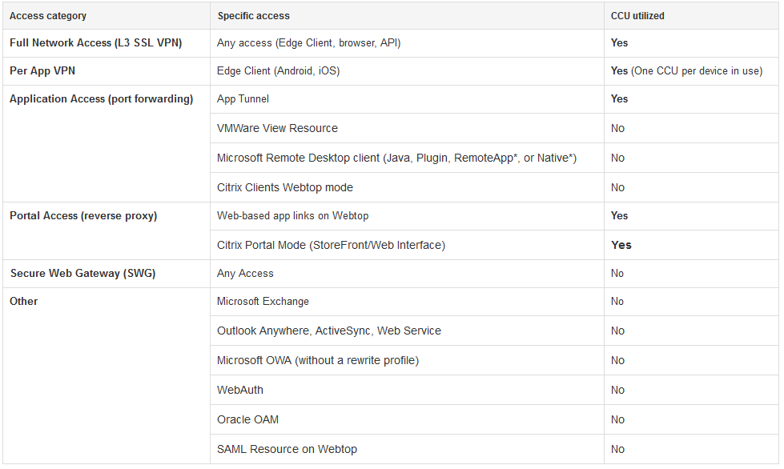
  License Usage Detail
  L3 SSL VPN / Per App VPN
  Portal Access Rewrite / Citrix Storefront Replacement
K13267: BIG-IP APM connectivity license use.

Slide 8
  Access Policy Types
  Per Session Policy
  Per Request Policy
  Happens once per authenticated access
  Collected attributes/metadata is static
  Happens upon every request
  Has configurable subroutine looping and gating criteria
  Has capabilities to support static or dynamic attributes/metadata
  Has extended capabilities for
    Step-Up Authentication
    Accessibility to external telemetry/metadata

Slide 9
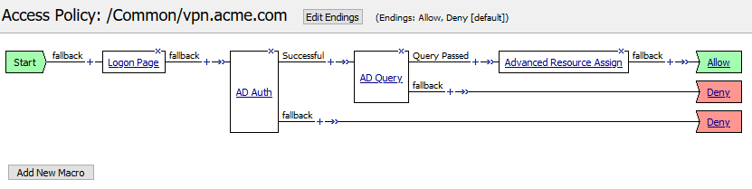
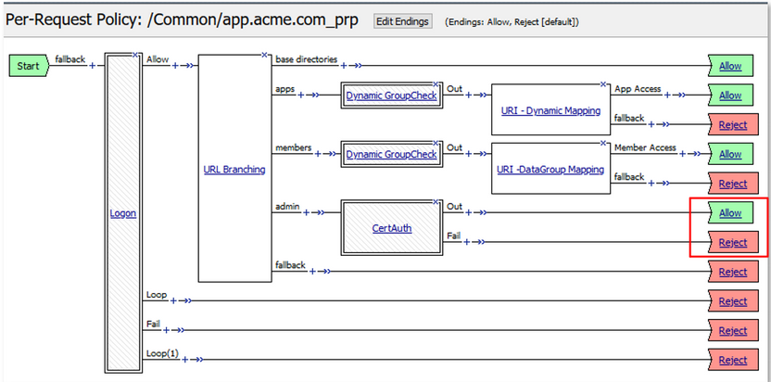
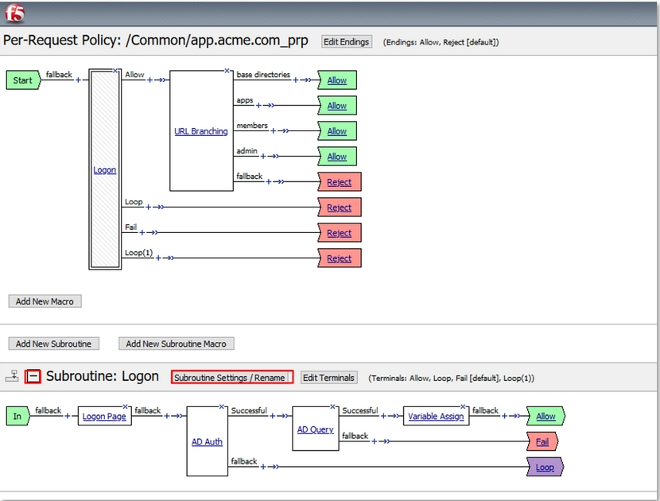
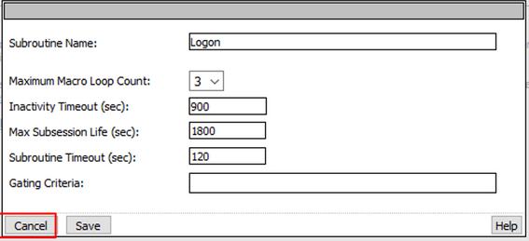
  Access Policy Types
  Per Session Policy
  Per Request Policy
  Access Policy Managers' Visual Policy Editor(VPE)

Slide 10
VDI Overview

Slide 11
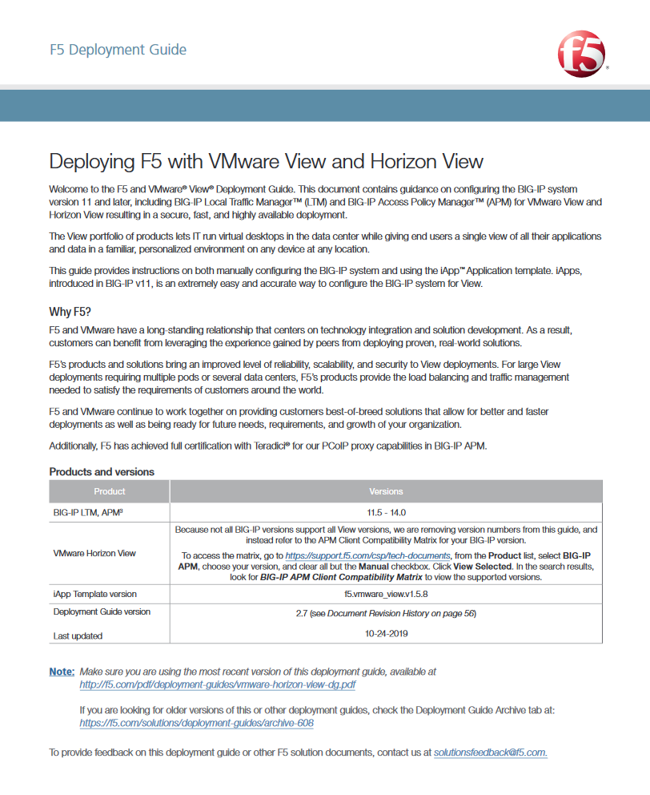
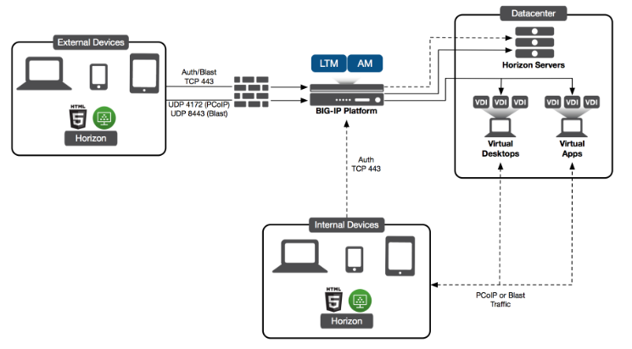
VMware View: Access Policy Deployment
APM Deployment (External/Internal – CS)

Slide 12
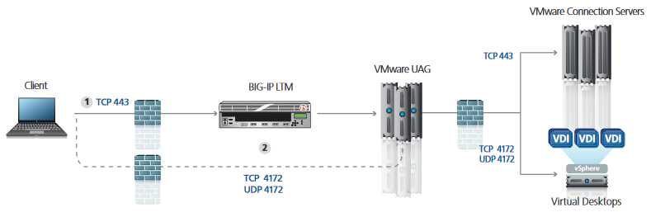
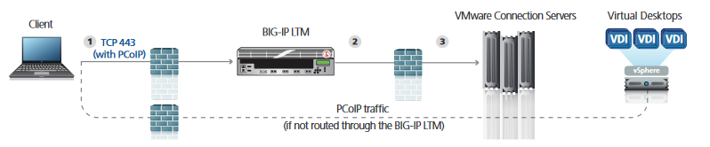
VMware View: Local Traffic Deployment
LTM Deployment (External – UAG/CS)
(If not routed through the BIG-IP LTM)
LTM Deployment (Internal - CS)
(If not routed through the BIG-IP LTM)

Slide 13
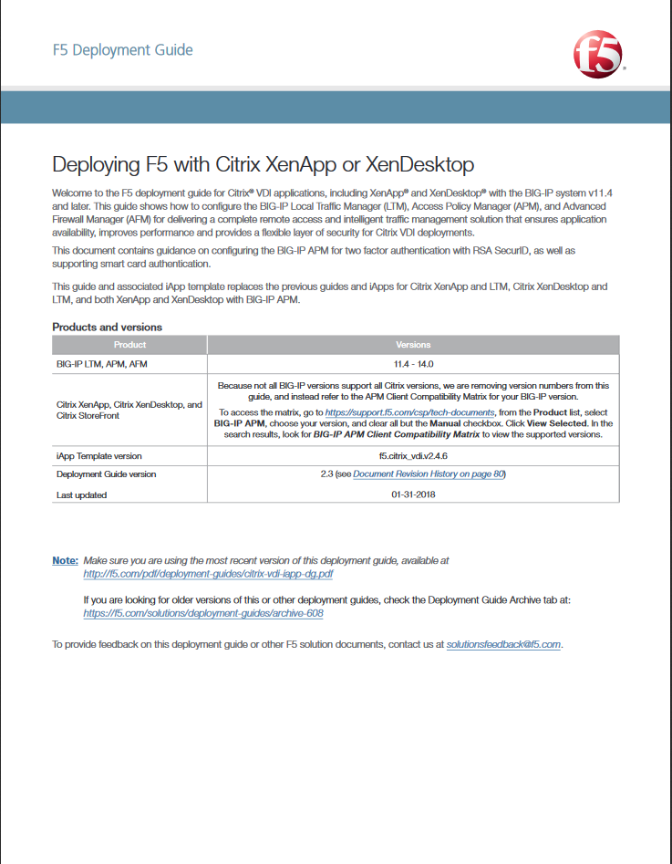
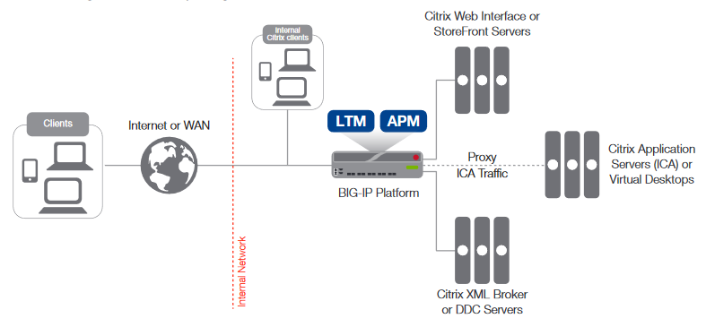
Citrix Storefront: Access Policy Deployment
APM Deployment (External/Internal – SF)

Slide 14
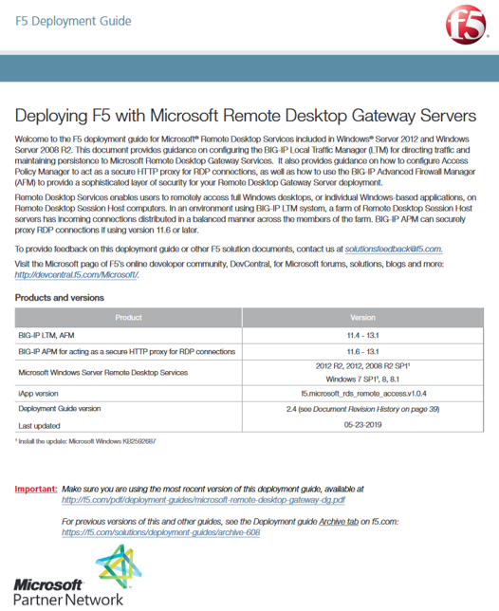
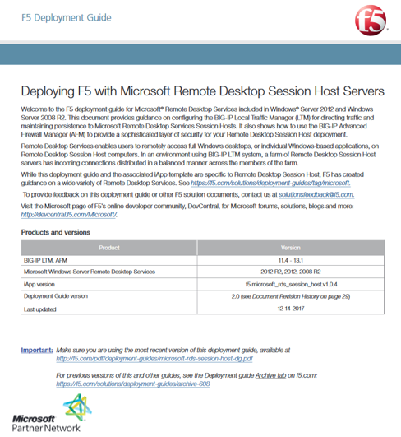
Microsoft RDP Deployments
APM Based Deployment
LTM Based Deployment
In this scenario, we use the BIG-IP Access Policy Manager to securely proxy Remote Desktop connections, so the deployment of Remote Desktop Gateway servers is not required. Continuing to use the Remote Desktop Connection client, the RDP sessions of the users are encapsulated in HTTPS, which is more likely to be allowed through firewalls.
In the scenario described in this guide, users connect through the BIG-IP LTM to an RD Session Host server farm using the Remote Desktop Protocol (RDP), with an RD Connection Broker server managing persistence. The BIG-IP LTM provides advanced load balancing to farm members, while honoring RD Connection Broker routing tokens.

Slide 15
Portal/SSLVPN Overview

Slide 16
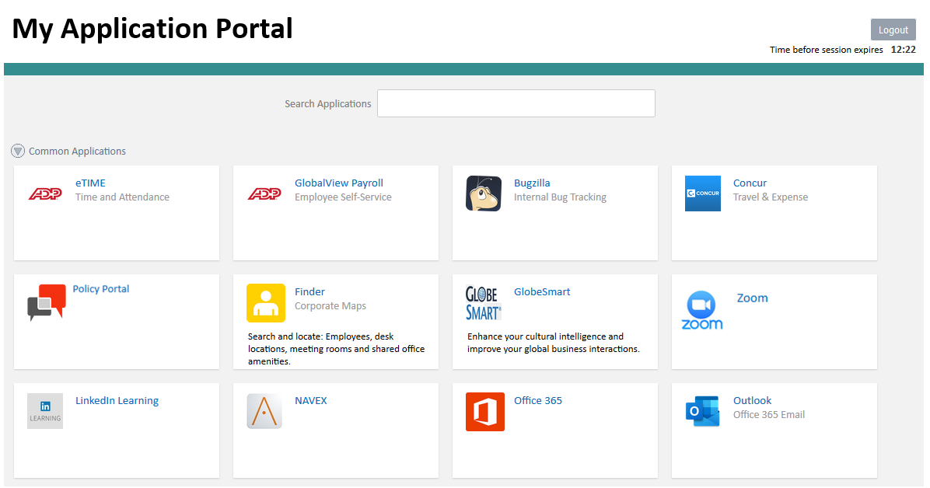
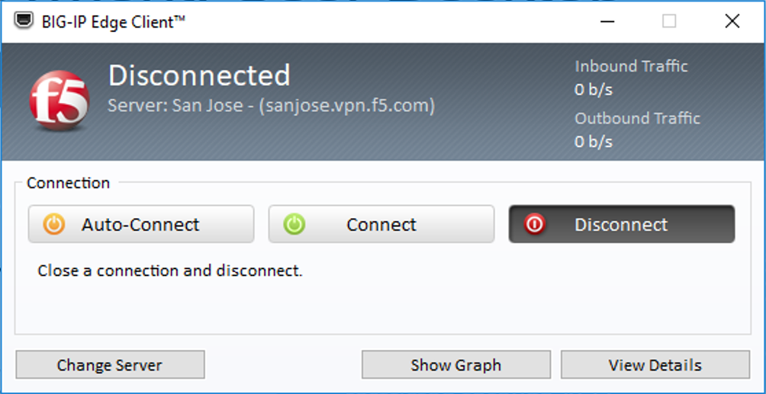
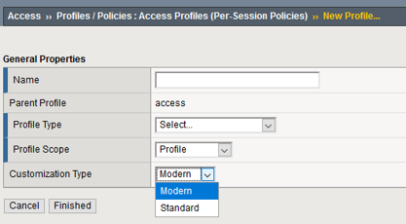
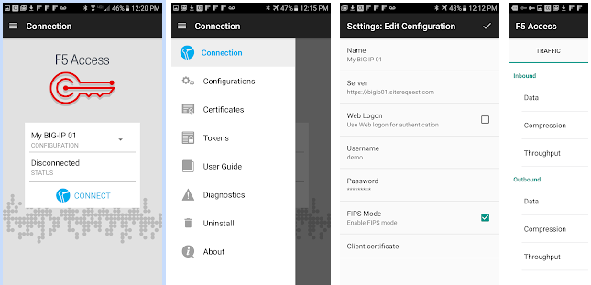
Portal/SSLVPN: Ways In…..
Webtop/Portal
Client (Windows, Mac, Linux)
Mobile (IOS, Android)

Slide 17
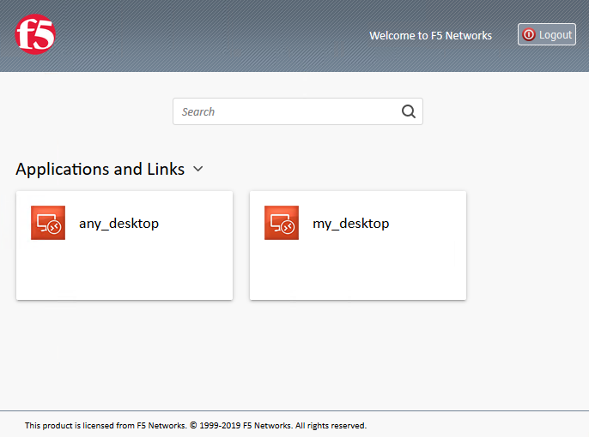
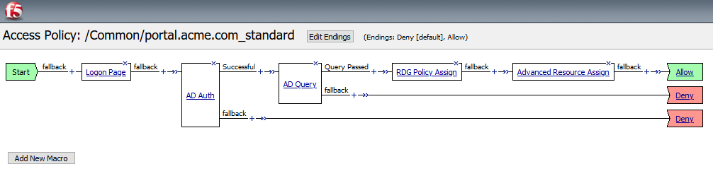
Portal: RDP Deployment - User Desktop
Dynamic Personal Desktop:
  Based on an AD attribute or some other resource which defines to which asset a user is authorized
User Defined Resource:
  User may enter to which resource they desire to connect to (Can be restricted through ACL)
1
2
  Access Policy (Per Session Policy) is straightforward without a lot of additional configurations.

Slide 18
SSLVPN: Networking Design
<- Route to 192.168.200.0/24
VDI Client

Slide 19
SSLVPN: Networking: Route Domains
X
  This will require Route Domains
  Techdocs

Slide 20
Identity Aware Proxy

Slide 21
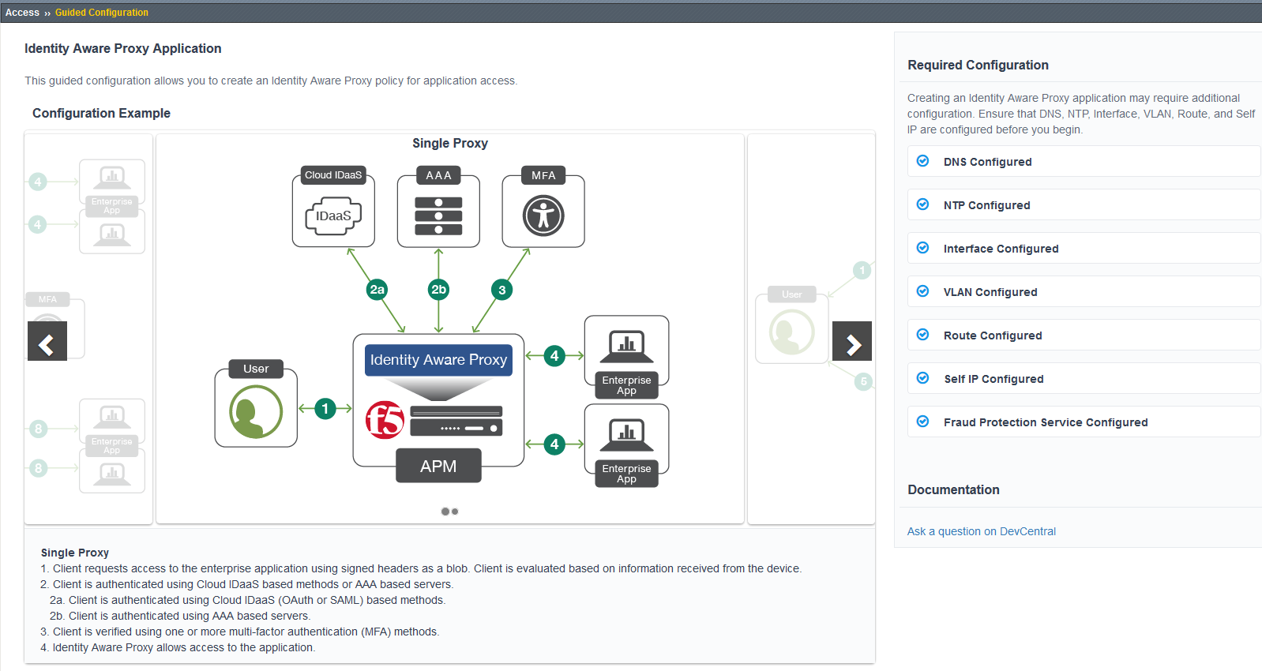
Identity Aware Proxy

Slide 22
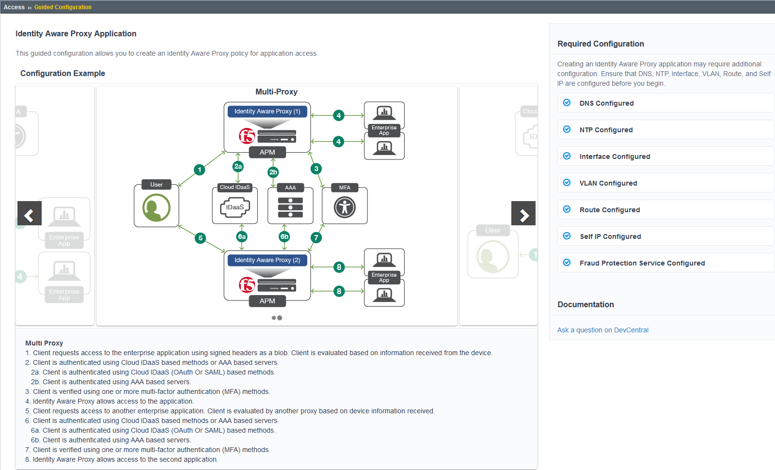
Identity Aware Proxy

Slide 23
Compromised Credentials

Slide 24
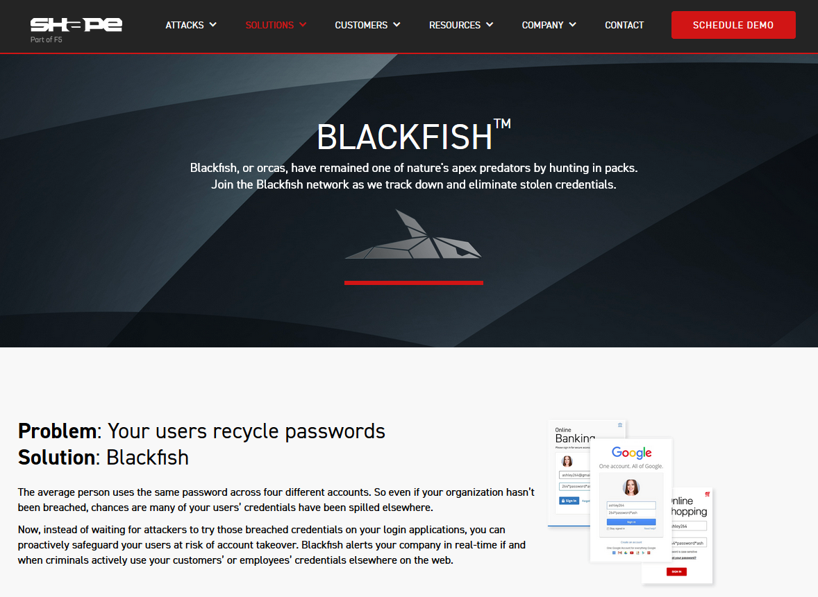
Comprised Credentials: Shape Blackfish
Blackfish:
  SaaS service (Subscription) that can check to see if submitted userID/password (SHA256/Hex Encoded values are used) are known to be a comprised pair BEFORE authentication occurs
Easy integration available TMOS 15.1+

Slide 25
Work Anywhere:
Key Performance Strategies

Slide 26
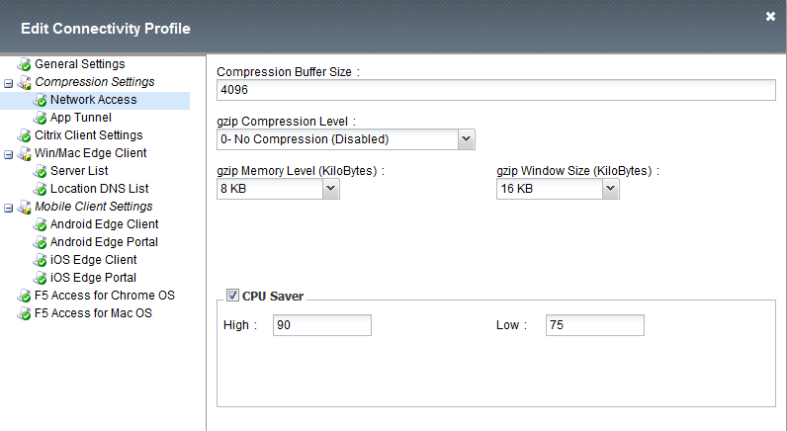
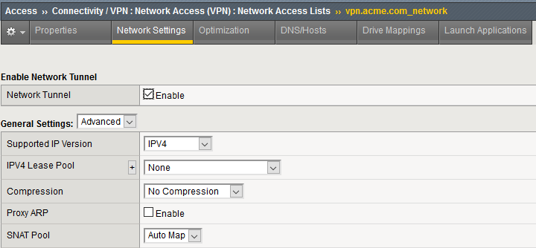
Key Performance Strategies: Compression
Disabling Compression:
https://support.f5.com/csp/article/K1252451
  Must be disabled in the connectivity profile
  Must also be disabled in the Network Access profile

Slide 27
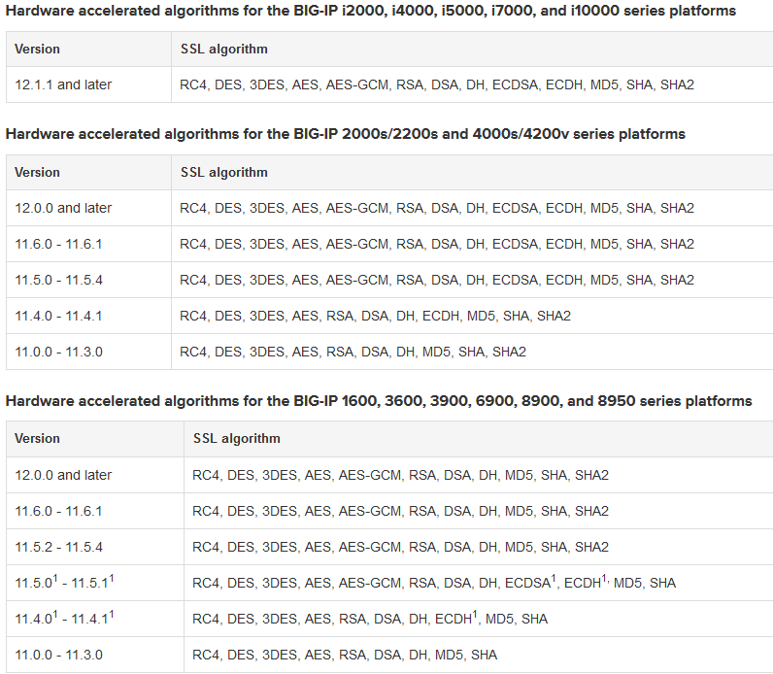
Key Performance Strategies: SSL
Selecting SSL Ciphers:
https://support.f5.com/csp/article/K13213
  Select Hardware Accelerated Ciphers

Slide 28
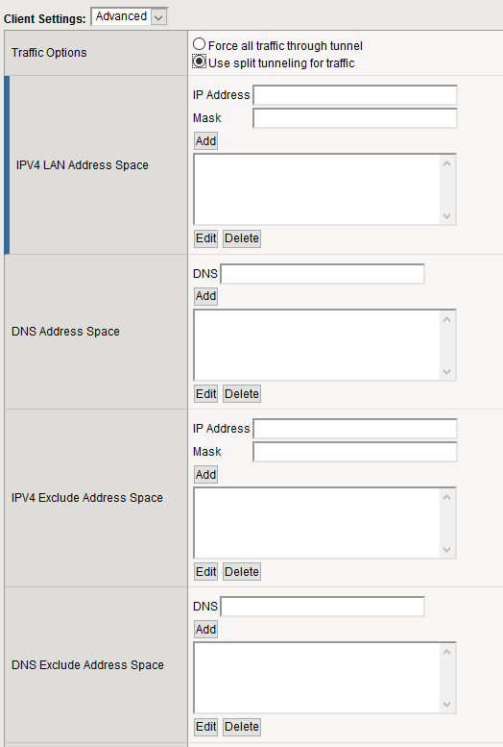
Key Performance Strategies: Split Tunnel
Configure Split Tunnel:
APM Techdocs
  Depends on organizations security posture
  Only allow VPN related traffic
  Pay attention to services like MS Teams, video Services etc
https://support.f5.com/csp/article/K23653432

Slide 29
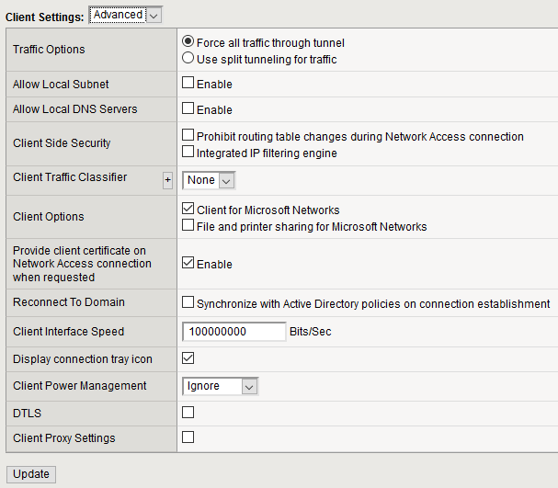
Key Performance Strategies: DTLS
Enable DTLS:
  Specifies, when enabled (checked), that the network access connection uses Datagram Transport Level Security (DTLS). DTLS uses UDP instead of TCP, to provides better throughput for high demand applications like VoIP or streaming video, especially with lossy connections.

Slide 30
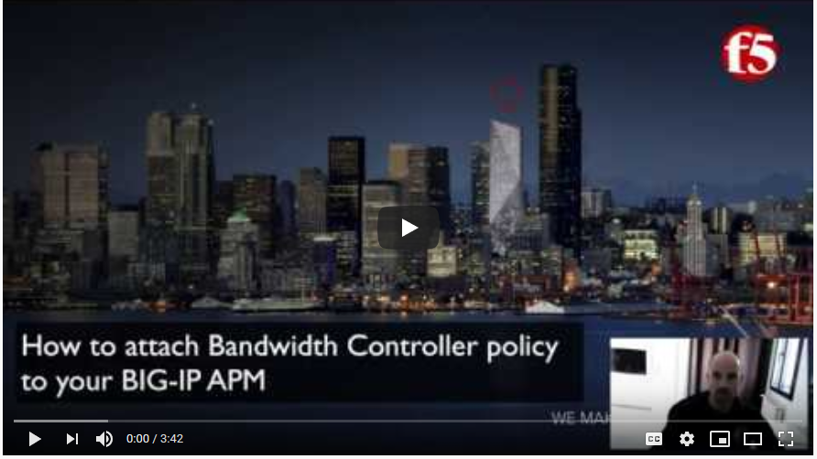
Key Performance Strategies: Bandwidth
Bandwidth Controller:
https://youtu.be/q4jdUMaF62g
Techdocs
  Bandwidth controller is the updated version of rate shaping on the BIG-IP® system. These features are mutually exclusive. You can configure and use either rate shaping or bandwidth controllers, but not both.

Slide 31
Key Performance Strategies: Usage
License Consumption:
https://support.f5.com/csp/article/K13267
  Confirming license consumption can be viewed from the CLI via the following command:
  tmsh show /apm license
  Highlighted in Yellow are the Access Sessions
  Highlighted in Green are the SSLVPN/CCU Sessions
-------------------------------------------
Global Access License Details:
--------------------------------------------
total access sessions: 10.0K
current active sessions: 0
current established sessions: 0
access sessions threshold percent: 75
total connectivity sessions: 500
current connectivity sessions: 0
connectivity sessions threshold percent: 75

Slide 32
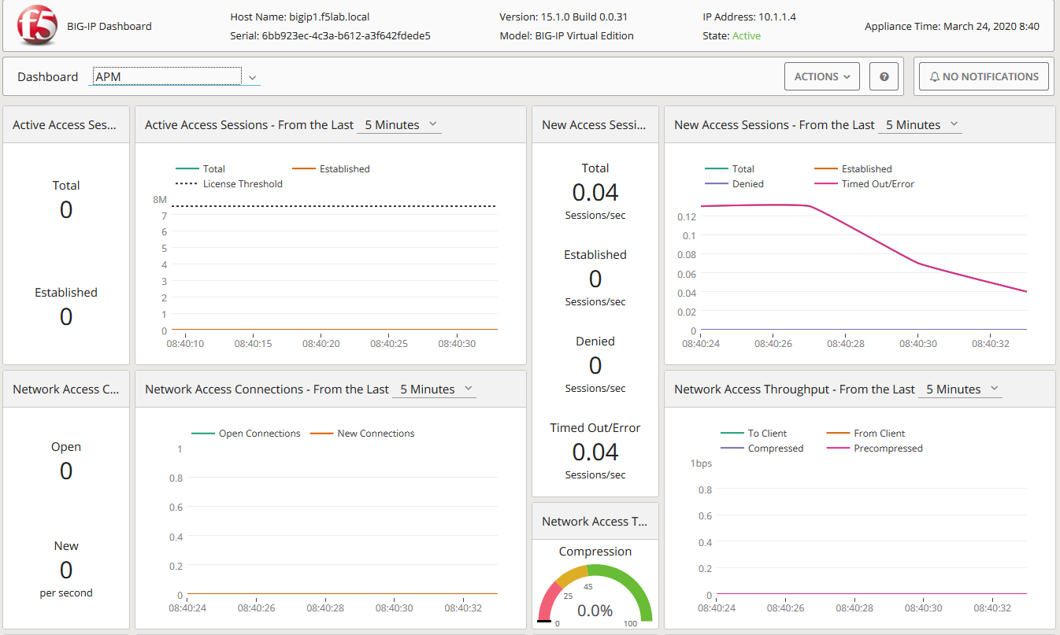
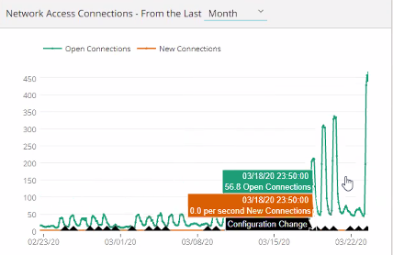
Key Performance Strategies: Usage
TMOS 14.1+

Slide 33
Practice Good Security

Slide 34


The Security Funnel
Can be applied to any application delivery model (network, microservice, micro service )
Move higher prevention services to top of funnel (BoT Mitigation, Protocol Filtering, SSL Control Authentication)
Only want to deal with “Clean” traffics
Evaluate and measure the tiers of service (What benefit is provided by each tier)
Visibility within and through each tier becomes invaluable to making informed decisions on security, which services are need and which services are not.
Communicating the effectives of the investment is key
Reducing Risk

