Slide 1

Every App, Anywhere
Maybe???
[Automated, Orchestrated]
Chas Lesley
May 28, 2020

Slide 2



Automation and Orchestration Use Cases
Multi-Cloud
App Services
Unlock the agility and scale of cloud-based applications
DevOps Driven Automation
Empower DevOps teams with support for declarative automation and easy integration
Analytics & Security Policy Management
Utilize analytics to trigger automation and drive consistent policies in multi-cloud environments
Ecosystem Integrations
Integrate F5 application services into every ecosystem
Notes:
While the uses for automation are limited only by your imagination, we most commonly see it be being used for:
Applying consistent network and security services across clouds and datacenters
Empowering DevOps and SuperNetOps teams
Better utilizing analytics and security events to drive policy changes
Integrating F5 solutions into broader automation and orchestration systems.

Slide 3








Automation Lifecycle
Bootstrap
Onboard
Deploy App Services
Monitoring/Telemetry
Change

Slide 4
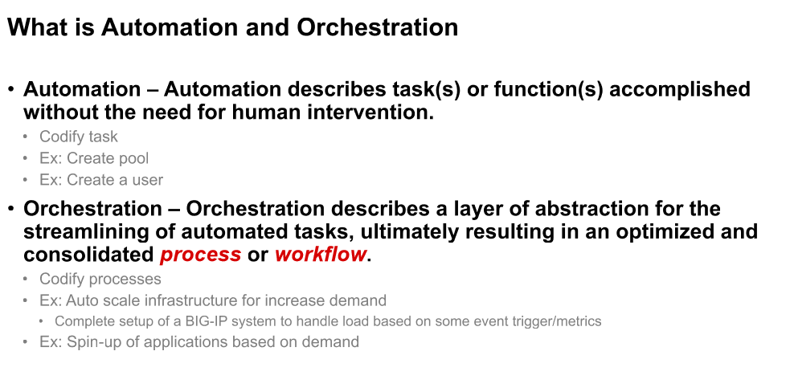
A versus O

Slide 5
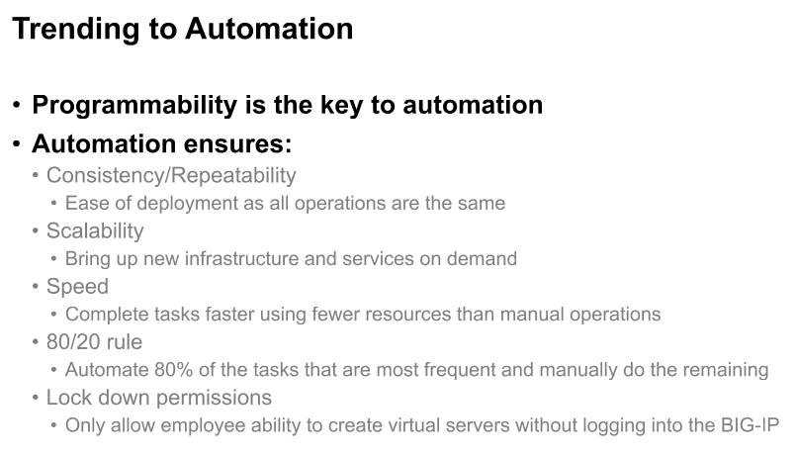
A versus O ..cont.
This is evolving as organizations transition from traditional architecture and support models to automated and modernized operational models

Slide 6
Let's talk about initial steps ….
TMSH
Basic CLI Commands
Shell Scripting
iControl
Imperative Model
Step-by Step Operations
Automation
Tool Chain
Declarative Model
Single Definition Build
…. Keep It Simple
Notes:
While the uses for automation are limited only by your imagination, we most commonly see it be being used for:
Applying consistent network and security services across clouds and datacenters
Empowering DevOps and SuperNetOps teams
Better utilizing analytics and security events to drive policy changes
Integrating F5 solutions into broader automation and orchestration systems.

Slide 7
Understanding imperative vs. declarative
Real world Example: making a sandwich
Imperative model: What everyone’s done for years. Every step of a process is meticulously defined, resulting in the desired outcome.
Declarative model: The model that F5 is aligning to. Just input the desired end-state and let the system figure out the rest.
Declaration
System Processes
End-state
A sandwich would be good
Find a recipe for PB&J
Ensure you have ingredients
Buy the required ingredients
Assemble the sandwich
Spread jelly on bread
Spread peanut butter on bread
Cut two slices of bread from loaf
Order a #3 with cheese
Meal gets made by the “system”
Enjoy the #3 with cheese!
Slice the sandwich
Put the sandwich on a plate
Enjoy the carefully crafted sandwich

Slide 8
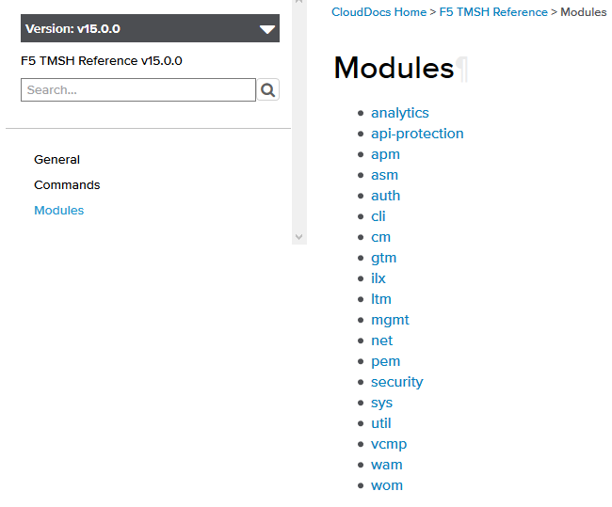
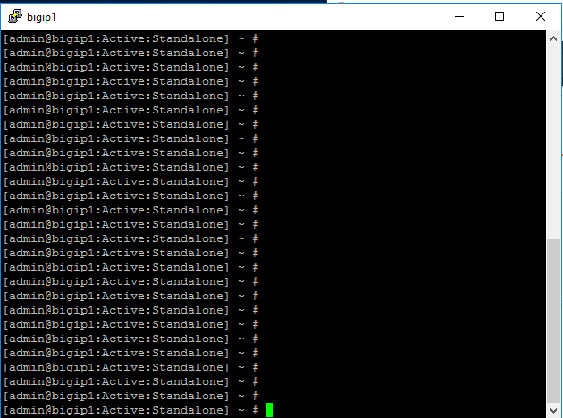
Good Ole’ Friend TMSH ….
TMSH
Notes:
While the uses for automation are limited only by your imagination, we most commonly see it be being used for:
Applying consistent network and security services across clouds and datacenters
Empowering DevOps and SuperNetOps teams
Better utilizing analytics and security events to drive policy changes
Integrating F5 solutions into broader automation and orchestration systems.

Slide 9
Cut & Paste/Scripts ….
TMSH
Node
tmsh create ltm node /Common/10.1.20.6 { address 10.1.20.6 } tmsh create ltm node /Common/10.1.20.7 { address 10.1.20.7 } tmsh create ltm node /Common/10.1.20.9 { address 10.1.20.9 }
Pool
tmsh create ltm pool /Common/ad-pool { members add { /Common/10.1.20.7:0 { address 10.1.20.7 monitor /Common/gateway_icmp } } } tmsh create ltm pool /Common/ldap-pool { members add { /Common/10.1.20.7:0 { address 10.1.20.7 monitor /Common/gateway_icmp } } } tmsh create ltm pool /Common/mtls_pool { members add { /Common/10.1.20.9:443 { address 10.1.20.9 } } monitor /Common/https }
Virtual Server
tmsh create ltm virtual /Common/mtls_vs { creation-time 2020-05-18:23:20:22 destination /Common/10.1.10.105:443 ip-protocol tcp last-modified-time 2020-05-19:11:49:17 mask 255.255.255.255 per-flow-request-access-policy /Common/certsso-prp pool /Common/mtls_pool profiles add { /Common/cert_sso { } /Common/client_certsso { context clientside } /Common/http { } /Common/rba { } /Common/server_certsso { context serverside } /Common/tcp { } /Common/websso { } } rules { /Common/Cert_SSO } serverssl-use-sni disabled source 0.0.0.0/0 source-address-translation { type automap } translate-address enabled translate-port enabled }

Slide 10

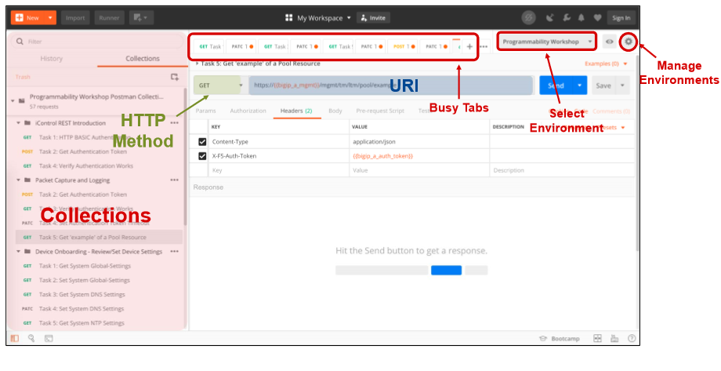
Small break …lets talk about Postman

Slide 11
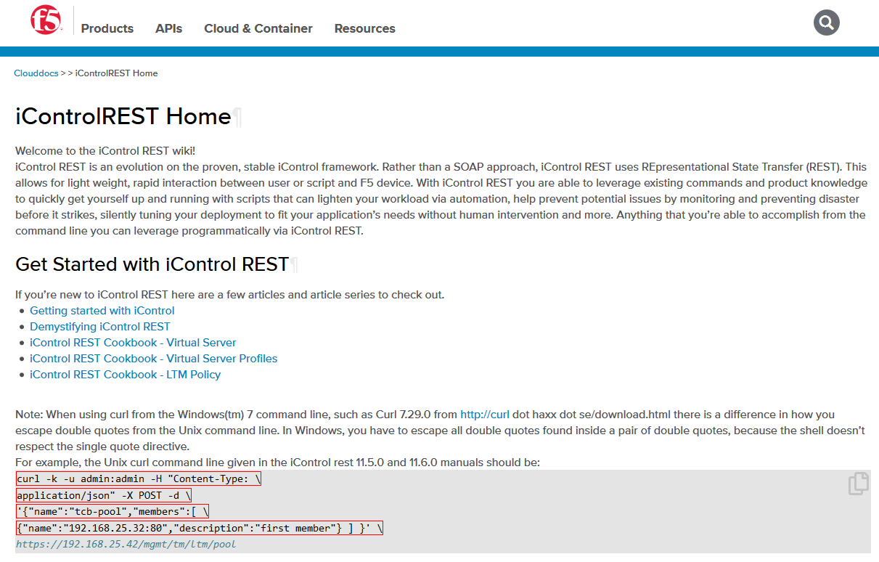
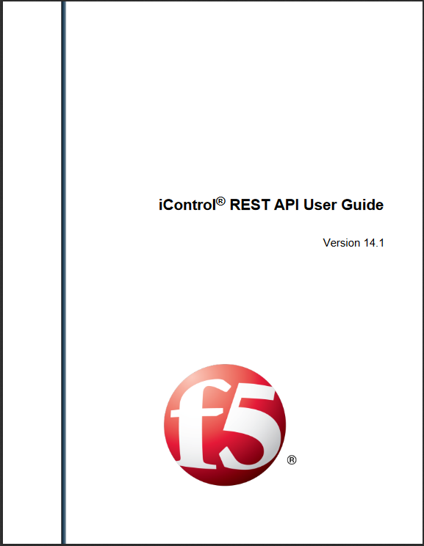
Hey Hey, now here is something ….
iControl
REST API Guide
Since 13.1 User accounts based on their associated role have access to the iControl REST API
Notes:
While the uses for automation are limited only by your imagination, we most commonly see it be being used for:
Applying consistent network and security services across clouds and datacenters
Empowering DevOps and SuperNetOps teams
Better utilizing analytics and security events to drive policy changes
Integrating F5 solutions into broader automation and orchestration systems.

Slide 12
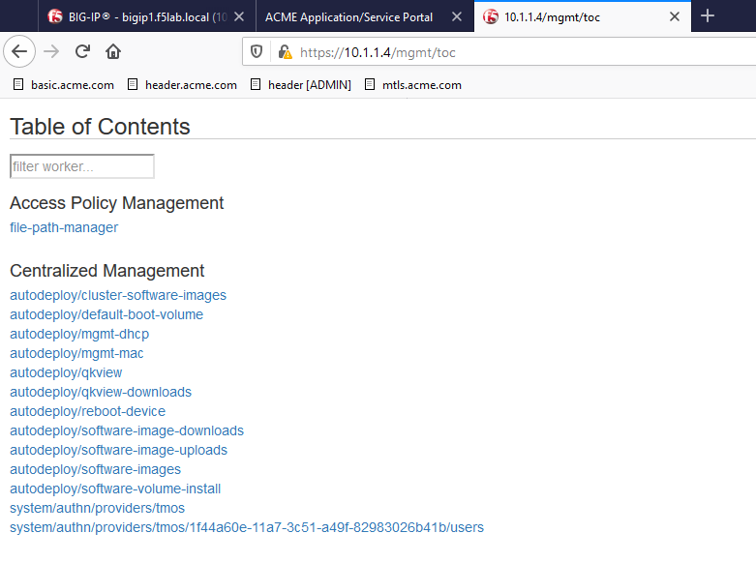
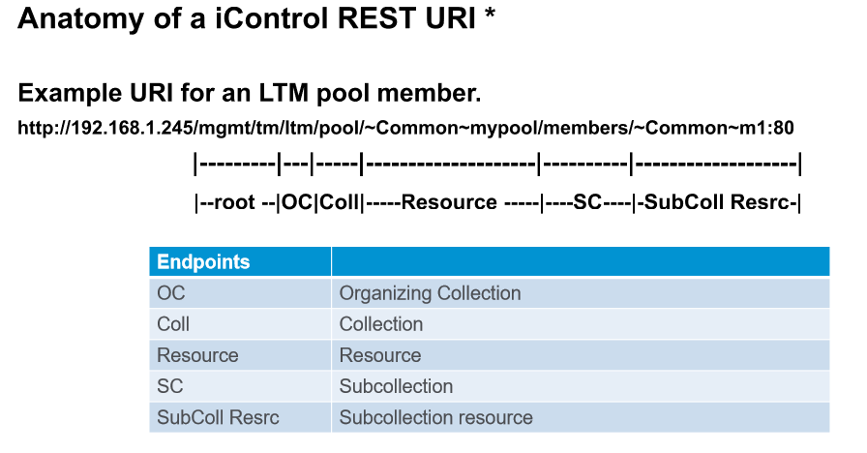
iControl Information …
iControl

Slide 13
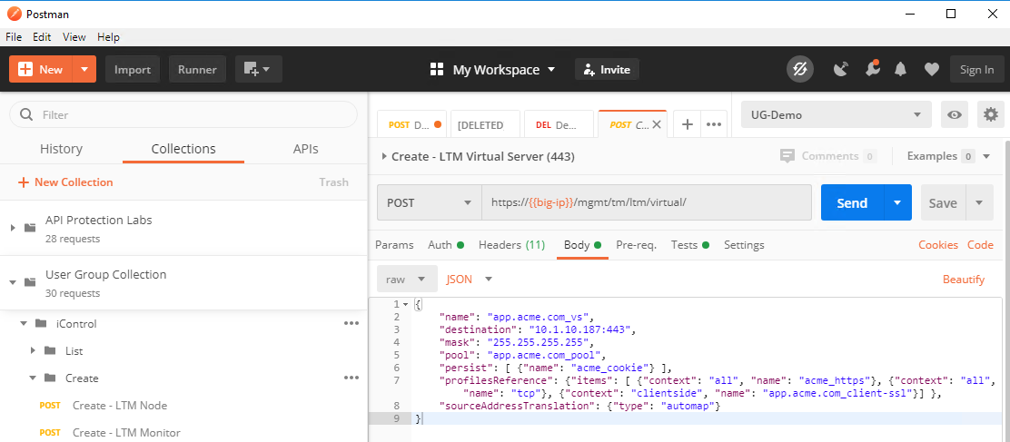
A Sample iControl Call
iControl

Slide 14

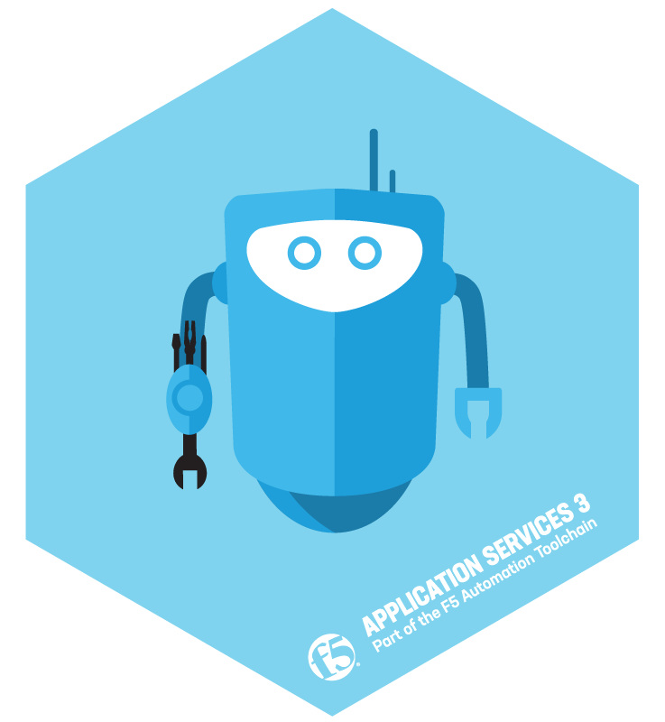

F5 Automation Toolchain
Automation Tool Chain
Bootstrap
Onboard
Deploy App Services
Monitoring/Telemetry
CLOUD TEMPLATES
DECLARATIVE ONBOARDING EXTENSION
APP SERVICES 3 EXTENSION
TELEMETRY STREAMING EXTENSION
Start BIG-IP Instances in Public & Private Clouds
Initial Config of BIG-IP Instances
Deploy Classic and Advanced Application Services on BIG-IP using Declarative REST APIs
Stream Telemetry, Events & Logs from BIG-IP to various Analytics and Logging solutions
L1-L3
L4-L7

Slide 15
Simplify Automation with AS3
Automation Tool Chain
Application Services 3 Extension – BIG-IP API extension that accepts a declarative API call
Configures BIG-IP L4-7 services
Minimizes need for BIG-IP domain expertise
Minimizes deployment errors
Makes it easy to integrate F5 automation into orchestration systems
Runs on BIG-IP, on BIG-IQ or in a container
Create application dashboards / monitoring / alerts when used with BIG-IQ
Notes:
Application Services 3 Extension (AS3provides a simple and consistent way for our customers to automate Layer 4-7 Applications Service deployments via Declarative REST APIs. Additionally, AS3 provides a sustainable foundation to enable F5’s Infrastructure as Code (IaC) strategy and future integration with third-party Orchestration, SDN, and NFV solutions.
AS3 simplifies and eliminates errors in F5 application service deployments, as well as enables reusable JSON document-based configurations as needed for our Super-NetOps, DevOps, and App Dev customers. AS3 delivers the ease and power of Declarative APIs needed in modern Agile environments. Delivering on our vision of Declarative APIs is important for BIG-IP adoption across our influential Super-NetOps and DevOps communities.

Slide 16

Without F5 Automation Toolchain
Automation Tool Chain
Configuring BIG-IP requires many REST API calls
Many Imperative Commands
Requires BIG-IP domain expertise
Dozens of REST API calls
Costly to automate and integrate with orchestration systems
Time-consuming
Error-prone

Slide 17
With F5 Automation Toolchain
Automation Tool Chain
Configuring BIG-IP requires a SINGLE REST API call
One Declarative Statement
Many Imperative Commands
AS3 abstracts away all BIG-IP configuration complexity
User only needs to define the desired configuration end-state
Requires no BIG-IP domain expertise
Single REST API call simplifies automation and orchestrator integrations
Accelerates app service deployment
Declaration is reusable, ensures consistency, reduces errors

Slide 18
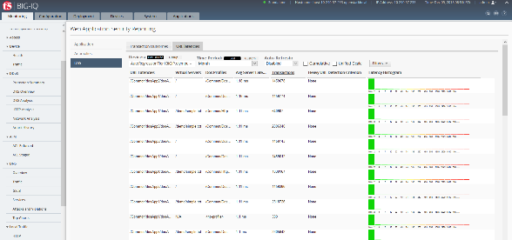
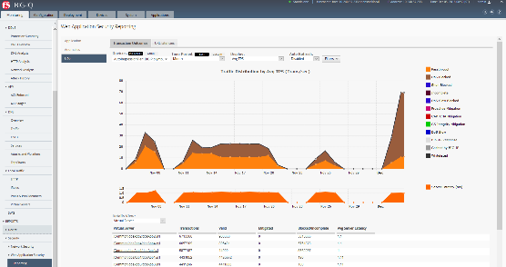
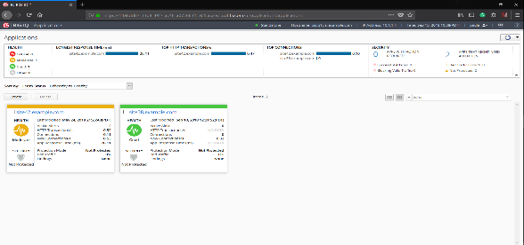
Automation & Analytics with BIG-IQ
Automation Tool Chain
Pulls AS3 from GitHub & pushes to BIG-IPs
Accepts declarative API
Create per-app dashboards
AS3 on
BIG-IQ
BIG-IP
One Declarative Statement
DeclarativeAPI Calls
BIG-IP
BIG-IP
BIG-IP
Minimizes need for BIG-IP domain expertise
Minimizes deployment errors
Generates per-app dashboards for monitoring and alerting
Notes:
F5® BIG-IQ® provides a central point of control for F5 physical and virtual devices and for the solutions that run on them. It integrates automation tools, simplifies management, provides advanced analytics, and gives you the tools you need to deliver your applications securely and effectively.
When AS3 is used through, BIG-IQ, it generates the per app dashboards and analytics that allow you to track the health, security and performance of your applications. BIG-IQ provides end to end analytics and alerts that provide insight into the state of your applications – and it does so across data centers and clouds.

Slide 19
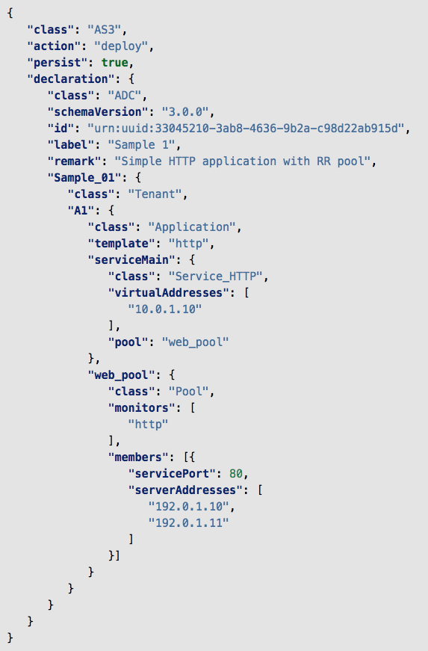
AS3 Sample Declaration
Create a simple HTTP application service:
HTTP Virtual Server
Pool named web_pool with 2 members
Monitored by default HTTP health monitor
Partition (tenant) named Sample_01
Declaration not ordered, nor sequenced
POST this JSON text to AS3 at /mgmt/shared/appsvcs/declare
That’s it!

Slide 20
Example Declarations
Onboard
Deploy App Services
Monitoring/Telemetry
APP SERVICES 3 EXTENSION
TELEMETRY STREAMING EXTENSION
Deploy Classic and Advanced Application Services on BIG-IP using Declarative REST APIs
Stream Telemetry, Events & Logs from BIG-IP to various Analytics and Logging solutions
L1-L3
L4-L7

Slide 21
Automate Deployments with Declarative Onboarding (DO)
Declarative API
User
What is it?
What are the Benefits?
F5 BIG-IP API Extension (Node.js)
Provides declarative interfaces for common L1-L3 device onboarding requirements
Deployments via a single REST API endpoint*
JSON-based document
Minimizes need for BIG-IP domain knowledge
Minimizes onboarding errors and maximizes onboarding consistency
TMOS-independent RPM package
Notes:
F5 Declarative Onboarding (DO) is an F5 offering that provides a simple and consistent way for our customers to automate BIG-IP onboarding via Declarative REST APIs. A brother to AS3, DO simplifies BIG-IP deployments and provides a point of integration with 3rd party orchestration system.
Whereas AS3 automates Layer 4-7 Applications Service deployments, DO automates L1-L3 on-boarding for BIG-IP, making BIG-IP available on the network and ready to accept L4-L7 Application Services configurations.
Just as with AS3, DO simplifies and eliminates errors in F5 application service deployments, as well as enables reusable JSON document-based configurations as needed for our Super-NetOps, DevOps, and App Dev customers.
DO is an iControl LX Extension delivered as a TMOS-independent RPM file. Installing the DO Extension on BIG-IP enables you to declaratively on-board BIG-IP via POSTing a DO JSON declaration to DO's declarative API endpoint.

Slide 22
Real-Time Analytics with Telemetry Streaming
TELEMETRY STREAMING
Provides stats on: Device, LTM, tenants and apps, TLS Cert Inventory, and event log (all sources)
Declarative Configuration
Streams from BIG-IP to a data store
Validated 3rd party consumers: Splunk, Azure Log Analytics, AWS CloudWatch, AWS S3, Graphite, & more
Notes:
Telemetry Streaming (TS) is an iControl LX Extension delivered as a TMOS-independent RPM file.
Installing the TS Extension on BIG-IP enables you to declaratively aggregate, normalize, and forward statistics and events from the BIG-IP to a consumer application – all via POSTing a single TS JSON declaration to TS’s declarative REST API endpoint.

Slide 23
Automate BIG-IP with Ansible
We integrate with ANSIBLE, the #1 DevOps automation solution
Simple
Powerful
Automated
Agentless solution: No new software to install on BIG-IP
Use Ansible to license a BIG-IP for application deployment
Ansible integrates to make use of the native APIs of BIG-IP
Ansible F5 modules follow best practice and enable compliance
Automate the initial configurations on BIG-IP and deploy HTTP(S) apps
Automate to Network the BIG-IP (VLANS, Self-IPs)
Full library of F5 modules on Ansible.com

Slide 24


App Services Automation with Ansible and F5
Imperative Interface
On-boarding & App services config
F5 Automation Toolchain
On-boarding & App services config
Ansible Host
Ansible Host
Declarative Interface
BIG-IP
BIG-IP
NGINX
F5CS
Playbook
Playbook
Imperative Configuration
Declarative Configuration
Notes:
We integrate with the #1 DevOps automation solution Ansible.
The combined Ansible and F5 solution provides:
Agentless solution: No new software to install on BIG-IP
Makes use of the native APIs of BIG-IP
End to End automation: licensing a BIG-IP to application deployment
Improved configuration and automation speed and consistency
Ansible F5 modules follow best practice and enable continuous compliance
You can find the full library of F5 modules for Ansible on Ansible.com
The F5 Automation Toolchain provides the tools you need to integrate monitoring, management, automation and orchestration of F5 solutions into a wide range of products and services.
Container Ingress Services enables automation spinning up and down app services in Kubernetes and OpenShift environments.

Slide 25
Where Can I Learn More?
Component | Type | Resource | Link
Cloud Solution Templates | Documentation | Overview | https://www.f5.com/pdf/solution-profiles/boost-agility-and-automation-with-f5-cloud-solution-technologies.pdf
Application Services 3 (AS3) | Downloads | AS3 Extension | https://f5.com/GetAS3
 | Documentation | AS3 Extension Documentation | https://f5.com/AS3Docs
 | Documentation | AS3/BIG-IQ Documentation | https://clouddocs.f5.com/products/extensions/f5-appsvcs-extension/latest/userguide/big-iq.html https://clouddocs.f5.com/products/big-iq/mgmt-api/v6.1.0/ApiReferences/bigiq_public_api_ref/r_as3_template.html
Declarative Onboarding (DO) | Downloads | DO Extension | https://f5.com/GetDO
 | Documentation | DO Extension Documentation | https://f5.com/DODocs
Telemetry Streaming (TS) | Downloads | TS Extension | https://f5.com/GetTS
 | Documentation | TS Extension Documentation | https://f5.com/TSDocs
Free Automation Training: https://f5.com/super-netops

