Slide 1
Identity Aware Proxy
The Evolution of Today’s Security Architectures
  Presented by
  Chas Lesley
    Solutions Engineer

Slide 2
What is Zero Trust?
Zero Trust is a data-first framework to achieve security using microperimeters and microsegmentation.
A Zero Trust Architecture (ZTA) strategy is one where there is no implicit trust granted to systems based on their physical or network location (i.e., local area networks vs. the Internet).
The network is always assumed to be hostile.
External and internal threats exist on the network at all times.
Network locality is not sufficient for deciding trust in a network.
Every device, user, and network flow is authenticated and authorized.
Policies must be dynamic and calculated from as many sources of data as possible.
Forrester
Zero trust networking is a concept for secure network connectivity where the initial security posture has no implicit trust between different entities, regardless of whether they are inside or outside of the enterprise perimeter. Least-privilege access to networked capabilities is dynamically extended only after an assessment of the identity of the entity, the system and the context.
NIST
Gillman and Barth
Gartner
Notes:
Forrester 2019 - Reinvent Your Security Strategy With Zero Trust - https://go.forrester.com/wp-content/uploads/2019/07/FMK_ZT_eBook-190725.pdf?utm_source=forrester_com&utm_medium=web&utm_campaign=zerotrust&utm_content=button

Slide 3


Beginning of the Journey
Everything
Else
Our Controlled Comfort Zone
DMZ
Perimeter
Security Stack
External
Partners
Internal
Core Routing
Data Center
Data Center
Security Stack
Applications
HQ Site
Corporate Enterprise
Remote Sites

Slide 4
Beginning of the Journey
Public Users
Our Controlled Comfort Zone
DMZ
Perimeter
Security Stack
Applications
External
Partners
Internal
Core Routing
Data Center
Data Center
Security Stack
Applications
HQ Site
Corporate Enterprise
Remote Sites

Slide 5
Beginning of the Journey
Private users
Our Controlled Comfort Zone
DMZ
Perimeter
Security Stack
VPN & VDI
External
Partners
Internal
Core Routing
Data Center
Data Center
Security Stack
Applications
HQ Site
Corporate Enterprise
Remote Sites

Slide 6
Beginning of the Journey
Private users
Our Controlled Comfort Zone
DMZ
Perimeter
Security Stack
VPN & VDI
External
Partners
Internal
Core Routing
Data Center
Data Center
Security Stack
Applications
HQ Site
Corporate Enterprise
Remote Sites

Slide 7
Today’s Architecture
Everything
Else
Multi-Cloud
Security Stack
IaaS
PaaS
%
%
SaaS
%
Our Controlled Comfort Zone
DMZ
IaaS
PaaS
Cloud
Security Stack
Perimeter
Security Stack
SaaS
External
Partners
Internal
Core Routing
Data Center
Data Center
Security Stack
Applications
HQ Site
Corporate Enterprise
Remote Sites

Slide 8
Today’s Architecture
Everything
Else
Multi-Cloud
Security Stack
IaaS
PaaS
%
%
%
%
SaaS
Our Controlled Comfort Zone
DMZ
IaaS
PaaS
Cloud
Security Stack
Perimeter
Security Stack
SaaS
External
Partners
Internal
Core Routing
Data Center
Data Center
Security Stack
Applications
HQ Site
Corporate Enterprise
Remote Sites

Slide 9

Tomorrow’s Architecture
?

Slide 10


Identity Aware Proxy (IAP)
Corporate
Asset
Agent Installed
POST /schedule
ByPhone
MDM Registered
User
GET /schedule
Non-Corporate
Asset
Identity
Aware
Proxy
[No Data]
10
Notes:
Introducing Identity Aware Proxy. Rather than implement a SDP and be forced to differentiate between public and private apps or between managed and unmanaged devices. IAP allows you to control access at granular level for ALL applications and supports both managed and unmanaged devices.
These are not layer 7 ACLs, but a granular control that can be integrated with outside tools to grant or deny access based on context.
This is also not NAC. NAC only permits or denies access to the network based on the posture of the machine. It doesn’t control which resources a device can access once it’s on the network

Slide 11

Posture Assessments
Firewall
Anti-Virus
Patch Management
Machine Certificate
Hard Disk Encryption
File
Process
Public File Sharing
Policy
Engine
Policy
Administrator
Enterprise
System
Portal/Gateway
[PEP]

Slide 12
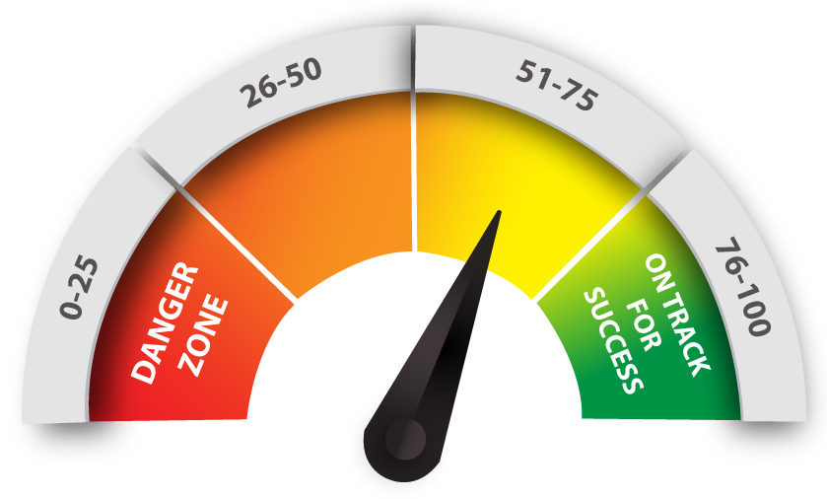


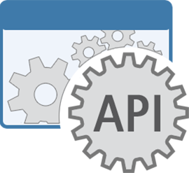






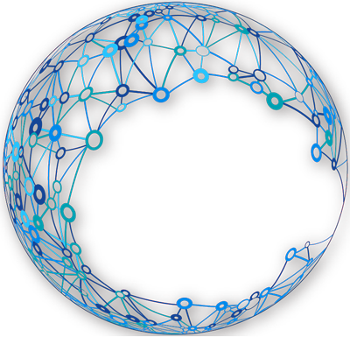
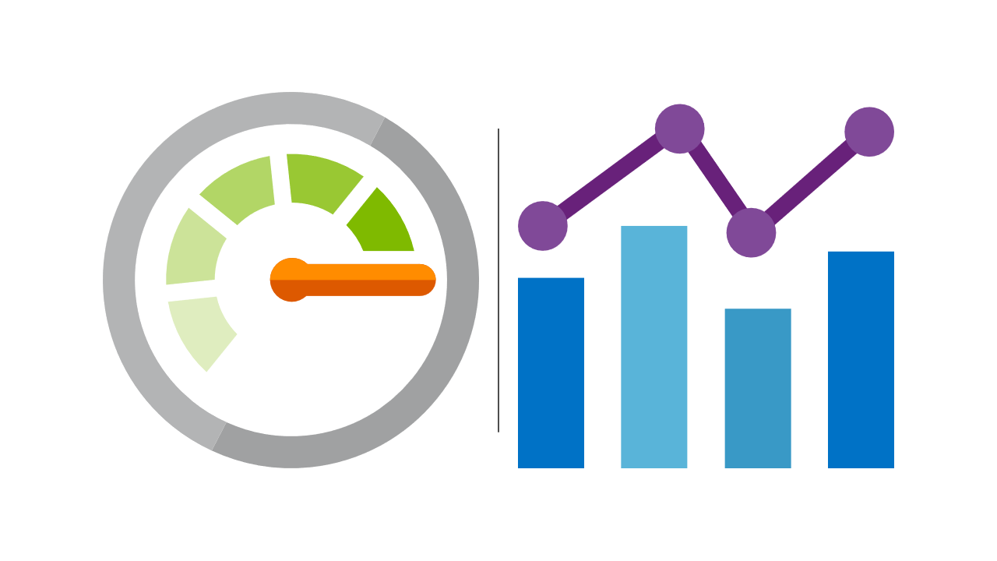


Integration with 3rd Party Tools
Anti-virus
Risk Engine
Policy
Engine
IDaaS
3
4
MDM
NAC
Policy
Administrator
2
5
IP Reputation
Bot Protection
IP
Portal/Gateway
[PEP]
IP
Enterprise
System
API-Based
Connections
1
Sensor Network
SIEM
Notes:
Continuous Diagnostic and monitoring provides real-time access control
SOAR Security, Orchestration, automation, and Response

Slide 13
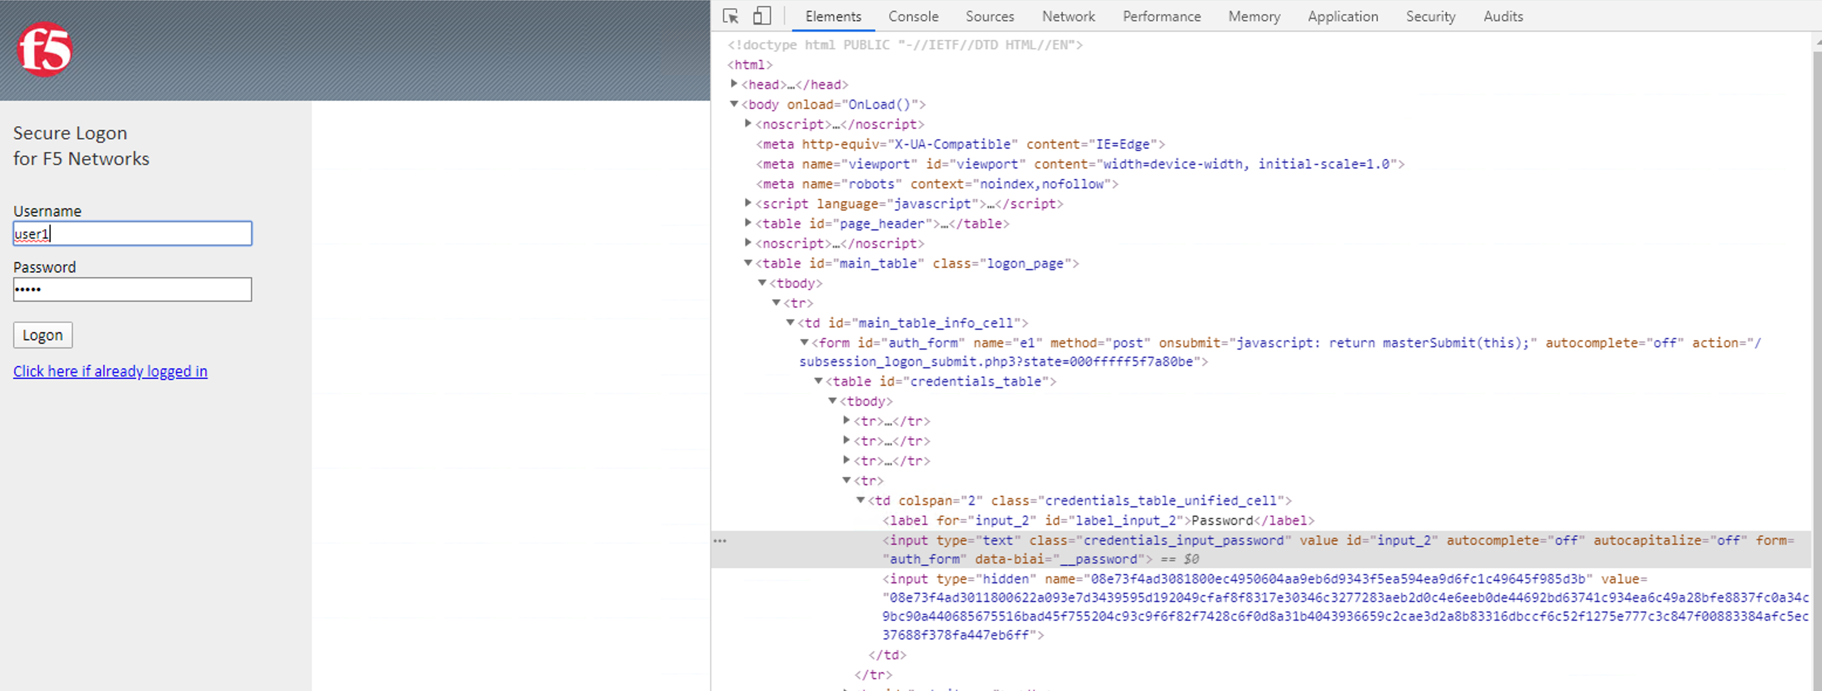
Credential Protection
Client Device
User
Identity
Aware
Proxy

Slide 14
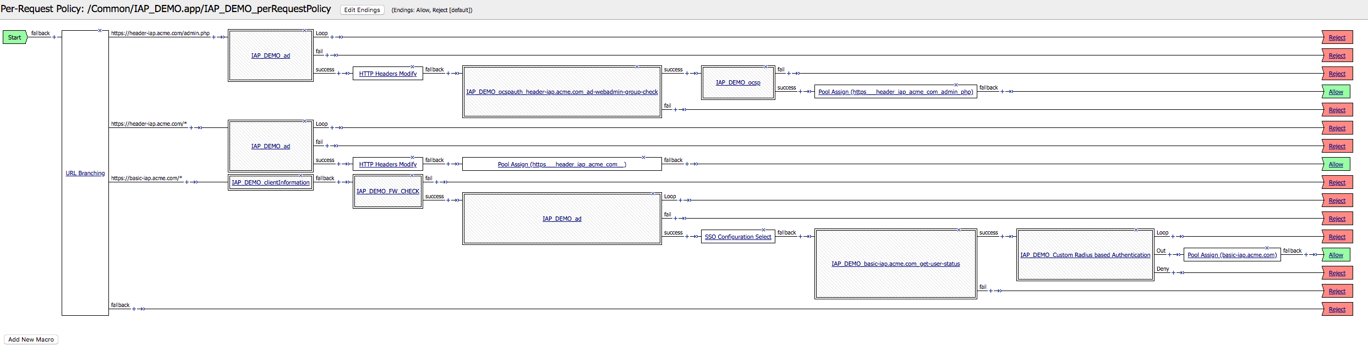
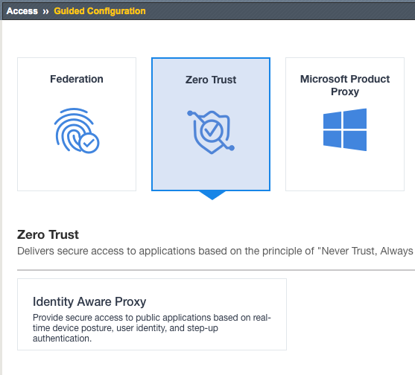
Two ways to implement IAP
Per-Request Policies using Visual Policy Editor
Identity Aware Proxy Guided Configuration

Slide 15
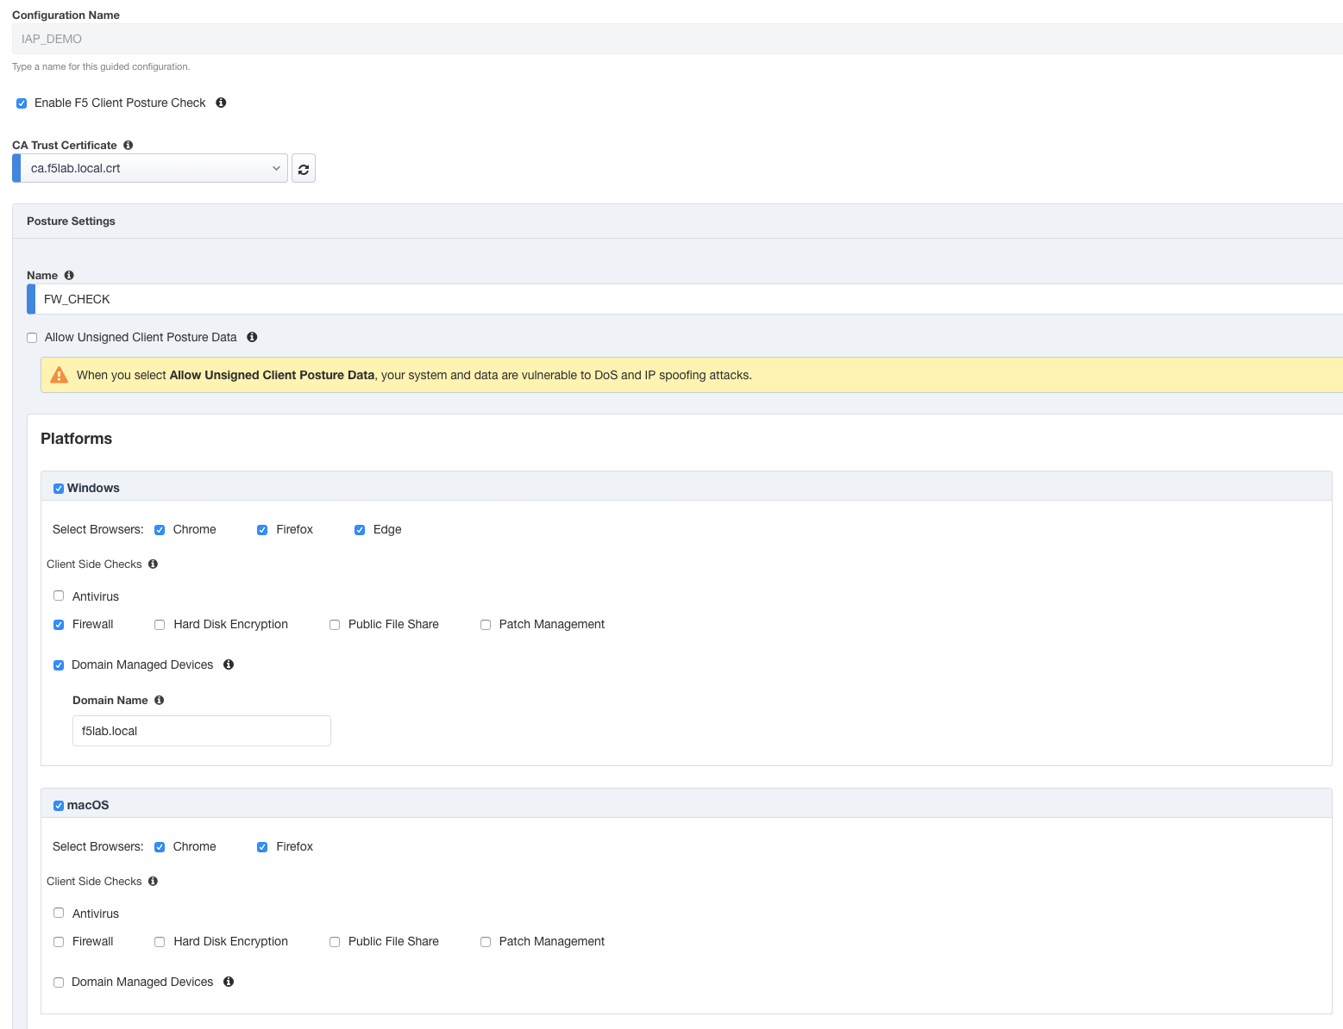
Device Posture

Slide 16
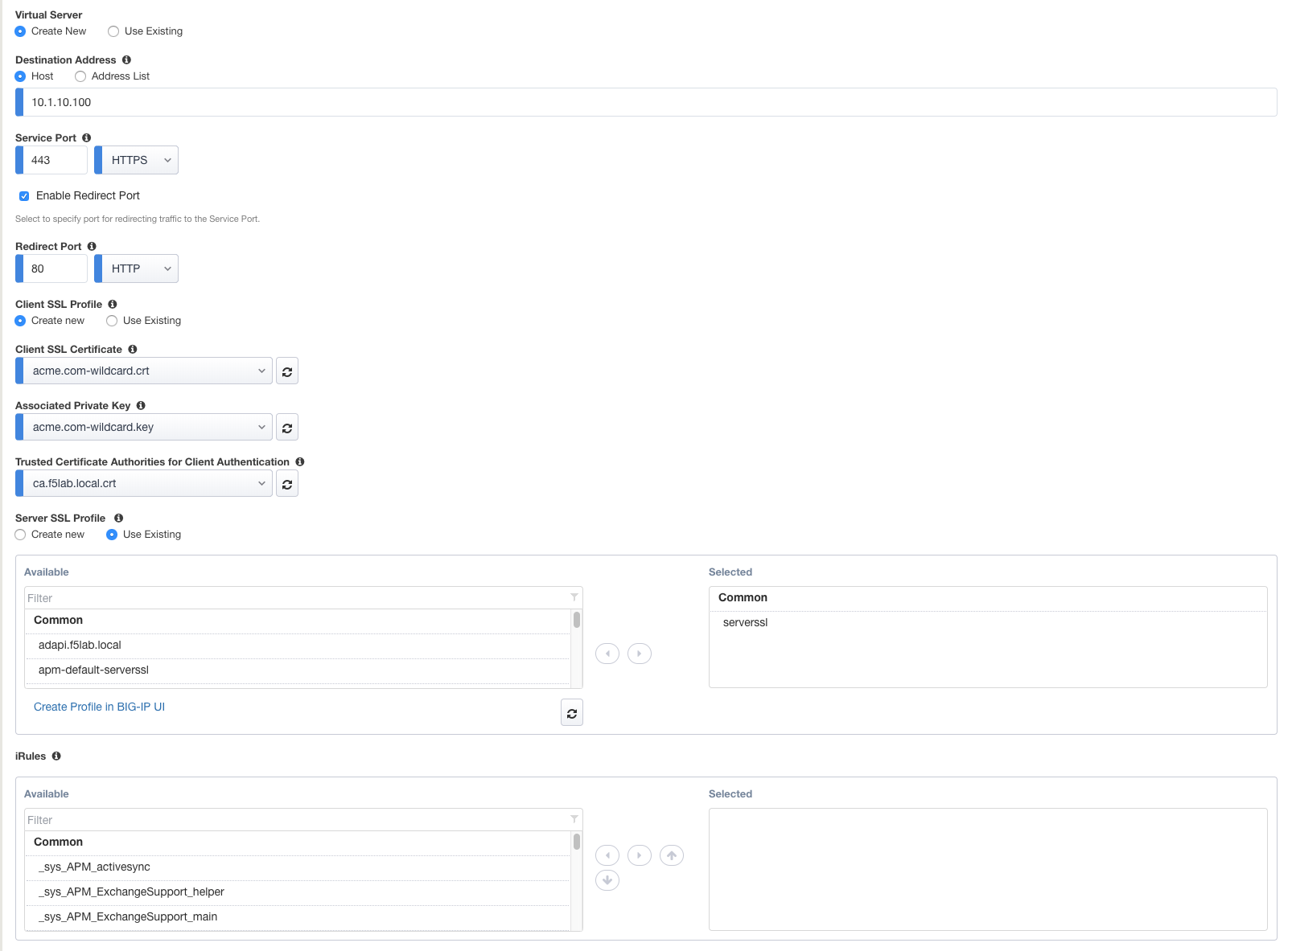
Virtual Server

Slide 17
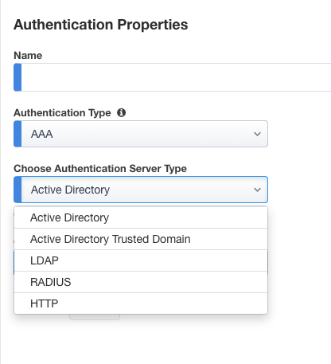
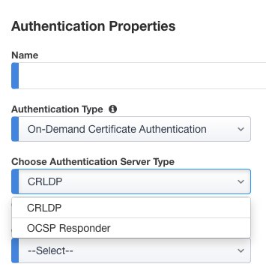
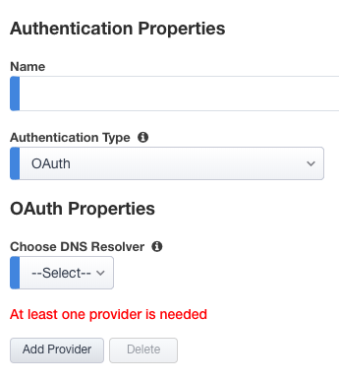
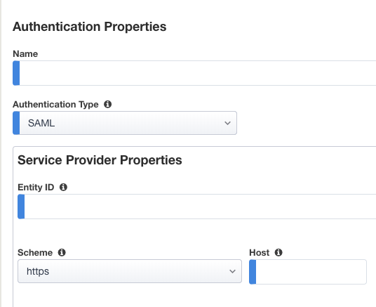
User Identities
Active Directory
LDAP
RADIUS
HTTP
SAML
CRDLP
OCSP
OAuth

Slide 18
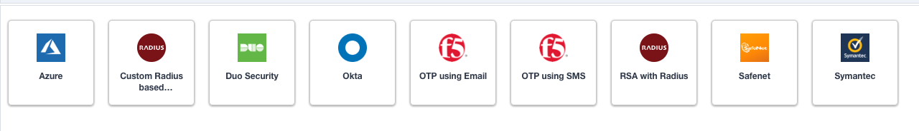
MFA

Slide 19
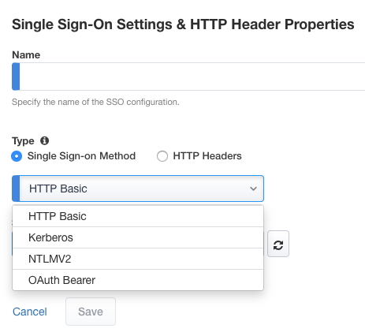
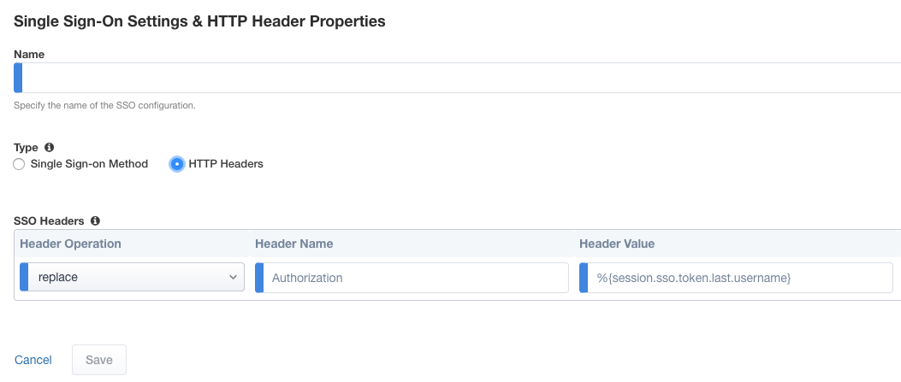
SSO & HTTP Header

Slide 20
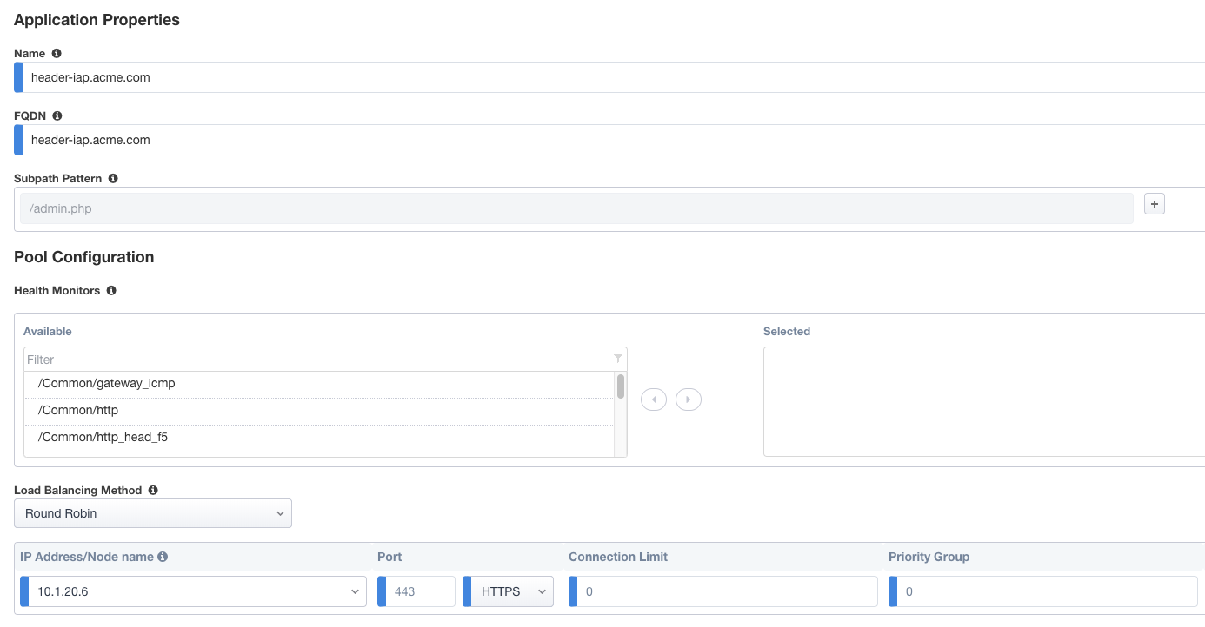
Applications

Slide 21
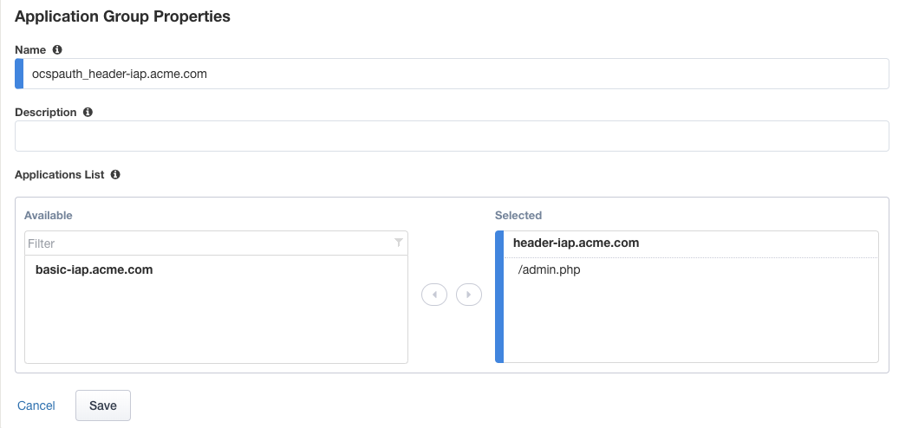
Application
Groups

Slide 22
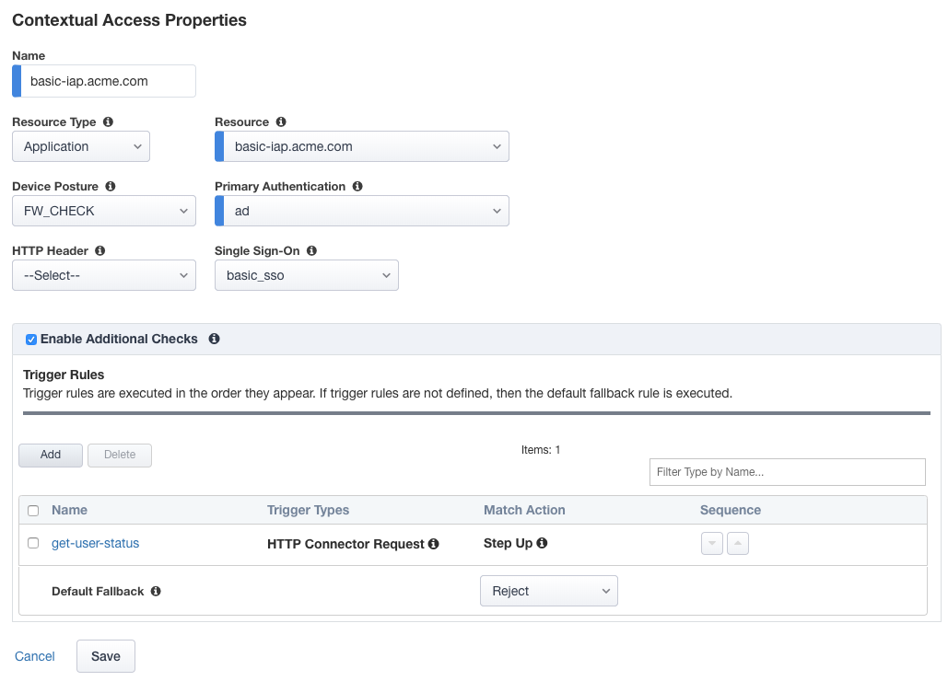
Contextual Access

Slide 23
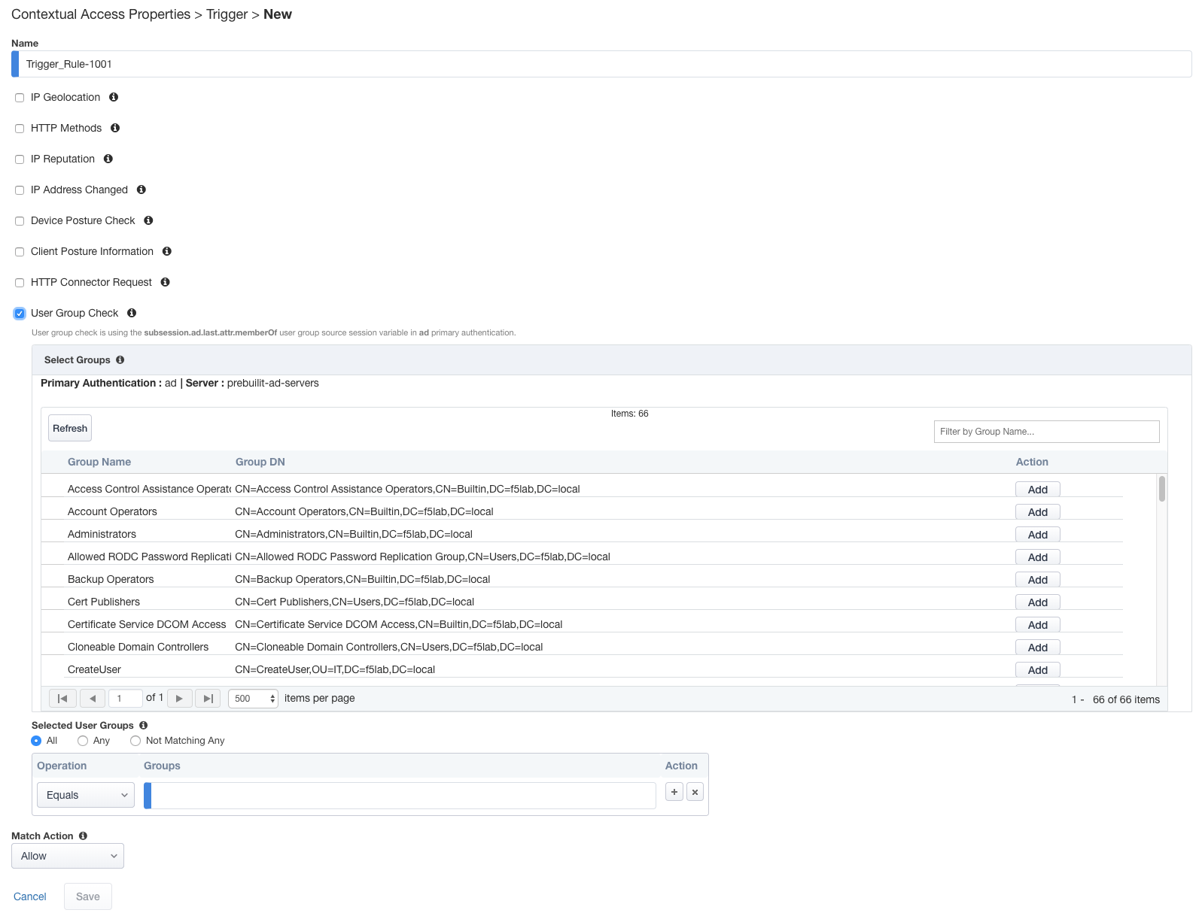
Contextual Access
(Triggers)

Slide 24
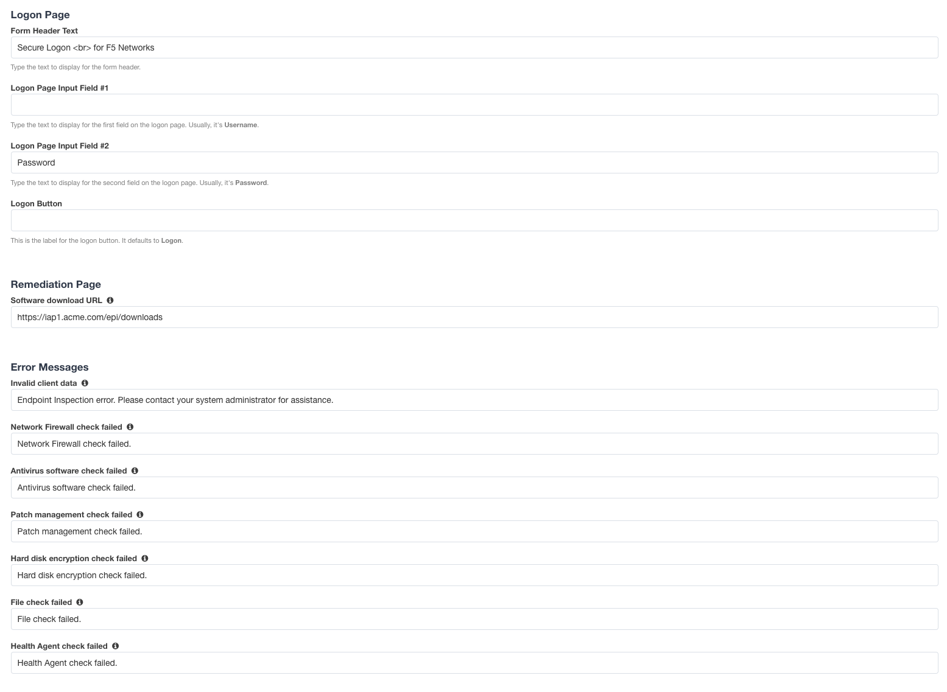
Customization

Slide 25
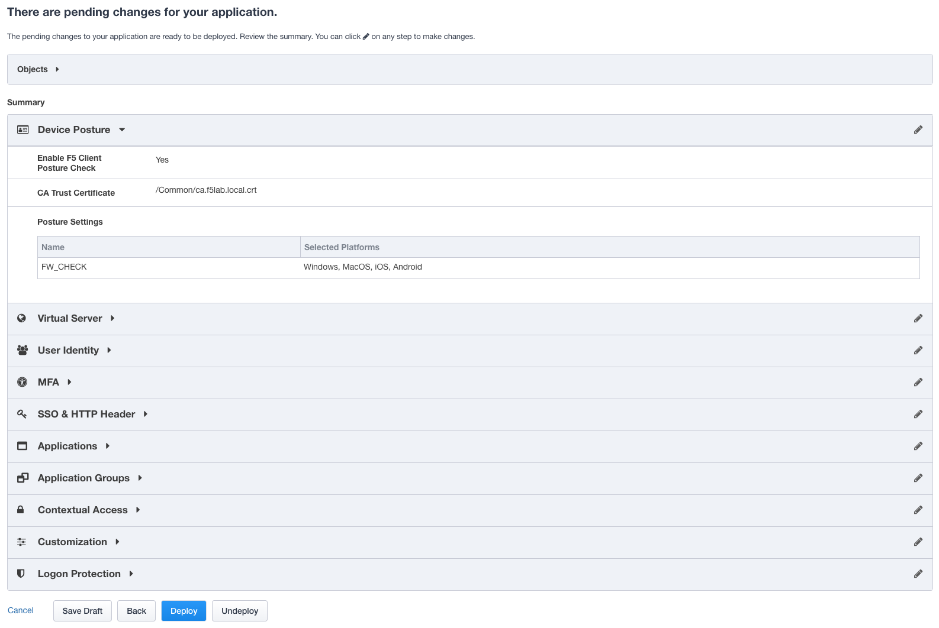
Summary

Slide 26
LAB TIME

