Slide 1


F5 Deployment Architectures
February 24, 2021
Refresh & Modernization Series - Part II
Tony Ganzer, F5 – Account Manager
Chas Lesley, F5 – Principal Solutions Engineer, CISSP

Slide 2
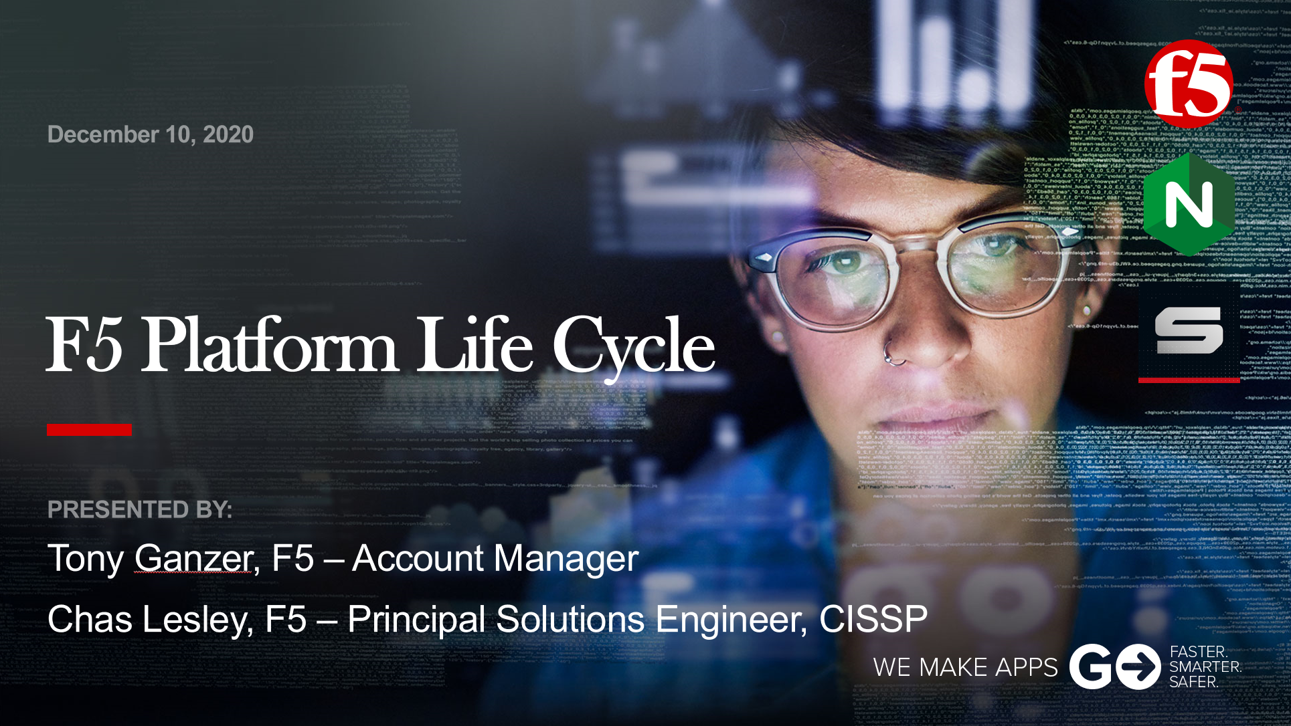
Welcome ….
Intro & Focus: What are we talking about?
Self Assessment: What questions should I be asking?
Design Drivers: What could affect my design decisions?
Architectures: What are we seeing in terms of designs?
Q & A
Refresh & Modernization Series Part II
Part I: Trends & Key Dates
Part II: Design Architectures
Part III: Migration Strategies
Part IV: Automating Builds
Part I: Trends & Key Dates
December 10, 2020 [Recorded]

Slide 3
A little focus, an opportunity for change ….
Need to refresh now
Will eventually need to refresh
(not your time now, but its good to plan ahead)
Self Assessment
Design Drivers
Architectures
How are the BIG-IPs currently performing?
What BIG-IP features is my org currently using or not using?
Existing design?
Operational requirements?
Standards & Conventions?
Projected Growth?
Time & Skill sets?
Network Architecture changes (ACI, Virtualization)?
Public Cloud Adoption?
Private Cloud Expansion?
XaaS Consumption?
DevOps Practices?
Executive Direction?
Regulatory Requirements?
Replacement
Public/Private Cloud (Virtual)
Hybrid
Incorporating SaaS
Incorporating DevOps technologies
Achieve the best overall design for the organization

Slide 4
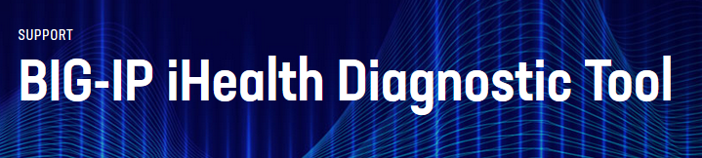
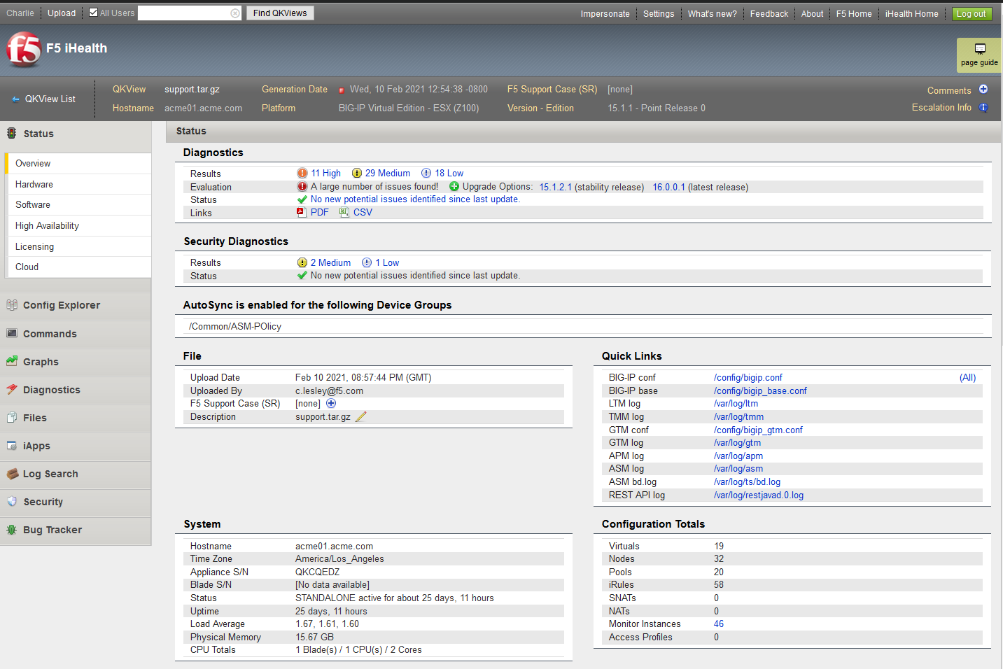
Getting Started – Self Assessment….
Overview:
https://www.f5.com/services/support/support-offerings/big-ip-ihealth-diagnostic-tool
iHealth:
https://ihealth.f5.com
QKView:
https://support.f5.com/csp/article/K12878

Slide 5
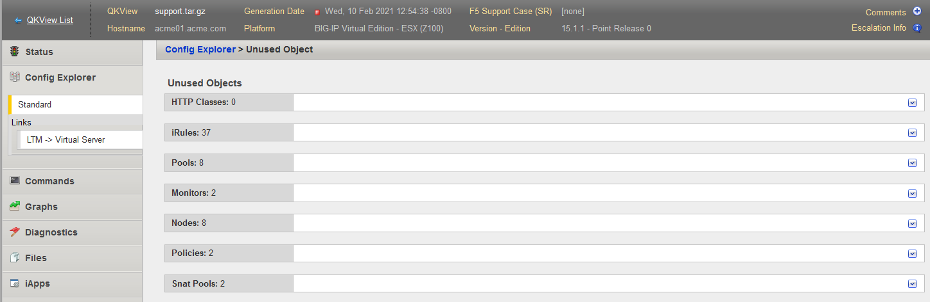
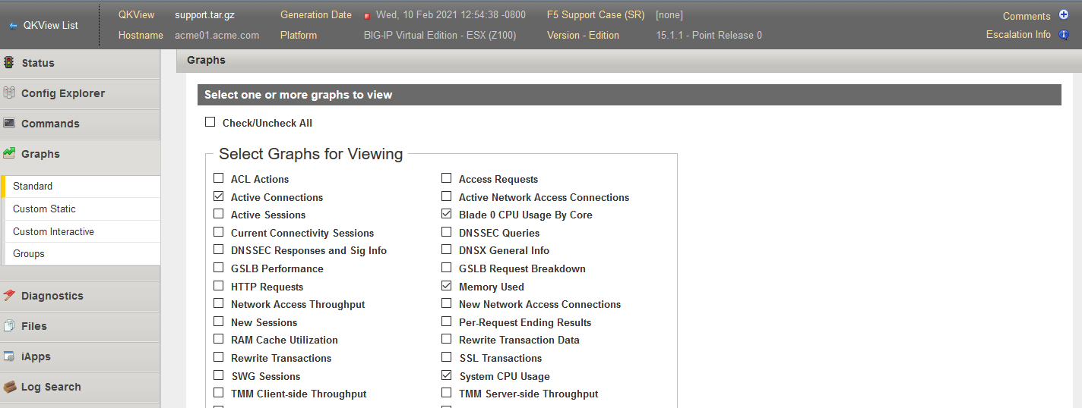
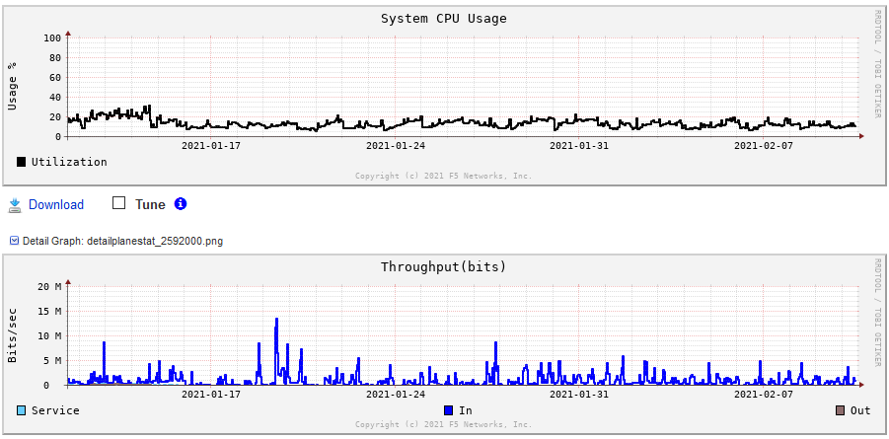

Getting Started – Self Assessment….
General Stats & Object Counts
Operational Information
  Code Version
  Uptime
  Last Failover
Unused Objects
Performance Graphs

Slide 6
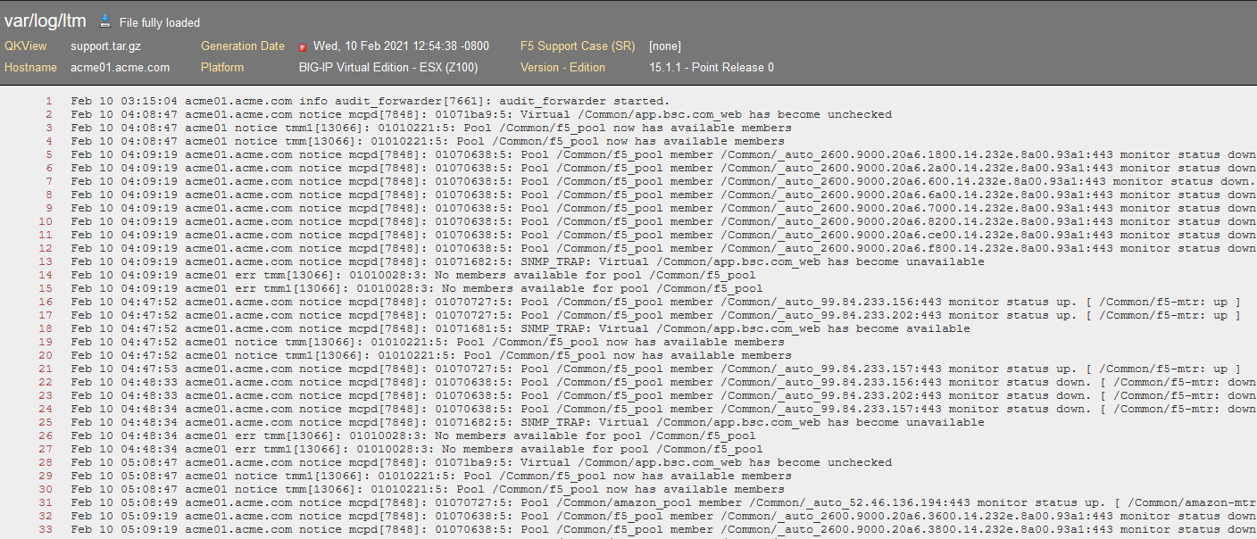
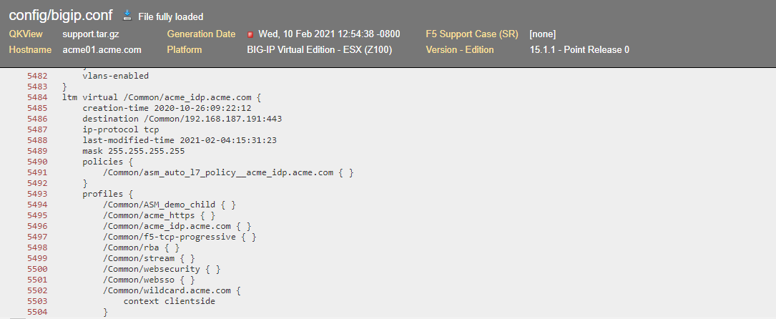
Getting Started – Self Assessment….
Logs, Logs, Logs ….
Configurations
  Virtuals, Pools
  iRules
  Standards & Conventions
Networking Design

Slide 7
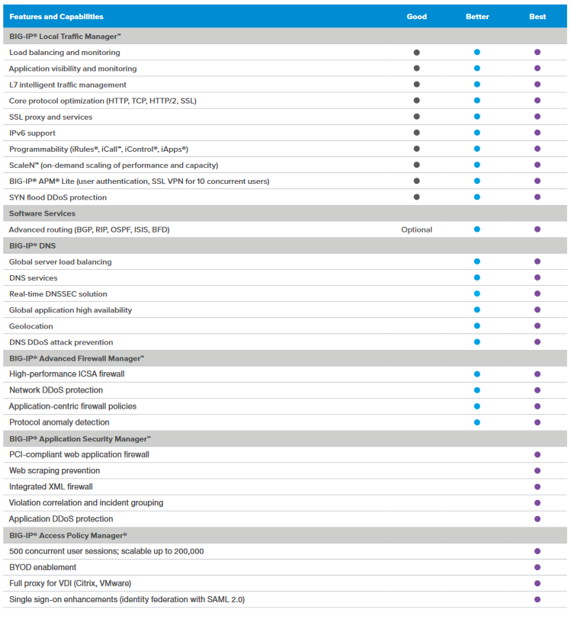
Getting Started – Self Assessment….
What’s Licensed
What’s Provisioned
What’s being used
  WAF Policies
  APM Policies
  DNS Configuration
Overall Licensing Needs

Slide 8
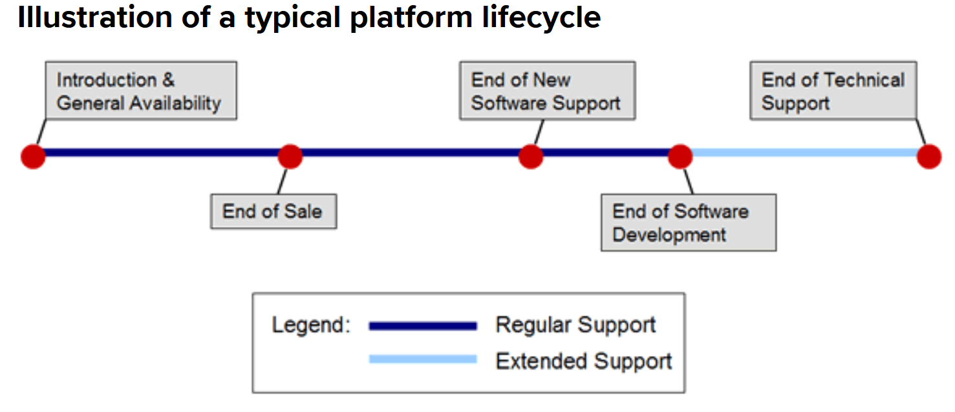
Design Drivers: Refresh Dates [Part I]
Focus Date
End of Life term | Description
End of Sale (EoS) | F5 stops selling this product, software version, or platform.
End of New Software Support (EoNSS) | A platform's EoNSS date indicates that new software versions produced after this EoNSS date will not run optimally on the platform due to hardware constraints or minimum system requirements, as listed in product release notes. F5 stops testing whether new software versions produced after this EoNSS date will run properly on platforms designated EoNSS. Unless specifically communicated differently by F5, the EoNSS default date is two years after the platform's EoS.
End of Software Development (EoSD) | Applicable to both platforms and software releases, Platform EoSD is the date that F5 Product Development has ceased considering the repair/maintenance of confirmed software/firmware defects for the designated platform. Unless specifically communicated differently by F5, a platform's EoSD date defaults to three years after EoS. Unless specifically communicated differently by F5, a software release's EoSD date defaults to three years after the release's first customer ship, or two years after the release's first customer ship for x.x.0 releases.
K3225: F5 End of Life policy:
https://support.f5.com/csp/article/K3225

Slide 9
Design Drivers: Change is always happening….
Network Architecture
Public/Private
Cloud
XaaS
Consumption
DevOps
Practices
Regulatory / Compliance
Datacenters
  Cloud?
Topology Changes:
  ACI
  Firewall
  Virtualization
Zones Changes
  DMZ/External
  Internal
Connectivity
  10Gb /40Gb
Multi-Cloud:
  Azure
  GCP
  AWS
Deployment Type
  Front-End
  Back-End
  Hybrid
Applications
Private Cloud
Severless
SaaS/IaaS/PaaS
Security Services
  WAF
  DDoS
  BoT
  Anti-Fraud
Infrastructure
  DNS
  Logging/SIEM
  Analytics
Hosted Applications
Automation & Orchestration
CI/CD Tooling
Blue/Green Design
Ingress Controllers
Containerization
Container Orchestration & Management
API Security & Management
FIPS
  140-2 Level I
  140-2 Level II
  140-2 Level III
WAF Compliance
TLS Security
PCI-DSS
HIPPA/ePHI
Technical Drivers
Business Level Drivers
Executive Direction & Prioritization

Slide 10

Architectures: General Trends
[ I realize some of these are no brainers…]
Increased Virtual Deployments
  Public/Private Cloud (Multi-Cloud)
More Virtual Edge
Increased Automation/Orchestration
  Requires Standardization
Increased XaaS Consumption
Minimizing Fault Domains (Applications)
Meshed/Stretched interconnectivity designs

Slide 11

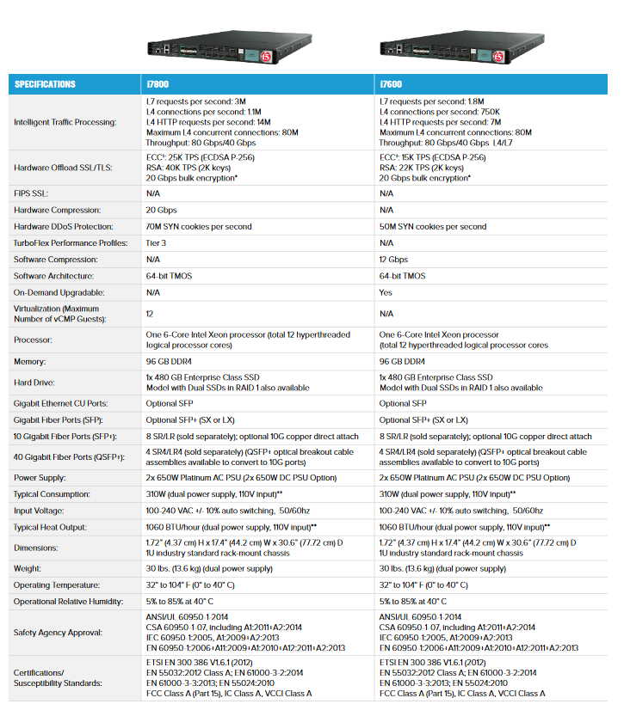
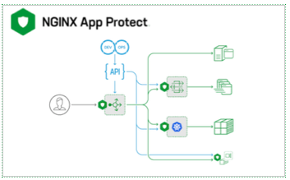
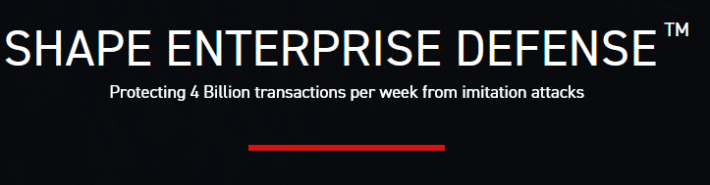
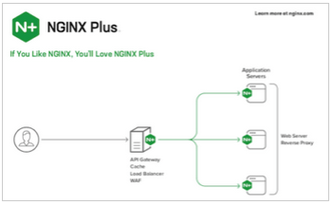
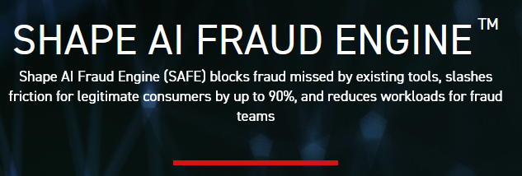
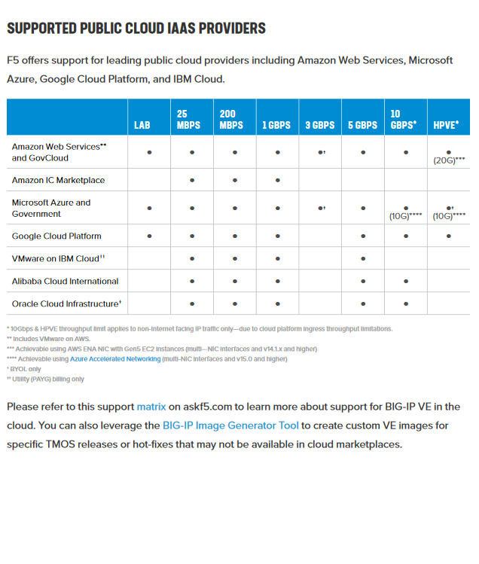
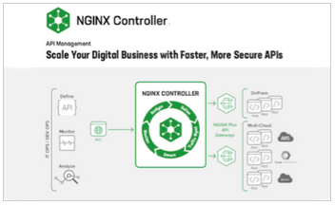
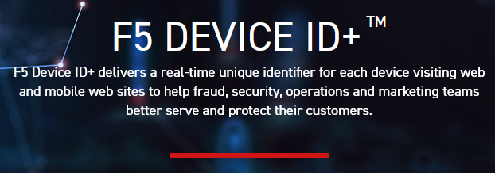
Architecture: Datasheets …
F5 Platform Datasheet
[ HW Appliance & Chassis ]
F5 Virtual Edition Datasheet
[ Public/Private Cloud ]

Slide 12
Architectures Scenarios

Slide 13
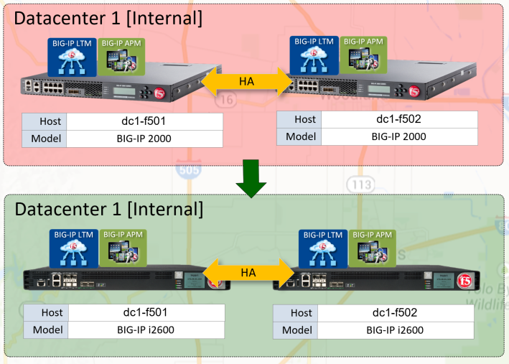
Architectures: Scenario 1a: Tale of Two 2000’s
Customer Drivers:
Replacement
End Design:
Replacement
Increased Performance*
Enable Analytics

Slide 14
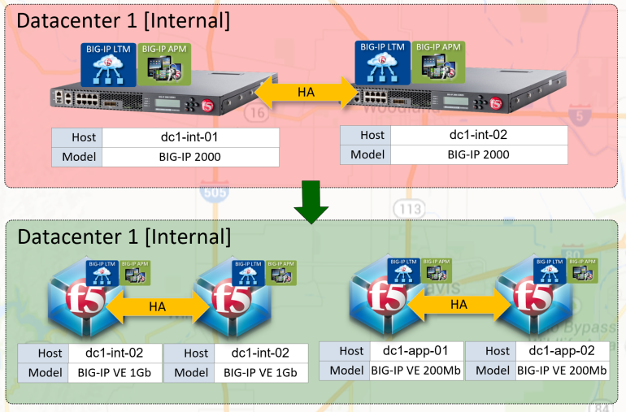
Architectures: Scenario 1b: Tale of Two 2000’s
Customer Drivers:
License Mobility
Reduce Fault Domain
Reduce Change Impact
End Design:
Virtual Editions
Cloud Migration Ready

Slide 15
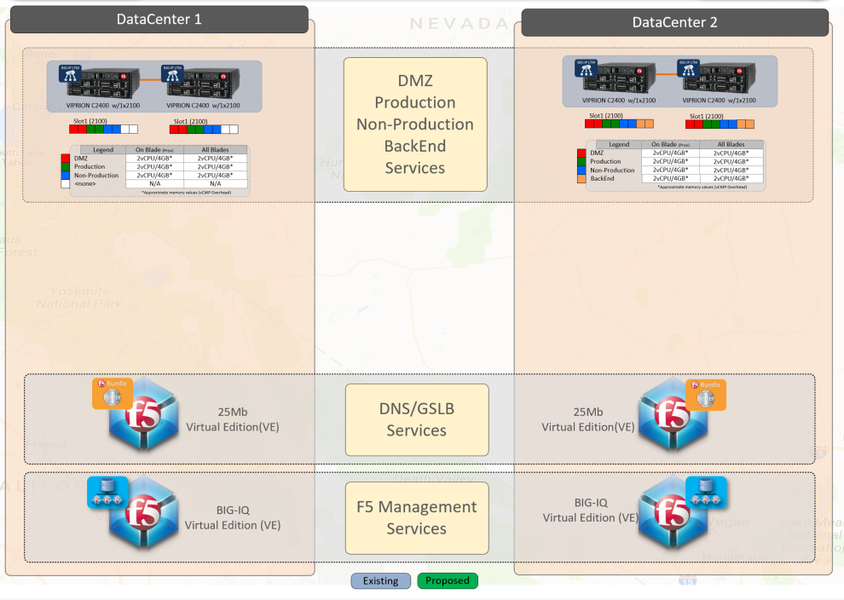
Architectures: Scenario 2: VIPRION Downsize
Customer Drivers:
Reduce Cost
Reduce Complexity
Provide Flexibility
Add Security Services
Prepare for Public Cloud

Slide 16
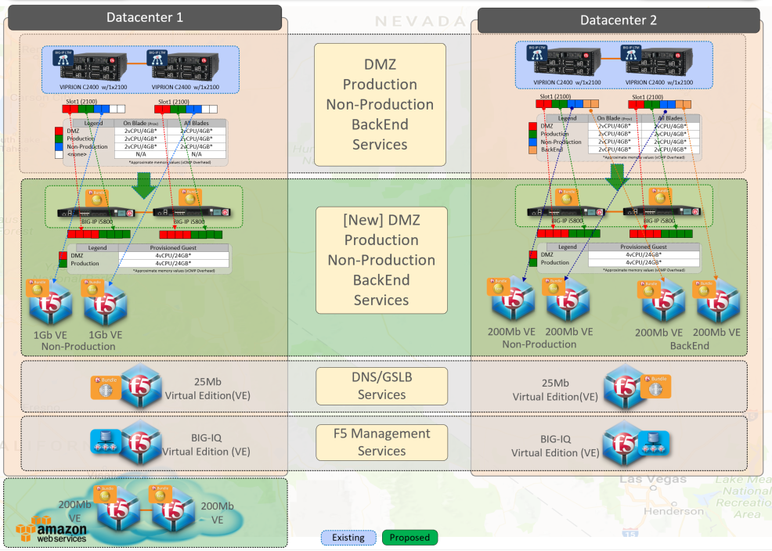
Architectures: Scenario 2: VIPRION Downsize
End Design:
Scaled VIPRION to i5800
Added Best Bundle
Add Virtual Editions
Engaged Public Cloud

Slide 17
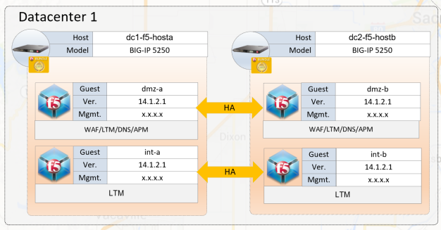
Architectures: Scenario 3: GO Modern
Customer Drivers:
Get Value from Security
Simplify Security
Move into Public Cloud
Add FIPS

Slide 18
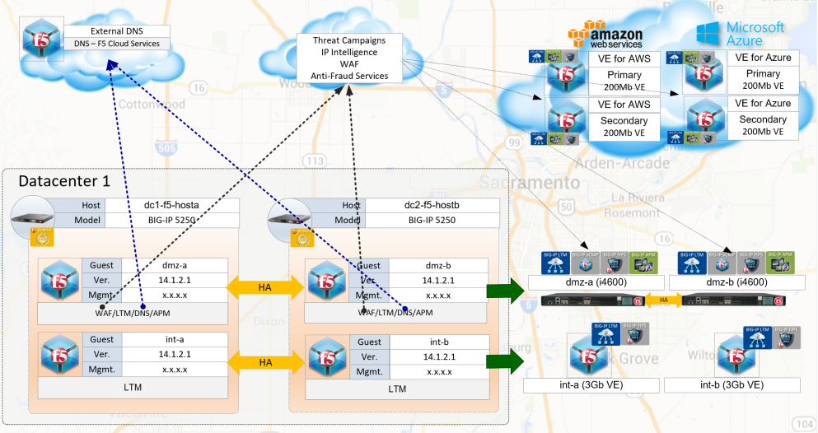
Architectures: Scenario 3: GO Modern
End Design:
Azure & AWS Footprints
Reduced on Premises Licensing
Engaged F5 Self-Service SaaS (WAF/DNS)
Added Anti-Fraud Services
Supported Internal Virtualization Design

Slide 19
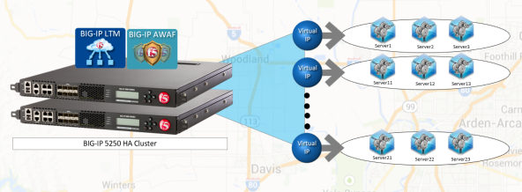
Architectures: Scenario 4: Get DevOpsy
Customer Drivers:
Maintain Security
Simplify & Modernize App delivery
Engage DevOps

Slide 20
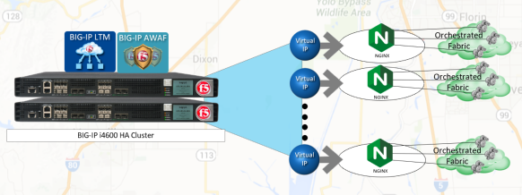
Architectures: Scenario 4: Get DevOpsy
End Design:
Added NGINX+
Reduced BIG-IP size
Reduced BIG-IP management operations & monitoring
More engaged with App Team

Slide 21
Conclusion:
There are way more architectures!
It just prudent to focus on a few and showcase how various customers have used their refresh opportunity to develop more operational friendly designs, reduce complexity and allow for design agility.

Slide 22







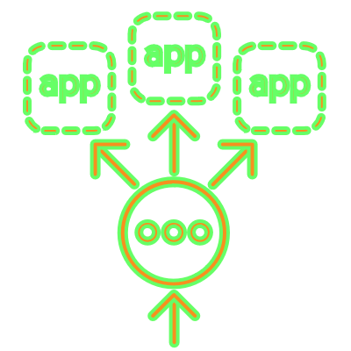







F5 Application Delivery & Security Solutions
ECOSYSTEM INTEGRATIONS
NGINX Controller
BIG-IQ
Ecosystems
PLATFORM CONTROL PLANES
Code
App / Web
server
Ingress controller
API
gateway
Load
balancer
App security
DNS
DDoS
CDN
Customer
Software
as a Service
Containers
Public
cloud
Virtual
machines
Commodity
hardware
Purpose-built
hardware
BIG-IP
NGINX
SHAPE

Slide 23

Thank You

Slide 24

Questions

